Slide 1

Invoice Genie Proposal
Steven Tautonico (CST4714)

Slide 2
Introduction
Invoicing suite
Keep track of customers/invoices/prices
Target audience: Law firm financial department
Invoicing = the second most important business operation
More cost-efficient than commercial solution

Slide 3
Objective
Keep track of billing (invoices to customers)
Keep track of payments
Directory of customers
Easy entry of invoices/products/prices
Automatic handling of invoice statuses and timestamp

Slide 4
Target Users
Target industry: Legal (law firm)
Target users: non-technical financial users
Simple usage (with web interface or GUI)
Automate common tasks for convenience

Slide 5
Application Features
Logging of invoices
Keeping track of customer data
Logging invoice payments
Tracking account balance
Infinite data retention
Report generation

Slide 6
Report Generation
Get Invoices by Customer
Get Invoices from this Month
Customers that have Unpaid Invoices
View Customer
Get Unpaid Invoices
Get Paid Invoices
Get Stale Invoices
Get Invoices by Number
Get Prices for Product
Get Total Billed this Month
Get Total Paid this Month
Calculate Remaining Balance
Get Invoice Payments
Find Amount Paid
Get Total Billed this Year
Get Total Paid this Year

Slide 7
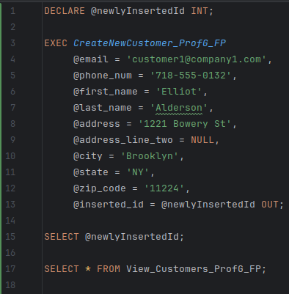
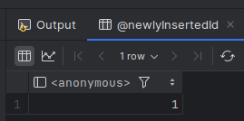
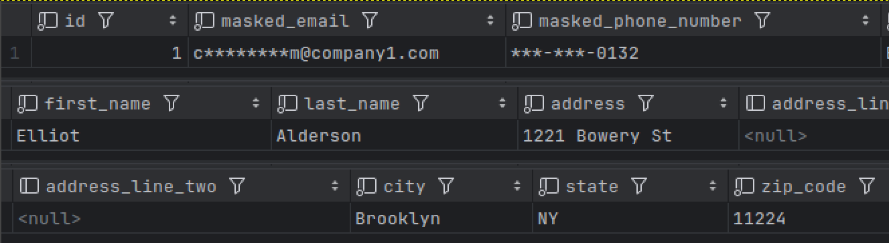
Demo (1)
Step 1. Add a new customer

Slide 8
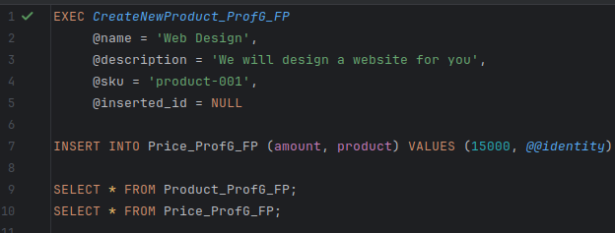


Demo (2)
Step 2. Add a new product and price

Slide 9
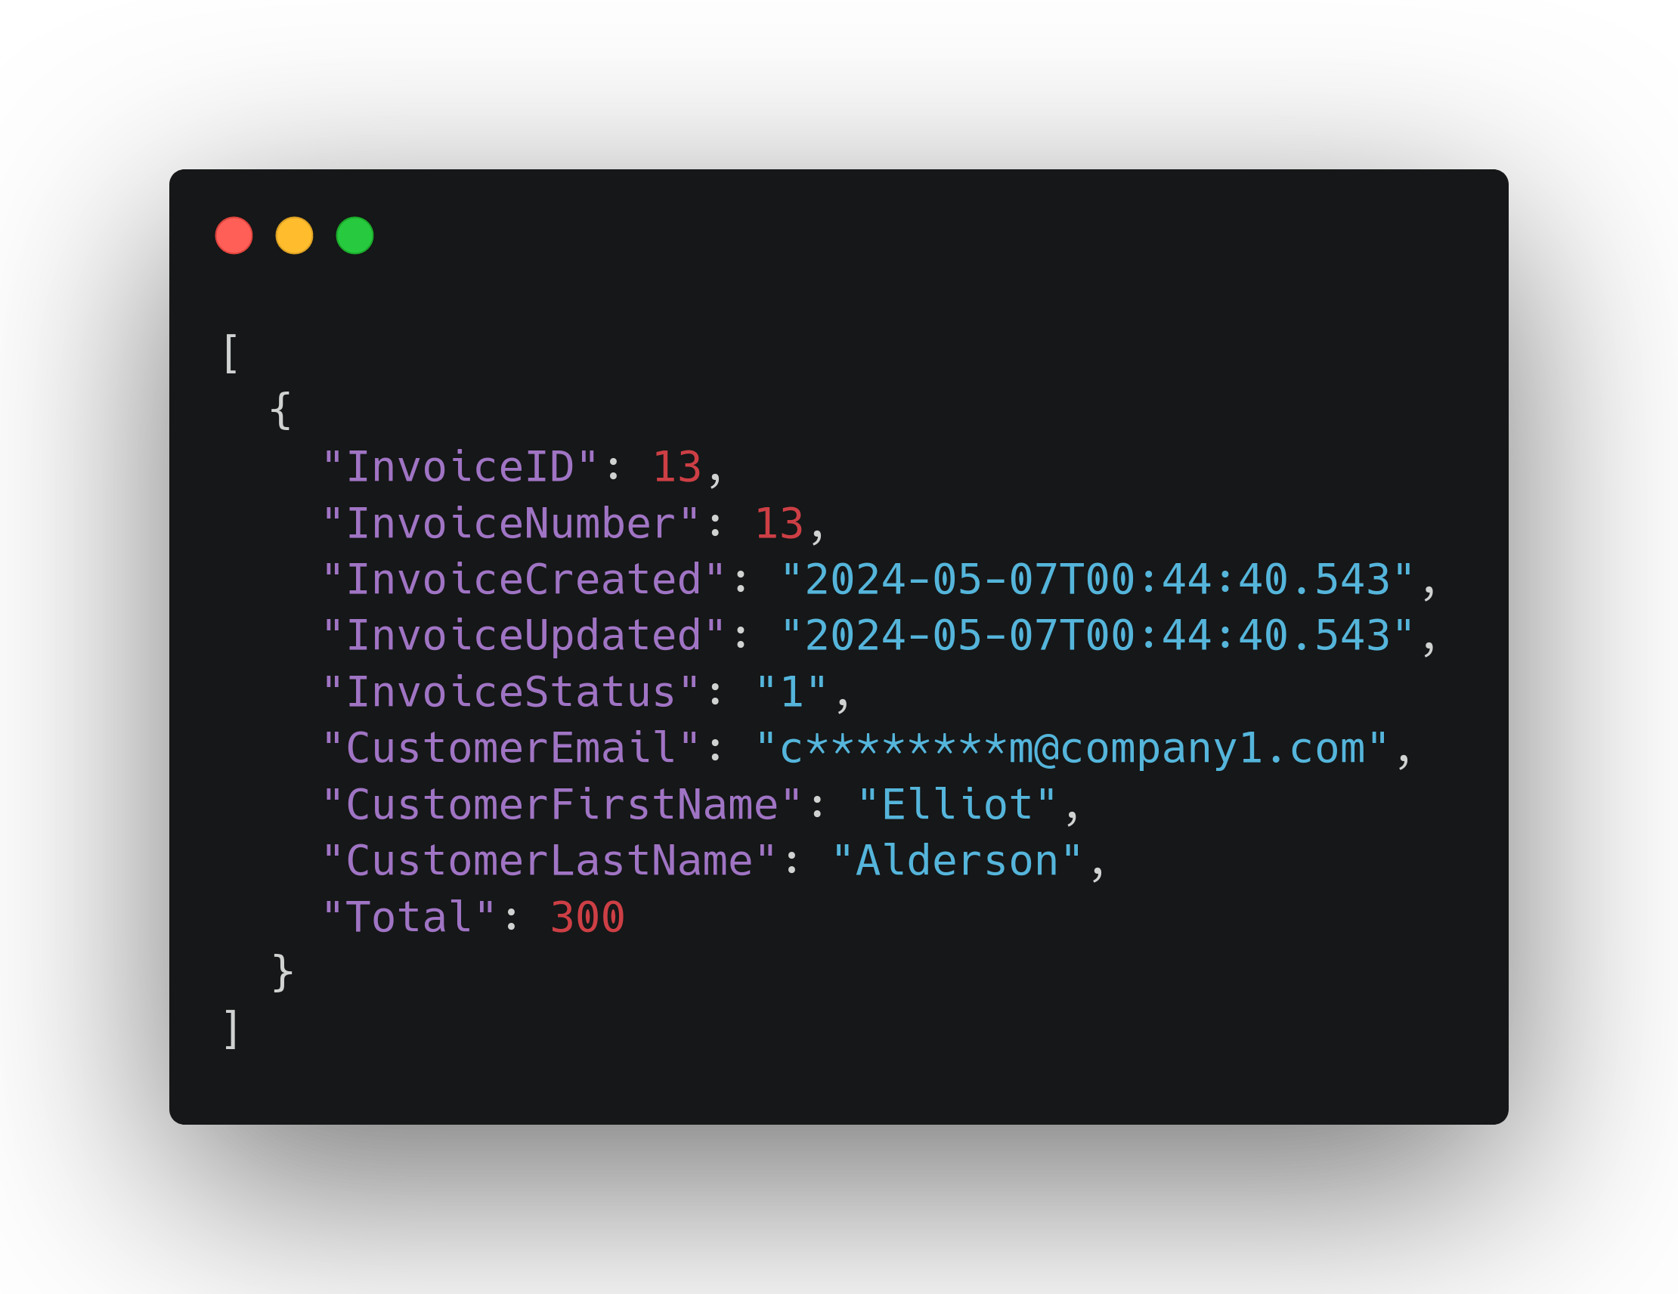
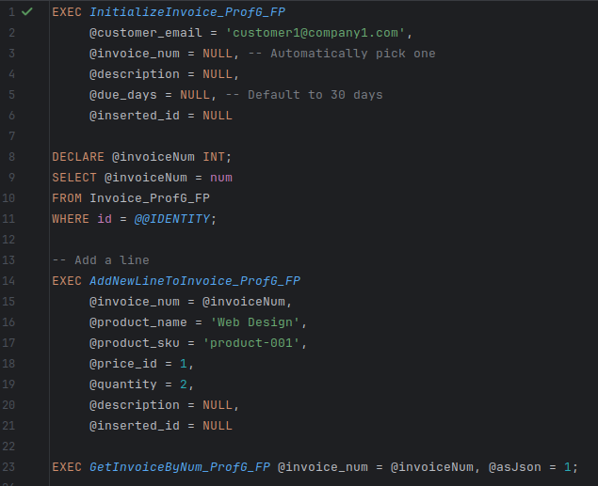
Demo (3)
Step 3. Initialize a new invoice and add a line

Slide 10
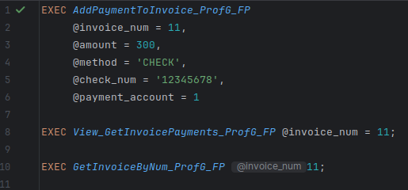


Demo (4)
Step 4. Log a payment

