Slide 1
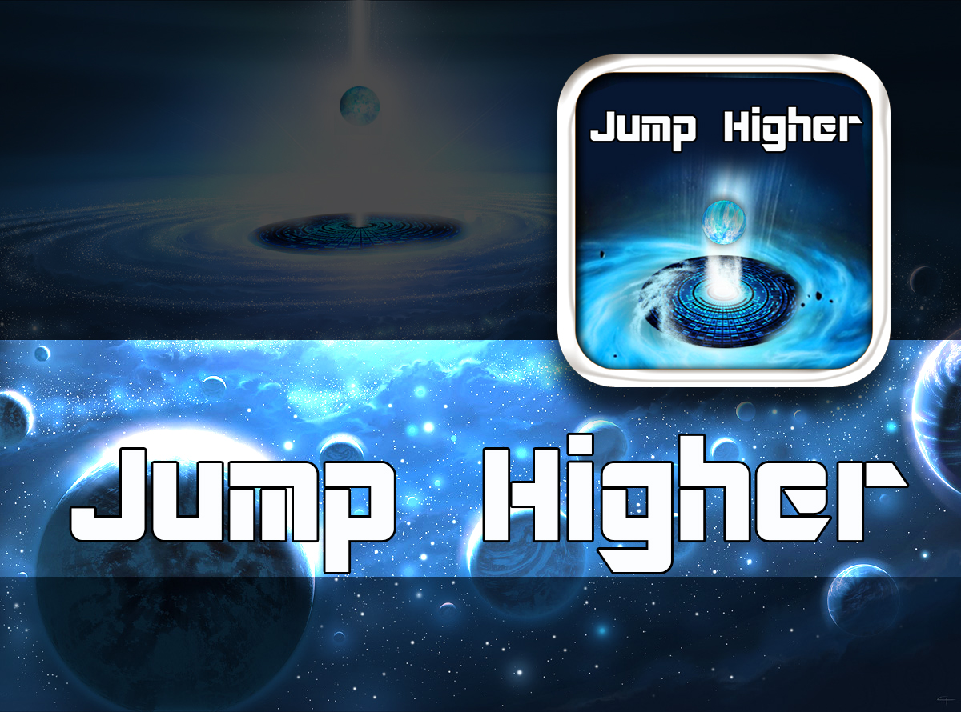

Slide 2

Application Purpose :
Creating competitive online game where users should compete for the highest rank.
Application Need:
Gamers who like to compete

Slide 3
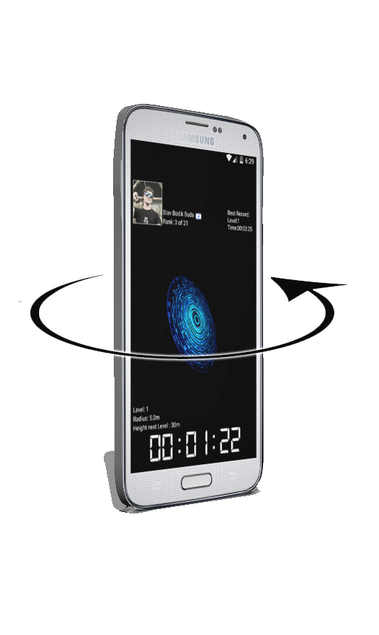
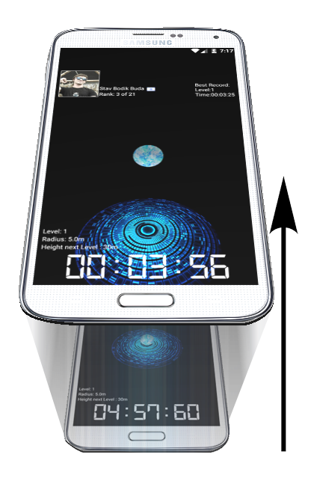
Game play:
The game play based on the device Gravity and acceleration sensors.
The gamer can control the surface Orientation by rotating the device 180 degree on the flat axis.
Rotating the surface will cause sphere movement,
If the sphere falls from the surface , the game is over .
For levelling up The gamer should jump higher then the height of current surface by doing this he is getting up to the next surface and so on .
This is done by acceleration the device on the Y axis .

Slide 4
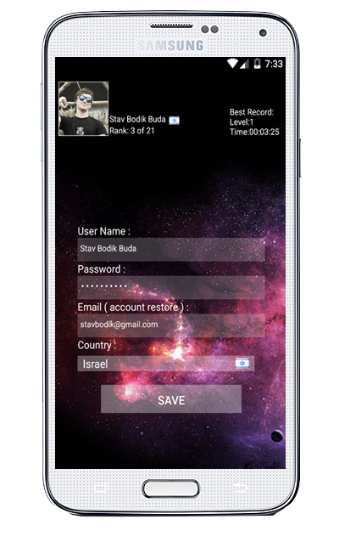
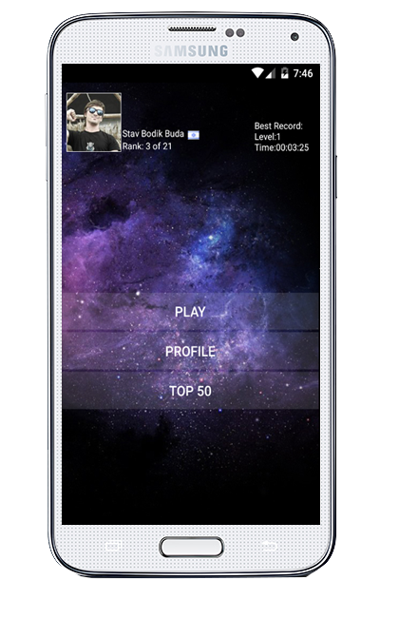
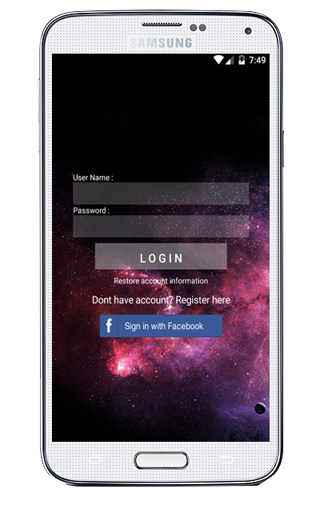
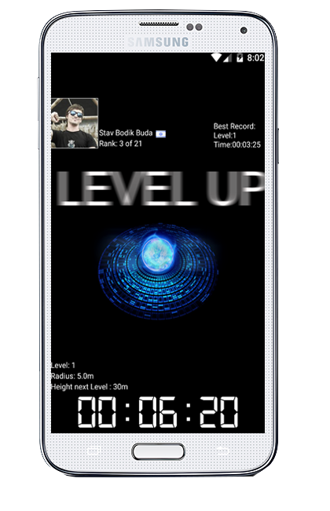
Gamer purpose :
The best gamer is the one who have got the
highest level in minimum time .
Top 50 :
Gamers can view their own and competitors score online
Personal profile :
Gamers can view/edit their personal profile with their best score

