Slide 1


Slide 2

Application Purpose :
Creating competitive online game where users should compete for the highest rank.
Application Need:
Gamers who like to compete

Slide 3
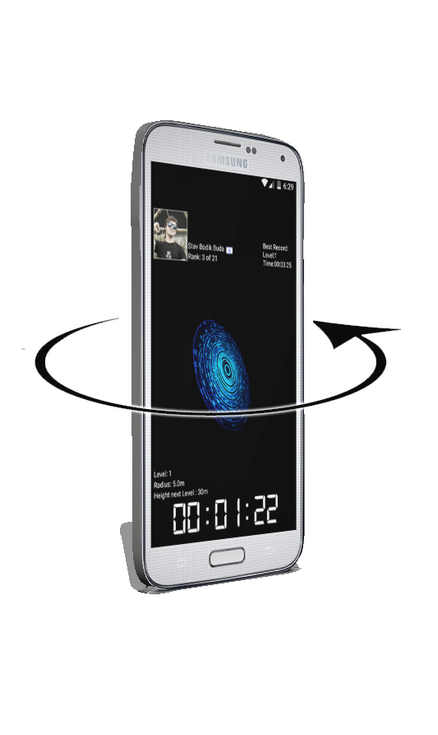
Game play:
The game play based on the device Gravity and acceleration sensors.
The gamer can control the surface Orientation by rotating the device 180 degree on the X,Z axis.
Additionally can control the sphere Height and cause the sphere jump
By acceleration the device on the Y axis .

