Slide 1

Steam Safety Management Program
Pressure Safety Valve Compliance · Data · Maintenance Strategy
Texas A&M University · Utilities & Energy Services
Field verified
Excel master file
Live dashboard
Maintenance strategy
Leadership Briefing · Reliability & Compliance

Slide 2
Executive Summary
End-to-end program built from the ground up
4 Phases
26+ Valves
3 Years
1 Source
Program path
Fleet tracked
Recert cycle
System of record
Field → Excel → Dashboard → Strategy
Boilers, HRSG, hot water
NBIC / ASME aligned
Dashboard + master Excel
✓ Walked boiler rooms and steam systems — photographed nameplates and verified installed valves
✓ Built a comprehensive Excel master register, then a live compliance dashboard for the full fleet
✓ Authored a formal PSV/SRV Maintenance Strategy aligned to ASME, NBIC, API RP 576, and Texas code
✓ Outcome: visible compliance, proactive due-date management, and a defendable maintenance program
Texas A&M UES · Steam Safety Management Program

Slide 3
Why Leadership Should Care
Reliability work that protects people, equipment, and compliance standing
Risk area | What was happening | What the program fixes
Regulatory | Missed 3-year recertification creates TDLR / NBIC exposure | Visible overdue tracking and PM schedule
Operational | Valve status and spare coverage hard to see across units | Equipment → Location → PSV hierarchy
Financial | Last-minute testing and unplanned outages drive cost | Planned Setpoint outages and spare pooling
Audit / safety | Scattered files and memory-based tracking | Traceable history, exports, and strategy document
Texas A&M UES · Steam Safety Management Program

Slide 4
Regulatory & Standards Foundation
Program decisions are code-informed, not ad hoc
Standard / code | Requirement | How the program uses it
ASME Section I | Safety valve design, capacity, manual-lift rules | Datasheet fields + capacity verification
NBIC Part 2 | In-service inspection; max 3-year test interval | Due-date engine + PM schedule
API RP 576 | Inspection, testing, repair best practice | Walkdowns, send-out vs in-place guidance
16 TAC Ch. 65 / TX HSC 755 | State boiler program requirements | Strategy ties PM to Texas expectations
Texas A&M UES · Steam Safety Management Program

Slide 5
Building the Program
Field data → Master register → Dashboard → Maintenance strategy

Slide 6
Program Development Path
From field discovery to a sustainable maintenance program
1
2
3
4
Field Data Collection
Master Excel Register
Digital Dashboard
Maintenance Strategy
Site walks Nameplate photos Valve verification
→
Sort & normalize Track due dates Inventory IDs
→
Fleet KPIs Drill-down views Excel exports
→
PM intervals Spare pooling Code alignment
Texas A&M UES · Steam Safety Management Program

Slide 7
Phase 1 — Field Data Collection
Ground truth before any database or dashboard
Data element | How captured | Why it matters
Equipment identity | Site walk + nameplate photo | Links valve to boiler / HRSG / unit
Protected location | Physical position on system | Steam drum, economizer, outlet, etc.
Serial number & NB # | Nameplate photo + field notes | Unique traceability for Setpoint / CMMS
Set pressure & capacity | Nameplate + datasheet review | Correct valve at correct point
Installed vs spare | Visual verification | Determines send-out vs in-place testing
Condition flags | Eyes-on inspection | Weeping, corrosion, isolation concerns
Texas A&M UES · Steam Safety Management Program

Slide 8
Field Work in Practice
On-site activities
Deliverables from the field
• Walk every boiler room and steam path
• Photograph every nameplate
• Confirm installed valve vs drawings
• Note discharge path and orientation
• Flag missing spares immediately
• Photo library per valve
• Verified equipment/location list
• Gap list (no spare, bad nameplate)
• Inputs for Excel master register
• Confidence before digitizing
Texas A&M UES · Steam Safety Management Program

Slide 9
Phase 2 — Master Excel Register
The bridge between field discovery and digital management
Register function | What it tracks | Leadership value
Master inventory | Every PSV by equipment, location, serial | Complete fleet picture
Due-date logic | Install date + 3-year recert | No valve left behind
Spare tracking | Installed / inventory / out for service | Swap planning for Setpoint
Inventory IDs | Warehouse + CMMS identifiers | Procurement and tagging alignment
Bulk reporting | 5-sheet export structure | Reviews without opening the app
Texas A&M UES · Steam Safety Management Program

Slide 10
Phase 3 — Digital Compliance Dashboard
Operational visibility for the whole fleet

Slide 11
Dashboard Capabilities
reliability-and-compliance-dashboar.vercel.app
Feature | What you see | Who benefits
Fleet KPIs | Total, Installed, Out for Service, Overdue, Compliant % | Leadership snapshot
KPI drill-down | Click any metric → valve list with Inventory ID | Planners & reliability
Hierarchy views | Equipment → Location → PSV faceplates | Operators
Compliance clock | Auto 3-year due date from install / service | Compliance tracking
Dual history | Status changes separate from repair/overhaul | Audit trail
Excel export | All PSVs, Installed, OOS, Overdue, Upcoming | Reporting & meetings
Texas A&M UES · Steam Safety Management Program

Slide 12
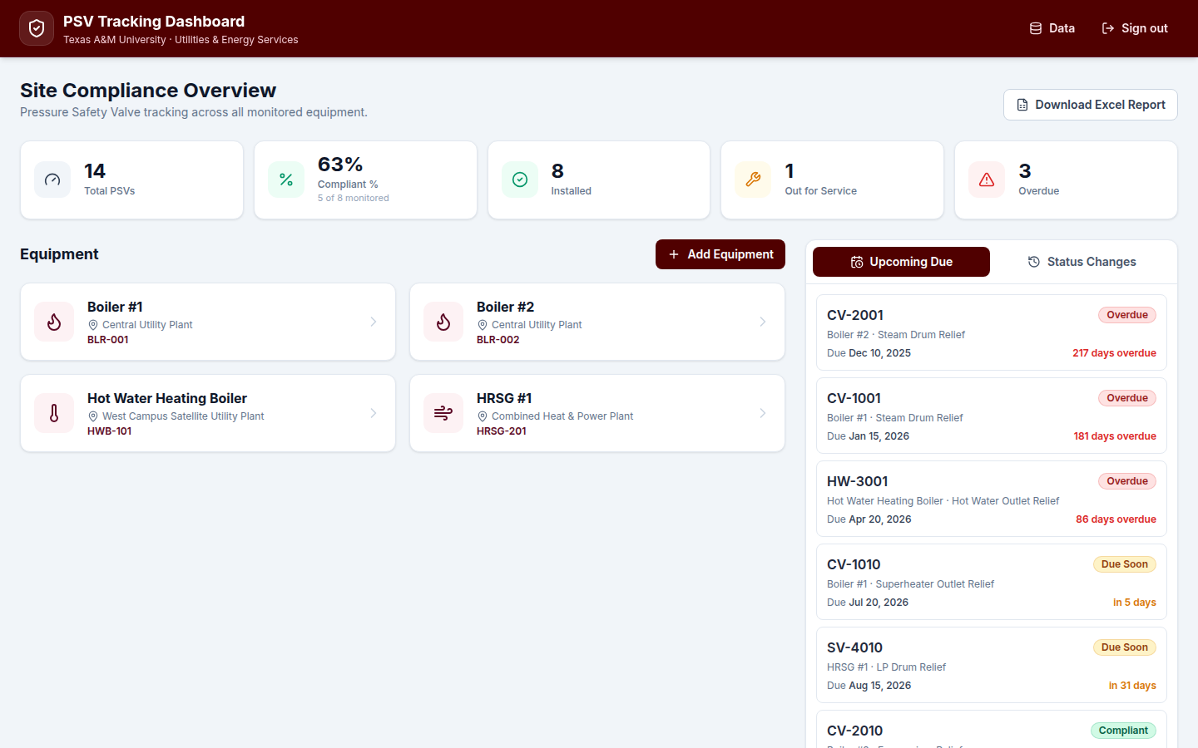
Dashboard — Fleet Compliance at a Glance
Key takeaways
▸ Fleet KPIs at the top — click any card to drill down
▸ Equipment grid mirrors plant layout
▸ Urgency panel shows overdue and due-soon valves
Site-wide compliance posture with equipment cards and upcoming due list
Texas A&M UES · Steam Safety Management Program

Slide 13
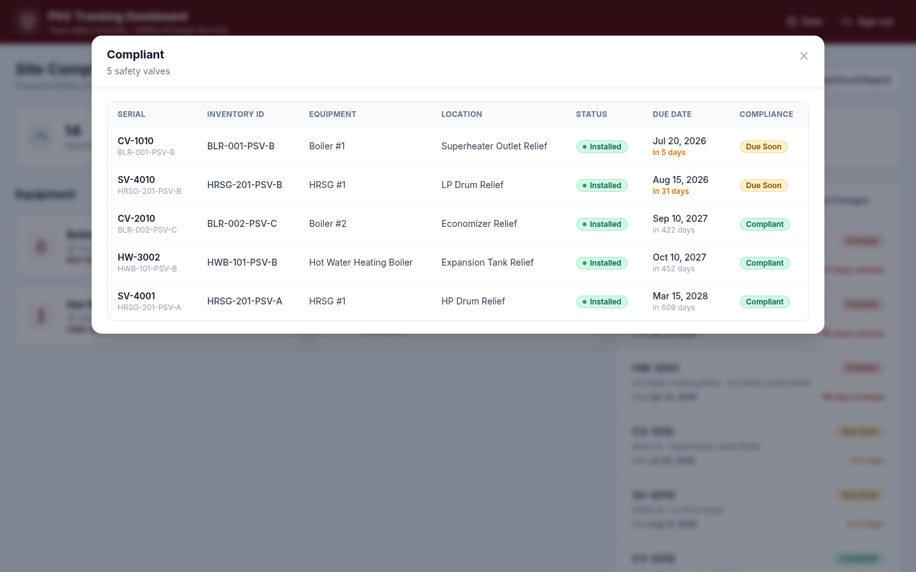
KPI Drill-Down — Compliant Valves
Key takeaways
▸ Inventory ID column on every filter
▸ Due Soon counts toward Compliant %
▸ Export-ready data for meetings
Every KPI opens a filterable table — serial, Inventory ID, due date, compliance state
Texas A&M UES · Steam Safety Management Program

Slide 14
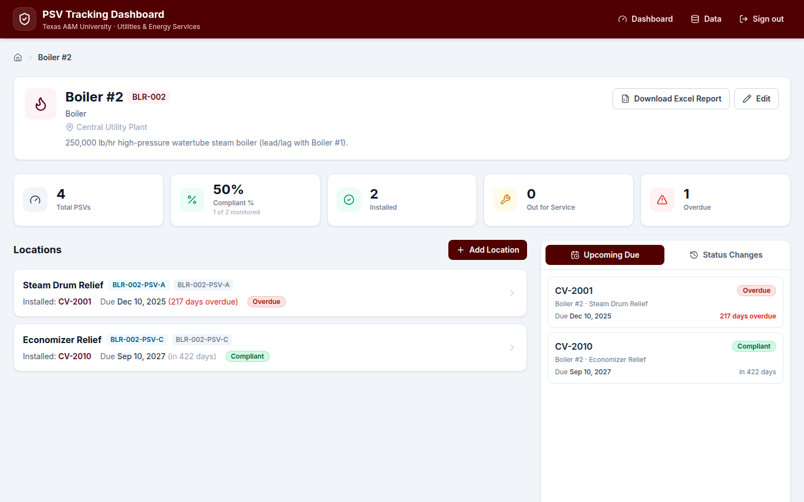
Equipment & Location Views
Scoped views per boiler with Inventory ID on every location row
View level | Shows | Example
Equipment | Scoped KPIs + location list | Boiler #2 → 4 PSVs
Location | Installed valve + due date | Steam Drum Relief
Faceplate | Status toggle + quick context | CV-2001 installed
Texas A&M UES · Steam Safety Management Program

Slide 15
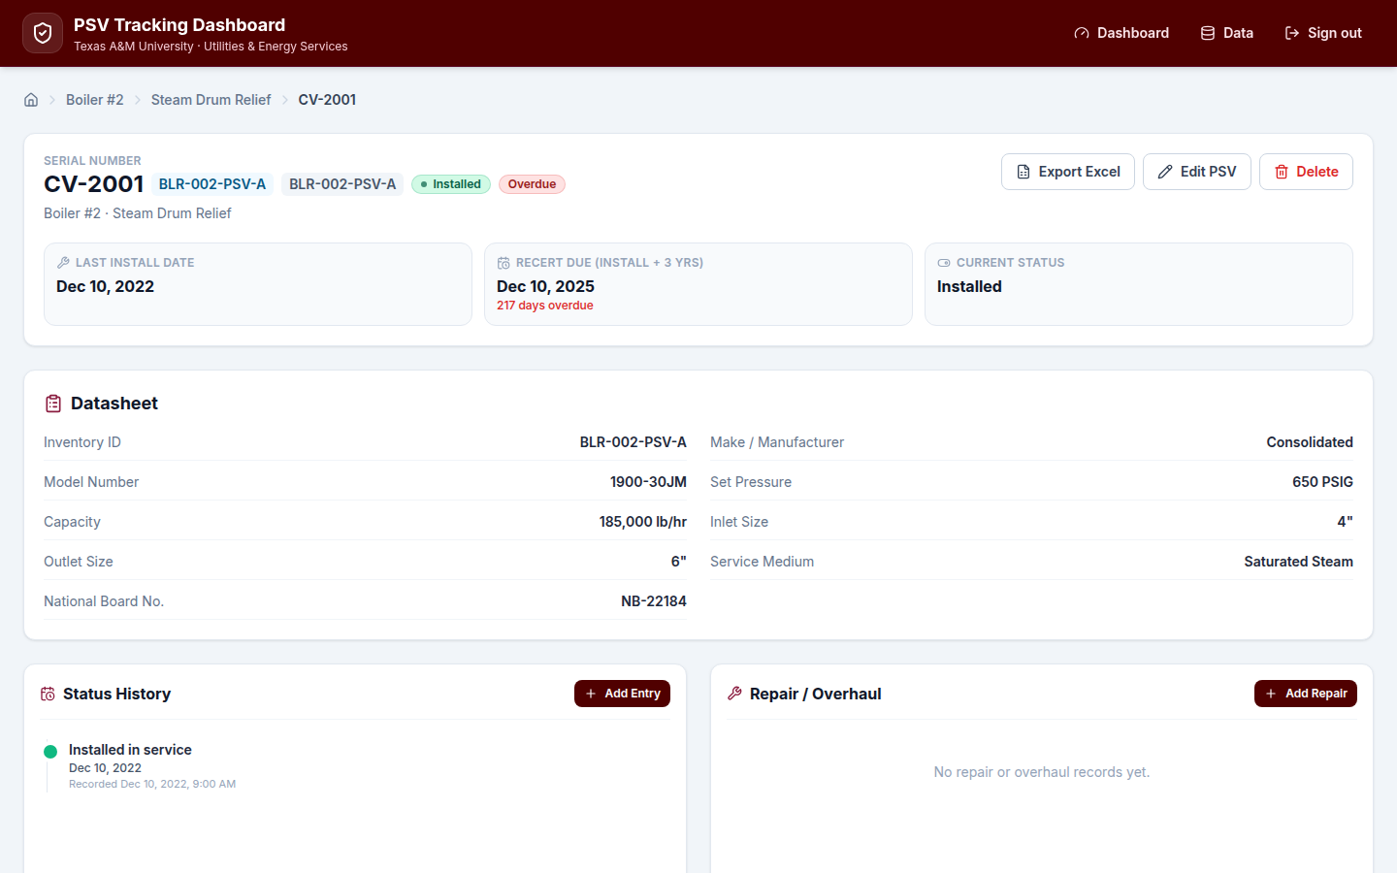
Valve Record Detail
Key takeaways
▸ Inventory ID on header and datasheet
▸ Status History vs Repair split
▸ One-click Excel export per valve
Full datasheet, compliance clock, status history, and repair/overhaul log in one place
Texas A&M UES · Steam Safety Management Program

Slide 16
Phase 4 — Maintenance Strategy
Formal PSV/SRV program document for UES operations

Slide 17
PM Intervals & Triggers
Maximum intervals shown — UES should complete before due date
Activity | Frequency | Code / reference | Notes
Pop test & overhaul | Every 3 years | NBIC Part 2, ASME Sec. I | Send to Setpoint — complete before due
Visual walkdown | Semi-annual | API RP 576 | Weeping, corrosion, discharge path
Manual lever test | Annual (optional) | PG-73.1.3 | Management decision — seat damage risk
Condition inspection | As needed | API RP 576 | Leakage, chattering, damage
Texas A&M UES · Steam Safety Management Program

Slide 18
Testing Methods — Send-Out vs. In-Place
Long-term goal: spare coverage for all valves to enable send-out testing fleet-wide
Factor | Send-out (preferred) | In-place (no spare)
Process | Remove valve → install spare → bench overhaul | Setpoint tests on live system
Inspection depth | Full disassembly, lapping, spring check | Functional lift only
Certification | Complete overhaul + pop test | Equivalent certification issued
Risk | Lower seat-damage risk | Higher risk on older valves
Goal | Fleet-wide spare coverage | Interim until spare acquired
Texas A&M UES · Steam Safety Management Program

Slide 19
Pre-Test Field Checklist
Section 4.1 of Maintenance Strategy — filed in CMMS work order
Check item | Pass criteria | Action if fail
Valve body / bonnet | No active corrosion or mechanical damage | Defer test — evaluate repair/replace
Discharge stack | Clear, supported, no standing water | Clear path before testing
Nameplate | Legible — set pressure, serial, orifice | Re-tag or replace nameplate
Seat / lever | No weeping; lifting lever free | Repair before test
Isolation | Valve not inadvertently isolated | Restore to service position
Texas A&M UES · Steam Safety Management Program

Slide 20
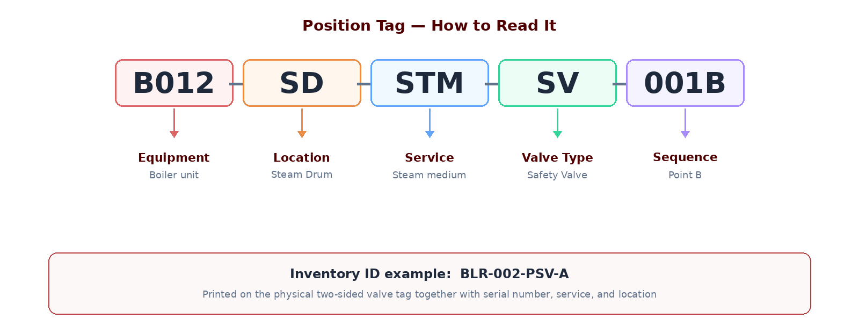
Valve Identification & Labeling
Read the tag left to right — each segment has a fixed meaning
Physical tag is two-sided: Position Tag + Inventory ID + Serial Number + Service + Location
Section 8 · Maintenance Strategy

Slide 21
Overhaul vs. Repair vs. Replace
Decision | When to use | Requirements | Outcome
Overhaul | Scheduled 3-year send-out | VR-stamp shop + pop test | Valve returned certified
Repair | Limited defect found | VR-stamp work + re-test | Targeted fix, lower cost
Replace | Body damage / obsolete / economics | New valve + correct capacity | Long-term reliability
Spare re-test | In storage > 5 years | API RP 576 guidance | Verify before installation
Texas A&M UES · Steam Safety Management Program

Slide 22
Commercial 125 psi Boiler Strategy
Section 7 of Maintenance Strategy — *illustrative pending actual vendor quotes
Approach | Annual valves | Unit cost trend | Recommendation
Replace-and-discard | ~16+ / year | Recurring purchase every cycle | Simple but highest lifecycle cost
Test-and-reuse + spare pool | Same fleet, pooled spares | ~40% reduction after pool built* | Mirror high-pressure program
Pilot program | 3–5 valves first | Validate quotes & turnaround | Prove before fleet-wide change
Texas A&M UES · Steam Safety Management Program

Slide 23
Highest-Impact Program Improvements
Quick wins and decisions that multiply program value
①
Acquire spares for no-spare locations — unlocks full bench testing
②
Rank valves by criticality (pressure, capacity, consequence) for capital prioritization
③
Adopt semi-annual visual walkdowns as standard UES practice
④
Keep dashboard + Excel register as single source of truth for due dates
⑤
Management decision on routine manual lever testing — risk vs. PG-73.1.3
Texas A&M UES · Steam Safety Management Program

Slide 24
Program Outcomes & Value Delivered
Category | Deliverable | Impact
Operational | Complete valve inventory across steam systems | Nothing missed in the field
Operational | Visible compliance by equipment and site | Leadership-ready status
Operational | Traceable status + repair history | Audit and incident support
Strategic | Code-aligned maintenance strategy | Defendable PM program
Strategic | Dashboard + Excel reporting | Capital requests backed by data
Strategic | Spare-pool foundation | Lower long-term testing cost
Texas A&M UES · Steam Safety Management Program

Slide 25
Recommended Next Steps
Concrete actions to move from program build to program sustainment
# | Action | Decision owner | Target
1 | Endorse Maintenance Strategy and PM frequencies | Leadership | This quarter
2 | Decide manual lever testing policy | Operations / Safety | Policy memo
3 | Approve spare-acquisition priority list | Leadership / Capital | FY planning
4 | Pilot test-and-reuse on 125 psi valves | Reliability | 3–5 valve pilot
5 | Fleet-wide physical tagging (Position Tag + Inventory ID) | Operations | Rolling install
Texas A&M UES · Steam Safety Management Program

Slide 26
Discussion
Steam Safety Management Program · Texas A&M UES · Reliability & Compliance

