Slide 1

Steam Safety Management Program
Pressure Safety Valve (PSV) Compliance · Data · Maintenance Strategy
Texas A&M University · Utilities & Energy Services
Leadership Briefing · Reliability & Compliance

Slide 2
Executive Summary
Built an end-to-end Steam Safety Management Program for UES boiler and steam systems
Started with field verification — walking units, photographing nameplates, confirming installed valves
Organized findings into a master Excel register, then a live compliance dashboard
Authored a formal PSV/SRV Maintenance Strategy aligned to ASME, NBIC, API RP 576, and Texas code
Outcome: one reliable system of record, proactive due-date management, and a defendable maintenance program

Slide 3
Why Leadership Should Care
Boiler PSVs are code-required safety devices — missed recertification creates regulatory and operational risk
Before this work, valve status, spare coverage, and due dates were difficult to see across the fleet
Unplanned failures and last-minute testing drive cost, outages, and audit exposure
A structured program reduces surprises, supports TDLR/NBIC expectations, and improves capital planning
This is reliability work that protects people, equipment, and compliance standing

Slide 4
Regulatory & Standards Foundation
Program decisions are code-informed, not ad hoc
ASME Section I — boiler safety valve design, capacity, and manual-lift requirements
NBIC Part 2 — in-service inspection and maximum 3-year test intervals
API RP 576 — industry best practice for inspection, testing, and repair of relief devices
16 TAC Chapter 65 & Texas Health & Safety Code Ch. 755 — state boiler program requirements
Maintenance Strategy document ties every PM activity back to these references

Slide 5
Building the Program
Field data → Master register → Dashboard → Maintenance strategy

Slide 6
Program Development Path
From field discovery to a sustainable maintenance program
1
2
3
4
Field Data Collection
Master Excel Register
Digital Dashboard
Maintenance Strategy
Site walks, nameplate photos, valve verification
→
Comprehensive master file for sorting & analysis
→
Live compliance tracking & operational visibility
→
Code-based PM program & spare-pool planning

Slide 7
Phase 1 — Field Data Collection
Ground truth before any database or dashboard
Walked boiler rooms and steam systems to locate every relief valve and protected point
Captured nameplate photos: serial number, set pressure (CDTP), orifice, manufacturer, NB number
Verified what was actually installed vs. what drawings or records showed
Documented whether a spare existed, valve orientation, discharge path, and visible condition issues
Flagged gaps: missing spares, illegible nameplates, weeping seats, isolation concerns

Slide 8
What We Captured in the Field
Equipment & location context
Valve identity & condition
Boiler / HRSG / commercial unit identity
Protected location (steam drum, economizer, etc.)
Position on the system
Installed vs. spare status
Serial number & manufacturer
Set pressure and capacity
National Board number
Nameplate photo evidence
Visible leakage, corrosion, or damage

Slide 9
Phase 2 — Master Excel Register
The bridge between field discovery and digital management
Built a comprehensive Excel master file as the first system of record
Sorted and normalized field data across equipment, locations, and serial numbers
Tracked install dates, service history, spare availability, and recert due dates
Assigned Inventory IDs and position-oriented tags for procurement and CMMS use
Used Excel to validate completeness before investing in a digital platform
Master file still supports bulk reporting and leadership reviews

Slide 10
Phase 3 — Digital Compliance Dashboard
Operational visibility for the whole fleet

Slide 11
Dashboard Capabilities
reliability-and-compliance-dashboar.vercel.app
Site-wide KPIs: Total PSVs, Installed, Out for Service, Overdue, Compliant %
Equipment → Location → PSV hierarchy matching how operators think about the plant
Automatic 3-year due-date calculation from install or on-site service history
Inventory ID visible on locations, KPI views, and exports
Status history and separate repair/overhaul history per valve
Excel report download: All PSVs, Installed, Out for Service, Overdue, Upcoming Due

Slide 12
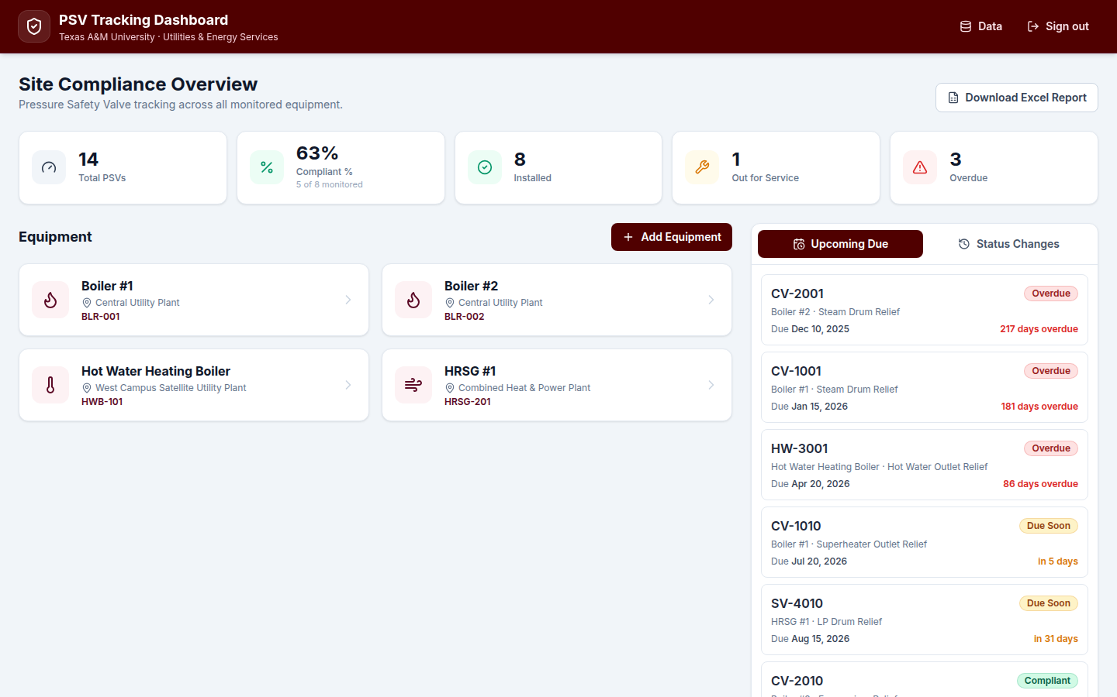
Dashboard — Fleet Compliance at a Glance
Leadership and operators can immediately see compliance posture and drill into equipment

Slide 13
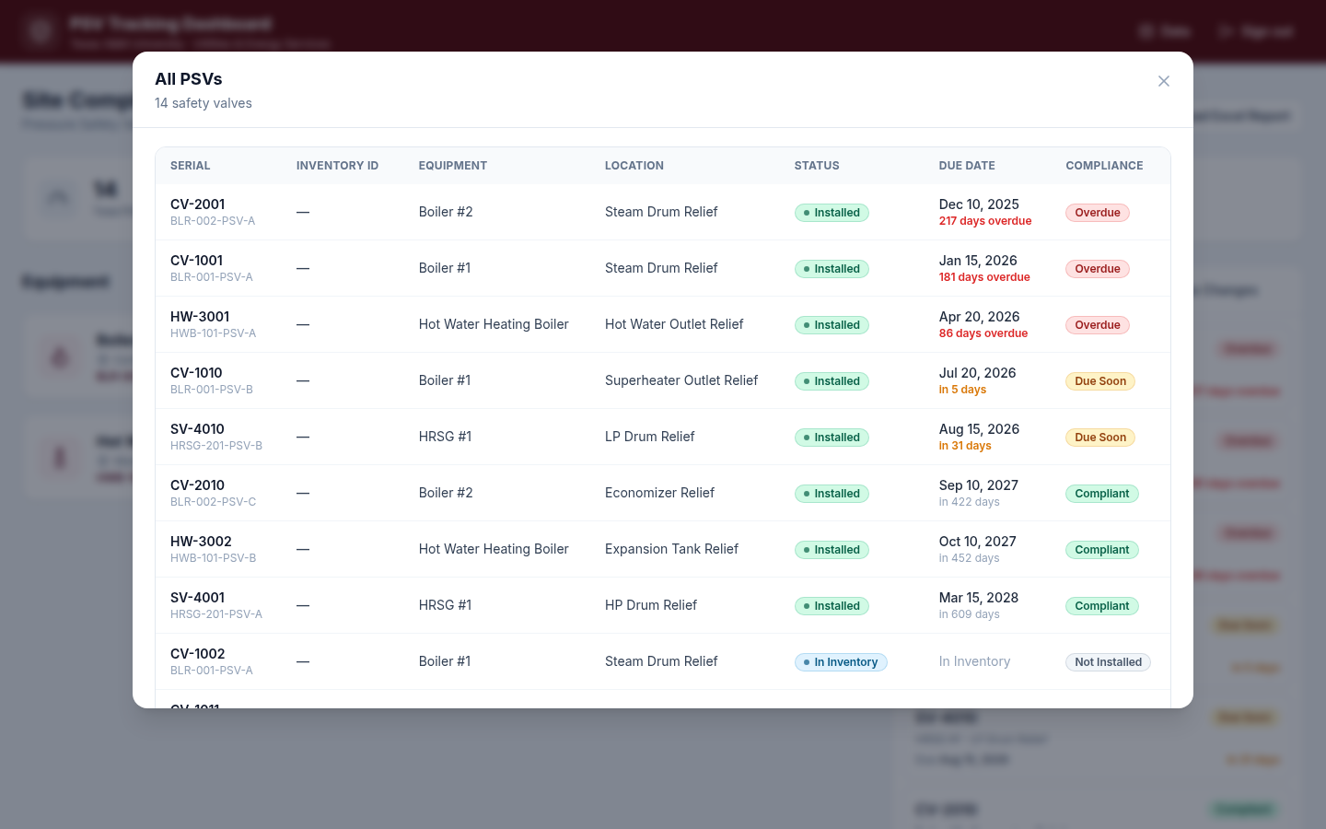
KPI Drill-Down
Click any KPI to see the exact valves driving that metric — serial, inventory ID, due date, status

Slide 14
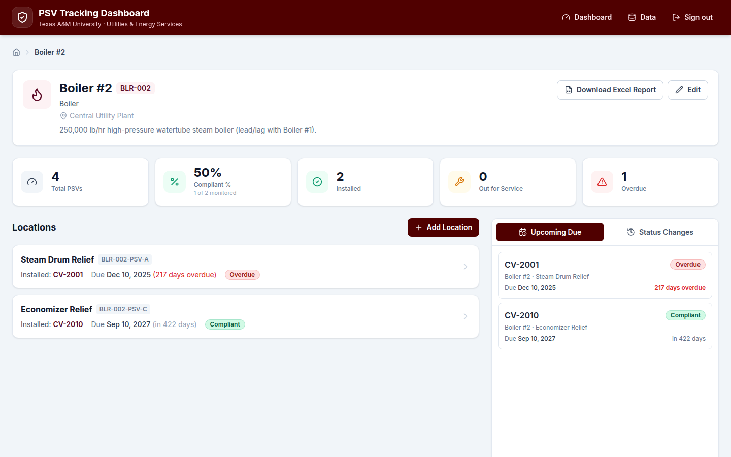
Equipment & Location Views
Scoped view per boiler with location-level inventory ID and installed valve due dates

Slide 15
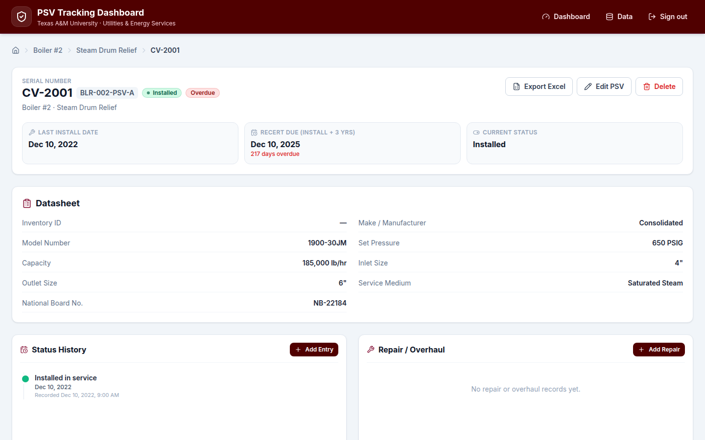
Valve Record Detail
Full datasheet, compliance clock, status history, and repair/overhaul log in one place

Slide 16
Phase 4 — Maintenance Strategy
Formal PSV/SRV program document for UES operations

Slide 17
PM Intervals & Triggers
Maximum intervals shown — UES should complete before due date
Formal pop test & overhaul (Setpoint): every 3 years — code minimum (NBIC Part 2, ASME Sec. I, 16 TAC Ch. 65)
Visual field walkdown: semi-annually — eyes-on check for weeping, corrosion, discharge issues (API RP 576)
Manual lever test: annual only if management approves — PG-73.1.3 allows but seat-damage risk exists
Condition-based inspection: immediately on leakage, chattering, actuation, or visible damage
Strategy distinguishes planned PM from emergency response

Slide 18
Testing Methods — Send-Out vs. In-Place
Long-term goal: spare coverage for all valves to enable send-out testing fleet-wide
Send-out (preferred when spare exists)
In-place (when no spare exists)
Valve removed; spare installed
Full bench overhaul at Setpoint shop
Internal inspection, lapping, spring check
Complete condition assessment
Lower seat-damage risk
Setpoint tests on live system
Equivalent certification issued
Functional lift test only — no disassembly
Higher seat-damage risk on older valves
Interim measure until spare acquired

Slide 19
Pre-Test Field Checklist (Highlights)
Section 4.1 of Maintenance Strategy
Valve body/bonnet — no active corrosion or mechanical damage
Discharge stack — clear, supported, no standing water
Nameplate legible — record set pressure, serial, orifice, manufacture year
No seat weeping at inlet; lifting lever free if equipped
Confirm valve not inadvertently isolated
Checklist completed before every removal or in-place test — filed in CMMS work order

Slide 20
Valve Identification & Labeling System
Section 8 of Maintenance Strategy
Position Tag (fixed point): EQUIPMENT – LOCATION – SERVICE – VALVE TYPE – SEQUENCE
Example: B012-SD-STM-SV-001B (Boiler B012, Steam Drum, Steam service, Safety Valve, point 001B)
Inventory ID — warehouse/stock identifier used on physical tags and in dashboard
Physical two-sided tag on valve body: Position Tag, service, inventory ID, location, serial number
Links field equipment to CMMS, Setpoint paperwork, dashboard, and spare pool tracking

Slide 21
Overhaul vs. Repair vs. Replace
Overhaul: full disassembly, seat lapping, spring inspection, certified pop test — bundled with 3-year send-out
Repair: limited-scope fix (e.g., seat lapping, spring) — must be VR-stamp work with re-test before return
Replace when: body damage, obsolete design, economics favor new valve, or high-criticality risk
Spares in storage >5 years: re-test before installation per API RP 576 guidance
Decision criteria documented so procurement and operations align on the same rules

Slide 22
Commercial 125 psi Boiler Strategy
Section 7 of Maintenance Strategy — management decision framework
Current practice: replace-and-discard (~16+ valves/year) — simple but recurring cost
Alternative: test-and-reuse with a shared spare pool — mirrors high-pressure boiler program
Illustrative savings: ~40% unit-cost reduction after pool is built (pending actual quotes)
Staggered 3-year rotation groups spread workload and cost evenly across years
Variability pooling: shared spare inventory covers more locations than one spare per site
Recommendation: pilot on 3–5 valves, validate costs and turnaround before fleet-wide change

Slide 23
Highest-Impact Program Improvements
Acquire spares for valves currently without a designated spare — enables full bench testing
Rank valves by criticality (pressure, capacity, consequence of failure) to prioritize capital
Adopt semi-annual visual walkdowns as standard UES practice between formal tests
Keep dashboard and master register as the single source of truth for due dates and status
Management decision needed on routine manual lever testing — risk vs. PG-73.1.3 compliance

Slide 24
Program Outcomes & Value Delivered
Operational value
Strategic value
Complete valve inventory across steam systems
Visible compliance status by equipment and site
Traceable history for audits and incidents
Faster planning for Setpoint outages and swaps
Reduced reliance on memory and scattered files
Code-aligned maintenance strategy document
Foundation for CMMS integration and spare pooling
Data to support capital requests for spares
Leadership-ready reporting via dashboard & Excel
Sustainable program ownership within UES

Slide 25
Recommended Next Steps
Leadership endorsement of the Maintenance Strategy and PM frequencies
Decision on manual lever testing policy (Section 3 — management choice)
Approve spare-acquisition prioritization for no-spare locations
Pilot test-and-reuse for commercial 125 psi valves (Section 7.5)
Continue populating dashboard with remaining field discoveries
Integrate Position Tags and Inventory IDs fleet-wide on physical valve tags

Slide 26
Discussion
Steam Safety Management Program · Texas A&M UES · Reliability & Compliance

