Slide 1

Steam Safety Management Program
Pressure Safety Valve Compliance · Data · Maintenance Strategy
Texas A&M University · Utilities & Energy Services
Field verified
Excel master file
Live dashboard
Maintenance strategy

Slide 2
Executive Summary
End-to-end program built from the ground up
4 Phases
51+ PSVs
3 Years
1 Source
Program path
Tracked fleet
Recert cycle
System of record
Field → Excel → Dashboard → Strategy
Boilers, HRSG, HHWB, DHWB
NBIC / ASME aligned
Dashboard + master Excel
✓ Walked boiler rooms and steam systems — photographed nameplates and verified installed valves
✓ Built a comprehensive Excel master register, then a live compliance dashboard for the full fleet
✓ Authored a formal PSV/SRV Maintenance Strategy aligned to ASME, NBIC, API RP 576, and Texas code
✓ Outcome: visible compliance, proactive due-date management, and a defendable maintenance program
1

Slide 3
Why Leadership Should Care
Risk reduction through visibility and a sustainable maintenance program
Boiler PSVs are code-required — missed recertification creates regulatory risk
Valve status, spare coverage, and due dates were hard to see fleet-wide
Unplanned failures and rushed testing drive cost, outages, and audit risk
A structured program cuts surprises and improves capital planning
This reliability work protects people, equipment, and compliance standing
2

Slide 4
Regulatory & Standards Foundation
Program decisions are code-informed, not ad hoc
ASME Section I — boiler safety valve design, capacity, and manual-lift requirements
NBIC Part 2 — in-service inspection and maximum 3-year test intervals
API RP 576 — industry best practice for inspection, testing, and repair of relief devices
16 TAC Chapter 65 & Texas Health & Safety Code Ch. 755 — state boiler program requirements
Maintenance Strategy document ties every PM activity back to these references
3

Slide 5
Building the Program
Field data → Master register → Dashboard → Maintenance strategy
4

Slide 6
Program Development Path
From field discovery to a sustainable maintenance program
1
2
3
4
Field Data Collection
Master Excel Register
Digital Dashboard
Maintenance Strategy
Site walks Nameplate photos Valve verification
→
Sort & normalize Track due dates Inventory IDs
→
Fleet KPIs Drill-down views Excel exports
→
PM intervals Spare pooling Code alignment
5

Slide 7
Phase 1 — Field Data Collection
Ground truth before any database or dashboard
Walked every boiler room to locate all relief valves and protected points
Captured nameplate photos: serial, set pressure (CDTP), orifice, NB number
Verified what was actually installed vs. what drawings or records showed
Documented spare availability, valve orientation, discharge path, and visible condition
Flagged gaps: missing spares, illegible nameplates, weeping seats, isolation concerns
6

Slide 8
What We Captured in the Field
Equipment & location context
Valve identity & condition
• Boiler / HRSG / commercial unit identity
• Protected location (steam drum, economizer, etc.)
• Position on the system
• Installed vs. spare status
• Serial number & manufacturer
• Set pressure and capacity
• National Board number
• Nameplate photo evidence
• Visible leakage, corrosion, or damage
7

Slide 9
Phase 2 — Master Excel Register
The bridge between field discovery and digital management
Built a comprehensive Excel master file as the first system of record
Sorted and normalized field data across equipment, locations, and serial numbers
Tracked install dates, service history, spare availability, and recert due dates
Assigned Inventory IDs and position-oriented tags for procurement and CMMS use
Used Excel to validate completeness before investing in a digital platform
Master file still supports bulk reporting and leadership reviews
8

Slide 10
Phase 3 — Digital Compliance Dashboard
Operational visibility for the whole fleet
9

Slide 11
Dashboard Capabilities
reliability-and-compliance-dashboar.vercel.app
Site-wide KPIs: Total PSVs, Installed, Out for Service, Overdue, Compliant %
Equipment → Location → PSV hierarchy matching how operators think about the plant
Automatic 3-year due-date calculation from install or on-site service history
Inventory ID visible on locations, KPI views, and exports
Status history and separate repair/overhaul history per valve
Excel report download: All PSVs, Installed, Out for Service, Overdue, Upcoming Due
10

Slide 12
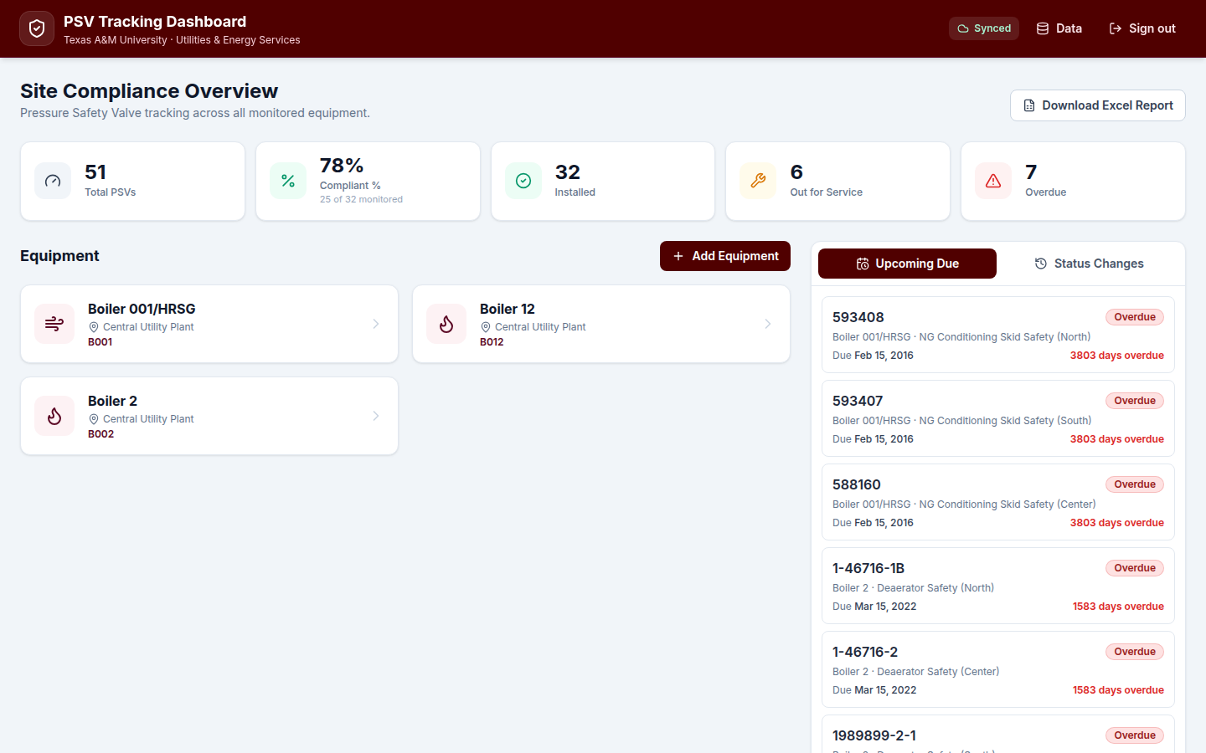
Dashboard — Fleet Compliance at a Glance
Live production — 51+ PSVs tracked, fleet-wide equipment view
11

Slide 13
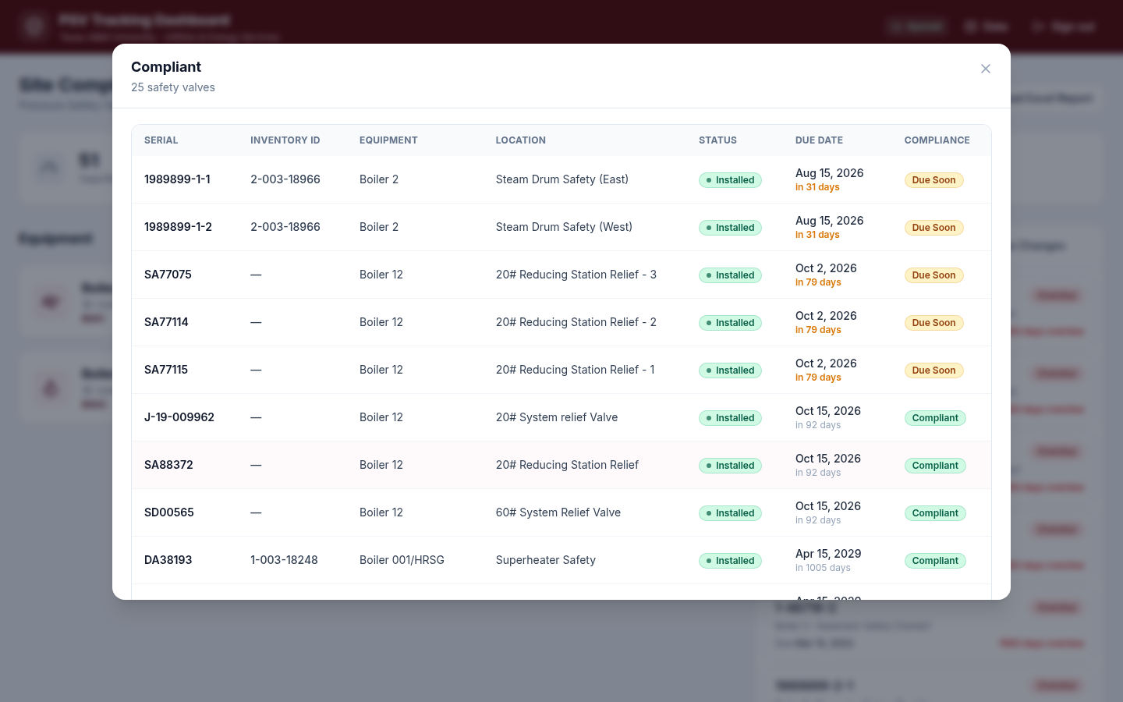
KPI Drill-Down
Click any KPI to see the exact valves driving that metric
12

Slide 14
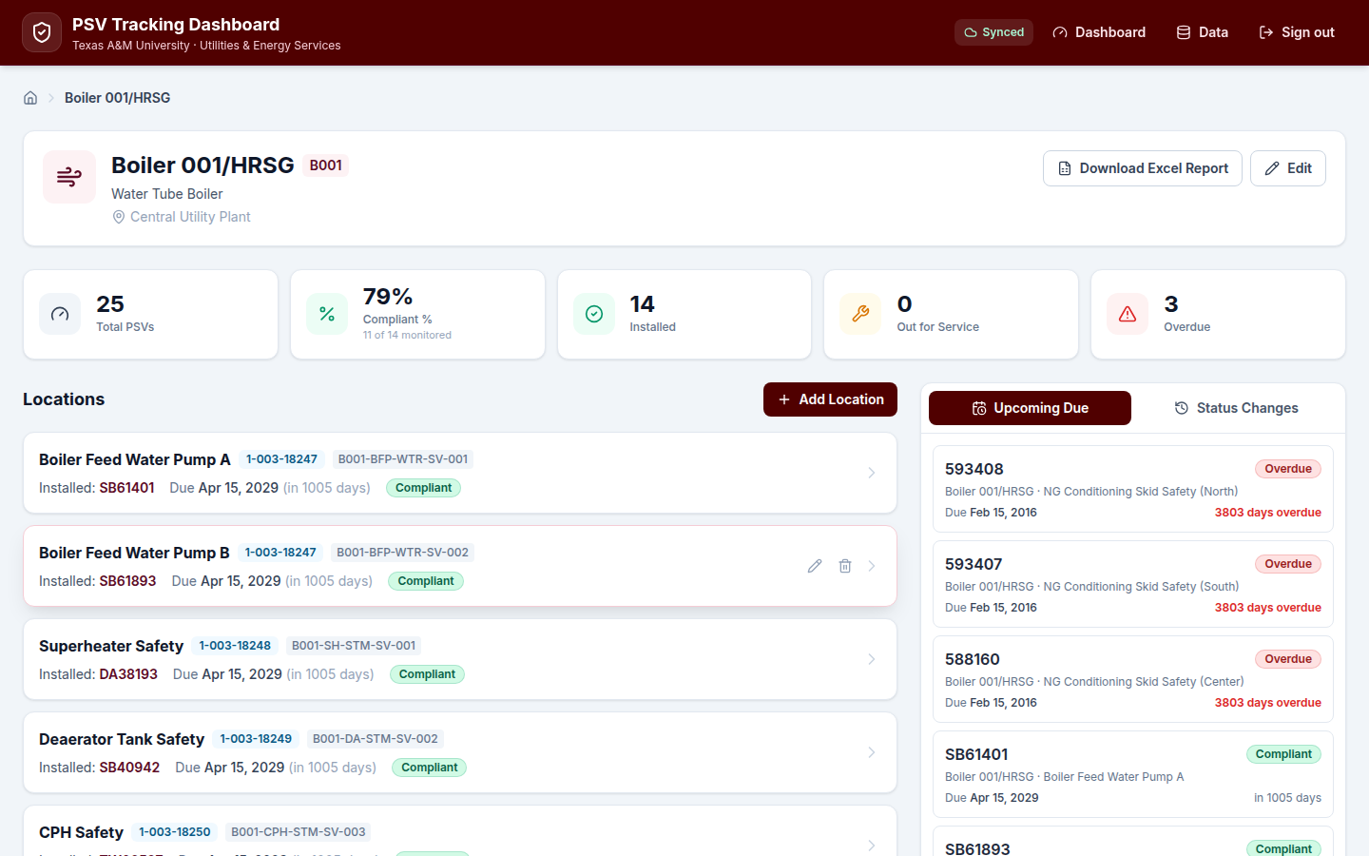
Equipment & Location Views
Scoped view per boiler with location-level Inventory ID and installed valve due dates
13

Slide 15
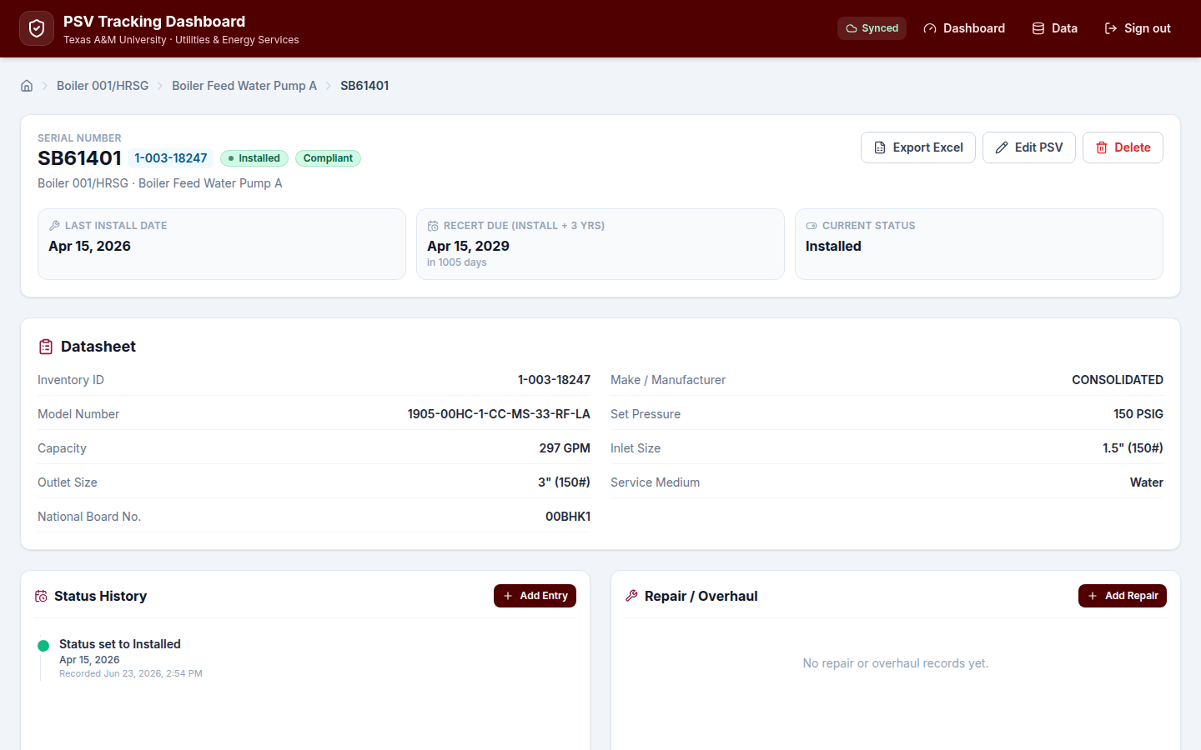
Valve Record Detail
Full datasheet, compliance clock, status history, and repair/overhaul log
14

Slide 16
Phase 4 — Maintenance Strategy
Formal PSV/SRV program document for UES operations
15

Slide 17
PM Intervals & Triggers
Maximum intervals shown — UES should complete before due date
Activity | Frequency | Code / reference | Notes
Formal pop test & overhaul | Every 3 years | NBIC Part 2 §2.5.8; ASME Sec. I; 16 TAC Ch. 65 | Code minimum — Setpoint send-out or in-place
Visual field walkdown | Semi-annual | API RP 576 §8 & §9 | Eyes-on only — recommended UES program addition
Manual lever test | Annual (optional) | ASME Sec. I PG-73.1.3 | Management decision — see Section 3
Condition-based inspection | Immediately | API RP 576 §9 | Leakage, chattering, corrosion, unplanned actuation
16

Slide 18
Testing Methods — Send-Out vs. In-Place
Long-term goal: spare coverage for all valves to enable send-out testing fleet-wide
Factor | Send-out (Setpoint shop) | In-place (Setpoint on-site)
Who performs | Setpoint certified shop technicians | Same Setpoint technicians, on-site
Certification | Full Setpoint test certificate | Full certificate — equivalent
Scope of work | Bench overhaul: disassembly, lapping, pop test | As-found lift; reseat & seat tightness check
Internal assessment | Complete — worn parts replaced | Limited — functional test only
Seat damage risk | Lower — controlled bench environment | Higher — especially older or corroded valves
Best suited for | Preferred when spare is available | Interim until spare is acquired
17

Slide 19
Pre-Test Visual Inspection — Field Checklist
Section 4.1 · Complete before every removal or in-place test · File in CMMS work order
Checkpoint | Accept / Reject criteria | Pass | Fail | N/A
Valve body and bonnet | No active corrosion; minor surface rust OK if no pitting | ☐ | ☐ | ☐
Discharge pipe / stack | Clear and unobstructed; properly supported; no standing water; drip pocket if applicable | ☐ | ☐ | ☐
Drain / weep hole (if equipped) | Open; no plugging or paint blockage | ☐ | ☐ | ☐
Body and bonnet bolting | All fasteners present and intact; no visible cracks or corrosion | ☐ | ☐ | ☐
Nameplate legibility | CDTP, serial, orifice, and manufacture year legible — record in work order | ☐ | ☐ | ☐
Inlet / nozzle area | No visible leakage or weeping at seat; dry mating surfaces | ☐ | ☐ | ☐
Test gag / lifting lever | Free of obstructions; lever not locked or wired shut (if equipped) | ☐ | ☐ | ☐
Inlet isolation (if applicable) | Valve in-line and not inadvertently isolated | ☐ | ☐ | ☐
Technician: _______________ Date: __________ WO #: __________ Equipment / Location: _______________
18

Slide 20
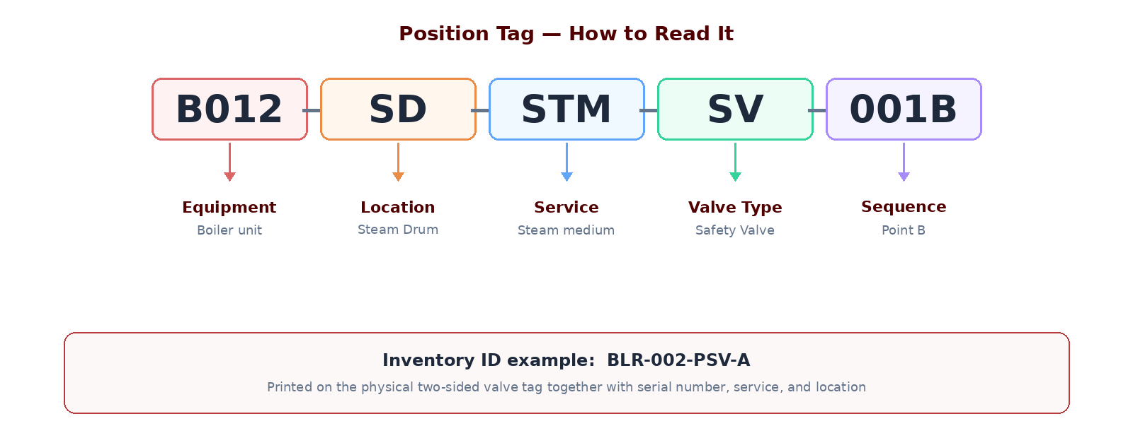
Valve Identification & Labeling
Section 8 · Read the tag left to right — each segment has a fixed meaning
Physical tag is two-sided: Position Tag + Inventory ID + Serial Number + Service + Location
19

Slide 21
Manual Lever Testing — Management Decision Required
Section 3 — both testing methods performed by Setpoint; certification equivalent
Arguments for
Arguments against / risks
• PG-73.1.3 requires capability to manually lift at ≥75% of set pressure on Section I boilers
• Low-cost field check that disc is not stuck to seat from corrosion or scale
• Brief test at operating pressure confirms disc and seat are functional
• Can damage seating surfaces — especially older valves or soft seats
• Post-test seat leakage may require immediate removal and bench overhaul
• API RP 576 does not recommend routine lever tests as substitute for formal pop testing
• Low incremental benefit if formal test is already scheduled
20

Slide 22
Overhaul vs. Repair vs. Replace
Decision guide for Setpoint and procurement
Overhaul: full disassembly, lapping, and certified pop test — bundled with send-out
Repair: limited-scope fix — must be VR-stamp work with re-test before return
Replace when: body damage, obsolete design, or high-criticality risk favors new
Spares in storage >5 years: re-test before installation per API RP 576 guidance
Decision criteria documented so procurement and operations align on the same rules
21

Slide 23
Commercial Boiler Safety Valves (150 PSI)
Cost-driven maintenance logic — test-and-reuse is not worth pursuing for this valve class
Section 6 — ASME Section IV heating-boiler devices; different class from Section I steam PRVs
F275464 (~$351/valve) replaces discontinued 0275464 — use ~$350–360 for planning
Use-and-trash is correct: repair cost exceeds ~60% of replacement at this price point
Annual lever test required per Watts ES-174A/740 — replace immediately on failed reseat
Recommend 3–5 year replacement cycle; align with fleet 3-year PSV cadence (Section 6.4)
22

Slide 24
3-Year Replacement Cycle by Location
Stagger replacements across sites so capital costs are predictable — not concentrated in one year
Without a rotation plan, valves installed together age out together — creating a single-year budget spike.
Assign each building or boiler location to a Year 1, 2, or 3 bucket so replacement and recert spend is level-loaded.
Year 1
Year 2
Year 3
Rotation group A
Rotation group B
Rotation group C
• Assign ~⅓ of locations (by valve count)
• Commercial 150 psi replacements due this cycle
• Setpoint send-outs aligned to spare swaps
• Next third of campus / plant locations
• Balance workload with Year 1 completions
• Update dashboard due dates after each swap
• Remaining locations complete the cycle
• Cycle restarts — locations return to Year 1
• One due-date logic across the whole fleet
How to build the plan: use dashboard valve counts and due dates per location · prioritize failed annual lever tests and overdue recerts into the nearest rotation year · leadership approves a 3-year capital forecast (~⅓ of fleet cost per year)
23

Slide 25
Highest-Impact Program Improvements
Section 5.5 — spare coverage is the single highest-impact improvement
Acquire spares for valves with none — enables full bench testing
Rank valves by criticality to prioritize capital spend
Adopt semi-annual visual walkdowns as standard UES practice between formal tests
Keep dashboard and master register as the single source of truth
Management decision needed on routine manual lever testing — risk vs. PG-73.1.3 compliance
24

Slide 26
Program Outcomes & Value Delivered
Operational value
Strategic value
• Complete valve inventory across steam systems
• Visible compliance status by equipment and site
• Traceable history for audits and incidents
• Faster planning for Setpoint outages and swaps
• Reduced reliance on memory and scattered files
• Code-aligned maintenance strategy document
• Foundation for CMMS integration and spare pooling
• Data to support capital requests for spares
• Leadership-ready reporting via dashboard & Excel
• Sustainable program ownership within UES
25

Slide 27
Recommended Next Steps
Leadership decisions to sustain the program
Leadership endorsement of the Maintenance Strategy and PM frequencies
Decision on manual lever testing policy (Section 3 — management choice)
Approve 3-year location rotation plan for commercial replacements and recert spend
Approve spare-acquisition prioritization for no-spare locations
Continue populating dashboard with remaining field discoveries (walkdowns in progress)
Integrate Position Tags and Inventory IDs fleet-wide on physical valve tags
26

Slide 28
Discussion
Steam Safety Management Program · Texas A&M UES · Reliability & Compliance
27

