Slide 1
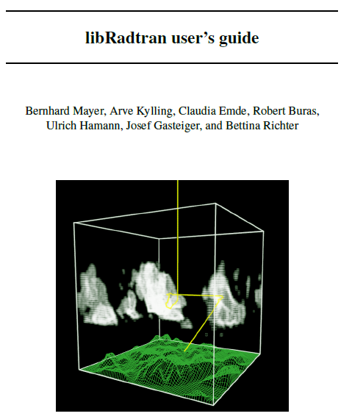

Slide 2
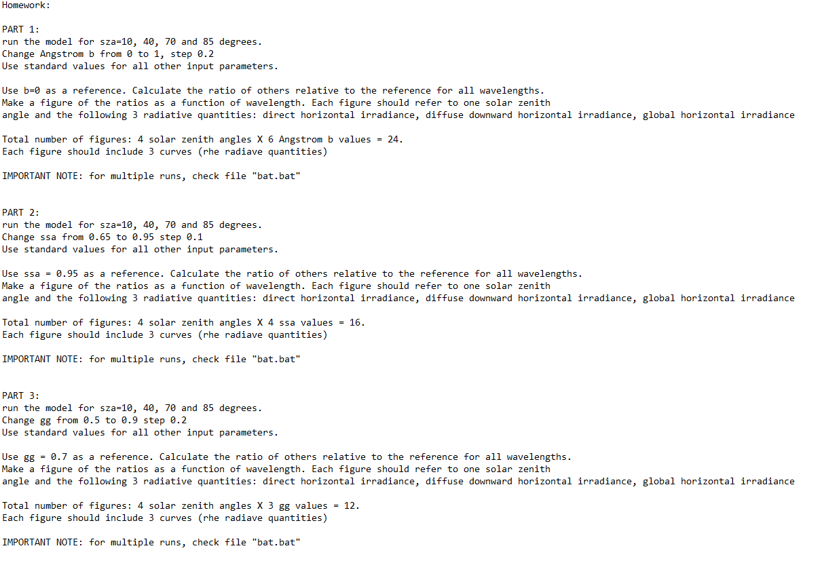
LibRadtran = Solving the radiative transfer equation
Which means… many various scenarios
For example: A homework with 3 parts and… 42 plots.
The “.out” file name must be representative of the made changes.

Slide 3
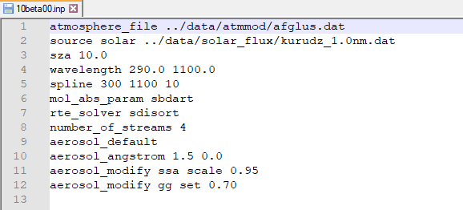
A reference scenario in LibRadtran
In the first part of the homework in the previous slide must run the model for:
4 solar zenith angles
5 b values of Angstrom Exponent
So, as outputs you have 4x5=20 files=plots.
An example is presented below:
b info on file name
SZA info on file name

Slide 4
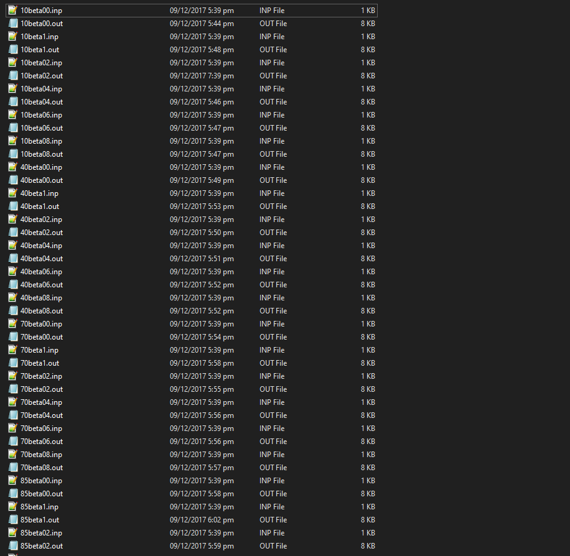
Your folder should be like that

