Slide 1
miRNA pressure on cancer-hallmark programs in TCGA-BRCA
…and what changes from healthy breast to tumor — work in progress Stav Zok

Slide 2
A · Framing

Slide 3
The question
Three questions, one quantity — miRNA “pressure” on the 50 MSigDB hallmark programs:
Which hallmark programs are most targeted by high-evidence miRNAs?
Does miRNA pressure anti-correlate with hallmark target-gene expression — and is it gated by AGO/RISC?
How does it vary by PAM50 / immune / stage — and what does the tumor acquire vs healthy breast?
Cohort: TCGA-BRCA primary tumors (n ≈ 1,077). Edges: miRTarBase. Programs: MSigDB Hallmark.

Slide 4
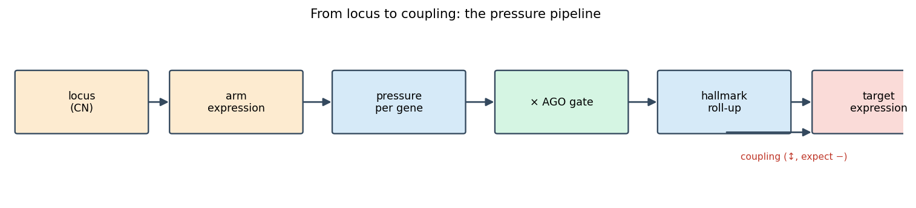
The objects

Slide 5
hallmark sets (50, ~4,384-gene union) · miRNA arms (~515 ranked; 721 in the landscape) · edges (miRNA→target, high-evidence flag) · AGO/RISC (rate-limiting capacity) · PAM50 / immune / stage strata.

Slide 6
The data
source | modality | role
miRTarBase | curated miRNA→target edges | the regulatory map
MSigDB Hallmark | 50 gene sets | the program universe
TCGA-BRCA miRNA-seq / RNA-seq | log2(RPM+1) / log2(TPM+1) | pressure & readout
ASCAT3 | copy number | dosage
GTEx-healthy + TCGA-NAT | cross-state | the landscape
CPTAC-2 prospective | protein (TMT) | independent validation
Buffa 2011 | independent miRNA+mRNA | replication

Slide 7
B · Method

Slide 8
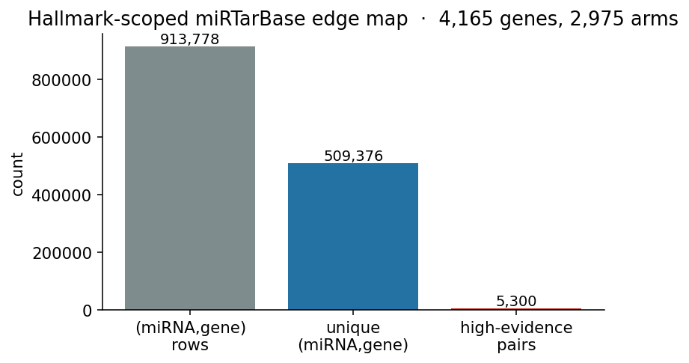
Step 1 — the edge map

Slide 9
Evidence tiers: reporter / protein > RNA / perturbation > binding.
High-evidence = ≥1 functional MTI and reporter-or-protein validation.

Slide 10
Step 2 — pressure (key formula #1)
pressure(g,s)=m∈R(g)​sm(m,s) z(m,s) log2(RPM+1)⏟expression ⋅ log(1+evidenceeff)evidence_mass(m)⏟evidence
share = the arm’s slice of gene $g$’s regulator budget (softmax, sums to 1).
z = does the arm move across tumors (the coupling signal).
log2(RPM+1) = anchor to real abundance.
spine M0 = miRTarBase-only edges, S1 scorer (softmax_z_logrpm).

Slide 11
6a · The master equation
pressure(g,s)=m∈R(g)​c(m,g,s), c=expr_mult⋅edge_w
Sum, not mean — total repressive load is additive; a gene crowded by many regulators is under more pressure.
$c$ is the atom: every share, family and acquired number is built from it.
Everything is within-scope (cohort vs one PAM50) — subtype tables are not cohort numbers re-sliced.

Slide 12
6b · The expression piece
$$\text{expr_mult}=\underset{\text{competition}}{\underset{⏟}{sm(m,s)}}⋅\underset{\text{dynamics}}{\underset{⏟}{z(m,s)}}⋅\underset{\text{abundance}}{\underset{⏟}{\log_{2}(RPM+1)}}$$
share — arms compete for finite RISC on a gene → softmax over $R(g)$, centered on each arm’s cohort median.
z — the dynamics term coupling reads; by design a stably-high arm → $z≈0$ → zeroed.
log2(RPM+1) — keeps absolute level, so a share between two near-zero arms ≠ one between two abundant arms.

Slide 13
6c · The evidence piece
$$\text{edge_w}=\frac{log(1+{\text{evidence}}_{\text{eff}})}{\text{evidence_mass}(m)}, {\text{evidence}}_{\text{eff}}=\text{confidence_logclass}+0.5 \text{enc_depth}$$
assay-directness weights: reporter 3.0 > protein 2.5 > RNA/perturb 1.5 > CLIP-binding 0.5.
log1p within each class → diminishing returns, defuses publication-count bias.
÷ evidence_mass = promiscuity penalty — a hub can’t dominate every gene by breadth.
+ ENCORI AGO-CLIP (α=0.5) — an orthogonal experimental layer on ~25% of pairs.

Slide 14
6d · Why three modes (the centering choice)
mode | centering | answers
softmax_z_logrpm (spine) | tumor mean | “who moves” → coupling
softmax_logrpm (no-z) | none | “who carries pressure” → attribution + cross-state
softmax_devhealthy_logrpm | healthy median | “what the tumor acquired”

Slide 15
Attribution policy: rank with global_abs_share, diagnose with global_signed_share, compute under no-z.

Slide 16
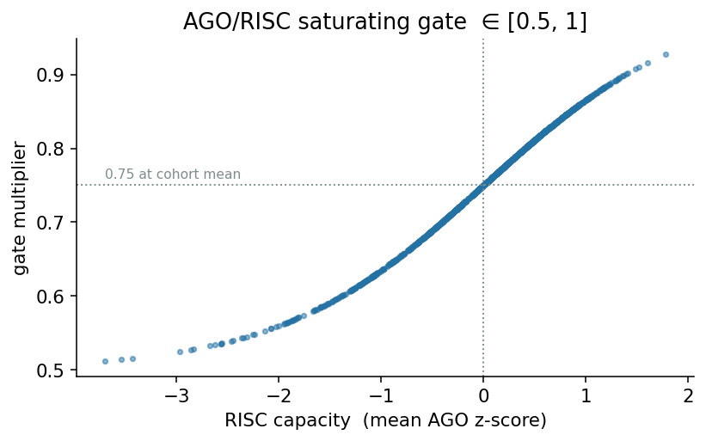
Step 3 — the AGO/RISC gate (key formula #2)
$$\text{gate}(s)=g_{min}+(1−g_{min}) σ​\left(k(\text{cap}(s)−c_{0})\right)$$
$$\text{gated}=\text{pressure}×\text{gate}(s), \text{gate}∈[0.5,1]$$
capacity = mean AGO1–4 z-score.
a documented sensitivity layer, not a causal model — every result reported gated and ungated.

Slide 17
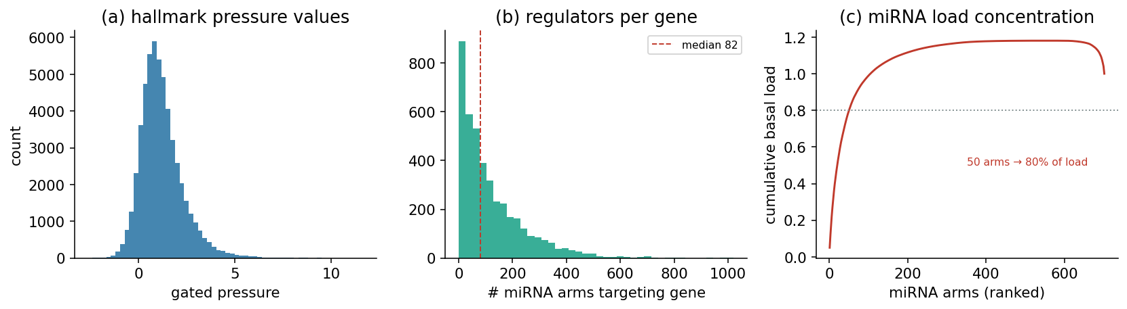
Pressure cohort-wide — what it looks like

Slide 18
structured, not noise: a heavy tail of hub arms carries most of the load; genes have many regulators.

Slide 19
The two read-outs — and what each is for
Enrichment — “where do miRNAs aim?”
one-sided hypergeometric over-representation of high-evidence targets per hallmark, FDR across 50.
descriptive; uses no expression.
Coupling — “is the pressure observed?”
partial Spearman of pressure vs target expression on a covariate ladder (raw → +CPE/HRD → +CN → +prolif).
inferential; negative = repression realized.

Slide 20
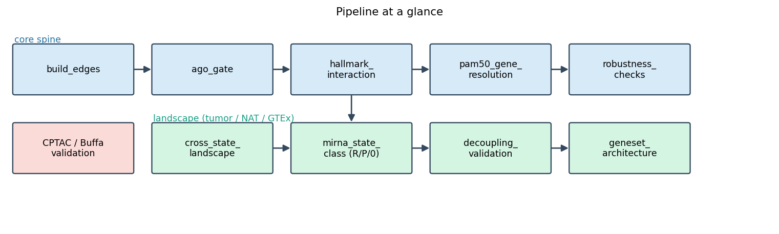
Pipeline at a glance

Slide 21
C · Core results (single state)

Slide 22
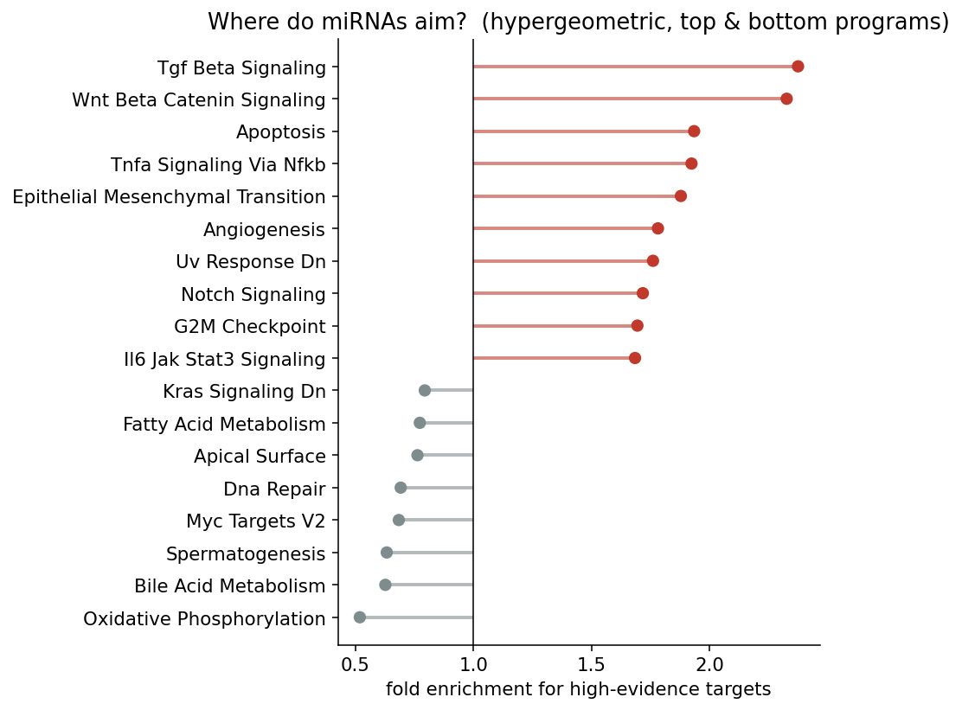
Result 1 — the targeting map

Slide 23
miRNAs buffer signaling & plasticity (TGF-β, WNT, apoptosis, NF-κB, EMT) — not housekeeping metabolism.

Slide 24
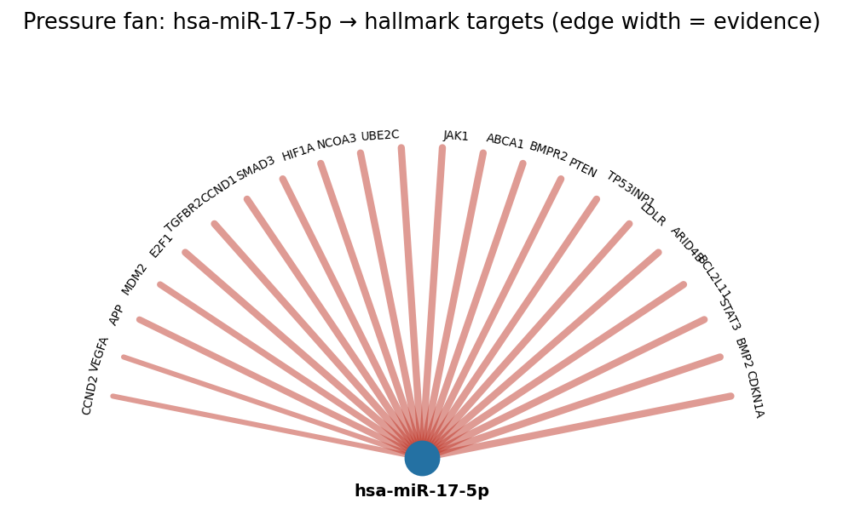
Result 2 — hub miRNAs
broadest regulators: miR-27a, miR-125b, miR-21, miR-34a (each ~44–45/50 sets).
program leaders are the canonical ones: miR-34a→WNT, miR-29→EMT, miR-21/155→NF-κB, miR-17→TGF-β → internal-validity check.

Slide 25
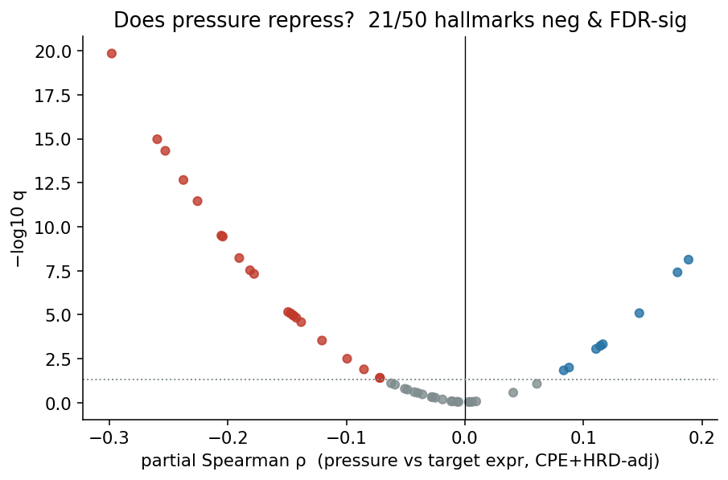
Result 3 — does pressure repress?
26/50 gated-negative; 21/50 survive CPE+HRD (shown).
positive couplings split into proliferation co-regulation (persists) vs a thinner composition artifact (collapses after purity/PAM50).

Slide 26
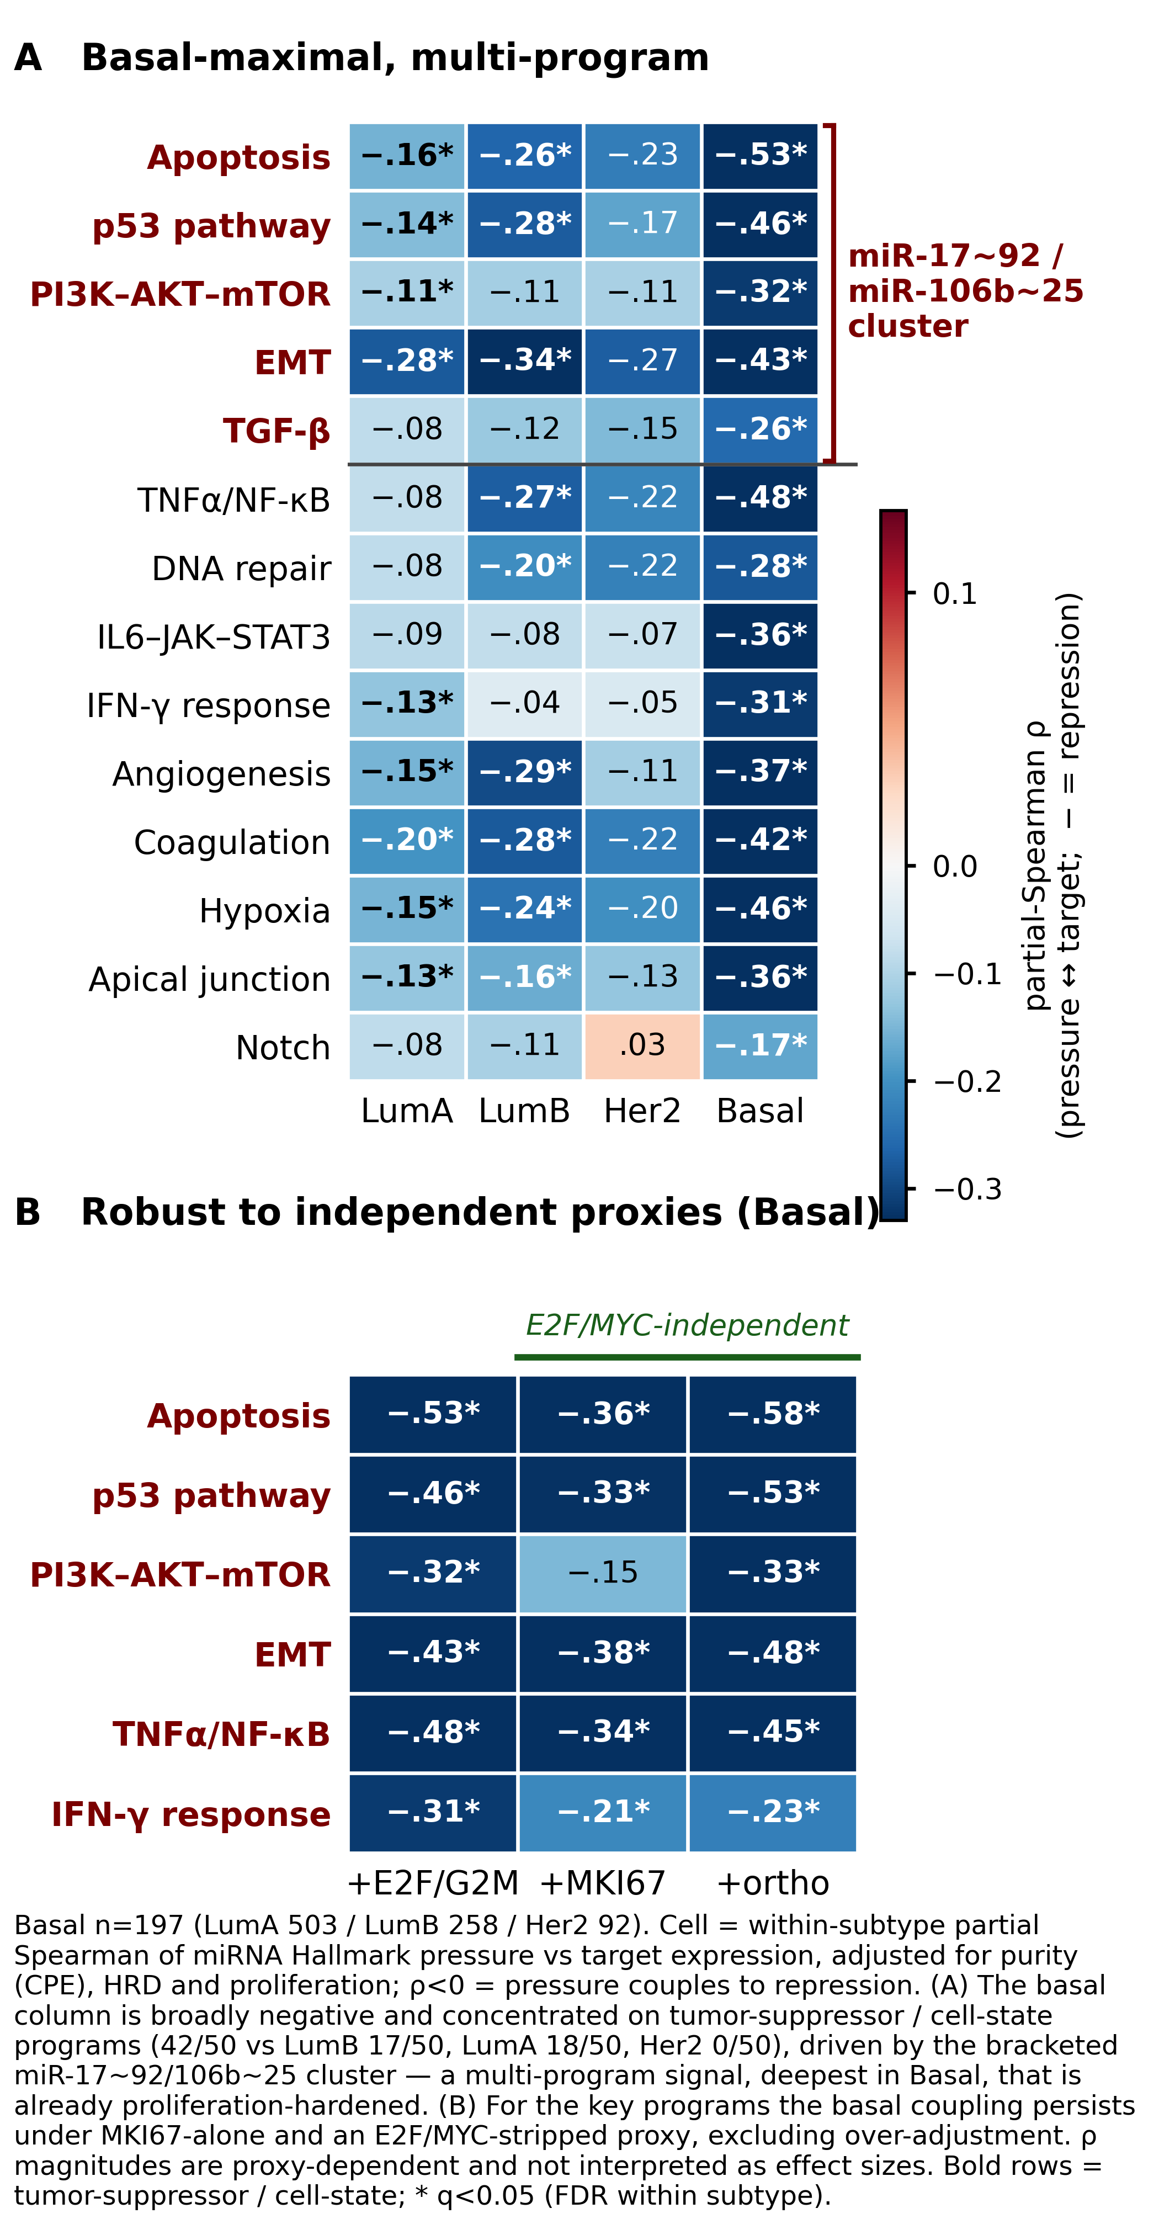
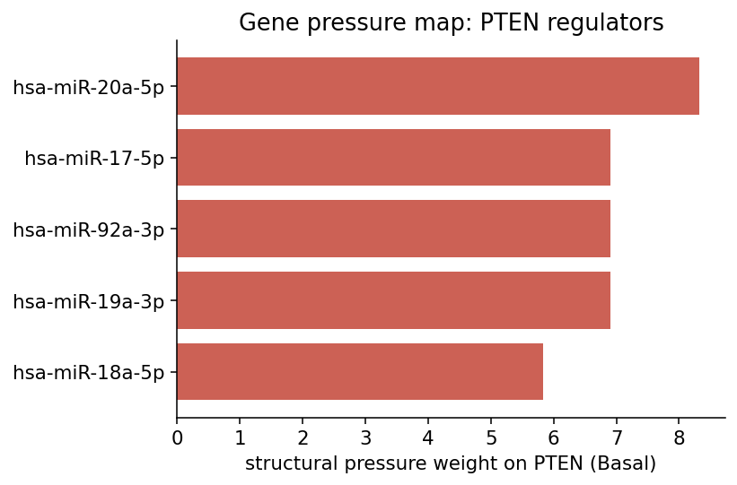
Result 4 — the subtype hub

Slide 27
Basal concentrates pressure on tumor-suppressor / EMT nodes — PTEN, BIM, FOXO1, CDKN1A, TGFBR2, VIM — via miR-17/20a/106b/23a/130b.

Slide 28
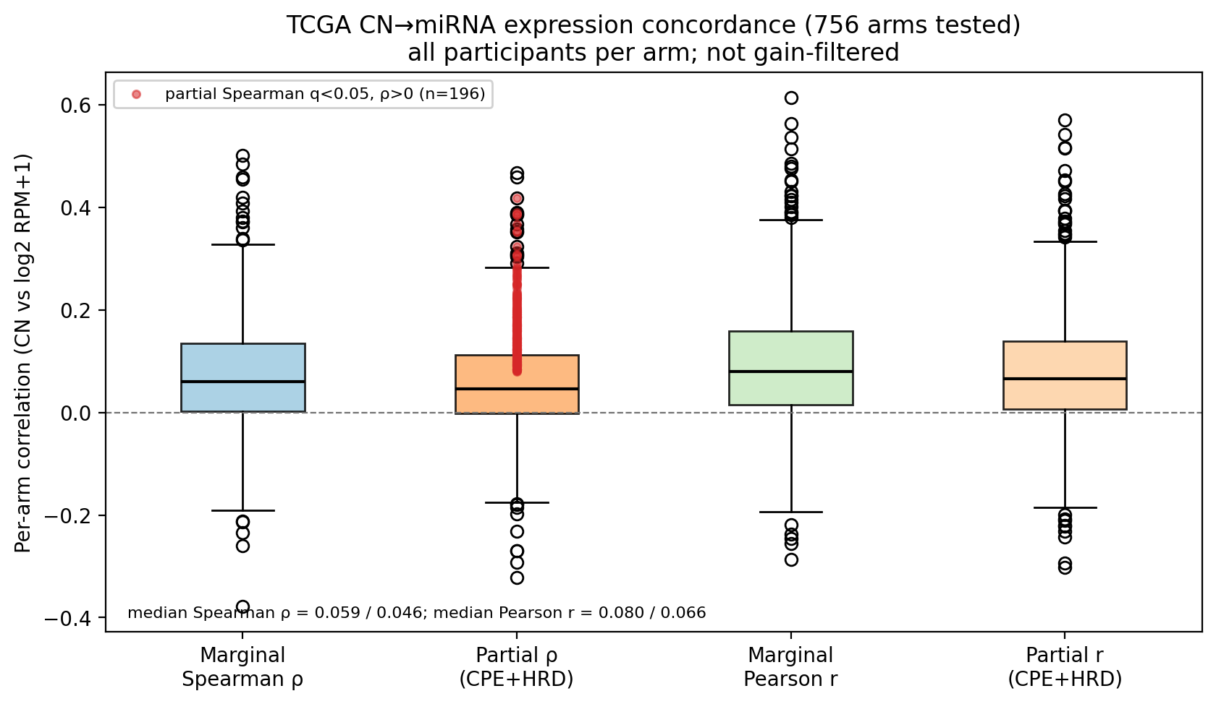
Result 5 — miRNA dosage
237/756 arms marginal positive locus-CN → expression concordance; 196/756 survive CPE+HRD partial.
top: miR-151a at the 8q24 MYC/AGO2 amplicon; subtype hierarchy LumB≈Her2 > Basal > LumA.
refreshed 2026-06-24 under the S1+MIMAT spine.

Slide 29
D · The cross-state landscape

Slide 30
From one state to three
A tumor-only snapshot can’t say what’s acquired. Add GTEx-healthy → TCGA-NAT → TCGA-tumor (721 arms / 5,108 edges).
Every edge carries two measurements:
pressure (potential) = edge weight × abundance — cross-state-comparable (no-z).
coupling (realized) = ESTIMATE+epithelial-adjusted partial-Spearman, per state.

Slide 31
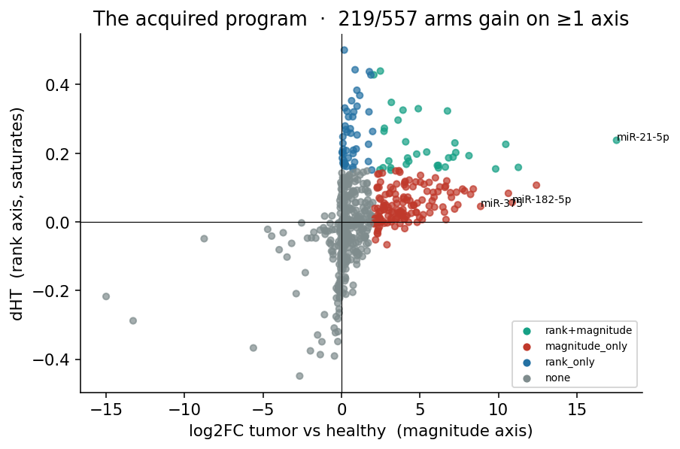
The acquired program
241/721 arms gain on ≥1 axis.
rank dHT saturates → magnitude log2FC recovers the oncomiR surge (miR-182/183/375/93).
top acquired = a coherent miR-21 program.

Slide 32
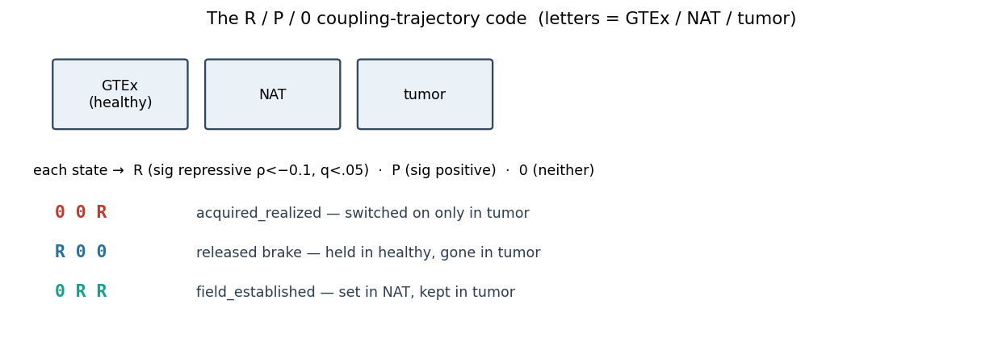
The R / P / 0 method

Slide 33
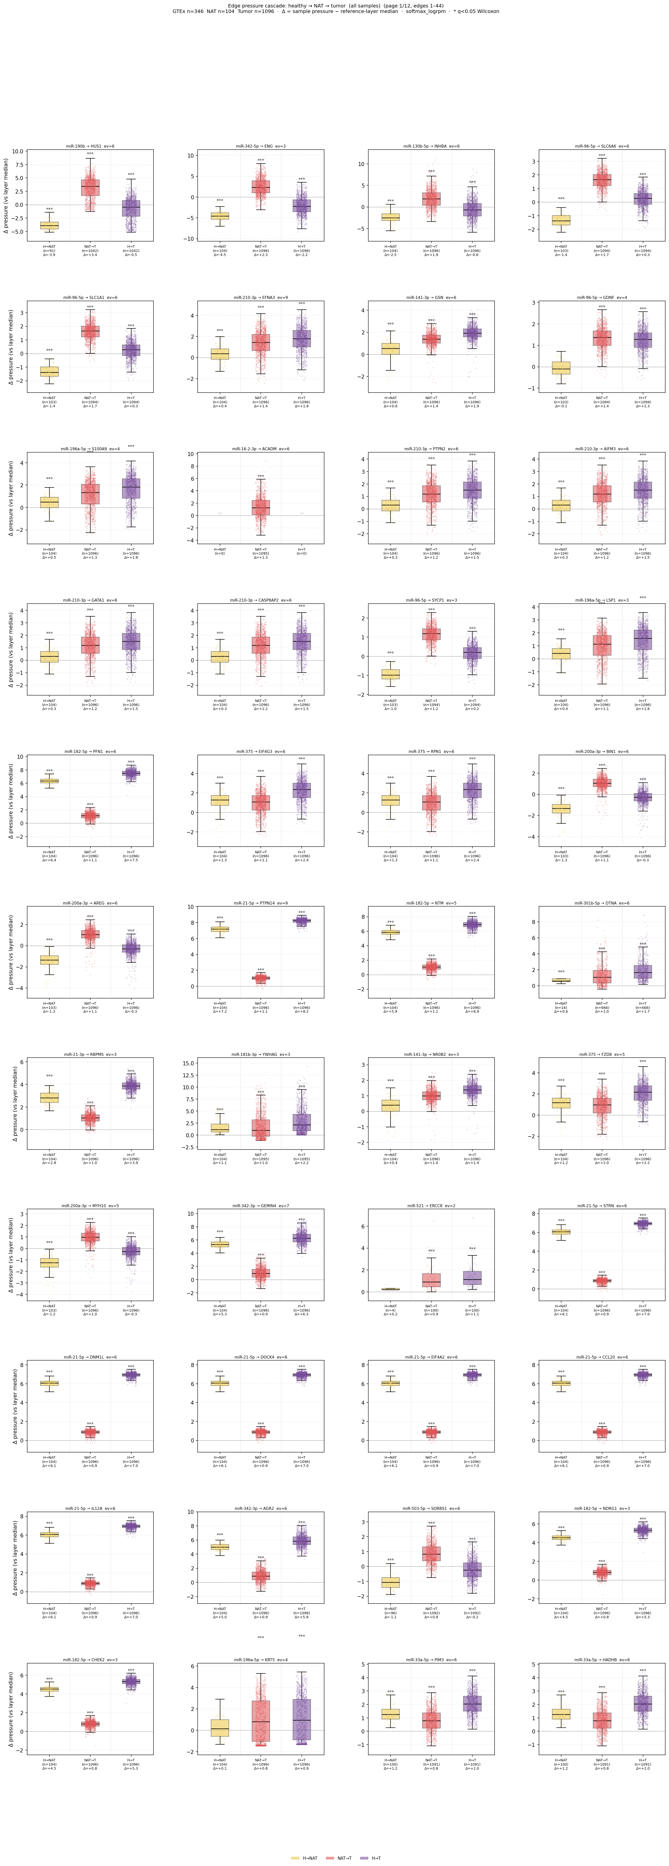
Switched-on repression & released brakes
acquired_realized (610 edges) — newly switched-on; highlight miR-744-3p → HLA-G + TGFB1 (acquired immune-tolerance, candidate).
released brakes (R00, 213 edges) — healthy holds ERBB2, CXCR4, MMP2/14, NOTCH2, BIM repressed; tumor releases.

Slide 34
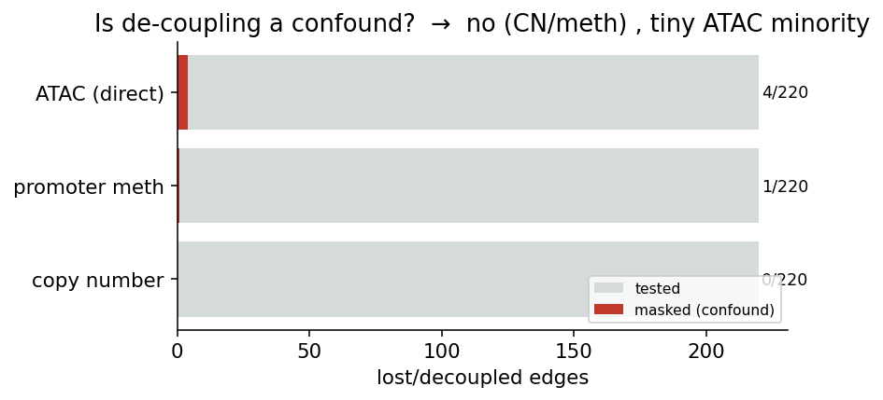
Is the de-coupling real?
not copy number (0/220), not promoter methylation (1/188).
small 4/134 direct-ATAC minority at growth/cell-cycle loci.
⇒ mechanism is post-transcriptional / competitive (APA, ceRNA, RISC).

Slide 35
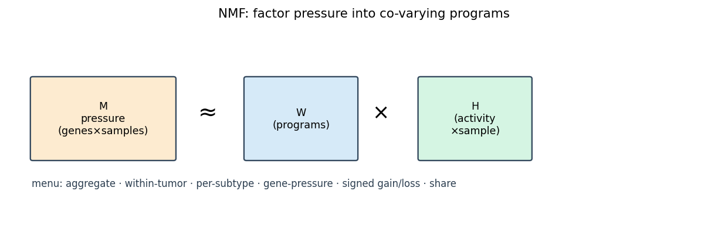
NMF — method & rationale
factor pressure matrices into co-varying programs; the menu spans aggregate, within-tumor, per-subtype, gene-pressure, signed gain/loss, and share.
factor indices renumber every rebuild → track the content factor_label.

Slide 36
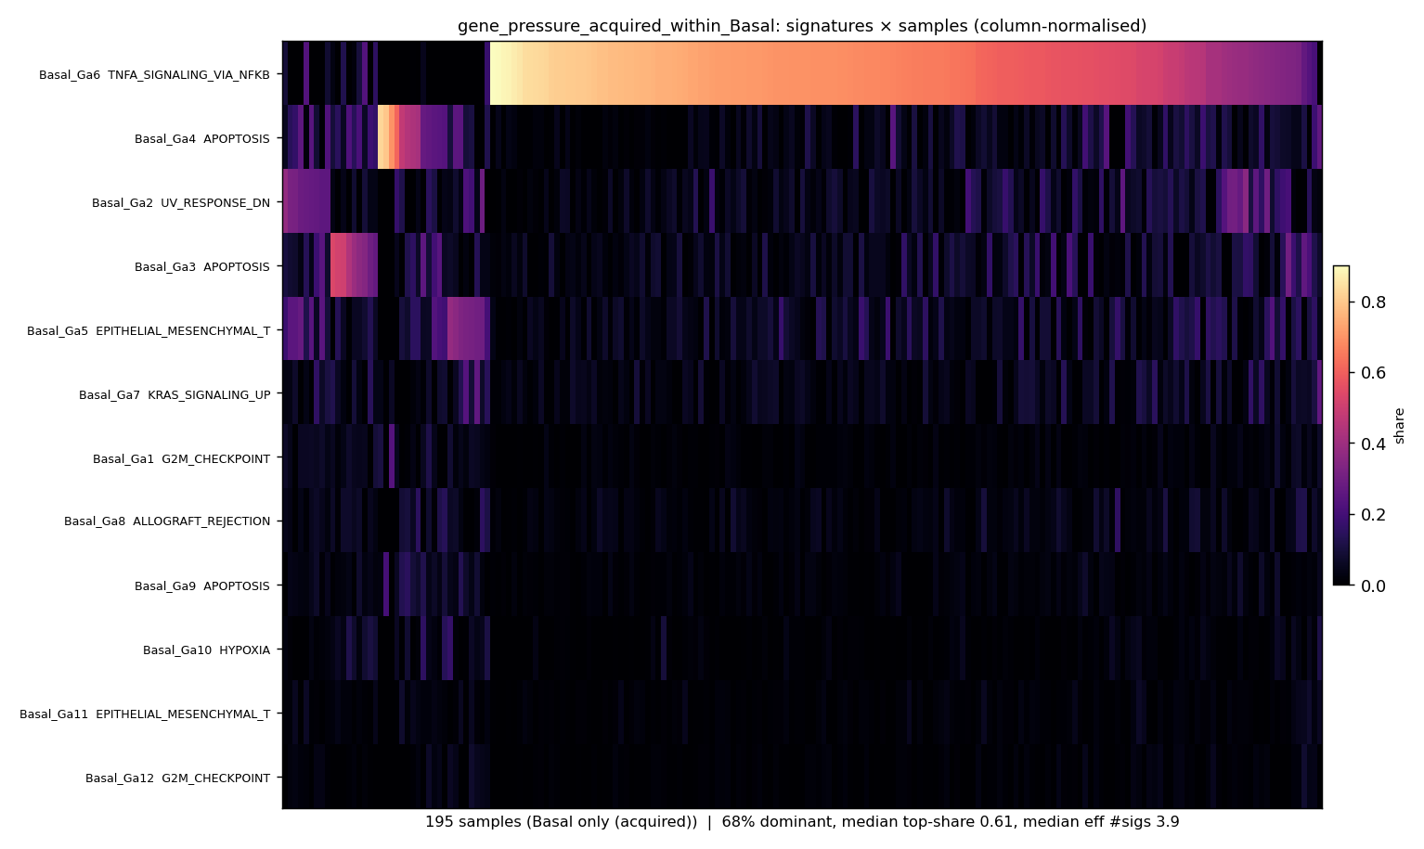
NMF — selected results
programs are PAM50-divergent (Basal TNFA/NFKB, q≈1e-139).
but what each tumor acquires is one shared backbone (46% cohort / 68% Basal).
divergent baseline, convergent acquisition.

Slide 37
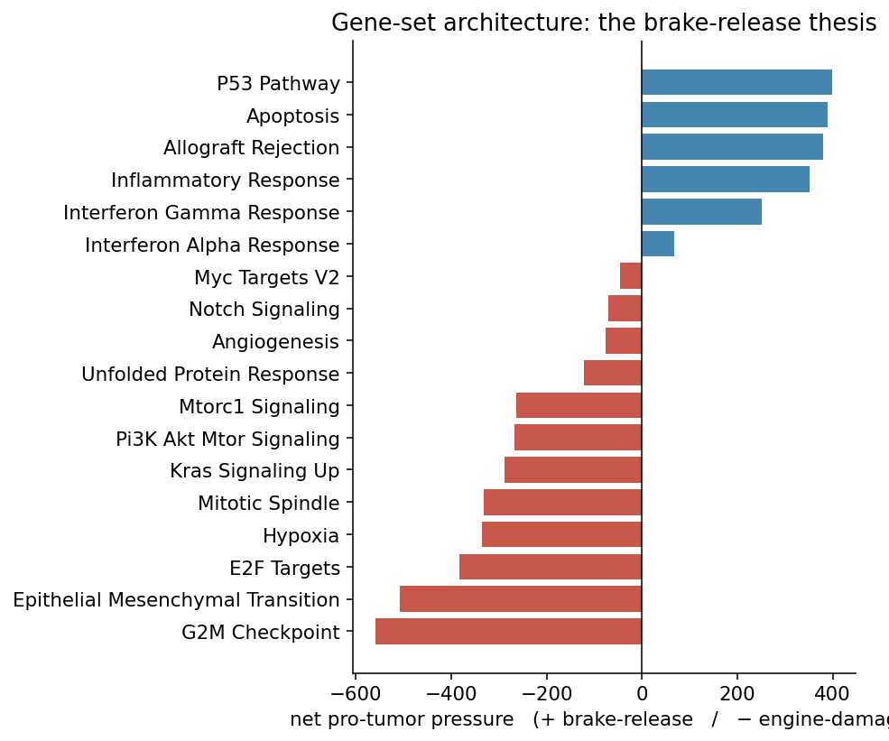
Gene-set architecture — the brake-release thesis

Slide 38
7,840 net-repressing vs 114 net-activating pairs: miRNAs damage engines, but their malignant effect is brake-release on suppressive programs. miR-21 #1 (93% acquired).

Slide 39
E · Did we believe it?

Slide 40
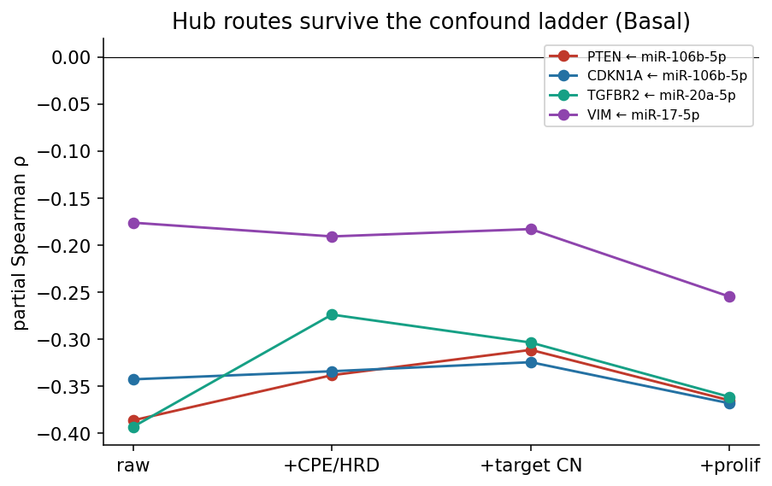
Robustness 1 — proliferation
adjust on MKI67 / E2F-MYC-stripped G2M / PC1 → coupling survives & strengthens (8/8 key; Basal 41/50).
proliferation is a suppressor confound. PTEN/CDKN1A/TGFBR2/VIM robust.

Slide 41
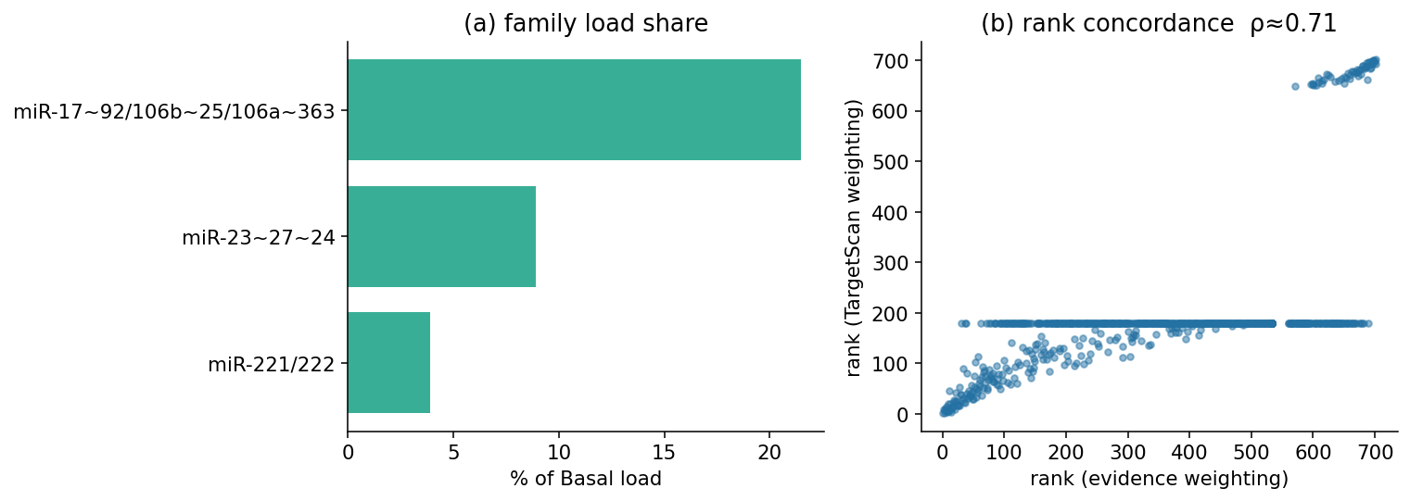
Robustness 2 — curation bias

Slide 42
miR-17-5p is #1 under evidence, binary and TargetScan weighting (ρ≈0.65). Not a curation artifact.

Slide 43
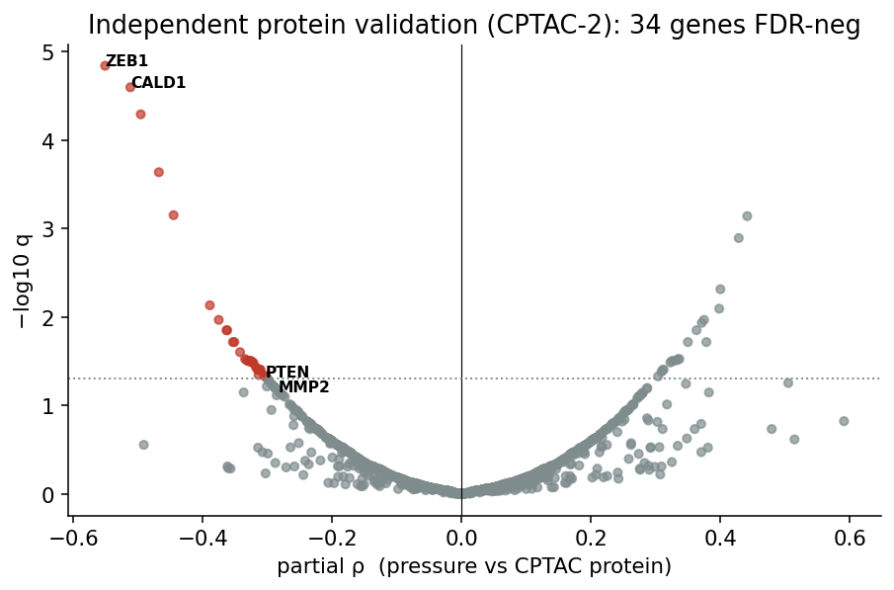
Validation 1 — protein layer (CPTAC)
Independent CPTAC-2 prospective (TMT) validates: 53/1143 genes FDR-neg; ZEB1 ρ=−0.55. Mostly mRNA-mediated.
A mRNA-dominant: ZEB1, CALD1, MMP2.
B protein/translational (the payoff): PTEN −0.10 → −0.38 via miR-17-5p, DDAH1, ARHGDIA, PEBP1.
C mixed: KRT8, BMP1.

Slide 44
Validation 2 — orphan-blind discovery
A blind scan of 20,663 orphan edges (miRTarBase-absent) vs CPTAC protein → 539 protein / 182 translational / 93 translational+TCGA-replicated candidates (76 fully uncurated).
method self-validates by de-novo recovery of miR-29 → collagen/ECM.
cell-composition confound pilot: 24 → 17 survive; robust core miR-15/16/195→PMM1, miR-19a/b→PPM1A.
wet-lab nominations, not validated edges.

Slide 45
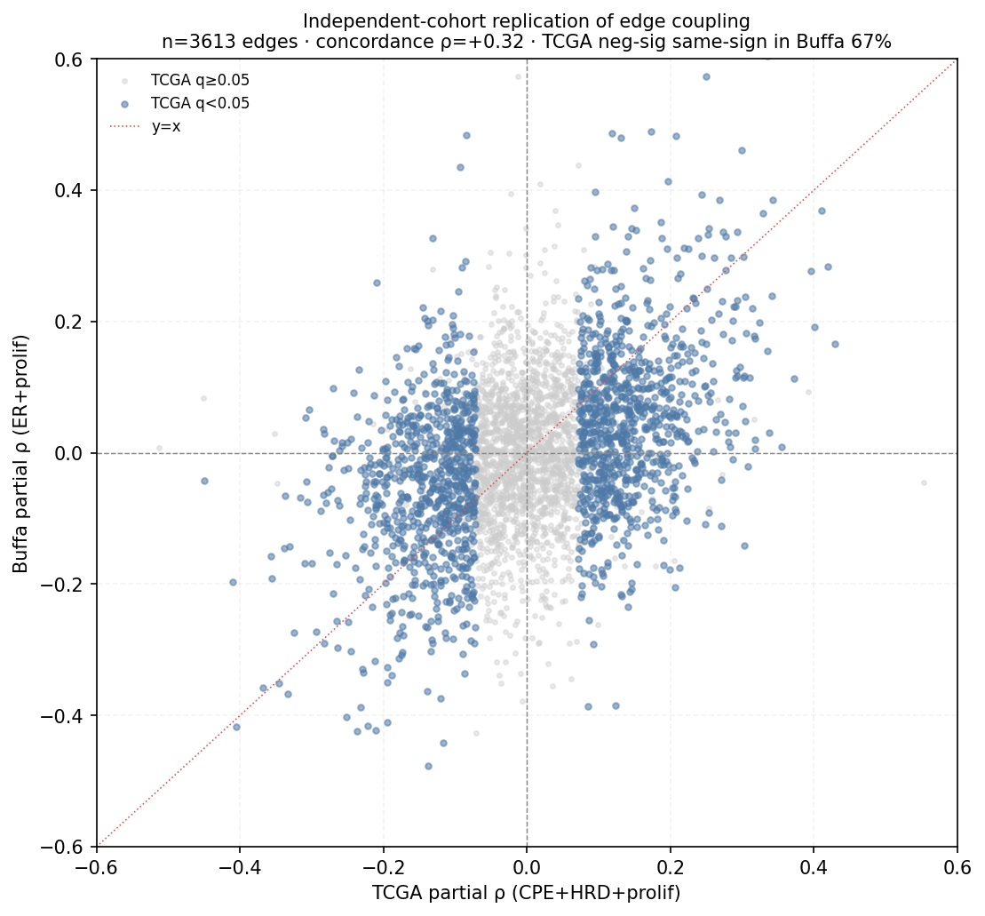
Validation 3 — independent cohort (Buffa)
207 paired breast tumors, no TCGA overlap: partial-ρ concordance +0.32, 67% sign-concordance; 108 orphans triple-validated (TCGA·CPTAC·Buffa).

Slide 46
Scorecard
Solid | Exploratory / candidate
targeting map | miR-744 → HLA-G immune edge
Basal tumor-suppressor hub | AGO-gate causality
proliferation robustness | de-coupling mechanism (APA/ceRNA)
CPTAC-2 protein validation | orphan nominations
brake-release architecture
miR-29 → ECM orphan axis

Slide 47
F · Wrap

Slide 48
Limitations
pressure is associative, not causal.
miRTarBase curation bias → read rankings, not absolute folds.
gene-gene topology can’t see lipid-mediated inhibition (PTEN→PIP3).
164 floor0 arms lack a healthy reference; AGO gate is a bounded heuristic.
de-coupling mechanism not yet pinned; dosage module pre-MIMAT.

Slide 49
What’s next
stratum-resolved within-PAM50 coupling.
pin the de-coupling mechanism with the APM motif / SV / APA per-sample layer.
loss-of-repression; fitted AGO×pressure; larger per-tumor ATAC; METABRIC.

Slide 50
Takeaway
miRNAs target signaling / plasticity programs.
the malignant move across healthy→tumor is brake-release on suppressive programs — subtype-structured (Basal miR-17~92 on tumor suppressors; PTEN the through-line: core → landscape → CPTAC protein).
it replicates at protein (CPTAC-2) and in an independent cohort (Buffa).

Slide 51
Backup — formulas
S1 evidence scorer (confidence_logclass weights) + ENCORI depth boost (α=0.5).
no-z cross-state spine; healthy-anchored dev mode.
hypergeometric enrichment; signed-path propagation (Katz α=0.25, 6 hops).
gene-role malignancy + DepMap continuous weight.
R/P/0 thresholds (|ρ|>0.10, q<0.05); arm-resolve Tier A/B/C.
Sources: docs/{FORMULAS,METHODS,LANDSCAPE_REPORT,CPTAC_VALIDATION_SESSION_SUMMARY}.md.

