Slide 1
Energy Management System for Mild Parallel Hybrid Electric Vehicles
Seminar Electromobility SS 2021
Stawan Chandrashekhar Kulkarni (419106)
Parth Rangani (419154)
Pranav Balasaheb Mohite (419272)

Slide 2
Agenda
Introduction
Classification of Hybrid Electric Vehicles
Vehicle Specifications
Driving Cycles
Rule Based Strategy
Operation Modes
Simulation Results
Conclusions
Future Scope

Slide 3
Introduction
Introduction
Transportation Systems are going through from conventional vehicles to other sustainable mobility solutions
Scarcity of fuel resources, legislations, increasing awareness about climate change etc. are drivers of this transition.
HEVs are widely considered as replacement for internal combustion engine vehicles
HEVs use electrical energy stored in battery for driving electrical motor along with conventional fuel for engine for propulsion of the vehicle
Due to two different prime movers and two different energy sources arises the need of energy management system
To reduce the fuel consumption of the vehicle easy implementation and computational feasibility a rule based strategy is used for energy management.

Slide 4
Classification of Hybrid Electric Vehicles
Hybrid Electric Vehicles
Series HEVs
Parallel HEVs
Combined HEVs
Engine
Engine
Engine
1st Electric
Battery
Battery
Motor
1st Electric
Electric
Motor
Powersplit
Motor
Battery
device
Gear Box
2nd Electric
2nd Electric
Motor
Motor

Slide 5
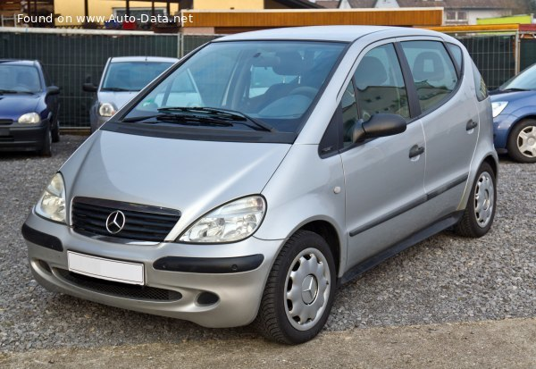
Vehicle Specifications
Vehicle Specification
Vehicle Model
Mercedes Benz A170 CDI (W168)
Engine Specifications
60 kW, 187 Nm, 4200 RPM, Diesel
Motor
12 kW, 60 Nm, 7639 RPM, PMS
Battery
Li-ion, 16.38 kW, 46.8 V, 0.468 kWh, 13 mΩ
Transmission
5 Speed Manual, friction clutch
Source: Auto-Data

Slide 6
Driving Cycles
NEDC
Specifications
Driving length: 11 km
Time: 1220 s
Maximum speed: 120 km/h
Average speed: 33.6 km/h
Used for light duty vehicles

Slide 7
Driving Cycles
FTP-75
Specifications
Driving length: 17.77 km
Time: 1877 s
Maximum speed: 91.2 km/h
Average speed: 34.1 km/h
Used for light duty vehicles

Slide 8
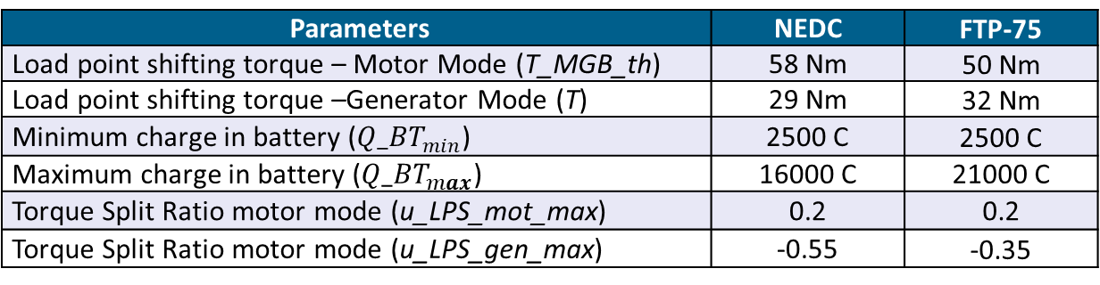
Rule Based Strategy
Rule Based Strategy
Introduction
Strategy based upon set of rules
Selection of set of variables which defines the driving conditions.
Shifting of operation modes is dependent on conditions.
The conditions are arranged in if-else loop to achieve shifting between modes in MATLAB.
Finding out the suitable value of parameters to obtain minimum fuel consumption.
Parameters | NEDC | FTP-75
Load point shifting torque – Motor Mode (T_MGB_th) | 58 Nm | 50 Nm
Load point shifting torque –Generator Mode (T) | 29 Nm | 32 Nm
Minimum charge in battery (${Q_BT}_{min}$) | 2500 C | 2500 C
Maximum charge in battery (${Q_BT}_{max}$) | 16000 C | 21000 C
Torque Split Ratio motor mode (u_LPS_mot_max) | 0.2 | 0.2
Torque Split Ratio motor mode (u_LPS_gen_max) | -0.55 | -0.35

Slide 9

Operation Modes
Torque Split Ratio
Introduction
Ratio of motor torque and gearbox torque.
Mathematically, $u=\frac{T_{EM}}{T_{MGB}}$
Dependent on mode of operation
Torque equation is given by, $T_{MGB}=T_{EM}$ $+{ T}_{CE}$
$_{MGB}$ = $_{CE}$ = $_{EM}$

Slide 10
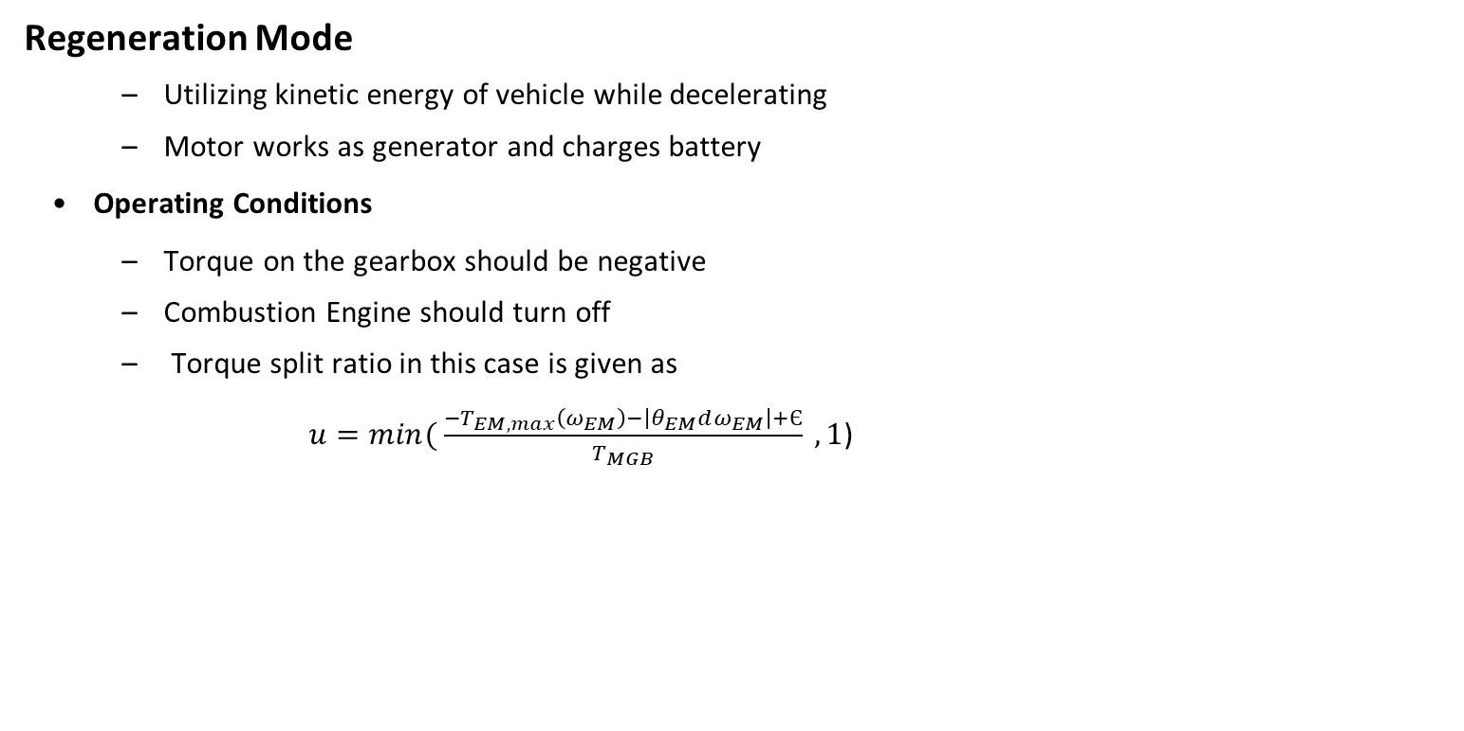
Operation Modes
Regeneration Mode
Utilizing kinetic energy of vehicle while decelerating
Motor works as generator and charges battery
Operating Conditions
Torque on the gearbox should be negative
Combustion Engine should turn off
Torque split ratio in this case is given as
$u=min⁡( \frac{{−T}_{EM,max}\left(ω_{EM}\right)−\left|θ_{EM}dω_{EM}\right|+Є}{T_{MGB}} , 1$)
CE
BT
EM
TC
MGB
V

Slide 11
Operation Modes
Regeneration Mode
Matlab Implementation
%% Mode 1 – Regeneration Mode
if(T_MGB<0)
u =min((interp1(w_EM_max,T_EM_max,w_MGB)+abs(theta_EM*dw_MGB)+epsilon)/T_MGB,1);

Slide 12
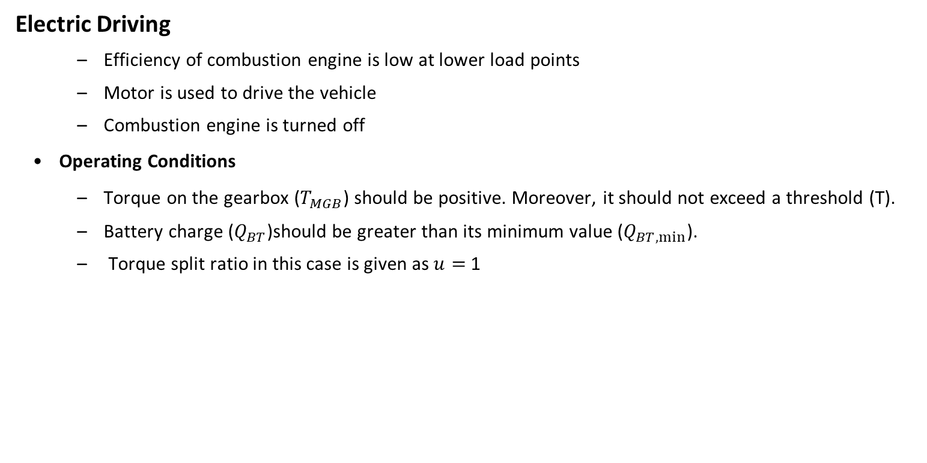
Operation Modes
Electric Driving
Efficiency of combustion engine is low at lower load points
Motor is used to drive the vehicle
Combustion engine is turned off
Operating Conditions
Torque on the gearbox ($T_{MGB}$) should be positive. Moreover, it should not exceed a threshold (T).
Battery charge ($Q_{BT}$)should be greater than its minimum value ($Q_{BT,min⁡}$).
Torque split ratio in this case is given as $u=$ 1
CE
BT
EM
TC
MGB
V

Slide 13
Operation Modes
Electric Driving
Matlab Implementation
%% Mode 2 – Electric Driving
elseif ((T_MGB>0) && (T_MGB <= T) && (Q_BT>Q_BT_min))
u =1;
%% For NEDC
% T = 29 Nm
% Q_BT_min = 2500 C
%% For FTP-75
% T = 32 Nm
% Q_BT_min = 2500 C

Slide 14
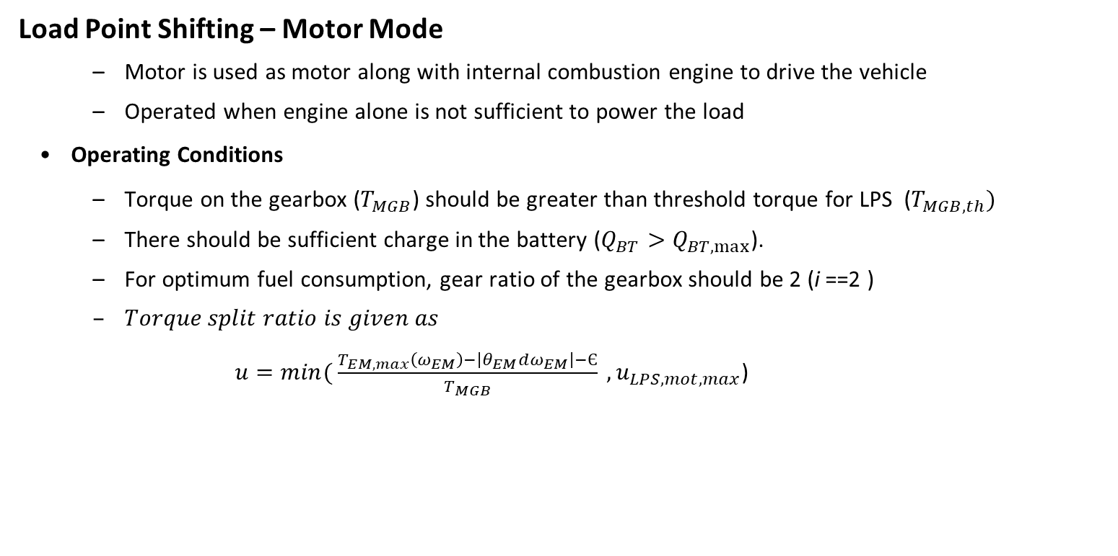
Operation Modes
Load Point Shifting – Motor Mode
Motor is used as motor along with internal combustion engine to drive the vehicle
Operated when engine alone is not sufficient to power the load
Operating Conditions
Torque on the gearbox ($T_{MGB}$) should be greater than threshold torque for LPS ($T_{MGB,th})$
There should be sufficient charge in the battery ($Q_{BT}>Q_{BT,max⁡}$).
For optimum fuel consumption, gear ratio of the gearbox should be 2 (i ==2 )
$Torque split ratio is given as$
$u=min⁡( \frac{T_{EM,max}\left(ω_{EM}\right)−\left|θ_{EM}dω_{EM}\right|−Є}{T_{MGB}} , u_{LPS,mot,max}$)
CE
BT
EM
TC
MGB
V

Slide 15
Operation Modes
Load Point Shifting – Motor Mode
Matlab Implementation
%% Mode 3 – Load Point Shifting – Motor Mode
elseif ((T_MGB >= T_MGB_th)&& (Q_BT> Q_BT_max) && (i ==2))
u = min((interp1(w_EM_max,T_EM_max,w_MGB)-abs(theta_EM*dw_MGB)-epsilon)/T_MGB,u_LPS_mot_max);
%% For NEDC
% T_MGB_th = 29 Nm
% Q_BT_max = 16000 C
% u_LPS_mot_max = 0.2
%% For FTP-75
% T_MGB_th = 29 Nm
% Q_BT_max = 2500 C
% u_LPS_mot_max = 0.2

Slide 16
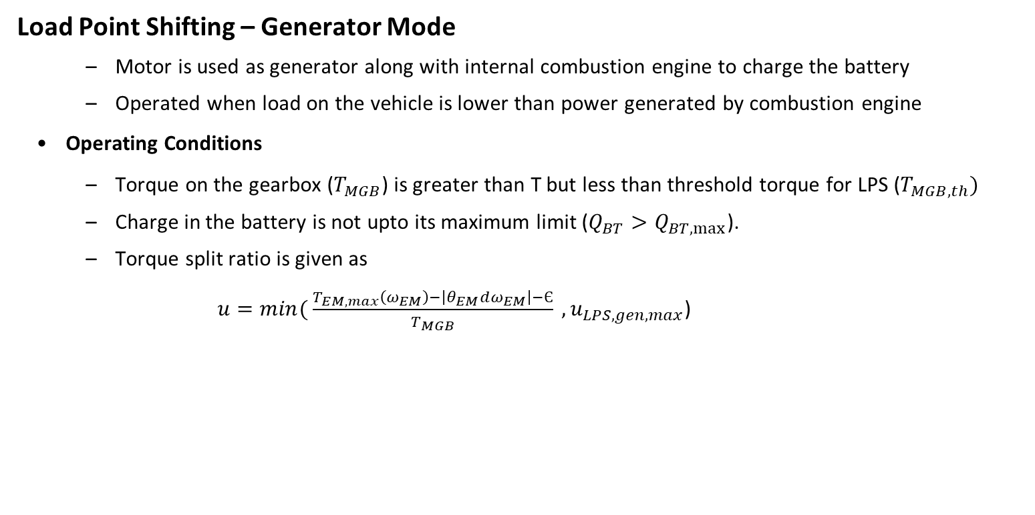
Operation Modes
Load Point Shifting – Generator Mode
Motor is used as generator along with internal combustion engine to charge the battery
Operated when load on the vehicle is lower than power generated by combustion engine
Operating Conditions
Torque on the gearbox ($T_{MGB}$) is greater than T but less than threshold torque for LPS ($T_{MGB,th})$
Charge in the battery is not upto its maximum limit ($Q_{BT}>Q_{BT,max⁡}$).
Torque split ratio is given as
$u=min⁡( \frac{T_{EM,max}\left(ω_{EM}\right)−\left|θ_{EM}dω_{EM}\right|−Є}{T_{MGB}} , u_{LPS,gen,max}$)
CE
BT
EM
TC
MGB
V

Slide 17
Operation Modes
Load Point Shifting – Generator Mode
Matlab Implementation
%% Mode 4 – Load Point Shifting – Generator Mode
elseif ((T_MGB >T) && (T_MGB< T_MGB_th) && (Q_BT < Q_BT_max))
u = max((interp1(w_EM_max,T_EM_max,w_MGB)+abs(theta_EM*dw_MGB)+epsilon)/T_MGB,u_LPS_gen_max);
%% For NEDC
% T_MGB_th = 29 Nm
% Q_BT_max = 16000 C
% u_LPS_gen_max = -0.55
%% For FTP-75
% T_MGB_th = 29 Nm
% Q_BT_max = 2500 C
% u_LPS_gen_max = -0.35

Slide 18
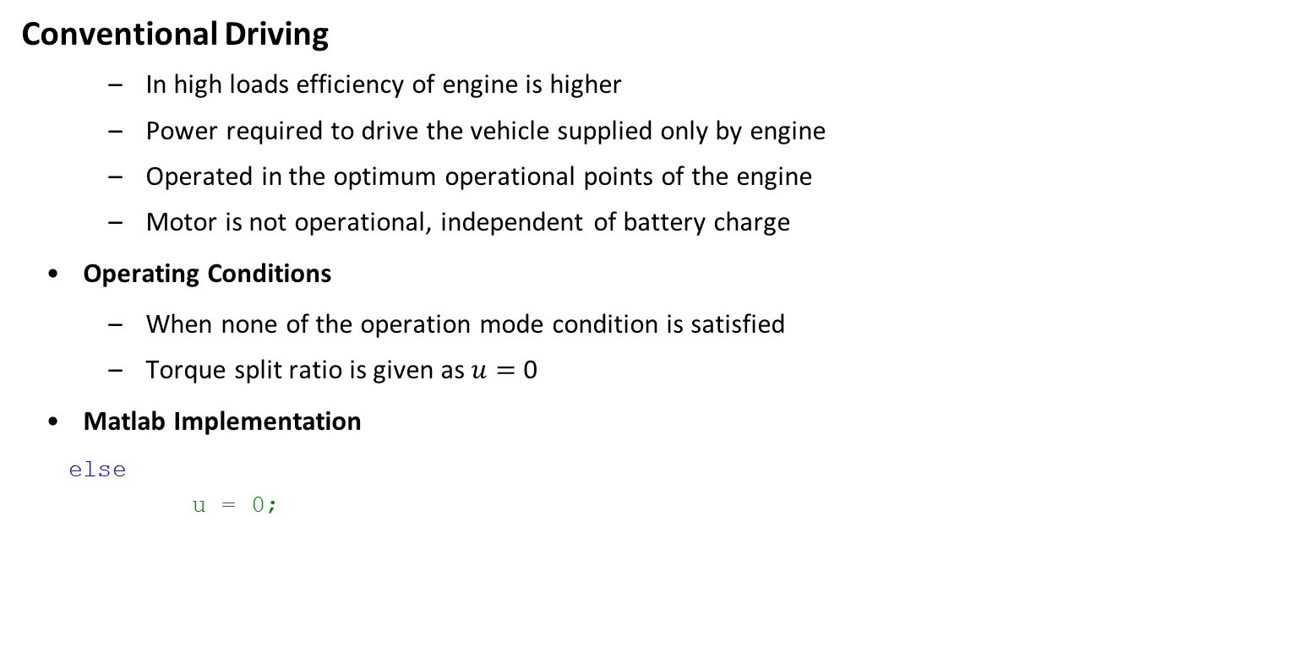
Operation Modes
Conventional Driving
In high loads efficiency of engine is higher
Power required to drive the vehicle supplied only by engine
Operated in the optimum operational points of the engine
Motor is not operational, independent of battery charge
Operating Conditions
When none of the operation mode condition is satisfied
Torque split ratio is given as $u=$ 0
Matlab Implementation
else
u = 0;
CE
BT
EM
TC
MGB
V

Slide 19
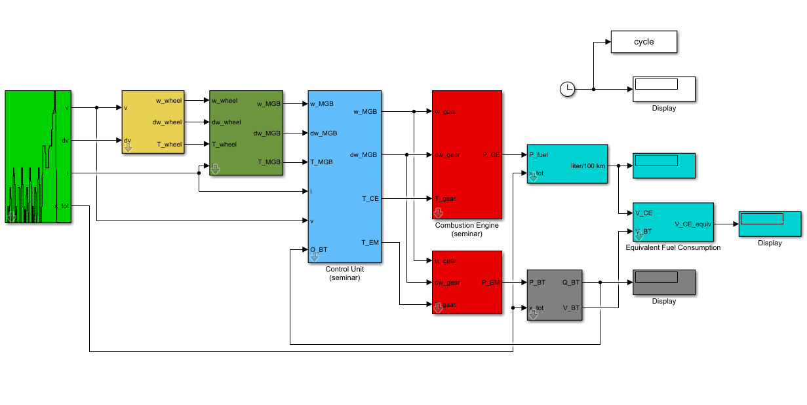
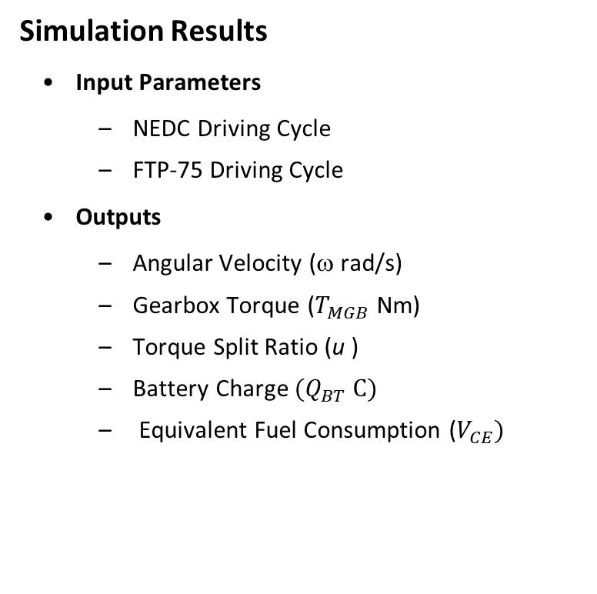
Results
Simulation Results
Input Parameters
NEDC Driving Cycle
FTP-75 Driving Cycle
Outputs
Angular Velocity (ω rad/s)
Gearbox Torque ($T_{MGB}$ Nm)
Torque Split Ratio (u )
Battery Charge ${(Q}_{BT} C)$
Equivalent Fuel Consumption ($V_{CE})$
QSS Toolbox
Outputs
Fast and Flexible Powertrain Design
Compatible with MATLAB/Simulink
Quasistatic Approach
Various powertrain layouts

Slide 20
Simulation Results
Results
Angular Velocity (ω rad/s)
NEDC Cycle
FTP-75 Cycle

Slide 21

Simulation Results
Results
Gearbox Torque ($T_{MGB}$ Nm)
NEDC Cycle
FTP-75 Cycle

Slide 22
Simulation Results
Results
Torque Split Ratio (u )
NEDC Cycle
FTP-75 Cycle

Slide 23

Simulation Results
Results
Battery Charge ${(Q}_{BT} C)$
NEDC Cycle
FTP-75 Cycle

Slide 24

Simulation Results
Results
Equivalent Fuel Consumption ($V_{CE})$
NEDC Cycle
FTP-75 Cycle

Slide 25
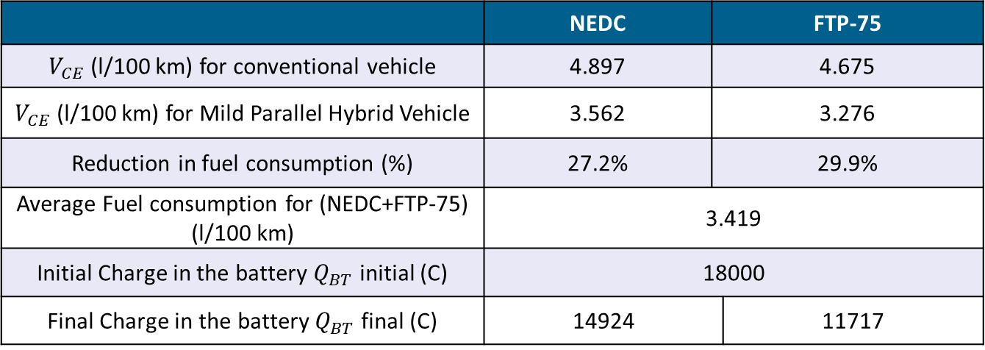
Simulation Results
Summary of Results
 | NEDC | FTP-75
$V_{CE}$ (l/100 km) for conventional vehicle | 4.897 | 4.675
$V_{CE}$ (l/100 km) for Mild Parallel Hybrid Vehicle | 3.562 | 3.276
Reduction in fuel consumption (%) | 27.2% | 29.9%
Average Fuel consumption for (NEDC+FTP-75) (l/100 km) | 3.419
Initial Charge in the battery $Q_{BT}$ initial (C) | 18000
Final Charge in the battery $Q_{BT}$ final (C) | 14924 |  | 11717

Slide 26
Conclusion
Conclusion
From this study following points are concluded
An efficient energy management strategy is necessary for designing fuel efficient mild parallel hybrid electric vehicle
Rule based strategy is easily implementable
To get optimum values of the parameter's iterations are required
Mathematical rules and experience plays a critical role in designing logical rule-based system
27.20 % and 29.90% fuel consumption reduction in NEDC and FTP-75 driving cycles respectively

Slide 27
Future Work
Future Work
Limitations of performed work
Iterative method
Rules defined only for set of driving conditions
This method does not ensure global optimality of the parameters
Future Work
Optimiation Algorithms can be used to save time for iterations
Online optimization technique such as Model Predictive Control can be implemented
Fuel Consumption values experiences sudden rise during start of the cycle, attenuation of this peak could result in more fuel saving

Slide 28
References
[1] D. Görges, “Electric and Hybrid Vehicles (summer term 2021),” Lecture ¨ Notes, Junior professorship for Electromobility, Department of Electrical and Computer Engineering, University of Kaiserslautern, Kaiserslautern, Germany, 2021.
[2] D. Görges, “Seminar Electrmobility (summer term 2021),” Lecture ¨ Notes, Junior professorship for Electromobility, Department of Electrical and Computer Engineering, University of Kaiserslautern, Kaiserslautern, Germany, 2021.
[3] F. R. Salmasi, "Control Strategies for Hybrid Electric Vehicles: Evolution, Classification, Comparison, and Future Trends," in IEEE Transactions on Vehicular Technology, vol. 56, no. 5, pp. 2393-2404, Sept. 2007, doi: 10.1109/TVT.2007.899933.
[4] L. Guzzella and A. Sciarretta, Vehicle Propulsion systems Introduction to Modelling and optimization, Springer Heidelberg New York Dordrecht London, Third edition 2013.
[5] S. G. Wirasingha and A. Emadi, "Classification and Review of Control Strategies for Plug-In Hybrid Electric Vehicles," in IEEE Transactions on Vehicular Technology, vol. 60, no. 1, pp. 111-122, Jan. 2011, doi: 10.1109/TVT.2010.2090178.
[6] A. Sciarretta and L. Guzzella, "Control of hybrid electric vehicles," in IEEE Control Systems Magazine, vol. 27, no. 2, pp. 60-70, April 2007, doi: 10.1109/MCS.2007.338280.

