Slide 1
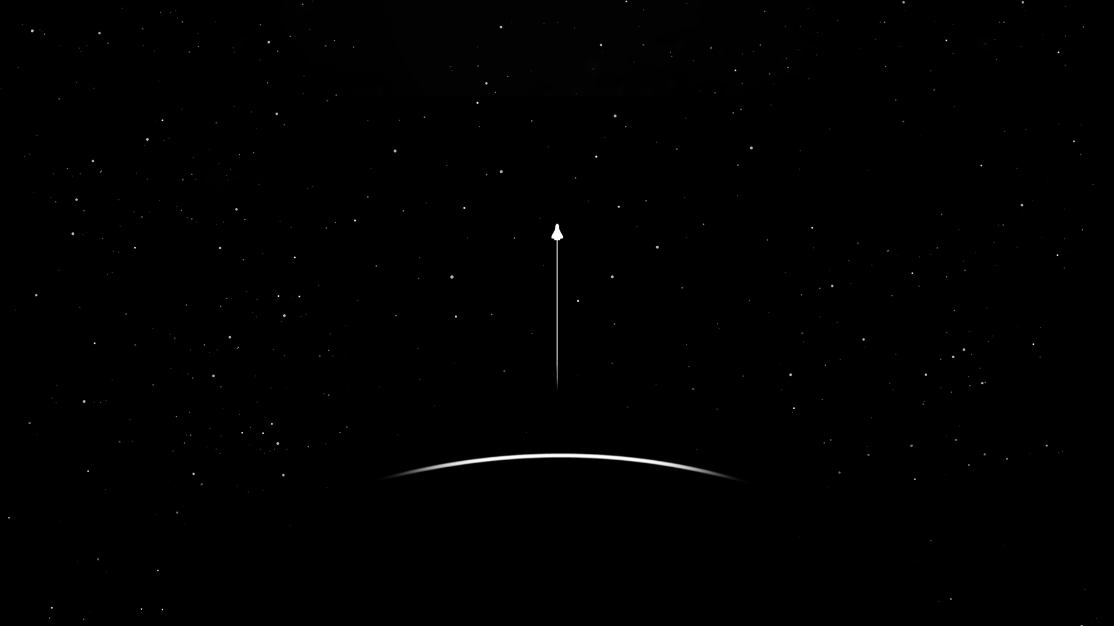
LANGUAGES I HAVE TO STUDY:
HTML
CSS
JAVASCRIPT
REACT
FLUTTER
PHP?
NODE JS?
UI/UX
STUFF I WANT TO DO:
CREATE A PROJECT: USEFUL TO DAILY LIFE

