Slide 1

Finding the More Select Area to Establish the Restaurant
Zhilin Zhang
March 2020

Slide 2
Introduction
It is an artwork to find a proper place for a restaurant. Good location represents many customers and a steady stream of money.
The development of machine learning and geographic technology gives us a new way to understand the business value.

Slide 3
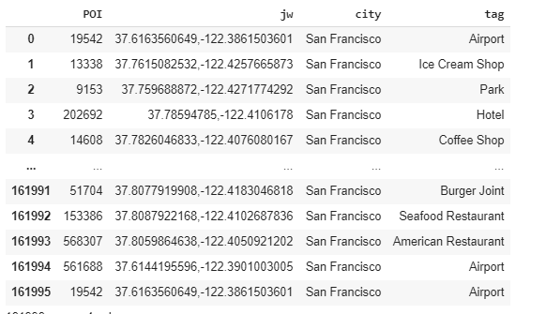
Data
We got the district data source from Coursera course Data Visualization with Python.
Meanwhile, the POI and geographical coordinates data are both got from Foursquare by web crawler.

Slide 4
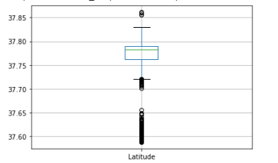
Data Processing
Divided the data into two types
place which may have possible customers
other restaurants.
Data cleaning by drawing boxplot

Slide 5
Cluster
K-means
K = 10
Utilize Latitude and Longitude columns

Slide 6
Analyses
ID | Close Space 1 | Close Space 2 | Crowed | Latitude | Longitude
1 | Office | Sport | 6509 | 37.76807836 | -122.39945868
2 | Airport | Hotel | 11400 | 37.6129963 | -122.39120866
3 | Park | Site | 751 | 37.77277806 | -122.4975116
4 | Park | Sport | 4578 | 37.8050439 | -122.41952574
5 | Office | Hotel | 24743 | 37.78865967 | -122.40204586
6 | Sport | Art Event | 7549 | 37.77485188 | -122.42653226
7 | Park | Art Event | 959 | 37.73481564 | -122.42821392
8 | Mall | Park | 1321 | 37.72868246 | -122.48066291
9 | Park | Art Event | 2843 | 37.76898467 | -122.46101539
10 | Sport | Site | 2077 | 37.80043101 | -122.45519854

Slide 7
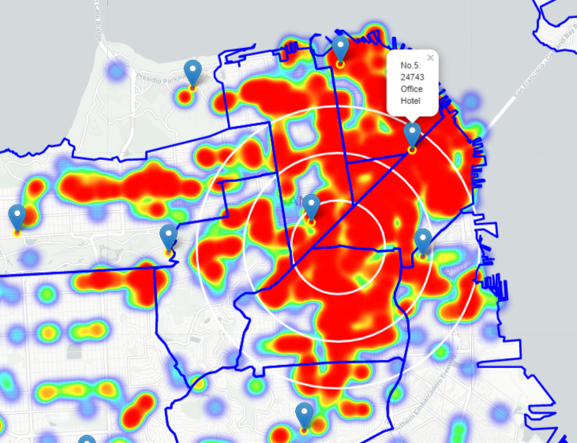
Analyses

Slide 8
Results and Discussion

Slide 9
Thank you

