Slide 1
Vehicle Parking Management System
Name | ID
Hafiza Sultana Nitu | 22103313
Riaz Rahman Santo | 22103285
Zarin Tasnim Oishe | 22103262
Md. Sajib Mia | 22103154
Course Name: Software Engineering Course Code: CSC 470

Slide 2
OBJECTIVES
The purpose of developing vehicle parking management system is to computerized the tradition way of parking. Another purpose for developing this application is to generate the report automatically.
Vehicle Parking Management System maintains a good record of vehicles check in and checkout time. Both two wheeler & four wheeler can be managed by this system and have different pricing system.
Vehicle parking management system enables the time management and control of vehicles by using parking number.
The system that will track the entry and exit of vehicles, maintain a listing of vehicle within the parking lot, and determine the parking and it will also determine the cost of parking of vehicle.

Slide 3
Introduction
Vehicle Parking Management system is a web-based technology that will manage the records of the incoming and outgoing vehicles in an parking house. It’s an easy for Admin to retrieve the data if the vehicle has been visited through number he can get that data. Vehicle parking management system is an automatic system which delivers data processing in very high speed in systematic manner.
In VPMS we use PHP and MySQL database. This is the project which keeps records of the vehicle which is going to park in the parking area. VPMS has two module admin and user.
User
Admin

Slide 4
Admin Module
Dashboard: In this sections, admin can briefly view the number of vehicle entries in a particular period.
Category: In this section, admin can manage category (add/update/delete).
Add Vehicle: In this section, admin add vehicle which is going to park.
Manage Vehicle: In this section, admin can manage incoming and outgoing vehicle and admin can also add parking charges and his/her remarks.
Reports: In this section admin can generate vehicle entries reports between two dates.
Search: In this section, admin can search a particular vehicle by parking number.
Admin can also update his profile, change the password and recover the password.

Slide 5
User Module
Home: It is welcome page for user.
Dashboard: It is welcome page for an users.
View Vehicle: In this section, users view the details of vehicle parking which is parked by him/her.
Users can also update his profile, change the password and recover the password.
.

Slide 6
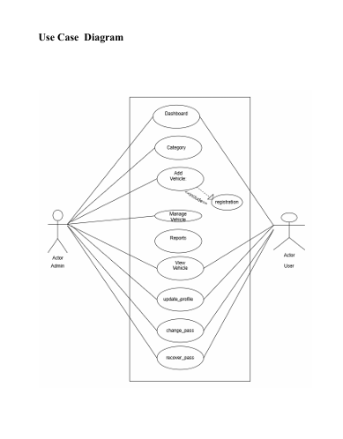
Notes:
USECASE DIAGRAM: A Use case is a description of set of sequence of actions. Graphically it is rendered as an ellipse with solid line including only its name. Use case diagram is a behavioral diagram that shows a set of use cases and actors and their relationship. It is an association between the use cases and actors. An actor represents a real-world object. Primary Actor – Sender, Secondary Actor Receiver.

Slide 7
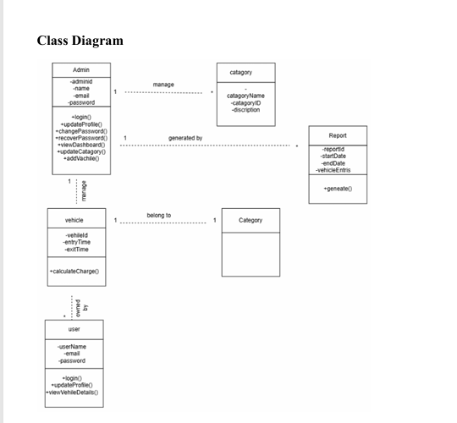
Notes:
Class Diagram:
A description of set of objects that share the same attributes operations, relationships, and semantics

Slide 8
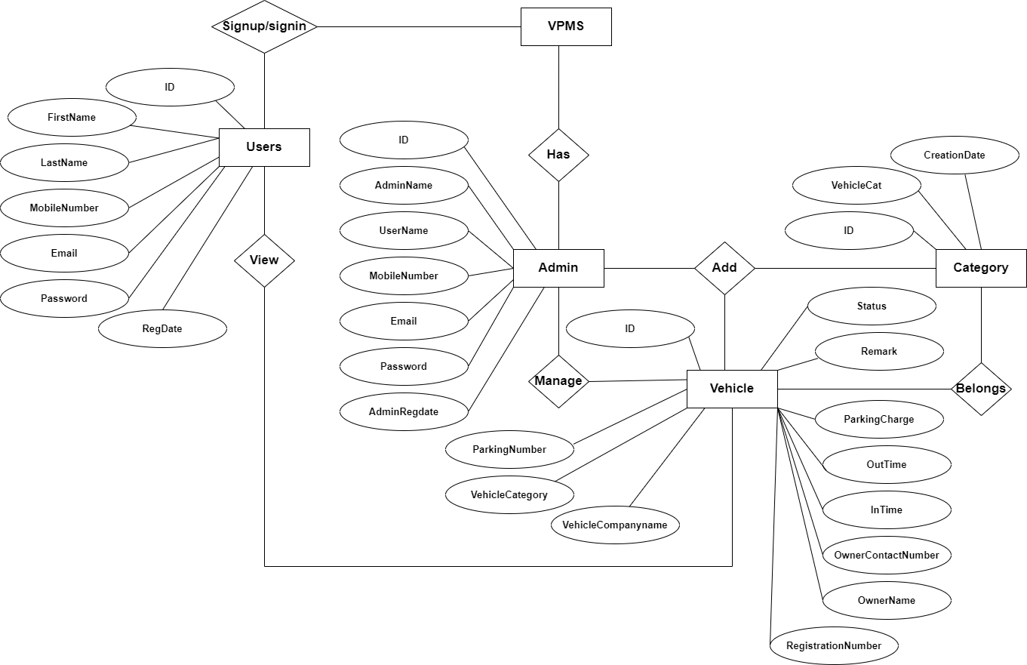
ER Diagram

Slide 9
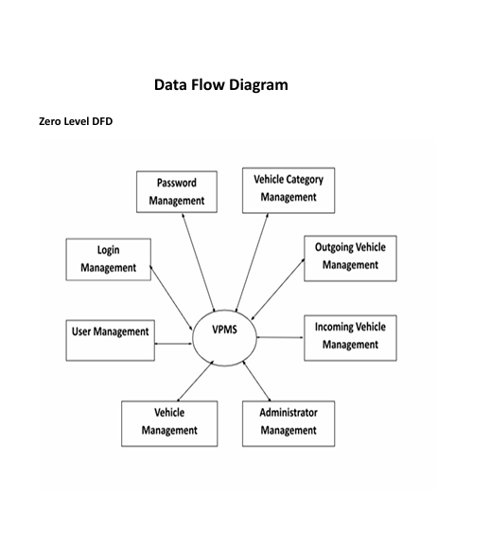

Slide 10
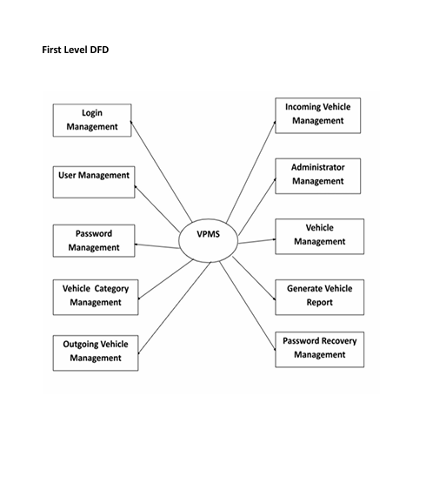

Slide 11
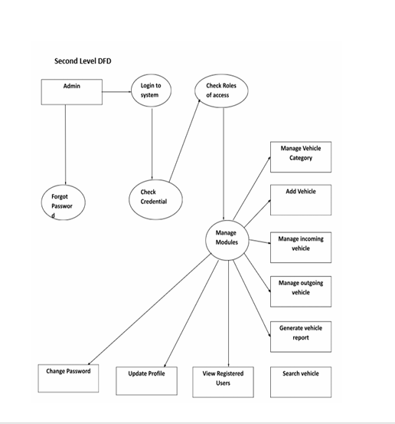

Slide 12
Technology
Language Used | PHP
Database | MySQL
Web Browser | Mozilla, Google Chrome
Software | XAMPP

Slide 13
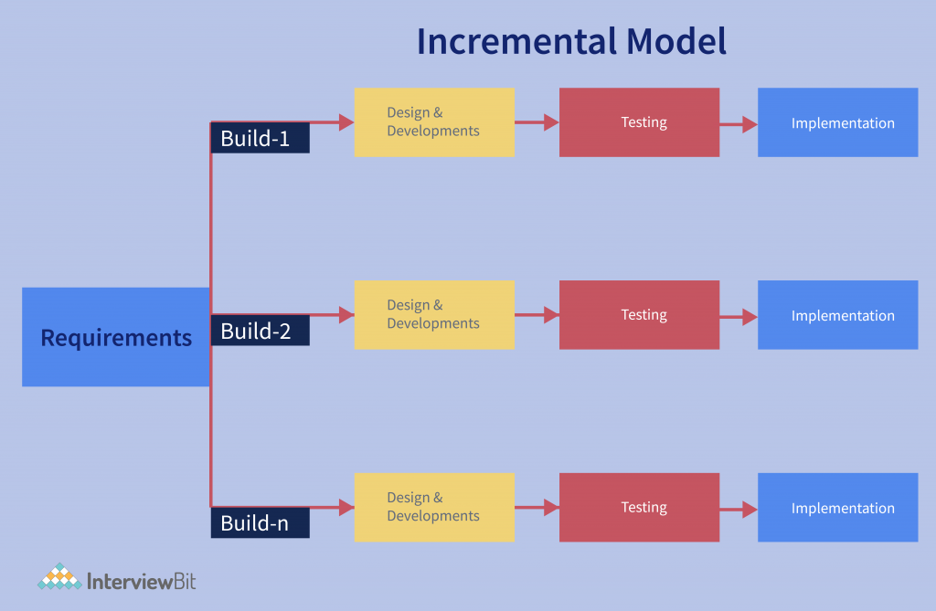
Software Engineering Process Model

Slide 14
Why Use the Incremental Model!
Progressive Development
Risk Management
user Feedback Integration
Better Testing and Debugging
Flexibility

Slide 15
Phases of the Incremental Model
Increment 1: Core Admin Module
Features:
Admin Login/Authentication
Admin Dashboard
Category management(add, update, delete)

Slide 16
Increment 2: Vehicle Management Module
Features:
Add Vehicle
Manage Vehicles

Slide 17
Increment 3: Reports & Search Module
Features:
Reports between two dates
Search vehicle by parking number

Slide 18
Increment 4: Admin Profile Management
Features:
Update Profile
Change Password
Password Recovery

Slide 19
Increment 5: User Module
Features:
User Dashboard
View Parked Vehicle Details
Update Profile / Change Password / Recover Password

Slide 20
Challenges
Database Designing
User Authentication & Session Management
CRUD Operations for Vehicles
Report Generation
Managing Timestamps & Durations
Testing

Slide 21
Thank You

