Slide 1
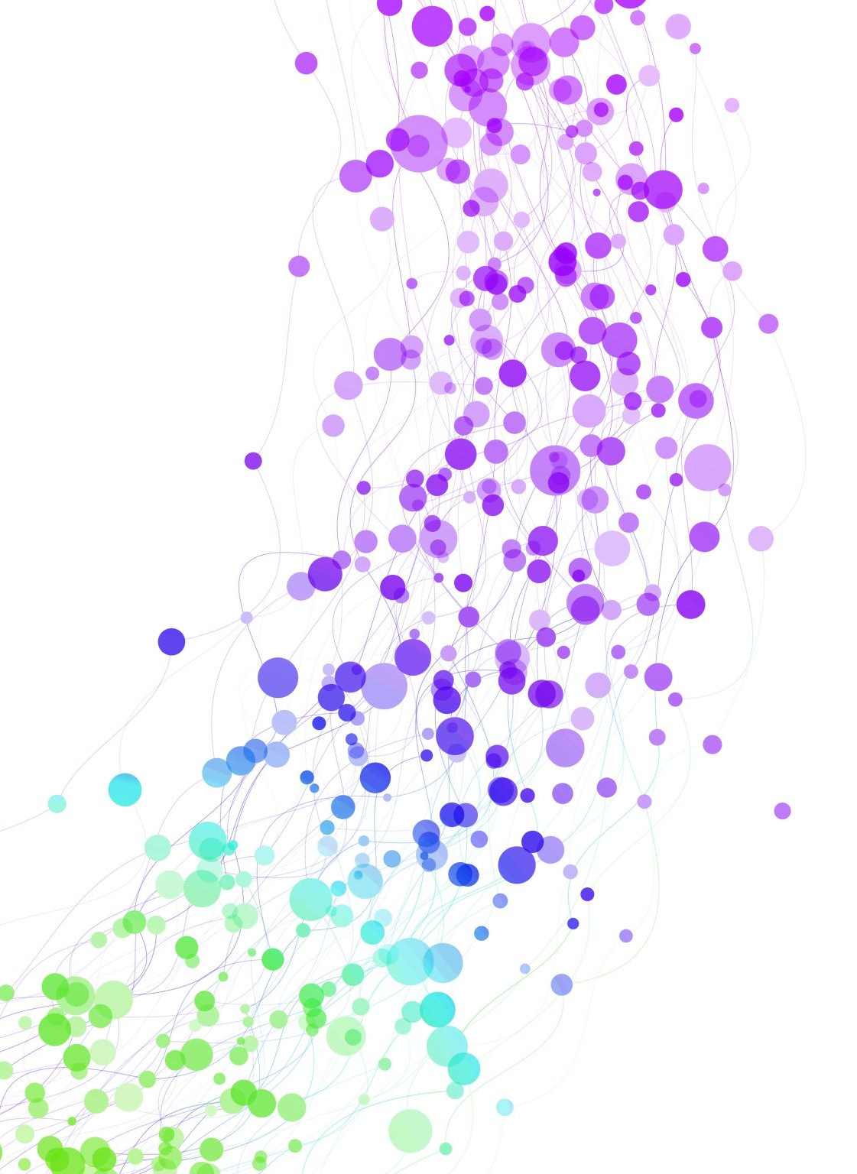
Art Pirates
your passion matters

Slide 2
Problem:
Traditional art majors who graduate from universities have limited job opportunities in our culture
A need has arised to create a method to generate revenue for these students.
Currently youtube's business model drives ad revenue in the billions of dollars, with only a tiny fraction of it shared with the creators

Slide 3
Solution:
We don’t think this is fair. We respect the value of creators’ work.
That’s why we’re building a platform that allows creators to engage in a direct, value-for-value exchange with the people that love their work the most

Slide 4
Business Model:
Our business model is straightforward
It charges creators 10 percent of their revenues through the platform
And the rest of the revenue we generate using Ads.
This simple model will get more complicated, as we introduce additional commission fees in exchange for access to some new functionality and services.

Slide 5
Payment Gateway and Security:
On any site of this nature handling transaction in a secure manner is the most time consuming task.
That's why we will be using stripe a payment infrastructure for the internet to handle all our transactions.
Millions of companies of all sizes use Stripe’s to manage their businesses online.

Slide 6
Subscriptions:
Our site will let fans subscribe to their favorite artist on a monthly basis
There will be different tier of subscription, which user could renewal at a monthly basis.
Each tier of subscription will have its own exciting benefits and awards.

Slide 7
Why Choose Us:
We believe that each person should have a right to do what they loves the most.
That’s why we are building this platform which will allow them to further enhance their skill sets.
At the same time, they will be able to earn more followers and recognition.

Slide 8
Conclusion:
We have seen a significant increase in interest in our site.
That’s why we are planning to take it to next step.
We will be offering free 6 months to any artist who sign up to our site from now on.
We also appreciate all the student taking interest in our application.

