Slide 1

Tracking cryptocurrency and stock marke trends
Group 2 – Project 3
Steve – Levi – Jared - Zac

Slide 2



Agenda
Steve: Quick-Dive Analysis
Jared: 6 Mo Crypto Trends
Zac: Stock/Crypto News: How Do They Relate?
Levi: Flask API Data & Insight Report

Slide 3
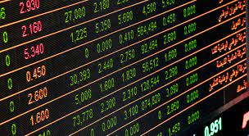


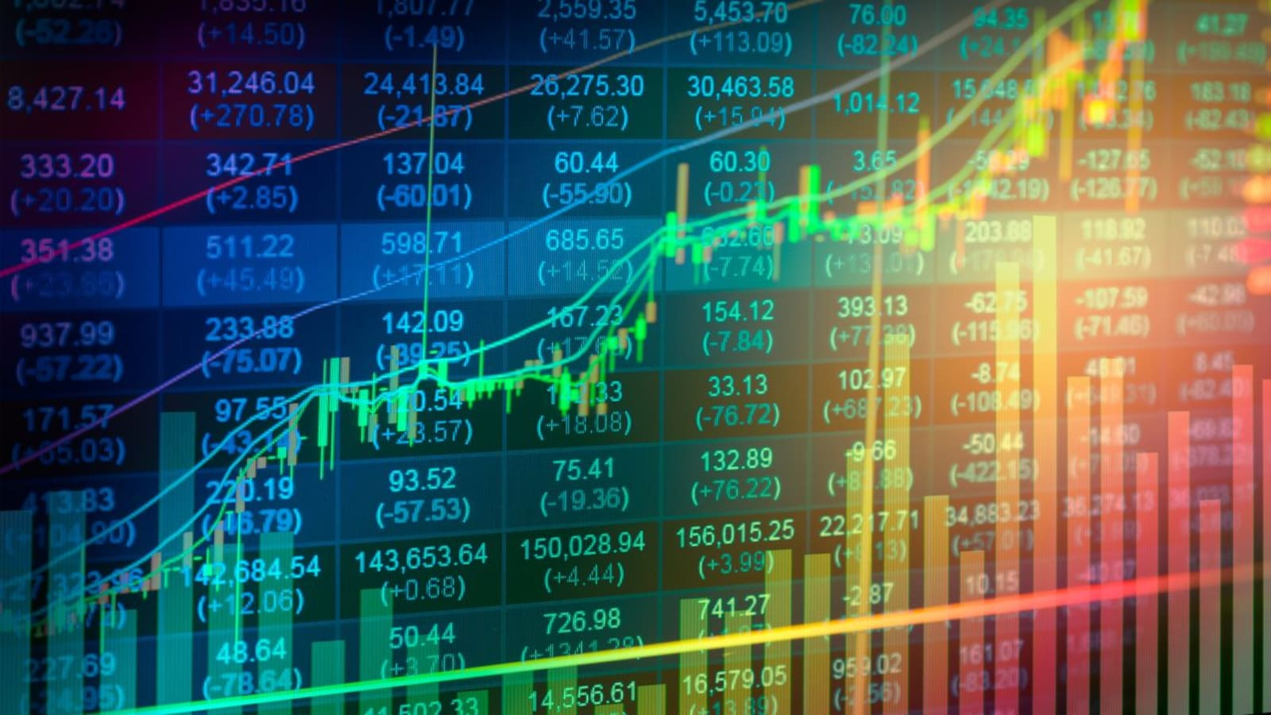


Introduction
We are excited to introduce you to our new web app that provides an insightful look into the last 6 months of stock market and cryptocurrency trends. As we all know, financial markets can be volatile and unpredictable, but by analyzing the trends and patterns over time, we can gain a better understanding of the market behavior and make more informed investment decisions. Let's dive in!

Slide 4

Steve R. Quick-Dive Analysis

Slide 5
Jared H. 6 Month Cryptocurrency

Slide 6
Zac L. News Cycle Correlation

Slide 7
Levi M. Flask API Data & Insight Report

Slide 8

"The stock market is filled with individuals who know the price of everything, but the value of nothing."
- Philip Fisher, American Investor & Author of “Common Stocks and Uncommon Profits”

Slide 9

Summary
It's important to note that the performance financial markets can be affected by different factors, such as changes in market sentiment, geopolitical events, and economic data. Therefore, any comparison of their performance should be done with caution and with an understanding of the unique characteristics and drivers of the market.

Slide 10


Thank You
Presenter name
Email address
Website address

