Slide 1
Airline On Time Performance
Adrian Lim, Lynnette Ng, Toh Zijing
Group 34

Slide 2
Dataset
ASA Data Expo 2009
Flight arrival and departure details for all commercial flights within the USA, from October 1987 to April 2008.
~120 million records, ~12GB
Have you ever been stuck in an airport because your flight was delayed or cancelled and wondered if you could have predicted it if you'd had more data?

Slide 3
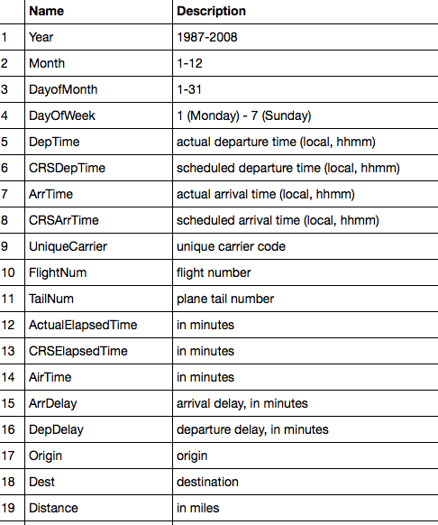
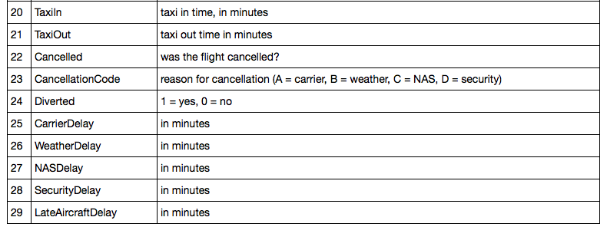
Flight Dataset
Spatial Data
Carrier Data
Temporal Data
Delay Statistics

Slide 4
 | Name | Description
1 | Year | 1987-2008
2 | Month | 1-12
3 | DayofMonth | 1-31
4 | DayOfWeek | 1 (Monday) – 7 (Sunday)
5 | DepTime | Actual departure time (local, hhmm)
6 | CRSDepTime | Scheduled departure time (local, hhmm)
7 | ArrTime | Actual arrival time (local, hhmm)
8 | CRSArrTime | Scheduled arrival time (local, hhmm)
9 | UniqueCarrier | Unique carrier code
10 | FlightNum | Flight number
11 | TailNum | Plane tail number
12 | ActualElapsedTime | In Minutes
13 | CRSElapsedTime | In Minutes
14 | AirTime | In Minutes
15 | ArrDelay | Arrival delay, in minutes
16 | DepDelay | Departure delay, in minutes
17 | Origin | Origin airport
18 | Dest | Destination airport
19 | Distance | In miles
20 | TaxiIn | Taxi in time, in minutes
21 | TaxiOut | Taxi out time in minutes
22 | Cancelled | Was the flight cancelled?
23 | CancellationCode | Reason for cancellation (A = carrier, B = weather, C = NAS, D = security)
24 | Diverted | 1 = yes, 0 = no
25 | CarrierDelay | In Minutes
26 | WeatherDelay | In Minutes
27 | NASDelay | In Minutes
28 | SecurityDelay | In Minutes
29 | LateAircraftDelay | In Minutes

Slide 5
Weather Dataset from NOAA
Collected from the Airport Weather Station: 2007-2008
1 | WSF2 | Fastest 2-minute wind speed (tenths of meters per second)
2 | FMTM | Time of fastest mile or fastest 1-minute wind (hours and minutes, i.e, HHMM)
3 | WDF2 | Direction of fastest 2-minute wind (degrees)
4 | AWND | Average daily wind speed (tenths of meters per second)
5 | WSF5 | Fastest 5-second wind speed (tenths of meters per second)
6 | WDF5 | Direction of fastest 5-second wind (degrees)
7 | SNOW | Snowfall (mm)
8 | PGTM | Peak gust time (hours and minutes, i.e., HHMM)
9 | TMAX | Maximum temperature (tenths of degrees C)
10 | TMIN | Minimum temperature (tenths of degrees C)
11 | PRCP | Precipitation (tenths of mm)
12 | SNWD | Snow depth (mm)
1. Missing data
i.e. airport has no weather station
Mean of state
Intelligently guess, i.e. Las Vegas weather data
2. Inaccurate data
SBA has no temperature readings but reported -9999.0 for TMAX and TMIN
Require data cleaning
Notes:
<number>

Slide 6
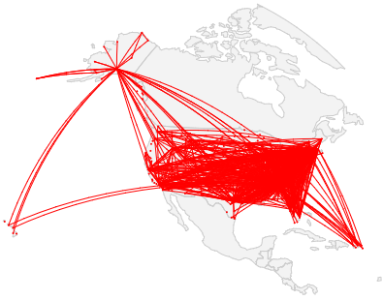
Latitude & Longitude of Airports
Collected from ??
Distance between airports in dataset calculated
Flight paths within US Airports 2007
Plotted with Plot.ly
Notes:
<number>

Slide 7
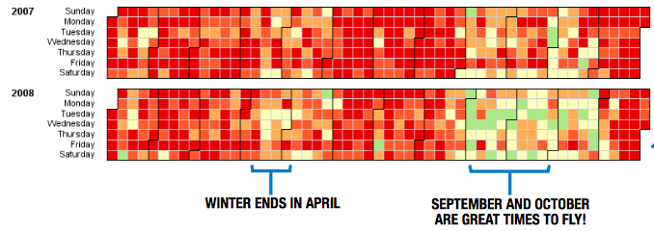
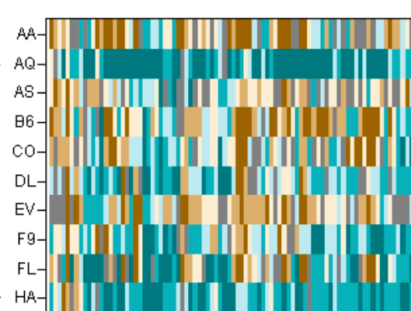
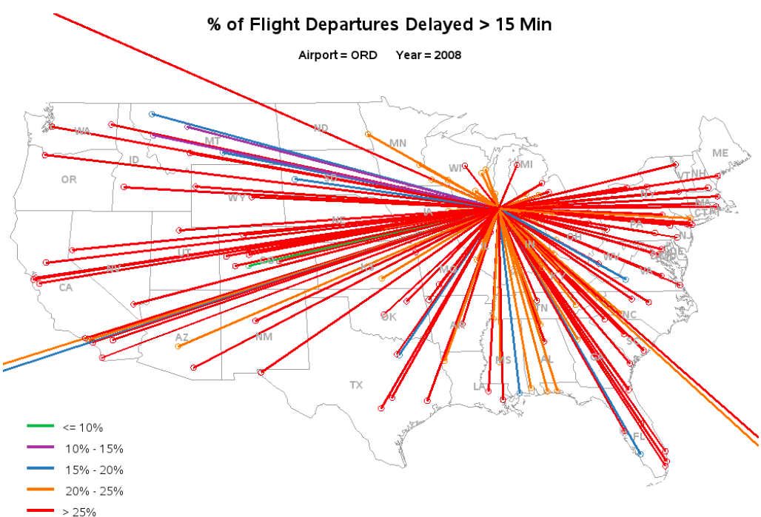
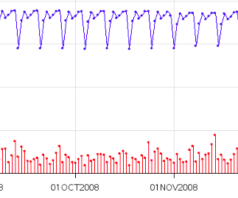
Original Challenge: Visualisation
Data: Dates, Arrival and departure times, Flight times, Origin and destination, Carrier
http://stat-computing.org/dataexpo/2009/
Temporal Effects
Spatial Effects
Carrier Effects
% of flights delayed by >15 mins
Seasonal Flights
All flights (blue) vs Late Flights (red)
Carriers often on time: Aloha, Hawaiian, Southwest…
Airports with consistent delays: Newark, JFK, ORD

Slide 8
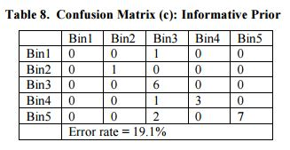
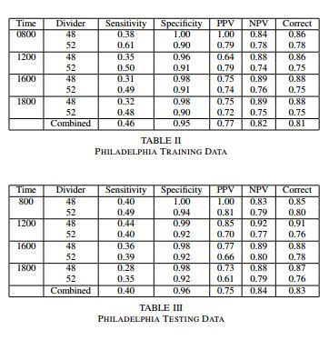
Predicting Flight Delays
Naive Bayes
~81%
Estimation of delay propagation in the national aviation system using bayesian networks (Ning Xu, George Donohue, Kathryn Blackmond Laskey, Chun-Hung Chen)
http://seor.gmu.edu/~klaskey/papers/delay.pdf
SVM
~83%
Decision Support Tool for Predicting Aircraft Arrival Rates, Ground Delay Programs, and Airport Delays from Weather Forecasts
http://catsr.ite.gmu.edu/pubs/Smith_ICRATPaper.pdf
Bin1 : delay < 15 m
Bin2 : 15m to 25m
Bin3 : 25 to 40m
Bin4 : 40 to 60m
Bin5 : >= 60m

Slide 9
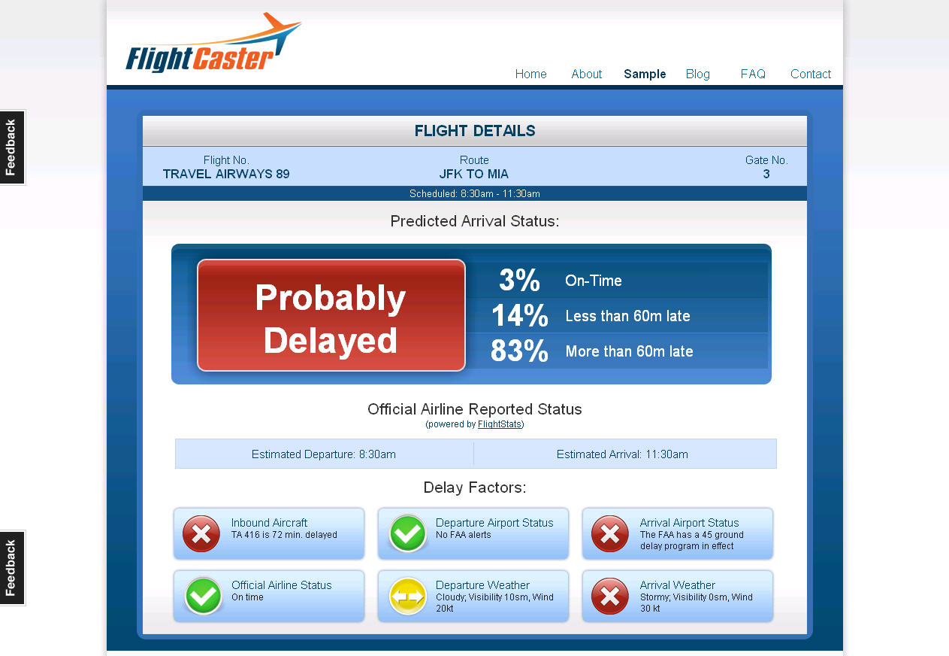
Predicting Flight Delays – Commercial Sites
FlightCaster - 85% precision, 60% recall.
http://www.datawrangling.com/how-flightcaster-squeezes-predictions-from-flight-data/

Slide 10
Our Approach
Use ASA flight data from Years 2007: ~7m records (1.04GB)
Add weather data from NOAA: Daily Wind Speed, Daily Min/Max temperature, Daily Precipitation
Add distance between airports
Python, Sklearn, Hadoop (Map-Reduce), Plot.ly for visualisation
Tembusu Compute Cluster
Given a flight details, can we whether the flight will be delayed?
Input: Flight data + Weather Data + Distance data
Output: Predicted IsDelayed with 95% confidence
Delay = Delay Time > 15 minutes (by RITA definition)

Slide 11
Our Approach – Exploring the Data
Preprocessing/ Merging the data
Total Delay = Arrival Delay + Departure Delay + Carrier Delay + Security Delay + Weather Delay + Security Delay + Late Aircraft Delay
Boolean variable IsDelayed if Total Delay > 15 minutes
If aircraft cancelled, Total Delay and IsDelayed set to infinity
Days from nearest holiday
Add weather data and distances between airports
Sorted the data by DateTime
Nominal data columns to numeric data columns
Number of Flight Delays in 2007: 2244514 Delayed Flights, 30%

Slide 12
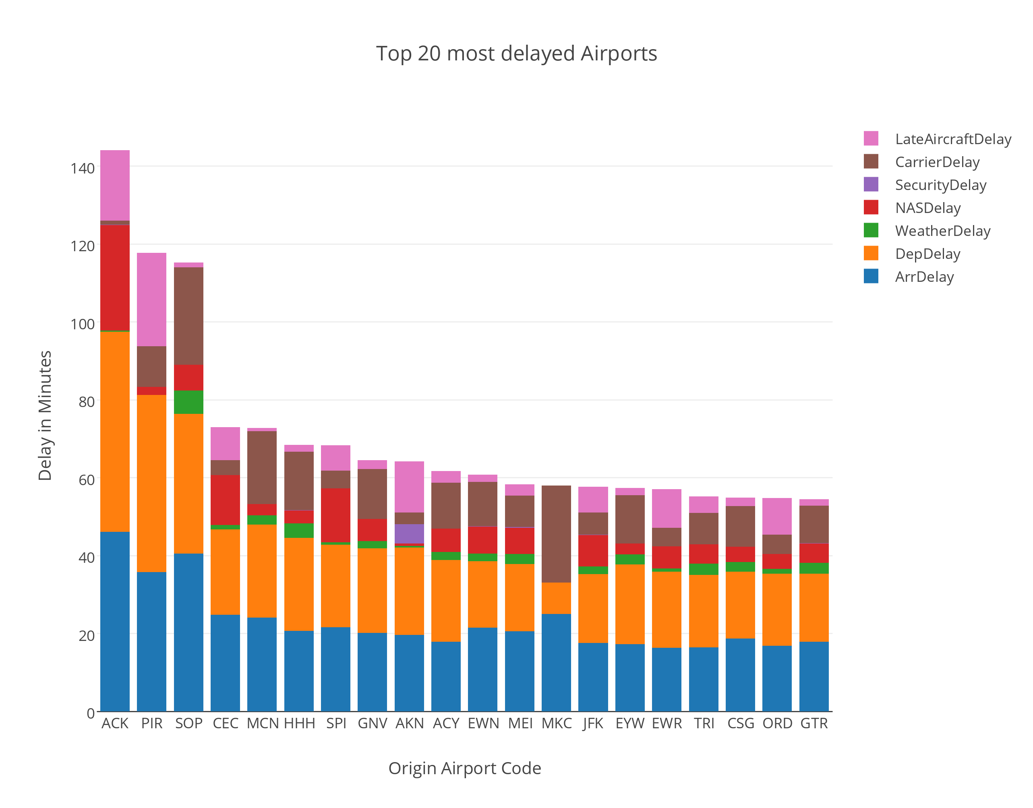

Slide 13
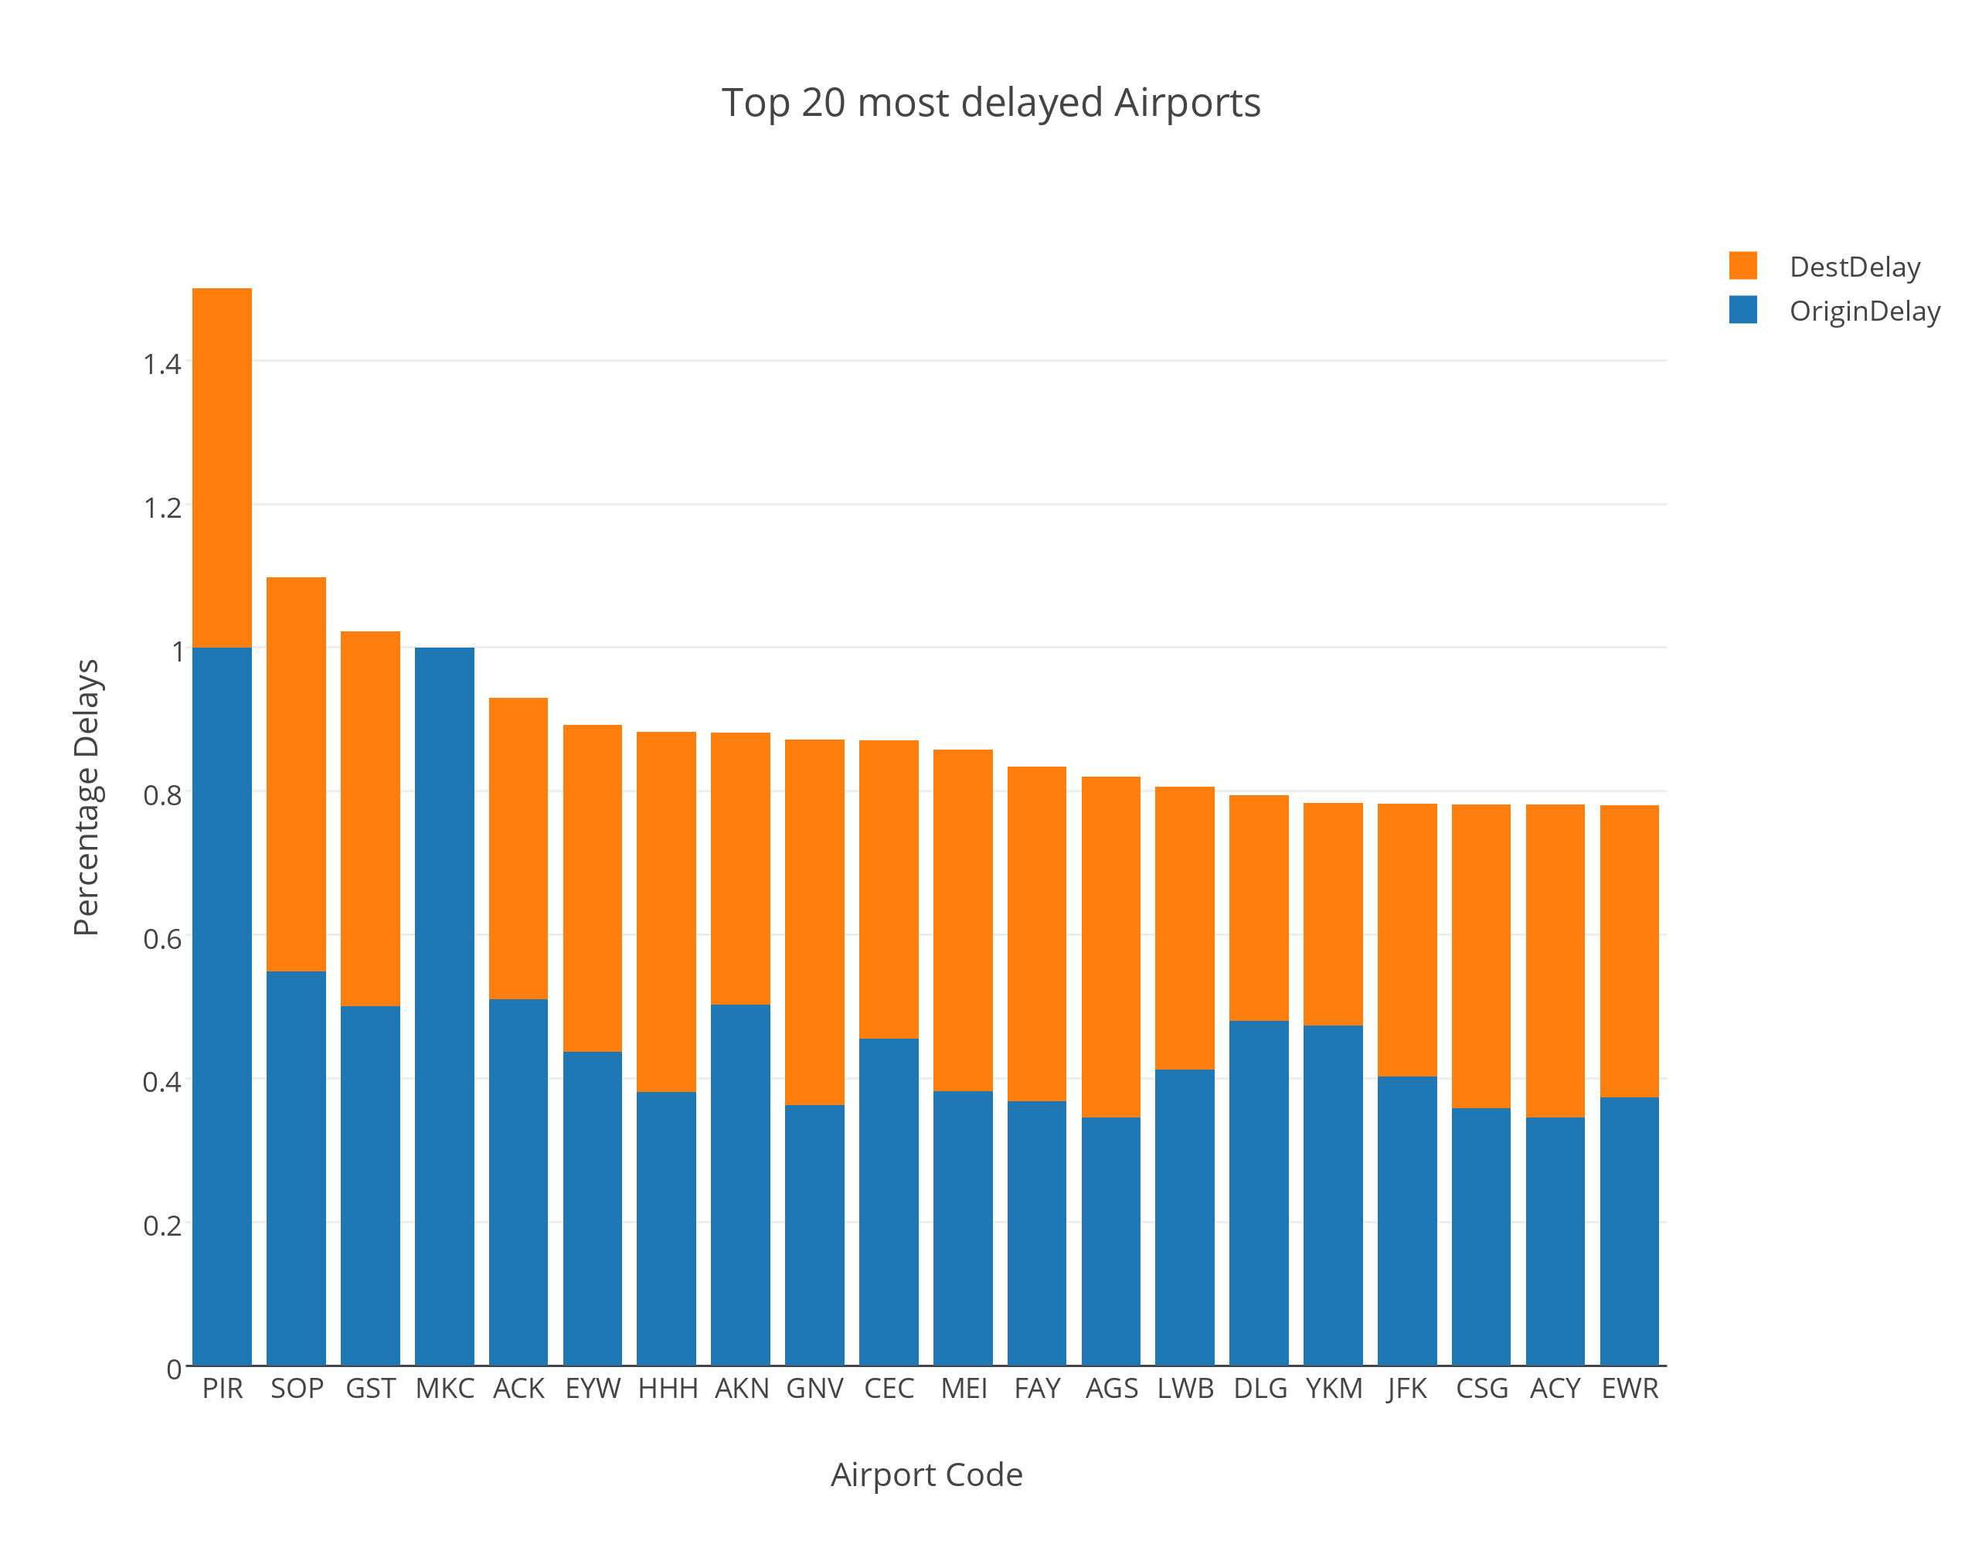

Slide 14
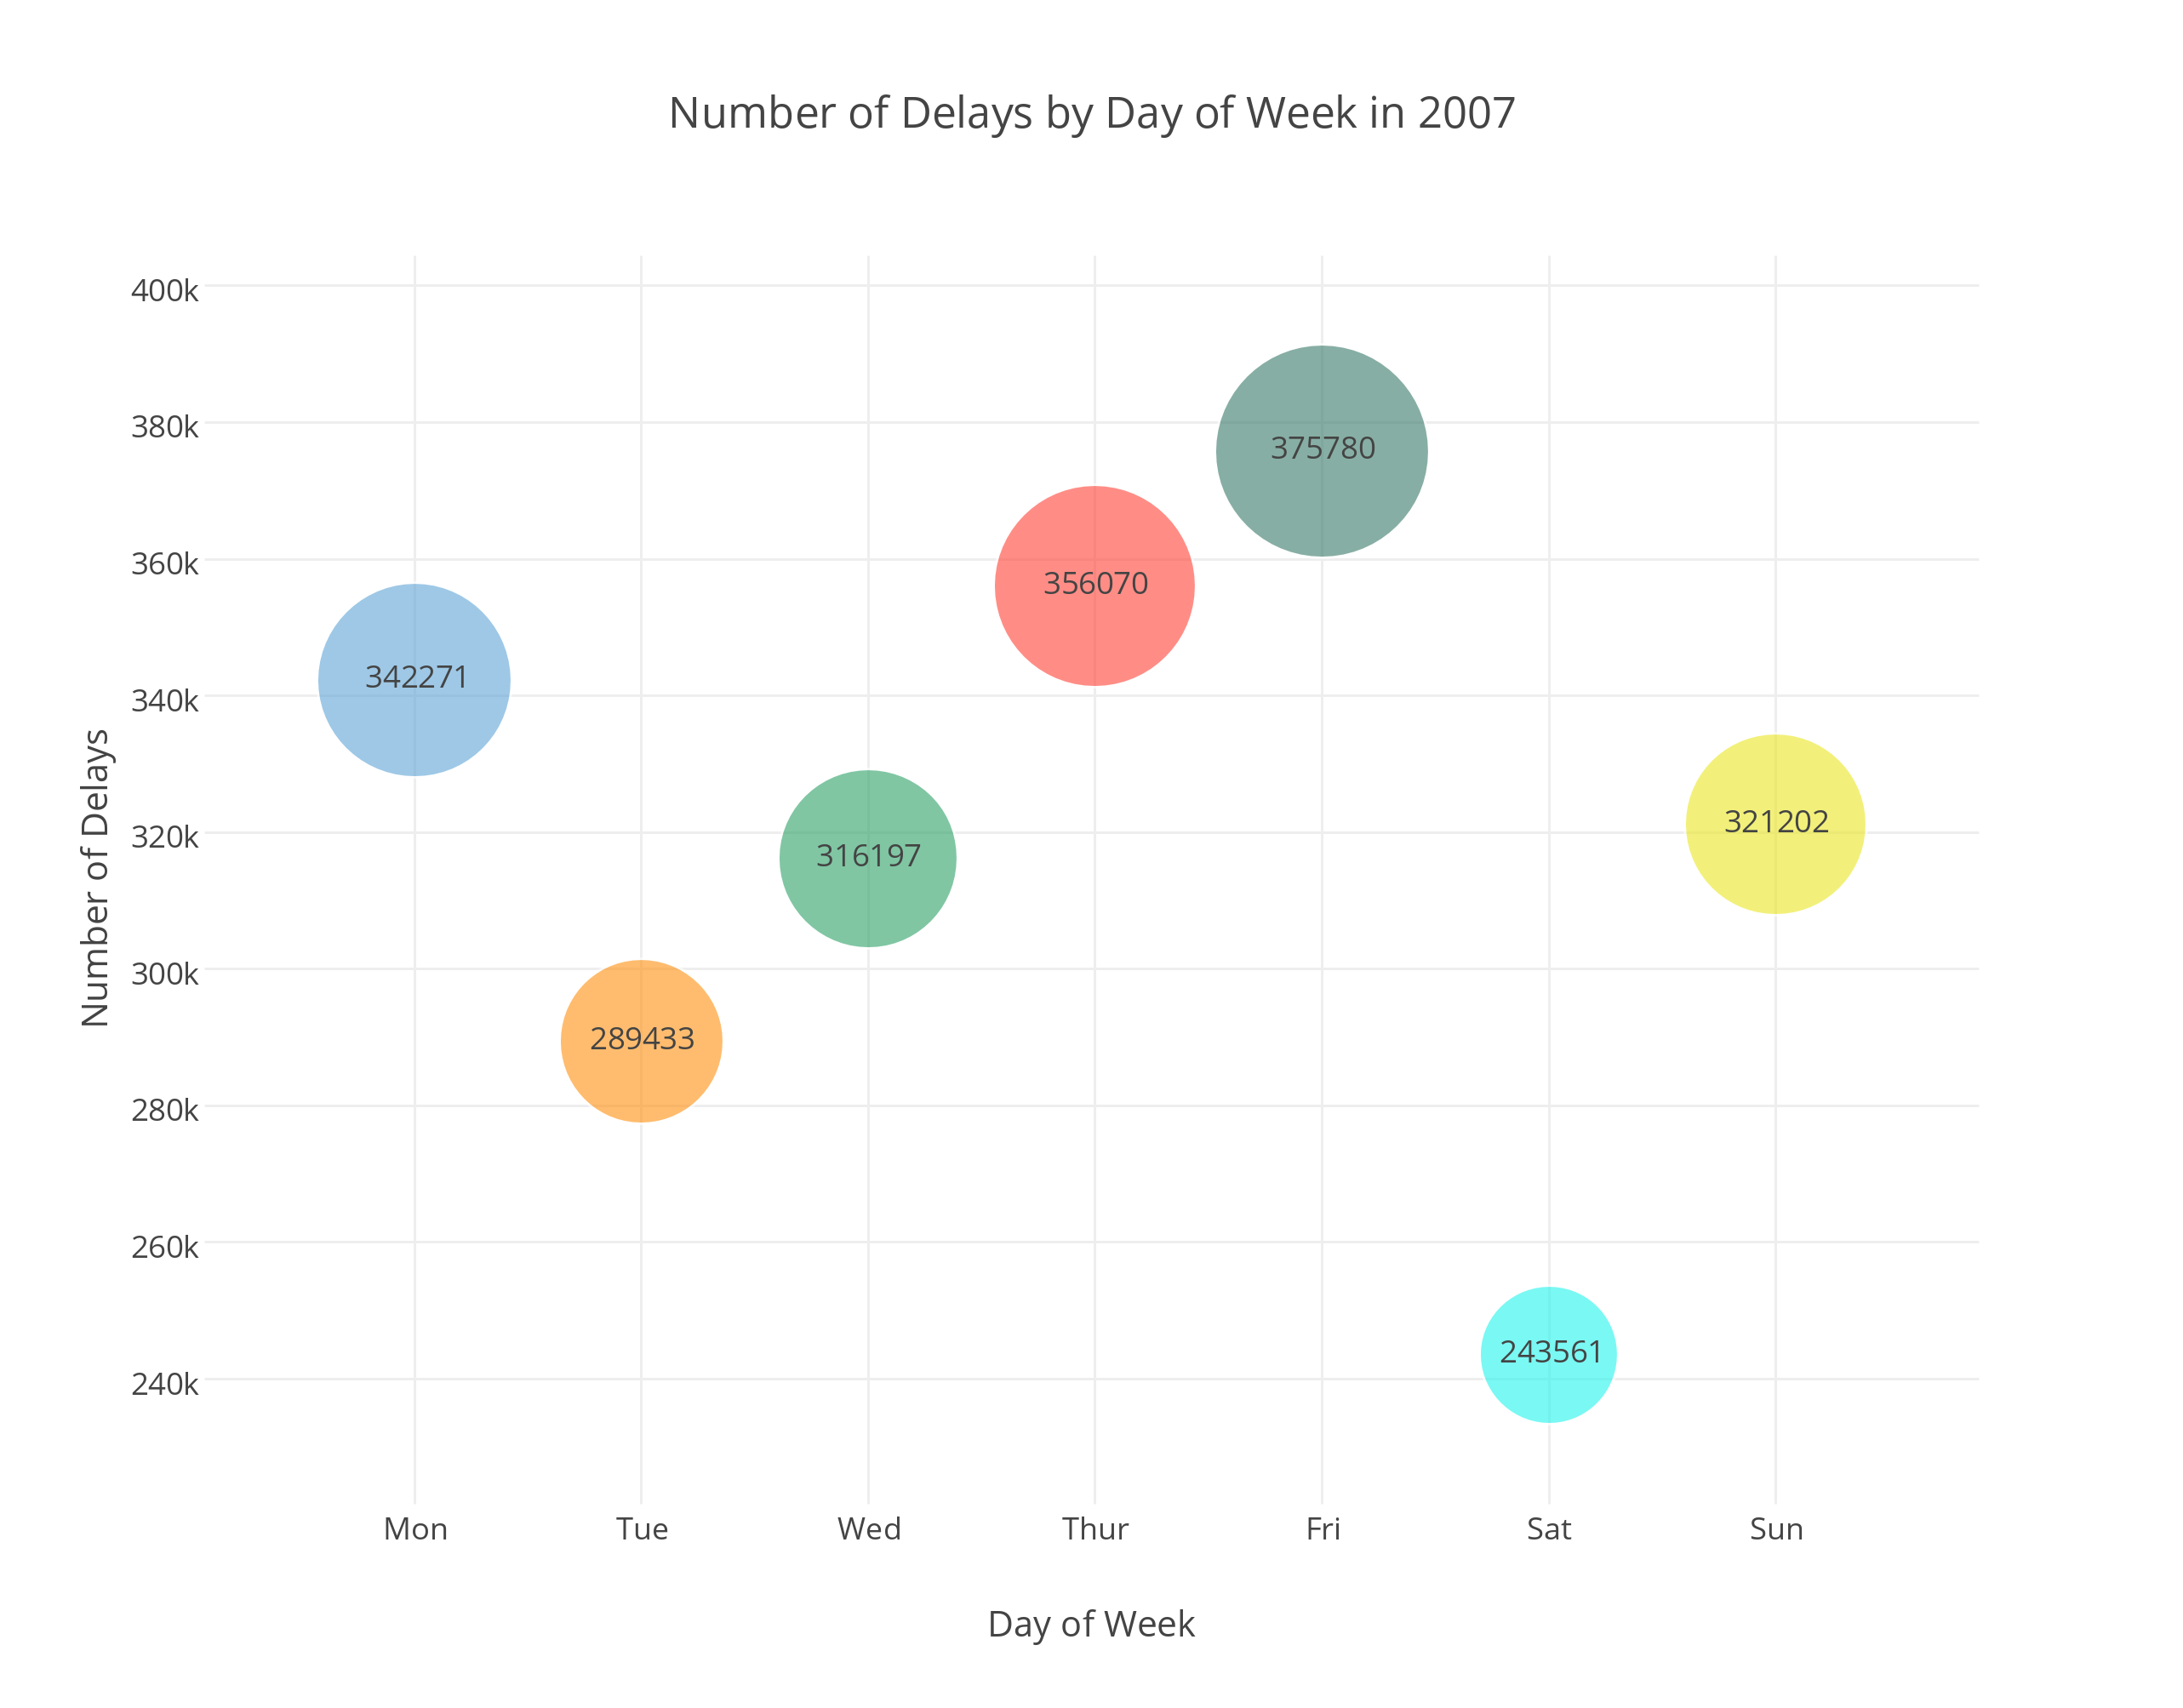

Slide 15
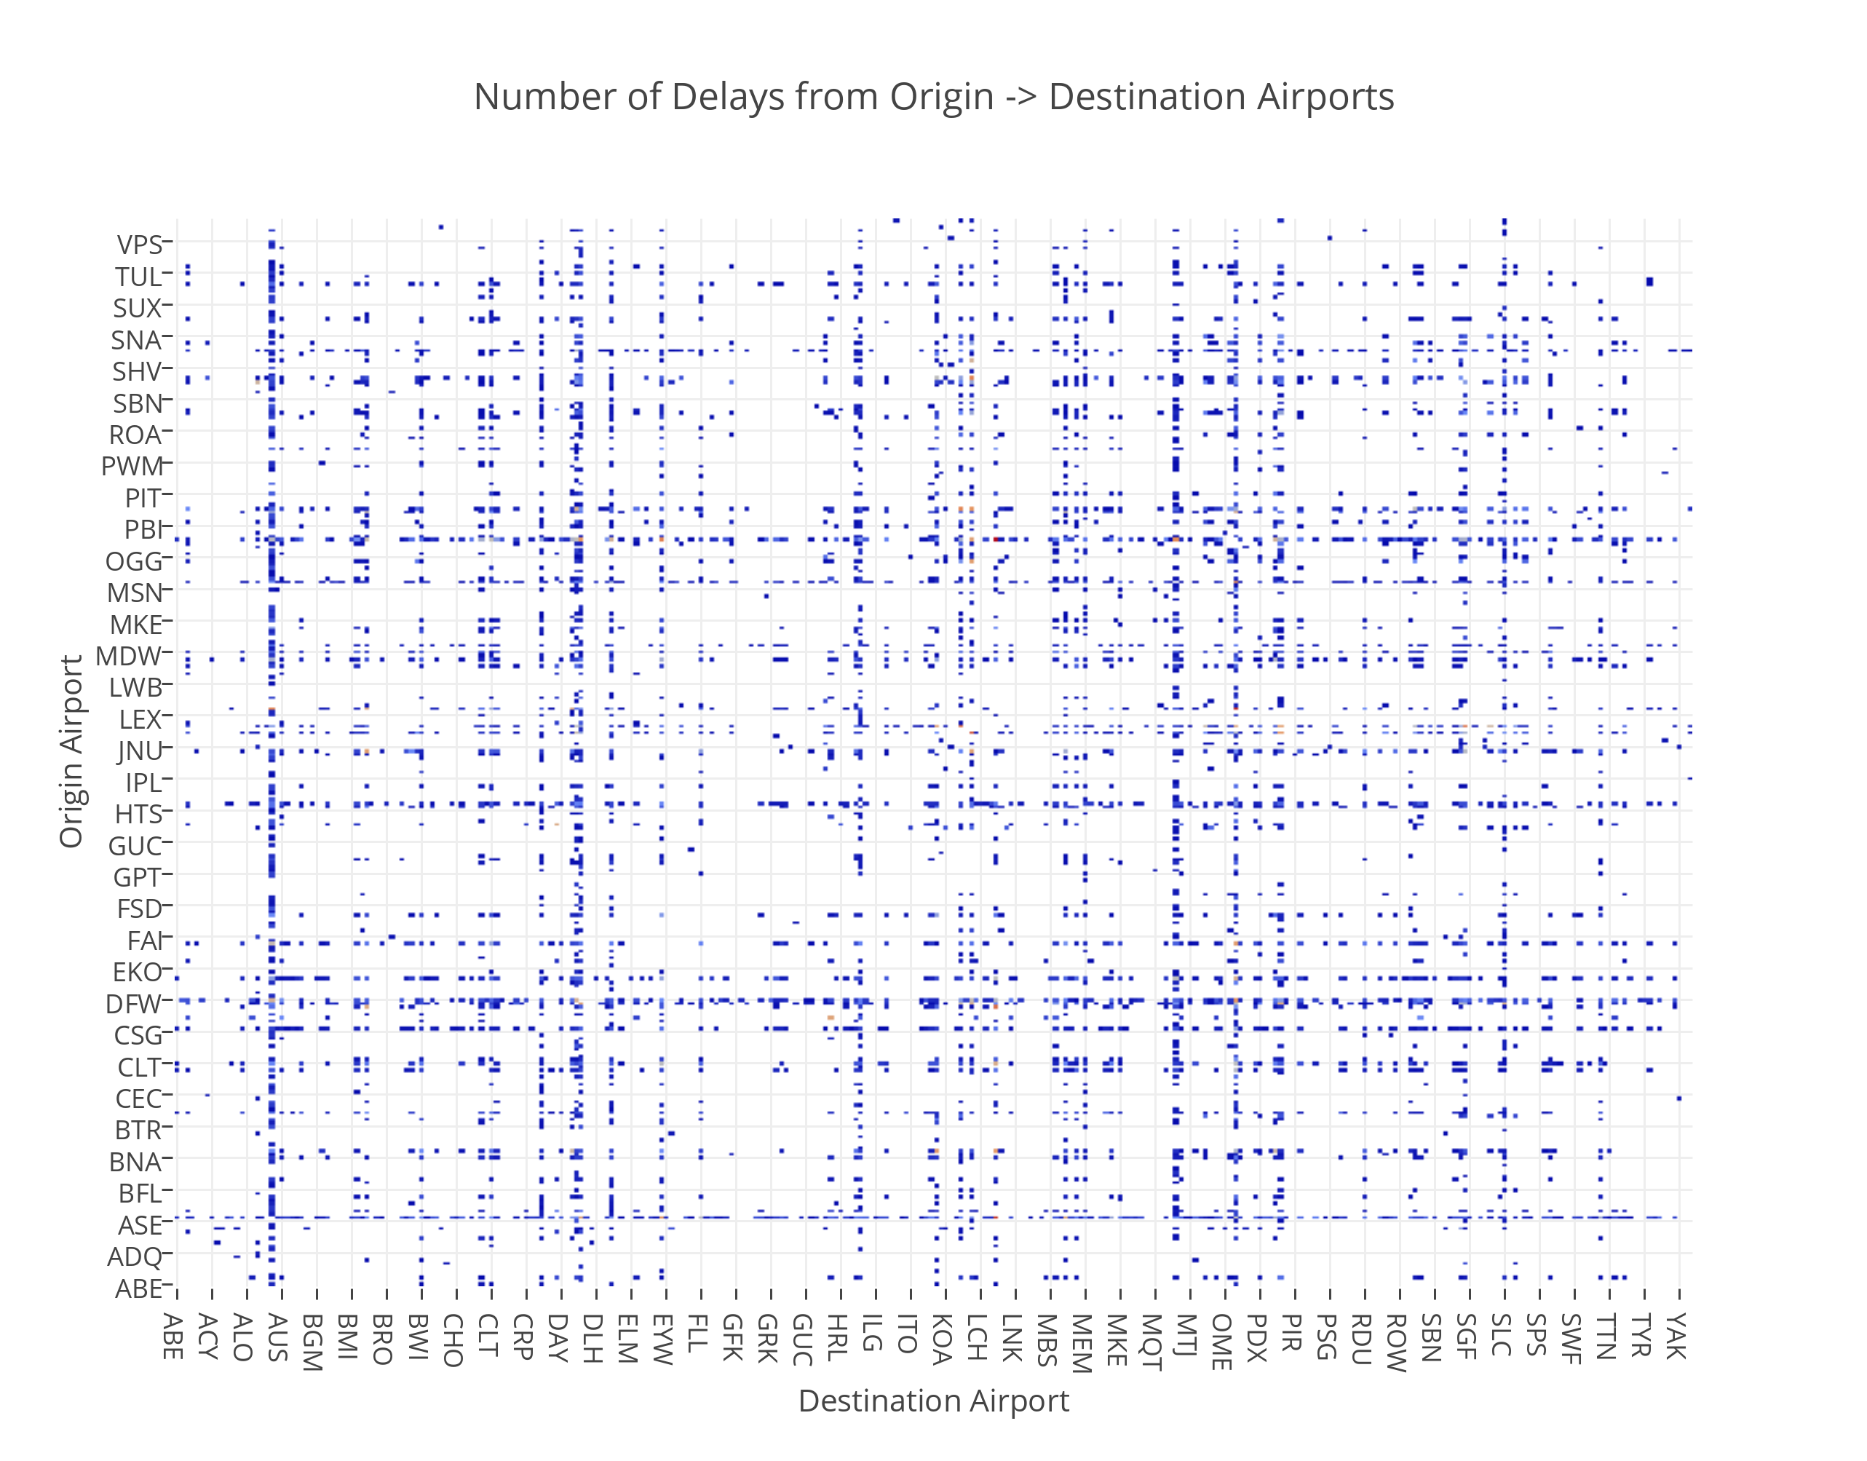

Slide 16
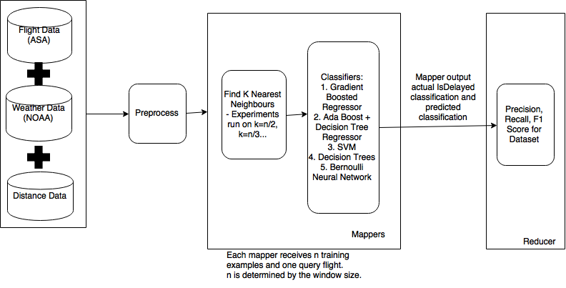
Our Approach – Predicting Data

Slide 17
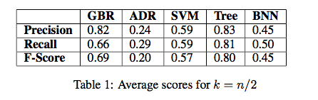
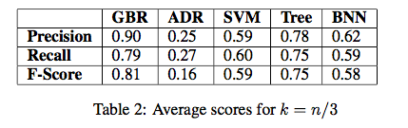
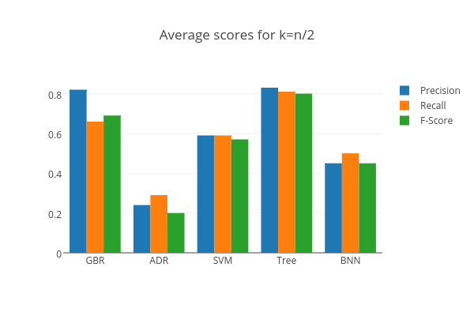
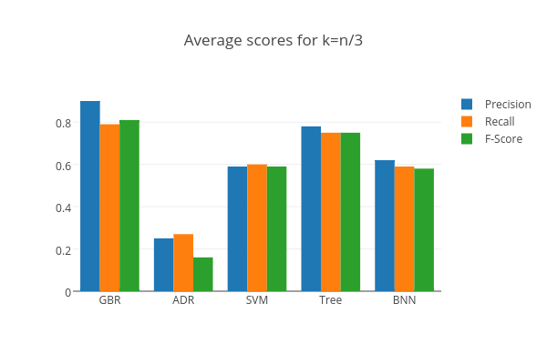
Our Approach – Evaluation of Prediction
Precision vs Recall
Prefer False Negatives (low recall): OK to anticipate a delay than be delayed
False Positives not preferred (High precision)

Slide 18
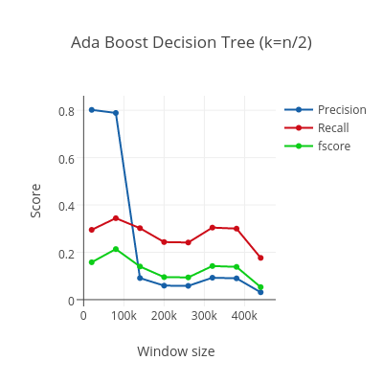
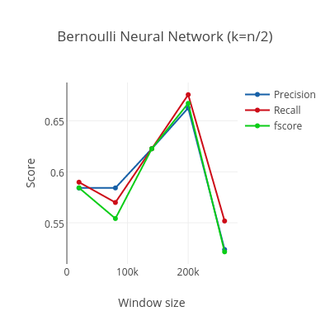
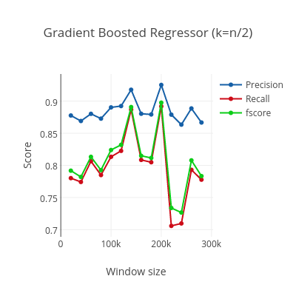
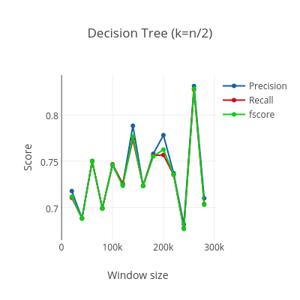

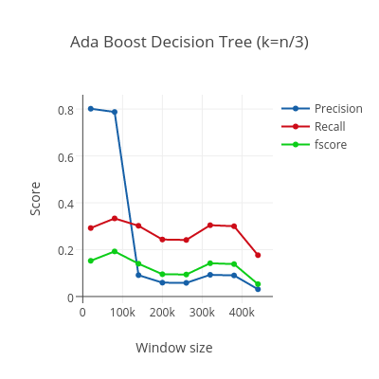
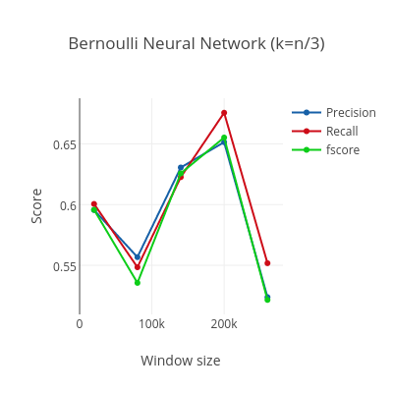
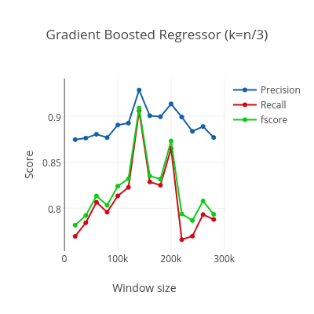
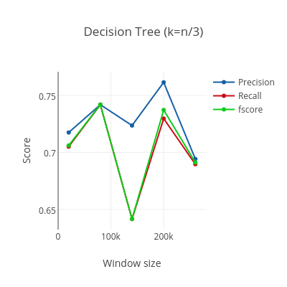

Results

Slide 19
Further Work
Scale up to full dataset from Years 1987 – 2008
Explore different parameters of classifiers:
Optimising Hyperparameters – Gaussian Processes?
Explore more different k sizes

Slide 20
Conclusion
At best, 90% with k=n/3 and Gradient Boosted Regressor
Small window sizes do have high precision – don’t need a lot of data for flight prediction

Slide 21
The END

