Slide 1


Introduction to MongoDB
Nosh Petigara
Director of Product Strategy
nosh@10gen.com
@noshinosh

Slide 2
MongoDB: The basics
Motivation & use cases
The document model
Flexible queries and updates
Deployment architecture

Slide 3
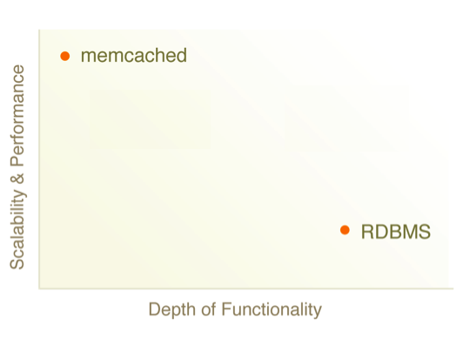
The Great Divide
MongoDB sweet spot: Easy, Flexible, Scalable

Slide 4
Use Cases
RDBMS replacement for high-traffic web applications
Semi-structured content management
Real-time analytics & high-speed logging
Web Infrastructure
Web 2.0, Media, SaaS, Gaming
Finance, Telecom, Healthcare, Goverment

Slide 5





Selected Users

Slide 6
Understanding the Document Model
{
_id:“A4304”
author: “nosh”,
date: 22/6/2010,
title: “Intro to MongoDB”
text: “MongoDB is an open source..”,
tags: [“webinar”, “opensource”]
comments: [{author: “mike”,
date: 11/18/2010,
txt: “Did you see the…”,
votes: 7},….]
}
Documents->Collections->Databases

Slide 7
Document Model Makes Queries Simple
db.posts.find({author: “nosh”,
tags: “webinar”})
Operators:
$gt, $lt, $gte, $lte, $ne, $all, $in, $nin, count, limit, skip, group
Where is my join??!!

Slide 8
Atomic Operations makes Updates Simple
db.posts.update({_id:A4304},
{title: “Intro to MongoDB(updated)”,
text: “MongoDB is a scalable..”},
${addToSet: {tags: “mongodb”}})
$set, $unset
$push, $pop, $pull, $addToSet
$inc
Where is my transaction??

Slide 9
Under the hood
Written in C++
Available on most platforms
Data serialized to BSON
Extensive use of memory-mapped files

Slide 10
Some Other Cool Features
Geo-spatial indexes
  $near
GridFS
  Store large binary files
Capped Collections
  Fixed-space FIFO collections

Slide 11
Single Master Deployments
Secondary/Slave
Configure as a replica set for automated failover
Add more secondaries to scale reads
Primary/Master

Slide 12
Auto Sharded Deployment
Secondary/Slave
Primary/Master
Mongo
Config
MongoS
Autosharding distributes data among two or more replica sets
Mongo Config Server(s) handles distribution & balancing
Transparent to applications

Slide 13
Next Steps
http://mongodb.org
@mongodb
http://10gen.com/events
nosh@10gen.com
@noshinosh

