Slide 1

Learning

Slide 2


Journey…
Class Room Course
Self Paced Learning
Classroom: £3500
Travel: £250
Accommodation: £300
Expenses: £200
Total: £4250
3 candidates, 2 course
Total: £25K
Self Paced: £1500
Total: £1500
3 candidates, 2 courses
Total: £9K

Slide 3

Options to Learn

Slide 4
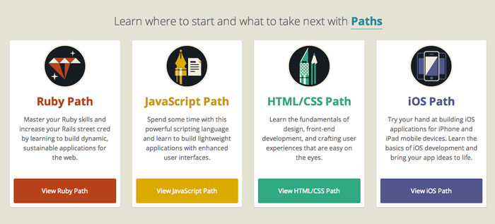



https://www.codeschool.com/
https://stcedin.github.io/home.html
https://stcedin.github.io/presentation.html

Slide 5


