Slide 1

Learning

Slide 2


Journey…
Class Room Course
Self Paced Learning
Classroom: £3500
Travel: £250
Accommodation: £300
Expenses: £200
Total: £4250
3 candidates, 2 course
Total: £25K
Self Paced: £1500
Total: £1500
3 candidates, 2 courses
Total: £9K

Slide 3

Options to Learn
edX
Feels a bit like the OU. Free, unless certification sought.
tuts+ premium
Reviews were a bit mixed, and support was very sketchy.
Udacity
Felt a little too full on, for what I wanted. I was looking to enjoy!
Code School (winner)
The clear winner for me. First class reviews, targeting topics I was interested in. Published reviews suggested this was the best choice for experienced developers (harder exercises).
Code Cademy (runner-up)
Very, very similar to Code School, but targeting less experienced developers. I found reported errors on tutorials less informing. Criticised for “copy and paste” from the lectures.

Slide 4
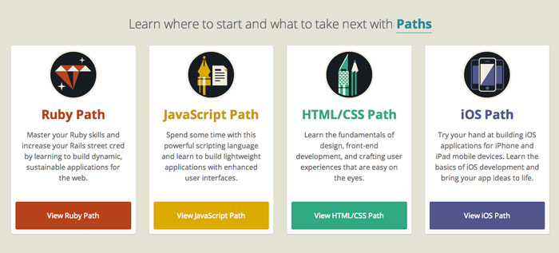



https://www.codeschool.com/
https://stcedin.github.io/home.html
https://stcedin.github.io/presentation.html

Slide 5


