Slide 1

Case Study:
Scalable Web Solution
The following presentation describes the recommended infrastructure to host the WTW public web app. It also discusses some deployment, and monitoring.

Slide 2
Design Summary
Components
Backend:
Data Tier:
AWS RDS MySQL Aurora
Compute:
AWS EKS Kubernetes Cluster
Blob Storage:
AWS S3 Bucket
Monitoring:
DataDog
Site Failover:
Route53 HealthChecks
Caching (Optional):
AWS Elasticache Redis Engine
Frontend: (Optional)
S3 Bucket for HTML and JS Assets
CloudFront CDN

Slide 3
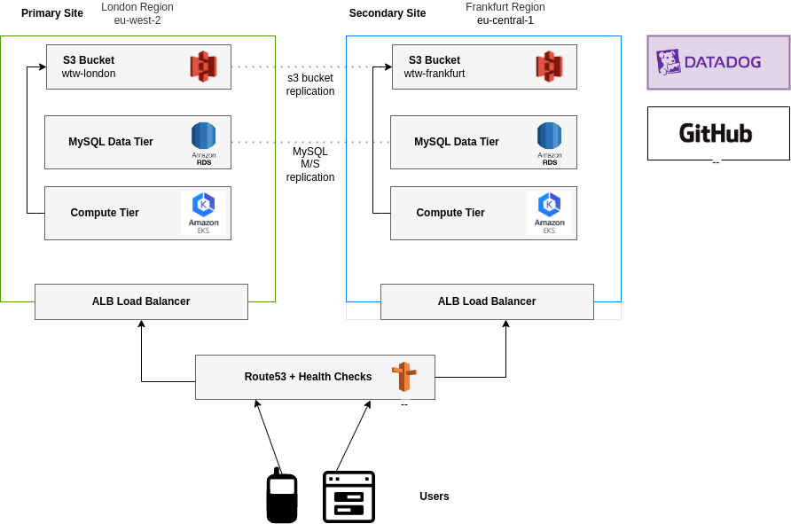
Design Diagram Overview

Slide 4
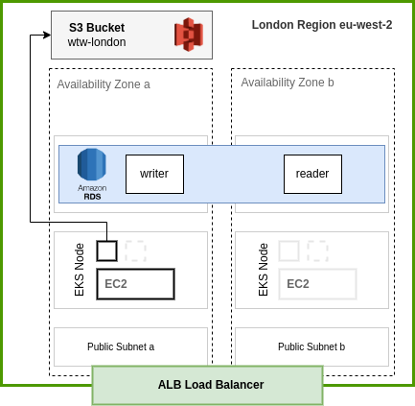
Design Diagram Site Detail

Slide 5
Going Deeper (1)
The system is made up of two sites; one primary in the London region and a secondary in the Frankfurt region.
Networking
Each region will have its own separate networking made up of VPC, IGW, NATGW, Public Subnets, Private Compute Subnets and Data Subnets.
Compute / Containerisation
Each Region will have an EKS cluster that will host and orchestrate the .NET application containers, and the Datadog agent containers
Observability and Alerting
Agents deployed on the EKS will collect EKS, EC2 and RDS metrics. DB APM for internal SQL metrics is also a recommended.
Alerts should be presented to the engineering team via slack for informational alerts and pager duty for P1 and P2 level alerts.

Slide 6
Going Deeper (2)
Data Sync
When the sites are first built they will be in sync, however as the primary processes traffic the secondary site will soon become stale.
The following describes how each of the components will be kept in sync:
The compute is made up of stateless containers. These will all be deployed simultaneously at the time of release via a CI/CD process.
The SQL layer will use MySQL replication between clusters. Note this requires some SQL commands to setup the replication. See https://repost.aws/knowledge-center/rds-mysql-cross-region-replica
S3 Blob storage. Use CRR (Cross Region Replication) to replicate data objects.

Slide 7
Going Deeper (3)
High Availability
To protect against region failure, the design has two sites. Both site are designed to be autonomous copies of each other. Each site will present a Health check API endpoint indicating the sites readiness to accept traffic.
Route53 will monitor these endpoints and in the event of a failure Route53 will no longer serve this endpoint to client, instead serving the secondary site.
Within each of the primary and secondary site components will be deployed across two or more availability zones. This will provide in-region resilience to failure within a particular AWS data centre.

Slide 8
Decision Process
S3 This was not difficult to justify – it is the core BLOB service AWS supply. ​
It also has built in mechanisms for replication to a separate region such as CRR.​It also has different storage classes depending on the use case of the blobs.
EKS Using EKS vs other container management system does require some justification. EKS is AWS managed Kubernetes. It costs around $70 per month on top of the compute costs whereas ECS you only pay for the compute costs. It is also more complex to manage than ECS. However, it is a very common platform and has a large eco system of tools including policy management, service meshes and git ops.
RDS MySQL Aurora MySQL Aurora is 100% compatible however it is quoted to be 5x faster than standard RDS MySQL. It is also treated as first class citizen compared to some other database engines such as MySQL RDS postgres. RDS MySQL also supports cross region replication and Blue Green deployments.
DataDog Datadog is very powerful and is straightforward to setup when compared self-hosted solutions such as Prometheus. It also has out of the box plugins for components such as EKS, RDS and a powerful APM solution.

Slide 9
Thank you

