Slide 1
Application Walkthrough

Slide 2
Problem Statement
Application
Choose a coding language to implement this using the appropriate Redis Data Type:
Insert the values 1-100 to the Redis OSS server
Extract them in reverse order from the Redis Enterprise DB resource.
For validation: preserve the output of steps 1 & 2.

Slide 3
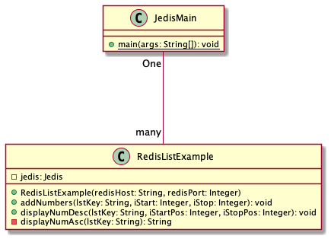
Solution Approach
Creates two instances of RedisListExample class (Constructor injection) –
One that connects to OSS instance for creating the list & adding the numbers
Second one connecting to enterprise DB instance (replica instance for fetching the list and displaying in reverse order)
Programming Tools
Programming Language: Java
Project Type: Maven
IDE : Eclipse
Redis Client Lib: Jedis
Pre-requisites
Redis source server is up & running (Open-Source Instance)
Redis destination server is up & running (Enterprise Server Instance)
The Enterprise Server is configured as replicaof redis open-source server instance
Source code Repo
https://github.com/stcloudgate/redisexamples

Slide 4
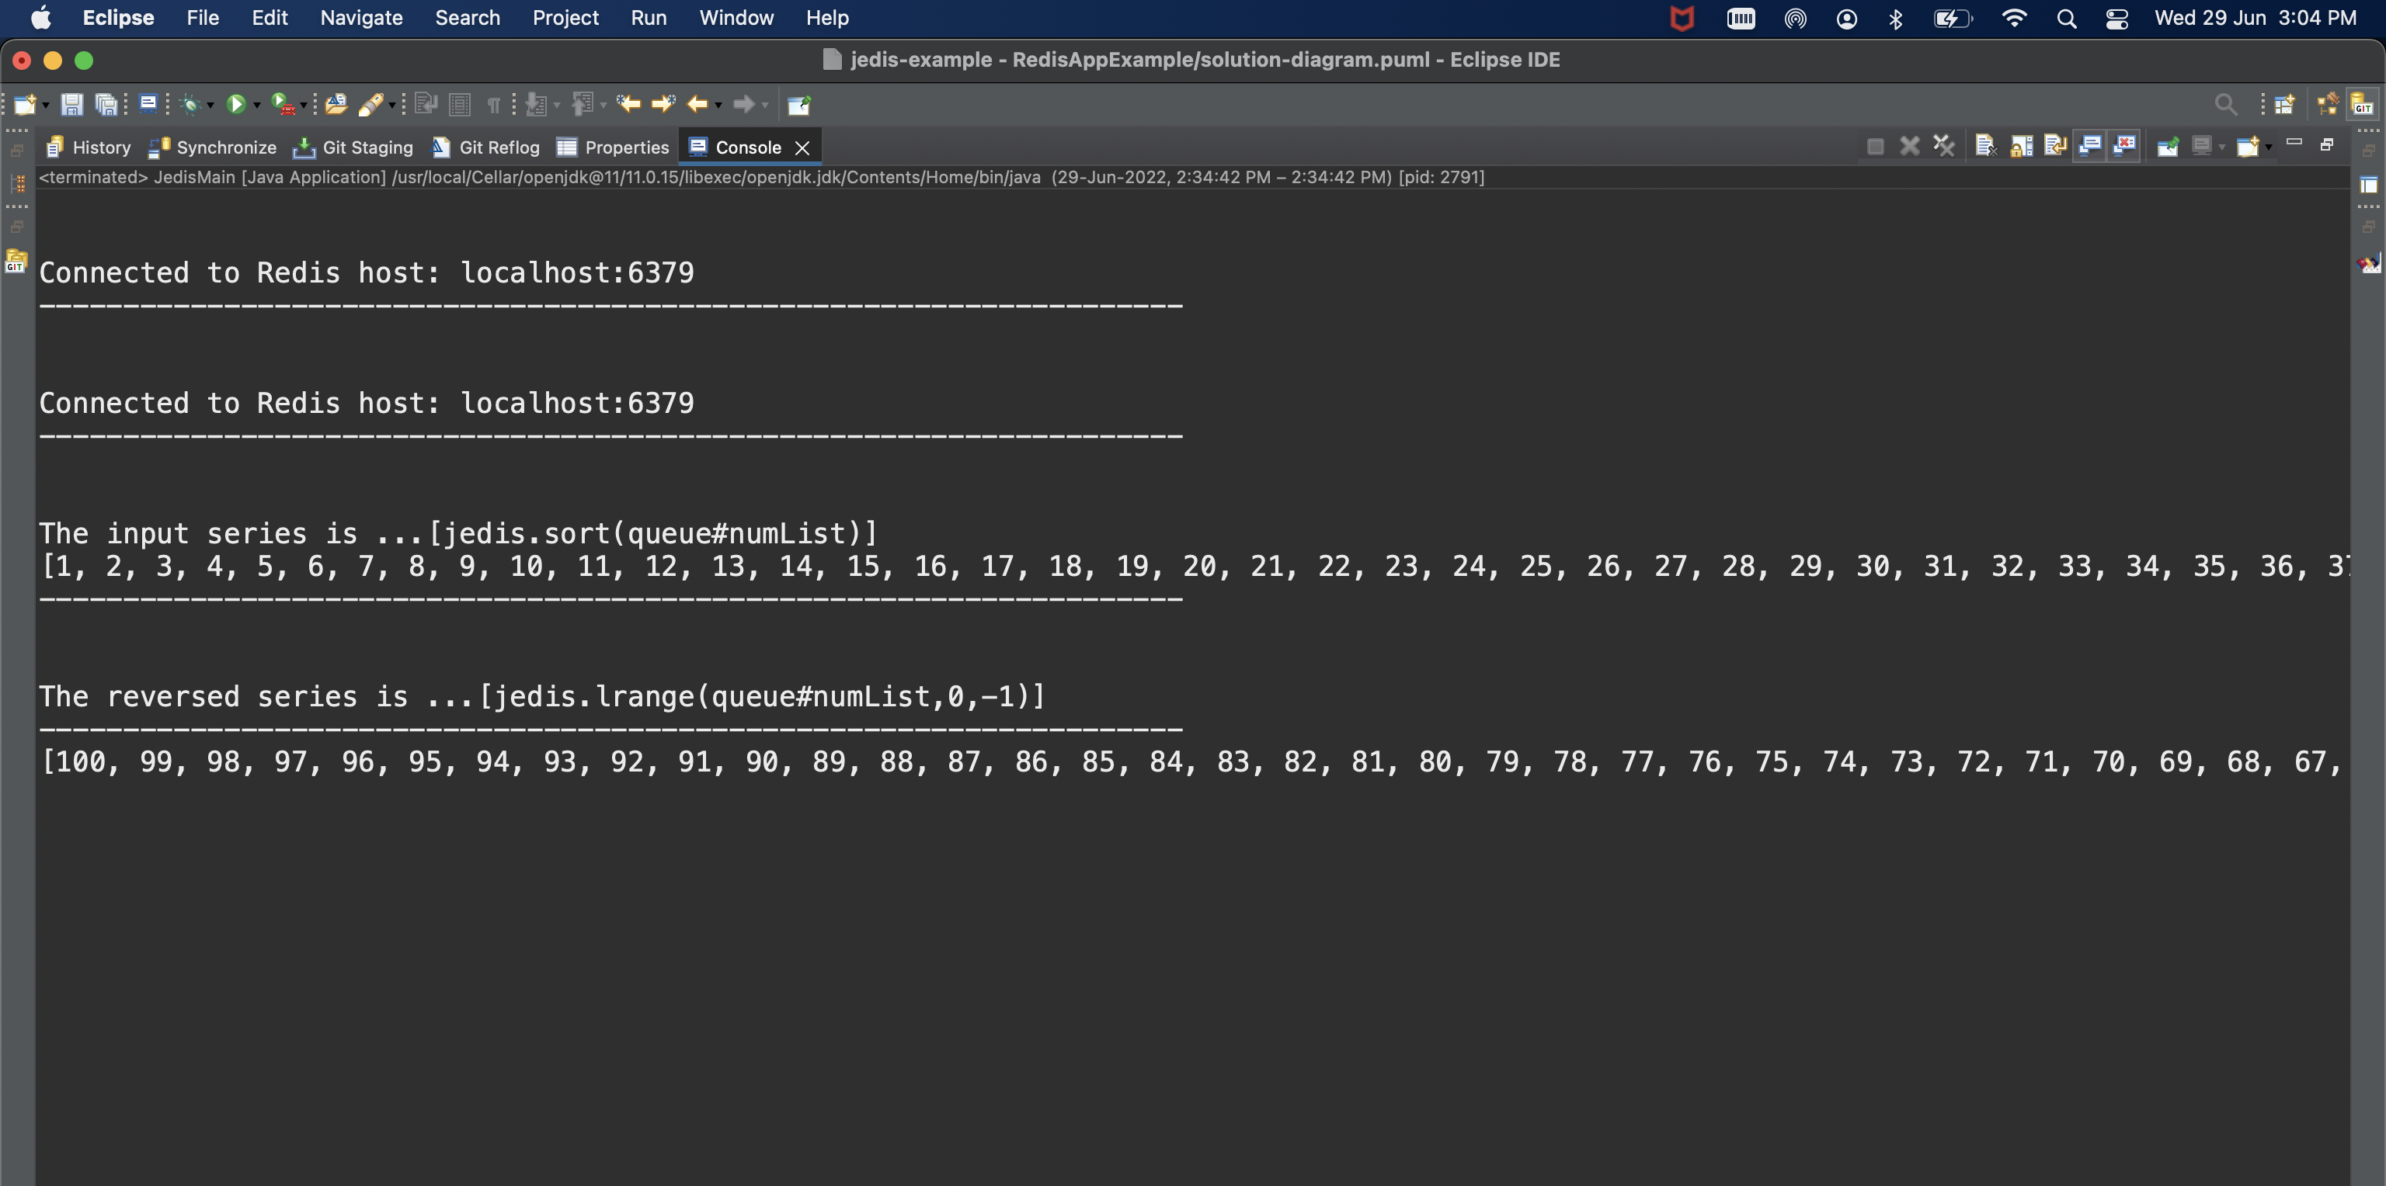
Application Outputs

Slide 5
Use Case Walkthrough

Slide 6
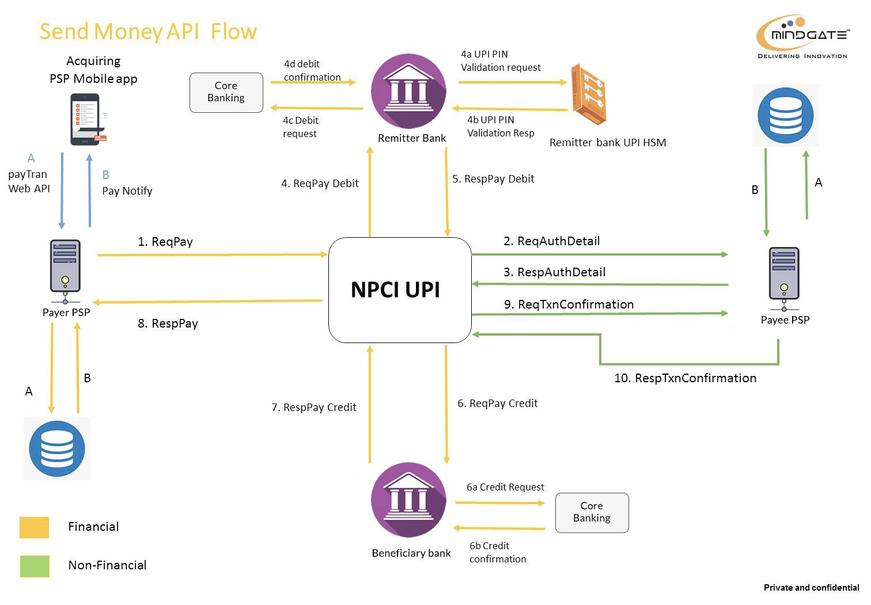
Problem Description
Use Context
One of the largest financial institution in India wanted to implement a UPI solution where one leg of payment transaction within UPI involved approx. 25-30 API calls. While the UPI product was undergoing a modernization journey to adapt microservices architecture, largely, the APIs were in form of SOA & REST services with shared database instances. Some of the envisaged challenges associated with the the overall architecture were as follows –
Heavy interactions with database layer - each step with multiple commits to complete one command transaction
Heavy database dependency leading to scaling constraints in light of anticipated volume growth
Challenges and anticipated complexities to implement single handling of NPCI interactions in HA mode (Active-Active)
Heavy Database operations

Slide 7


Solution Approach
The potential solution components for the problem could have been –
Maintaining separate data base instances for Write operations (Commands that leads to state change as part of fulfilling the transactions) and Read operations (Queries to fulfil enquiry and reporting transactions) – Application of CQRS Pattern
Implementing Redis as caching solution to optimise the performance of write operations – At individual API / microservice scale in the tobe state form.
Implementing clustering of Redis solution (Redis Sentinel) to optimise the read operations with objectives to gain min latency for eventually consistent read database instances.
Redis Layer for Caching
Redis Layer for Caching

Slide 8
Thank You

