Slide 1

Wrangle Works Wrangling Demo
Transforming Data with
Workflows and Templates
in the Trifacta Wrangler

Slide 2
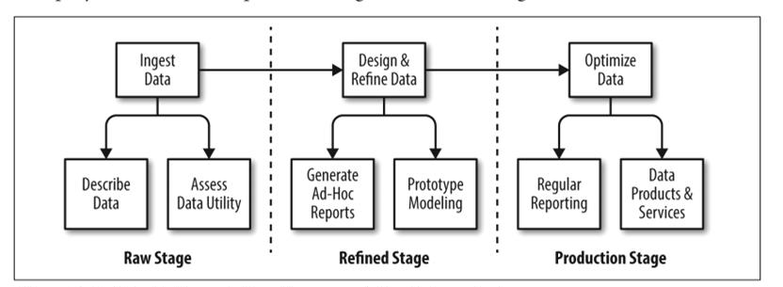
The Typical Wrangling Pipeline

Slide 3
The Method
REFINED
• Calculations • Statistics • Inferred Attributes • Data Joins and Unions • Other enrichments supporting downstream ad hoc reporting
RAW
• Data Set • Missing Columns • Empty Columns • Null Values • Schema Comparisons • Data Type Mismatches • Unique Values • Duplicates • Normalizing
PRODUCTION
• Polished data for automated downstream reporting • Value-adding reports Quality

Slide 4
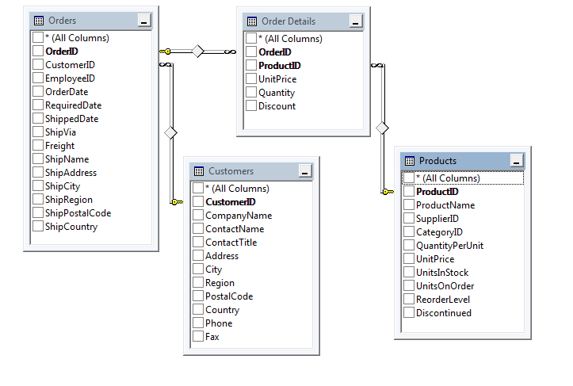
The Input Data Set

Slide 5
The Input Data Set
The Trifacta capabilities included in this Demo:
Profiles
Basic Cleaning Process
Using Lookup Tables to Normalize Data
Gluing Flows together with Reference Files
The ease of Joining, Aggregating, and Grouping
Using Target Schemas to shape data
Using Templates to create a Re-usable Pipeline

Slide 6
UPDATES
TotPurchase ➔ LineItemRevenue
After filling in Region values, add a step:
Ex: DACH Region (int’l) includes Germany, Austria, Switzerland, etc (look up common int’l regions)
Ex: NE Region (USA) includes ME, NH, MA, CT

