Slide 1
E-voting (polling) Android Mobile App (VoteForIt) + System Backend + Custom Load Balancer
ALTIN CIPI (M1309)
VASILIS SKOURTIS (M1341)
EYAGGELOS KARAGEORGOS (M1364)

Slide 2
General System View

Slide 3
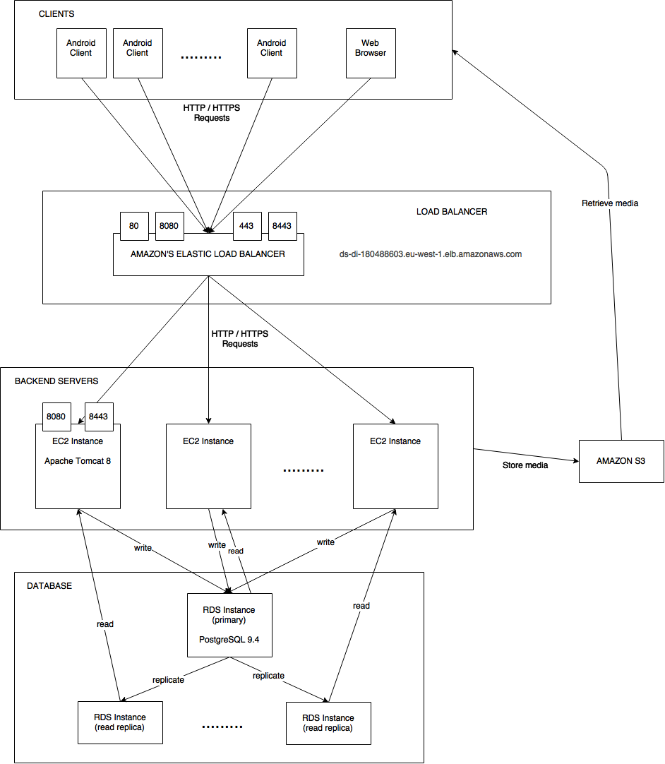

Slide 4
Client – Android Mobile App

Slide 5
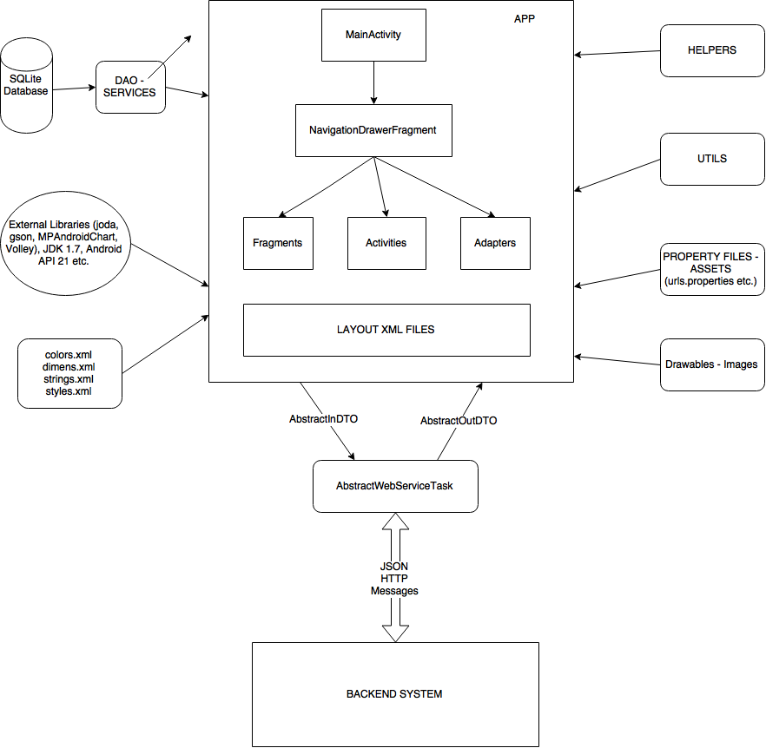

Slide 6
Backend System View

Slide 7
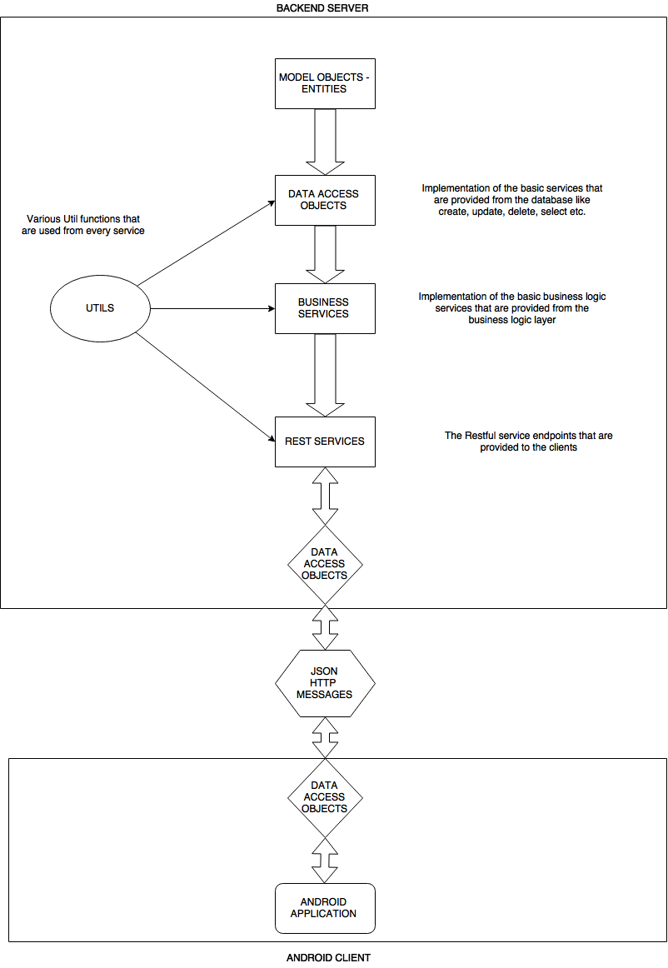

Slide 8
ds-pom
The parent pom.xml file
The basic Maven configuration is done here
All libraries dependencies
Developers
Properties
The build structure for all projects
It is extended by all the other project’s pom.xml files

Slide 9
ds-utils
Global Variables
Security Util Functions
encryption / decryption
password salting
Password validation
Util functions for Lists
Used by ds-dao and ds-web

Slide 10
ds-model
Persistence.xml
Two persistence units defined
ds : the primary for writes
ds_read : the replica for reads
Various .sql files that contain queries for the database initialization
The Model Objects of the backend system.

Slide 11
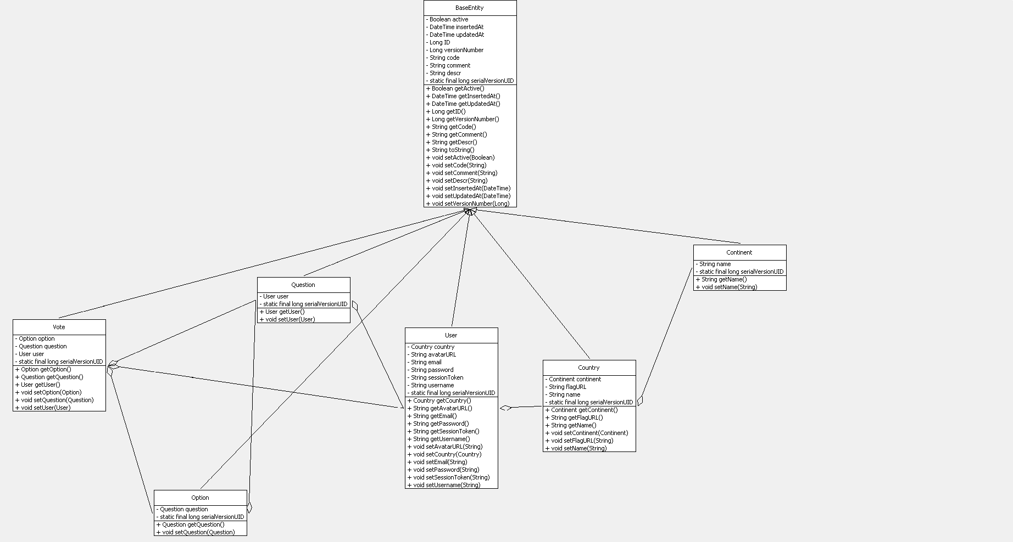

Slide 12
ds-dao
DAO
AbstractDAO and two implementations of it
One that uses the entity manager of the primary database for the write operations
One that uses the entity manager of the read replica database for the read operations
Two DAOs for every entity in the ds-model (one for each implementation)
SERVICES
AbstractService and two implementations of it
Each implementation uses its corresponding DAO
Every function in the DAO is provided also as a service
Two Services for every entity in the ds-model (one for each implementation)

Slide 13
ds-dto
Data Transfer Objects
It is the common “language” that the clients and the servers speak.
All the DTOs exist exactly the same in the android application so that the parsing of the json messages is the same in both sides.
ErrorDTO: send it to the client if something goes wrong
SimpleDTO: send it to the client if you want to respond with only a message
InDTOs
the DTOs that the clients send to the servers
From JSON messages to DTOs
The input of the rest services
OutDTOs
the DTOs that the server responds to the client
From DTOs to JSON messages
The output of the rest services
One InDTO and one OutDTO for every rest service that the system provides

Slide 14
ds-web (1)
Exception Mappers for handling every exception that was not caught
Rest Services for every action that is performed in the android client app and needs/sends data from/to the backend system (login, registration, user profile, home feed, questions etc.), and a service for the custom load balancer
URL path: ip:port/ds-web/rest/(secure/)/{rest service class path}/{function path}
http://localhost:8080/ds-web/rest/general/country/all
https://localhost:8443/ds-web/rest/secure/user/register/create
Every REST service
is a POST or GET request
consumes and produces JSON messages
is represented as a java function with an InDTO as input and a Response which contains an OutDTO as output.
secure/ : it is used by the services that want to use SSL connections and listen only to the 8443 or 443 port. Usually when user data credentials is sent from the client (username, password, userToken)
Various util classes (validators, helpers etc.)

Slide 15
ds-web (2)
Various properties files
The spring-main.xml for the configuration of the spring framework
Definition of the two datasources, entityManagerFactories, transactionManagers, etc.
The log4j.xml for the configuration of the log4j framework
Various Test classes for testing the system services.
context.xml for defining the sql connections to the two databases
Web.xml for configuring the whole web application that is deployed
An index.jsp with a dispatcher-servlet.xml and a Controller that shows the welcome page of our web application
It is not used for this project. It was just created for testing purposes.

Slide 16
Custom Load Balancer

Slide 17
Custom Load Balancer
Application-level load balancer
Could also be replicated and be accessed through a network-level load balancer
HTTP request proxy
Port translation from 80 and 443 to arbitrary ports
Requires a specific REST service implemented on each end point
Service performs work and returns the current CPU usage for the web server process
Basically a MITM attacker between the client and a specific server
For secure connections the TLS certificate for the system is also being utilized on the balancer
Ensures fault tolerance by never issuing requests on unresponsive servers

Slide 18
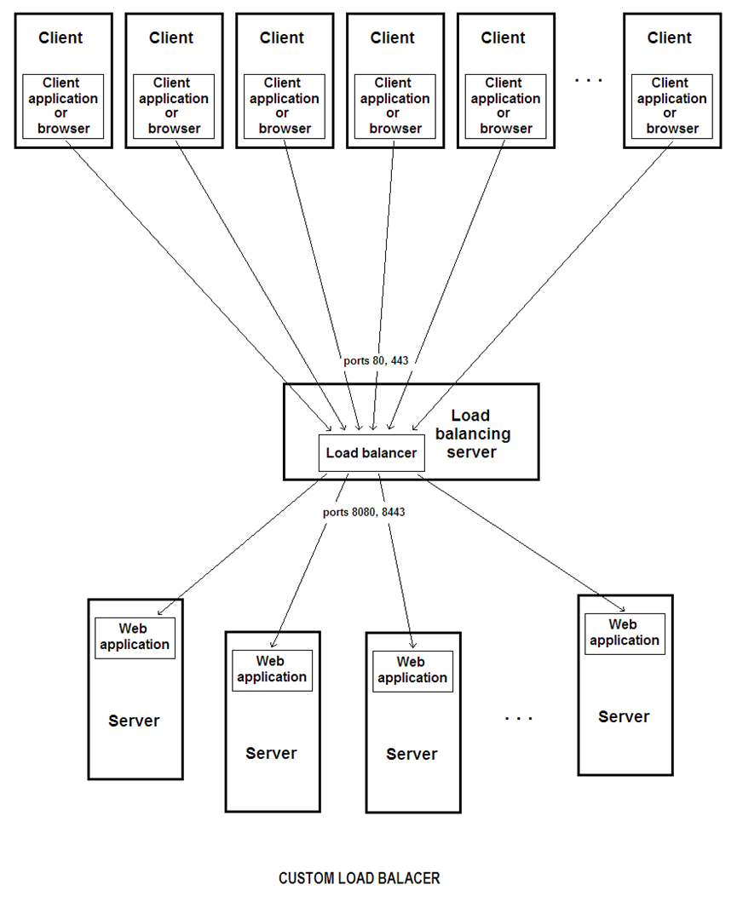

Slide 19
Custom Load Balancer
Server Rank
Takes into account the CPU usage and request latency.
Represents the server congestion, the time it takes to serve a request and the network latency compressed in a single scalar value.
If a server is unreachable, it receives an exceedingly large rank of 10000 (OVER 9000!)
Server selection
The load balancer frequently queries all the servers using the status service to refresh their ranks
Every time a request is being delegated to a server, the server’s rank increases
The server with the lowest rank will be selected
If servers are relatively equal in rank, the requests will be evenly distributed, while if a server has a significantly lower rank than the others it will be preferred constantly
Overall, the algorithm tends to distribute the load and in the same time optimize the request latency

Slide 20
Load Balancer Architecture
Hybrid ping
Total path latency estimation
DB included
Server work load / CPU consumption
Available Servers ranking
Local status update after each request
Periodic status update
Fault tolerance handling

Slide 25
Load Balancer Evaluation
Many scenarios
4 web servers
2 failures
1 server rejoins

Slide 26
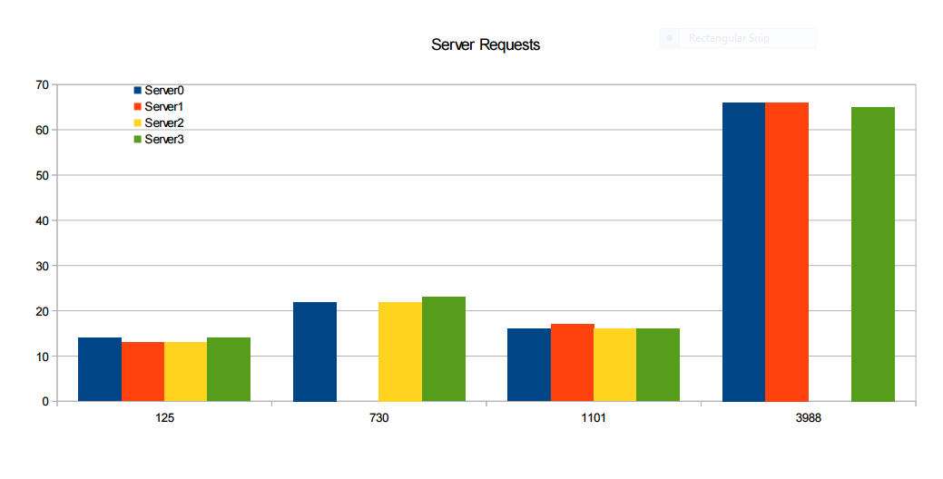

Slide 27
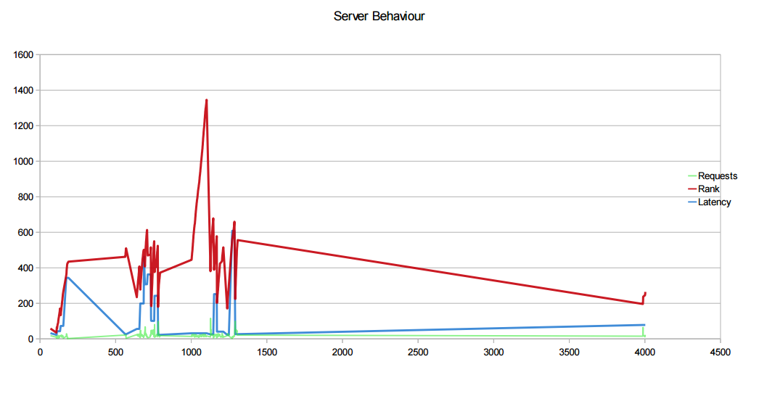

Slide 28
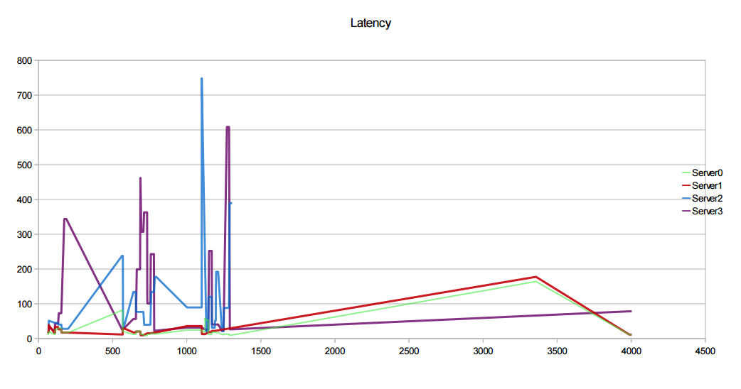

Slide 29
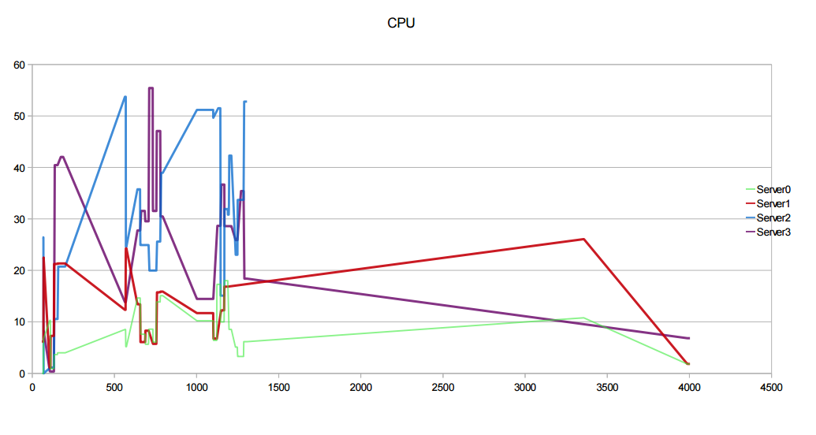

Slide 30
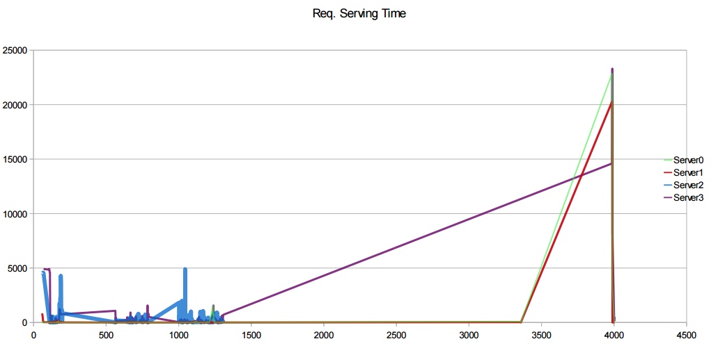

Slide 31
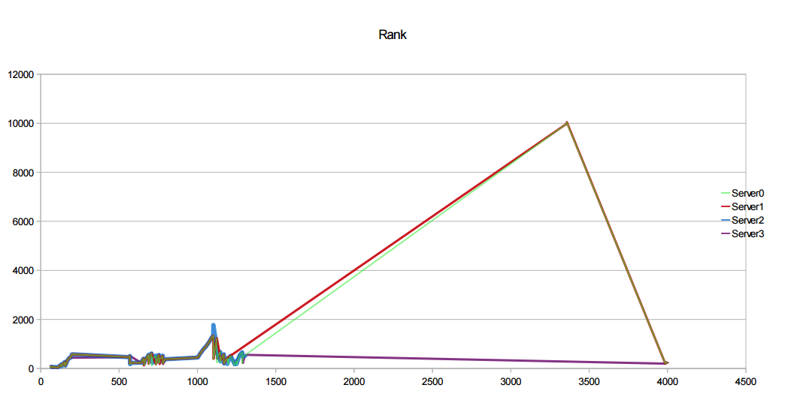

Slide 32
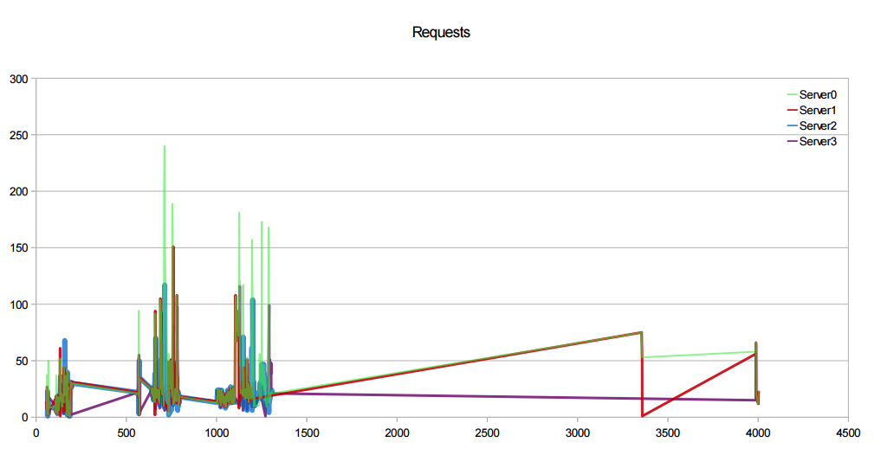

Slide 33
Technologies used

Slide 34
Java EE
JDK 1.7
Apache Tomcat 8
https://tomcat.apache.org/download-80.cgi
Eclipse Luna
http://www.eclipse.org/
PostgreSQL
9.4, jdbc driver, http://www.postgresql.org/
GitHub
GIT eclipse Plugin
GIT GUI
Maven
Maven eclipse plugin, 3.2.1, https://maven.apache.org/
Spring framework
4.1.4, https://spring.io/
Hibernate framework
4.3.8, http://hibernate.org/orm/
Jersey (JAX-RS)
1.18.3, JSON, https://jersey.java.net/
Amazon Web Services
AWS Java JDK 1.9.22, https://aws.amazon.com/

Slide 35
Jasypt
1.9.2, Encryption, http://www.jasypt.org/
Joda
2.7, DateTime library, http://www.joda.org/joda-time/
Junit
4.12, http://junit.org/
Log4J
1.2.17, http://logging.apache.org/log4j/2.x/
Android Studio
1.2, http://developer.android.com/tools/studio/index.html
Volley
Gson
2.3.1
MPAndroidChart
2.0.9
Android API 21

Slide 36
Subjects covered

Slide 37
Performance / Scalability
Cluster of servers (EC2)
Load Balancer (ELB)
Single point of failure
Cluster of databases (RDS)
Scalable Storage Server (S3)
REST Services
Replication
Database replication (Read Replicas)
Naming
We found available domain names at https://uniregistry.com/ (voteforit.click – 1USD), and at https://www.papaki.gr/ (vote4it.eu – 3 Euros) but we could not purchase it due to Capital Control :P
If we had purchased those domain names we would use Amazons’ DNS Servers to translate this domain name to the IP address of our Load Balancer

Slide 38
Fault Tolerance
Automated database backups
If primary database fails read replica becomes primary
If one server fails the others can share the load until another server becomes active
Communication
REST Services - Stateless
HTTP / HTTPS Messages
JSON
Session-token user authentication
Security
SSL (prevent MITM attacks), Self Signed Certificates, .keystore for tomcat
Salt hashing of passwords (prevent rainbow attacks)
Advanced Encryption functions
Amazon Security Groups (prevent unauthorized access to our instances)
IAM (user authentication and access privileges to AWS resources)

