Slide 1

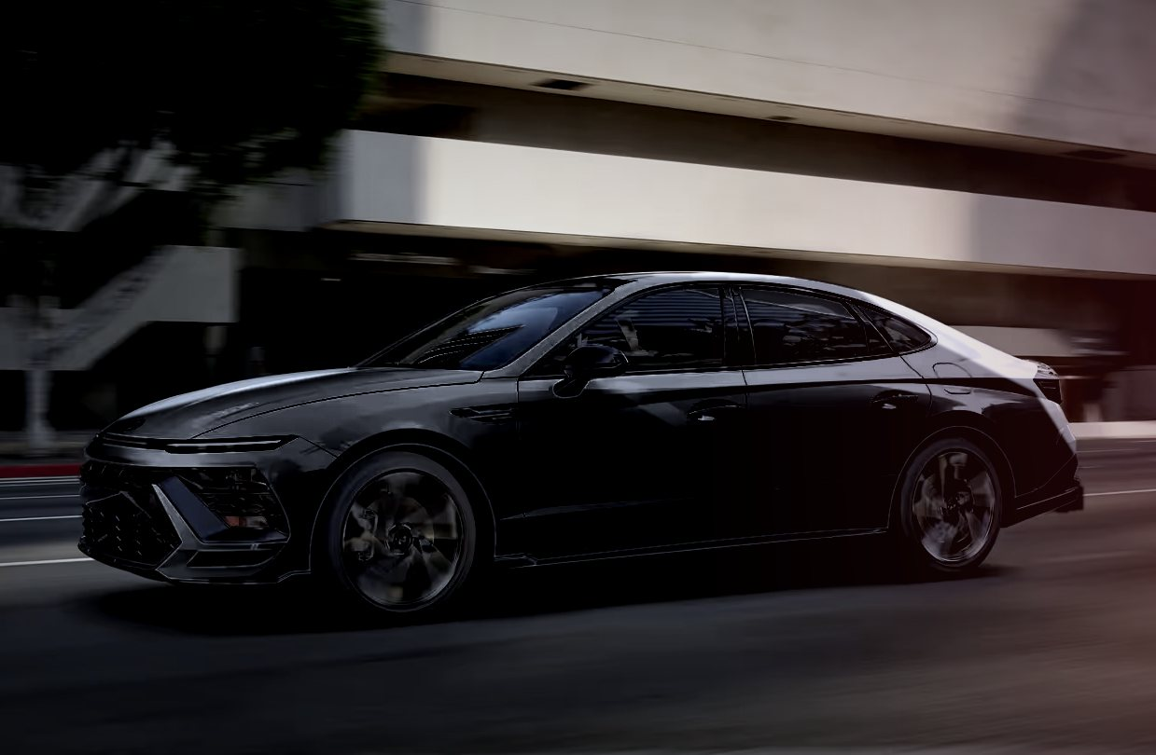
APEX DETAILING
Car detailing and ceramic coating, Karachi
Showroom finish for every car. Startup business plan and website prototype.
Group members: Abdullah Bin Waris, Rao Daniyal Ahmed & Zaid
International Financial Management | Instructor: Huma Abubakar | BBA, Spring 2026
Notes:
Introduce the team and the business in one sentence: we clean, polish and protect cars in Karachi.

Slide 2

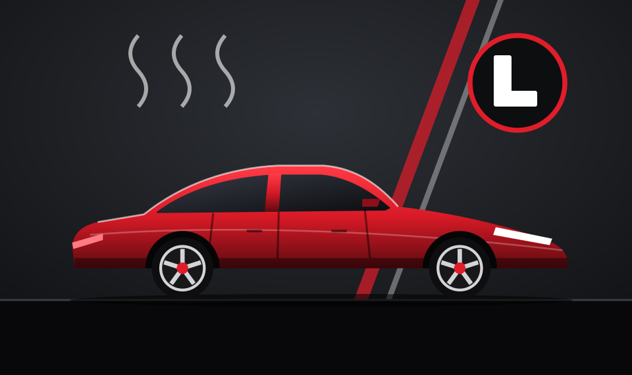


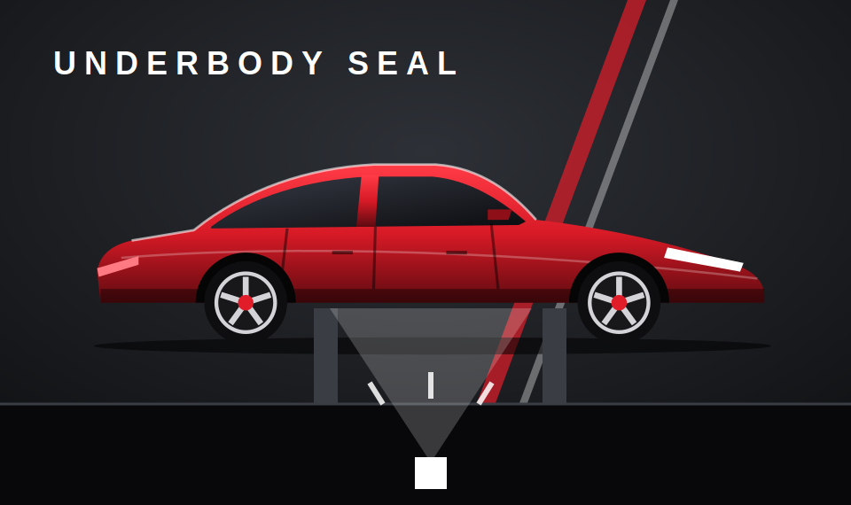
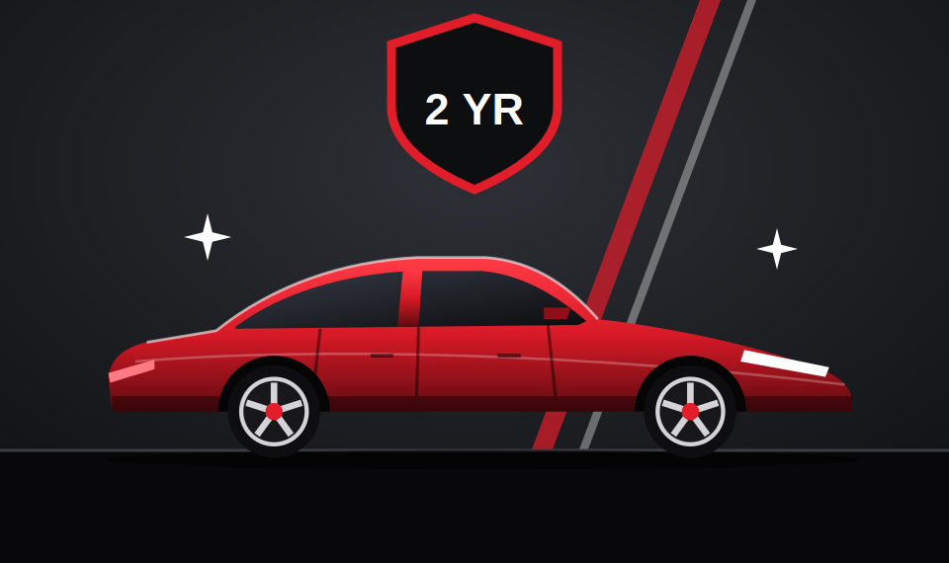
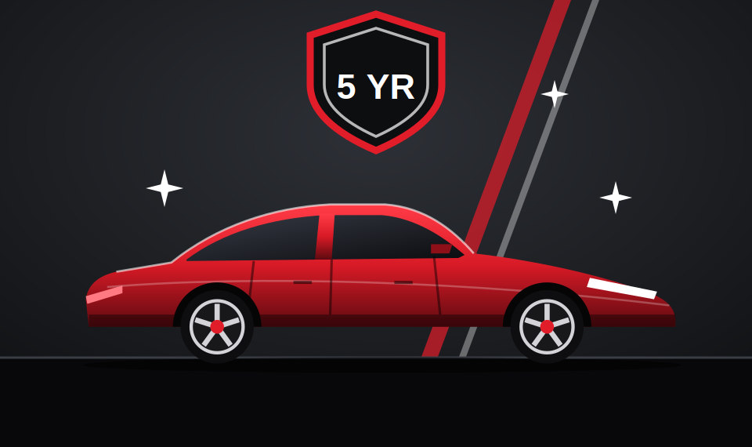
WHAT WE SELL
Premium Wash & Wax
Interior Deep Clean
Glass Coating
Full Detail
PKR 3,500
PKR 8,000
PKR 12,000
PKR 18,000
Prices are for a standard sedan. SUVs cost 20% more.
Our customers are car owners in Karachi who want their paint restored and protected.
Rust Proofing
Ceramic Coating (2 year)
Ceramic Coating Pro (5 year)
PKR 25,000
PKR 55,000
PKR 95,000
APEX DETAILING | INTERNATIONAL FINANCIAL MANAGEMENT
02
Notes:
Seven services. Prices are for a standard sedan, SUVs cost 20% more. Rust proofing suits the humid, salty air of Karachi.

Slide 3
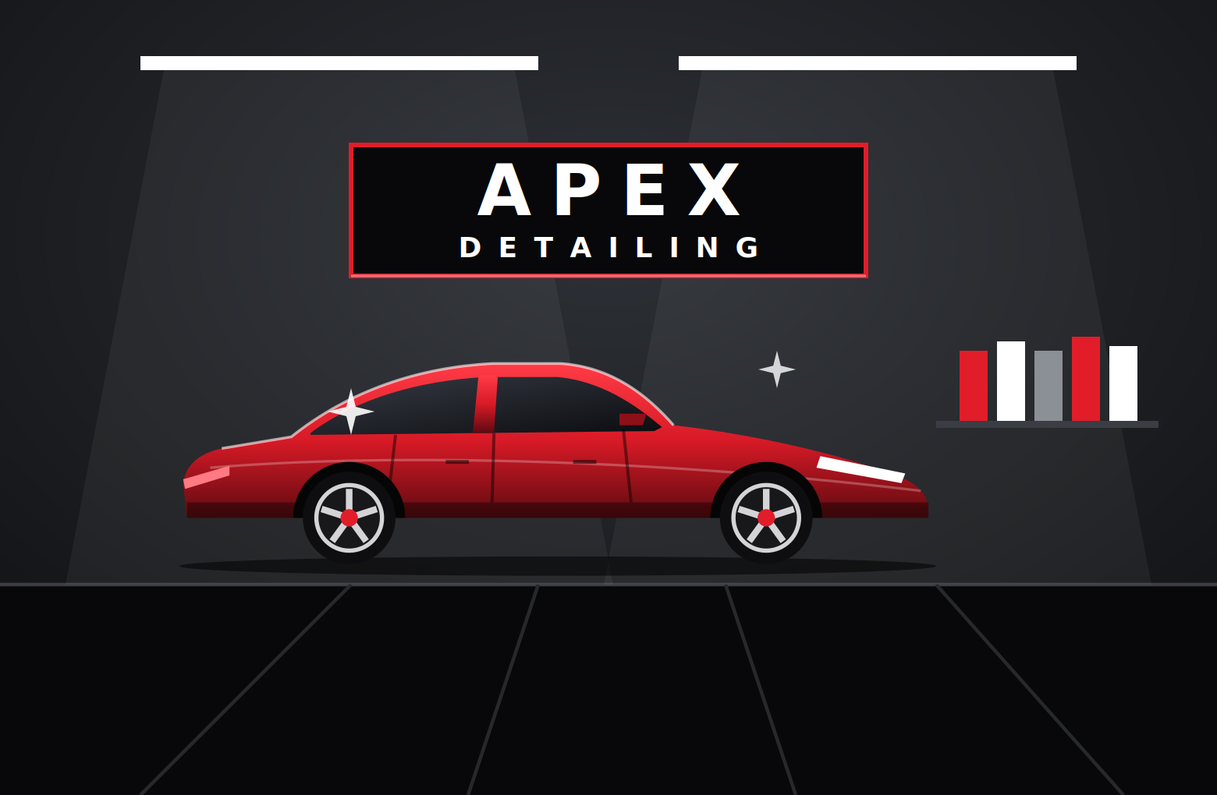
INSIDE APEX DETAILING
Open six days
Monday to Saturday, 9:00 am to 9:00 pm
Premium products
Ceramic, glass and rust-proof coatings, about 70% imported
Skilled team
Six people: lead detailer, detailer, helper and the three partners
Sample location
X Commercial, Phase X, Karachi
APEX DETAILING | INTERNATIONAL FINANCIAL MANAGEMENT
03
Notes:
Describe the workshop: clean bays, open six days from 9 am to 9 pm. Photo of a real sedan can replace this picture.

Slide 4





HOW A JOB WORKS
01
02
03
04
05
Book
Inspect
Detail
Protect
Deliver
Choose a service and a time slot online
We check the paint, glass and underbody
Wash, clay, polish or deep clean
Wax, ceramic, glass coating or rust seal
Final check and handover, same day for most jobs
APEX DETAILING | INTERNATIONAL FINANCIAL MANAGEMENT
04
Notes:
Walk through the five steps from booking to delivery.

Slide 5
WE NEED PKR 1,500,000 TO START
Startup costs (PKR thousand)
Total startup money
PKR 1,500,000
Equipment is the biggest item (27%).
We keep PKR 300,000 in reserve so the business survives its first slow months.
APEX DETAILING | INTERNATIONAL FINANCIAL MANAGEMENT
05
Notes:
Walk through the biggest items: equipment, workshop setup and the working capital reserve that covers slow early months.

Slide 6
FUNDED EQUALLY BY THE THREE PARTNERS
1/3
Partner 1
PKR 500,000
1/3
Partner 2
PKR 500,000
1/3
Partner 3
PKR 500,000
Total: PKR 1,500,000. Profit is shared equally, about PKR 147,333 per partner each month. The partners do not draw salaries.
APEX DETAILING | INTERNATIONAL FINANCIAL MANAGEMENT
06
Notes:
Each partner puts in PKR 500,000 and owns one third. No interest to pay. Profit is shared equally.

Slide 7
MONTHLY SALES AND EXPENSES
Sales by service (PKR thousand)
Monthly expenses (PKR)
Materials and chemicals | 239,000
Workshop rent | 80,000
Salaries (3 staff) | 123,000
Electricity, water, gas | 35,000
Marketing | 40,000
Maintenance and other | 30,000
Total expenses | 547,000
Total monthly sales: PKR 989,000
APEX DETAILING | INTERNATIONAL FINANCIAL MANAGEMENT
07
Notes:
Sales are cars per month times price. Materials depend on how many jobs we do, the other costs are fixed.

Slide 8
EXPECTED PROFIT: PKR 442,000 A MONTH
Sales
Expenses
Profit
−
=
PKR 989,000
PKR 547,000
PKR 442,000
44.7%
PKR 406,149
About 5 months
profit margin
break-even sales per month
to pay back PKR 1.5M, including slow early months
Profit is before tax. Figures are estimates for a normal month at full volume.
APEX DETAILING | INTERNATIONAL FINANCIAL MANAGEMENT
08
Notes:
Profit = sales minus expenses. Break-even is where profit is zero. Payback uses the 1.5M startup money.

Slide 9
INTERNATIONAL FINANCE: THE DOLLAR RISK
About 70% of our materials are imported and priced in USD, but our customers pay in PKR.
USD rate (PKR) | Dollar up by | Materials | Monthly profit
276.50 | 0% | 239,000 | 442,000
304.15 | +10% | 255,730 | 425,270
331.80 | +20% | 272,460 | 408,540
387.10 | +40% | 305,920 | 375,080
How we protect ourselves
Buy 3 months of stock in bulk when the rate is favourable
Review service prices every quarter
Add local suppliers for basic chemicals
Keep a cash reserve for rate shocks
Even if the dollar rises 40%, profit stays above PKR 375,000.
APEX DETAILING | INTERNATIONAL FINANCIAL MANAGEMENT
09
Notes:
This is transaction exposure: we pay dollars for imports but earn rupees. A weaker rupee raises costs. 70% of materials assumed imported, base rate 1 USD = PKR 276.50.

Slide 10
LIVE DEMO OF OUR WEBSITE
1
2
3
4
5
About us
Services
Startup costs
Calculator
Contact
What we offer, who we serve and how we earn
Seven services with prices
Costs and sources of funds
Sliders for sales, expenses, profit and the dollar rate
Contact details and a sample order form
Website: https://stdrao19946-code.github.io/apex-detail-studio/
APEX DETAILING | INTERNATIONAL FINANCIAL MANAGEMENT
10
Notes:
Open the website and click through the five parts in order, the same order as Part B of the assignment. Let the slider move profit live.

Slide 11
HOW AI HELPED US
What Claude (AI) did
What we did ourselves
Suggested business ideas
Helped estimate costs and prices
Structured the financial model
Wrote the website code and this deck
Chose the business idea
Checked every calculation by hand
Adjusted prices and costs to Karachi
Learned to explain every number
APEX DETAILING | INTERNATIONAL FINANCIAL MANAGEMENT
11
Notes:
Both members should explain this slide. Be honest about what AI did and what we checked ourselves.

Slide 12
PKR 1.5M in.
PKR 442K profit a month.
Paid back in about 5 months.
Thank you. Questions?
Notes:
Close with the three numbers: 1.5 million in, 442,000 profit per month, about 5 months to pay back. Then take questions.

