Slide 1
POWER ENJOY
DD: DESIGN DOCUMENT
Stefano Brandoli, Silvia Calcaterra, Samuele Conti

Slide 2
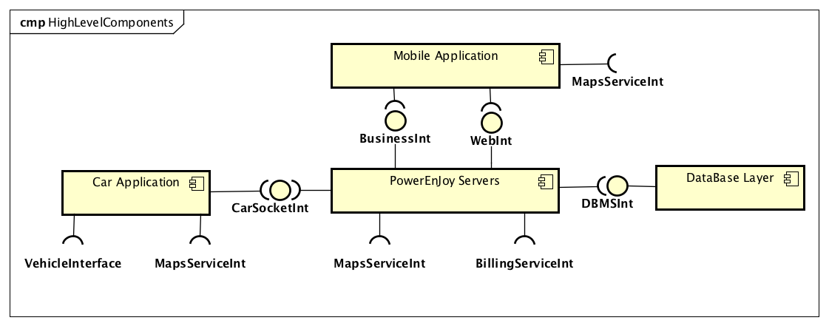
HIGH LEVEL COMPONENTS && INTERACTIONS

Slide 3
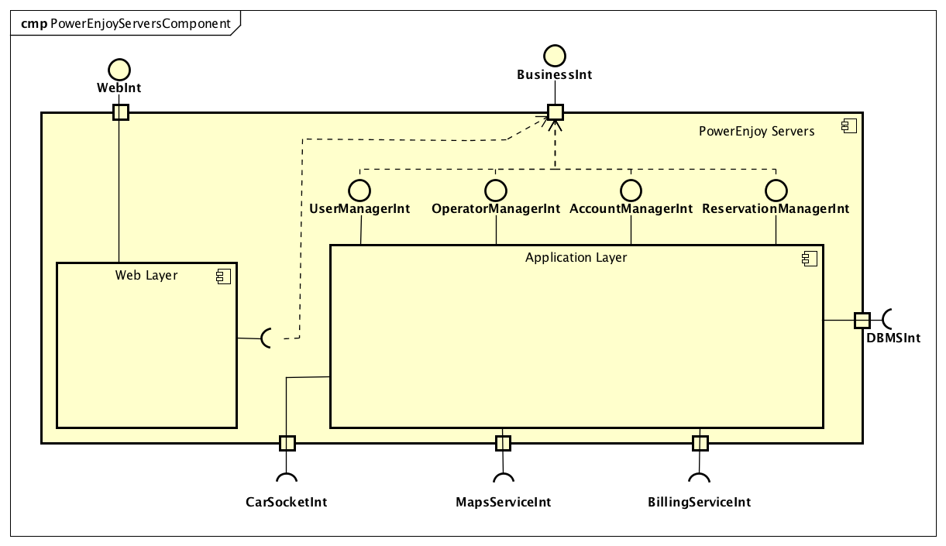
APPLICATION LAYER && WEB LAYER

Slide 4
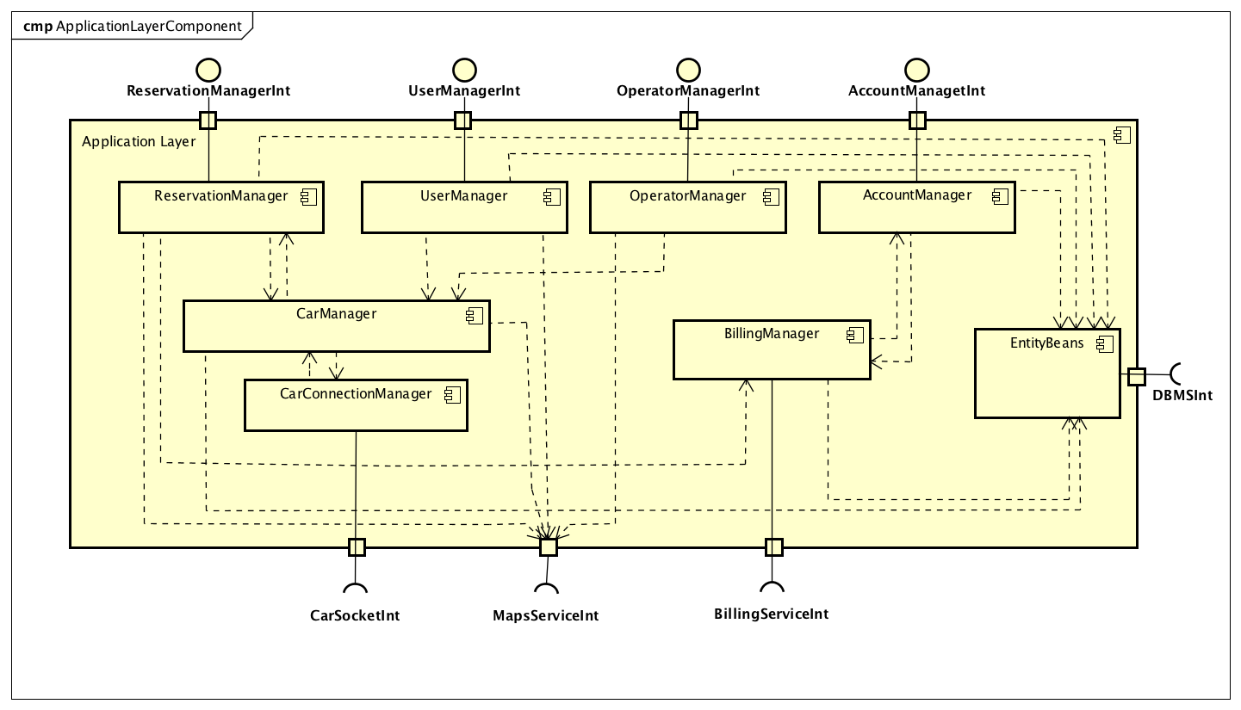
APPLICATION LAYER

Slide 5
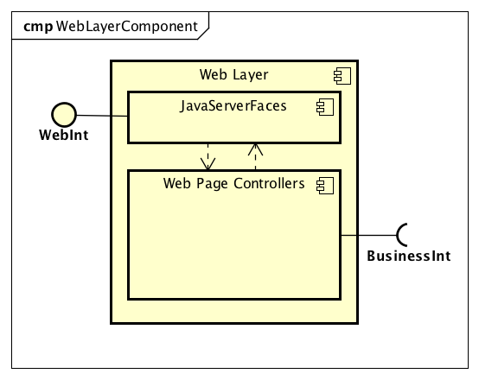
WEB LAYER

Slide 6
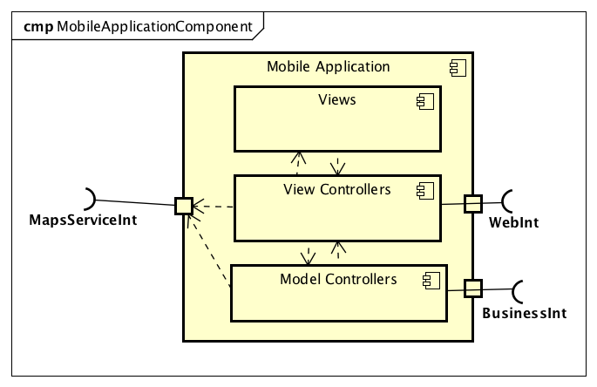
MOBILE APPLICATION: USERS && OPERATORS

Slide 7
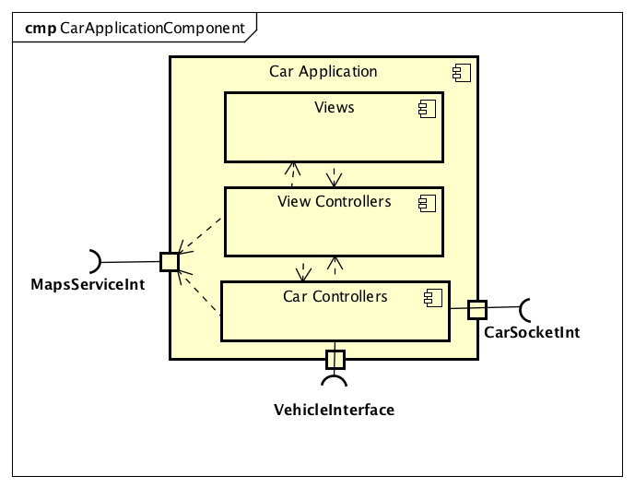
CAR APPLICATION

Slide 8
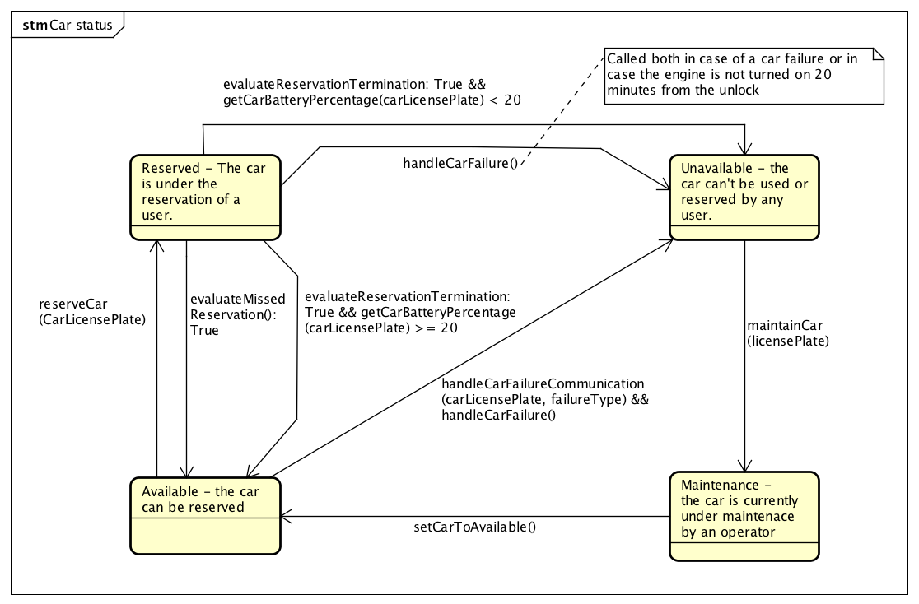
RUNTIME VIEW: STATECHART

Slide 9
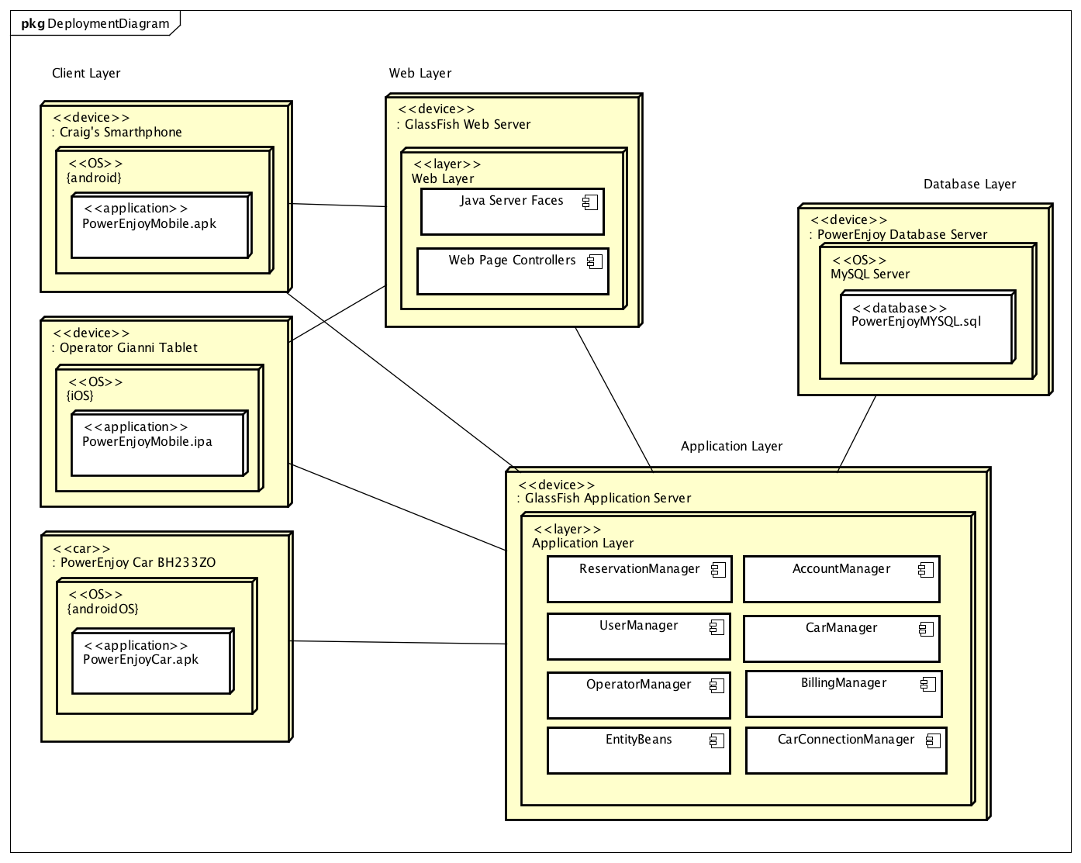
DEPLOYMENT VIEW

Slide 10
ARCHITECTURAL DESIGN && DESIGN PATTERNS
ARCHITECTURAL DESIGN
Client/Server
4-Tier Architecture
REST, “API First” Architecture
Active Server (Server Push)
DESIGN PATTERNS
MVC
Publisher/Subscriber

Slide 11
QUESTIONS?

