Slide 1

POWER ENJOY
SE2 PROJECT BY:
Stefano Brandoli, Silvia Calcaterra, Samuele Conti

Slide 2
RASD SUMMARY

Slide 3
GOALS and SUBGOALS
[G1] ALLOW USERS TO FIND AVAILABLE CARS AND RESERVE THEM
[G1.1] Allow users to access the system
[G1.2] Allow users to find available cars
[G1.3] Allow users to reserve available cars
[G2] ALLOW USERS TO USE THE RESERVED CARS IN THE CITY AREA
[G2.1] Manage the user reservation
[G2.2] Handle unexpected car situations and user behavior
[G3] GUARANTEE A UNIFORM DISTRIBUTION OF THE CARS IN THE CITY
[G4] INCENTIVIZE USERS TO USE PROPERLY THE RESERVED CARS
[G4.1] Reward the users that ease the experience of other users
[G4.2] Penalize the users that ruin the experience of other users
Money Saving Option

Slide 4
DESIGN DOCUMENT

Slide 5
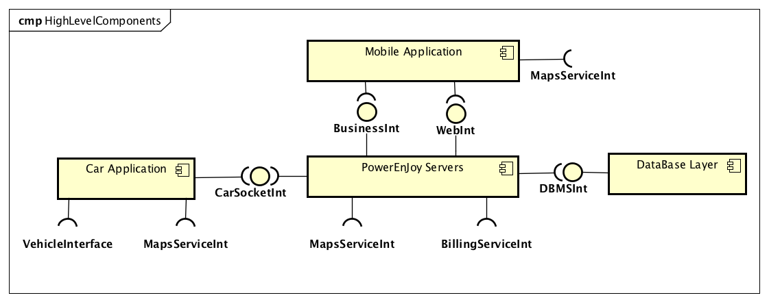
TIERS, MAIN COMPONENTS, BOUNDARIES
Refinement of the RASD System Boundaries
Vehicle Interface Car Interfacing
Maps Service Int Google Maps functionalities
Billing Service Int Stripe for billing management
DBMS Int JPA abstracting the DBMS connection
Not Fully Layered:
but interaction with Cars is CRITICAL in our business

Slide 6
DESIGN and PATTERNS meet TECHNOLOGY
Architecture mainly based on JEE 7
THIN CLIENT/FAT SERVER
4-TIER ARCHITECTURE
ACTIVE SERVER (SERVER PUSH)
API FIRST ARCHITECTURE
Avoid platform desynchronization
Device support flexibility
Maintenance
MVC
Scalability
Extendability: future web browser
High decoupling between tiers
Bidirectionality
HTTP Polling inefficiency
WebSocket technology
Publisher/Subscriber
Mobile devices first
RESTful technology: JAX-RS
Easier API extension
JSON: few assumptions about the receiver

Slide 7
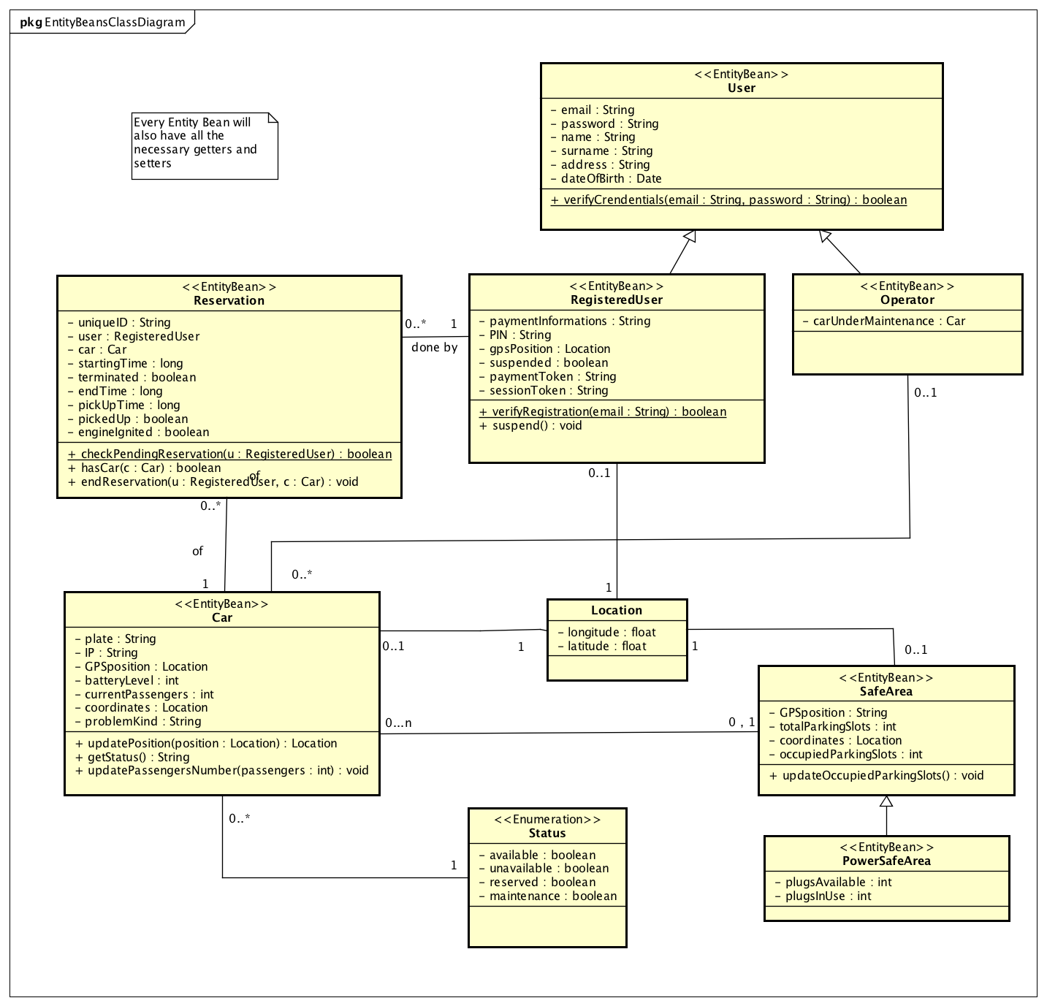
ENTITY BEANS
O/R MAPPING
Handled by JPA
JDBC is “under the hood”
SECURITY
No payment information plainly stored in the DBMS
STRIPE Payment Token

Slide 8
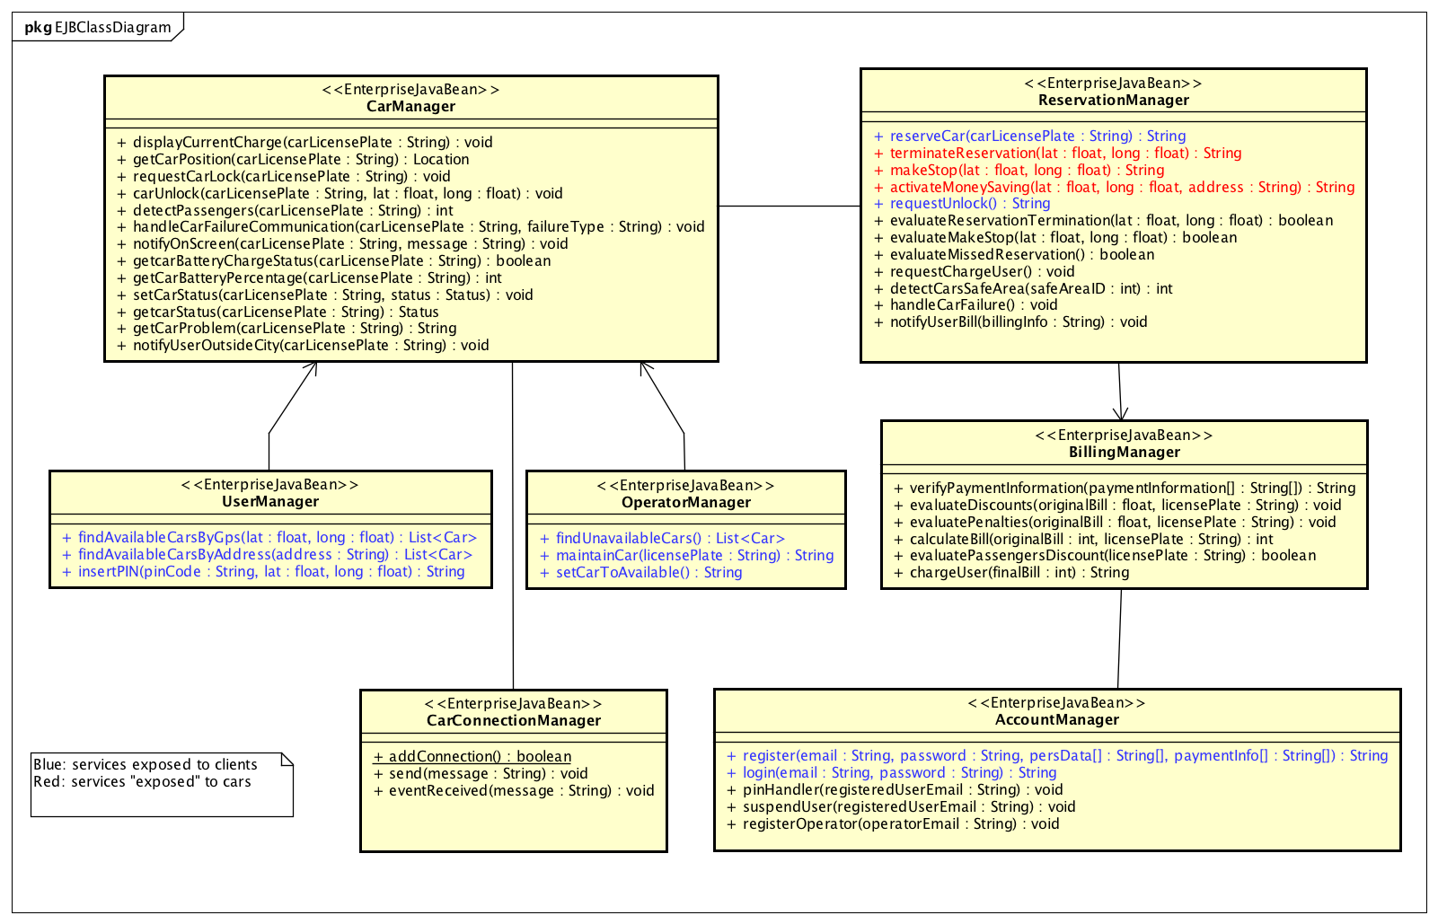
ENTERPRISE JAVA BEANS
GENERAL PRINCIPLES
High coesion, loose coupling
Stateless EJB
RESTful principles
MAIN SUB-COMPONENTS
Account Manager
User Manager
Operator Manager
Reservation Manager
Billing Manager
Car Manager
Car Connection Manager
Exposed API is detaily described in the DD

Slide 9
INTEGRATION TEST PLAN DOCUMENT

Slide 10
INTEGRATION STRATEGIES
Integrate the units belonging to the same subsystem
Integrate the subsystems
BOTTOM-UP APPROACH
Start the integration of the most independent units, in order to limit the number of stubs/mocks
Follow more closely the development process
CRITICAL MODULES APPROACH
First concentrate on the integration of the riskiest units
Discover sooner eventual critical “bad behaviours” that can compromise the fulfillment of the goals

Slide 11
INTEGRATION: APPLICATION LAYER

Slide 12
TOOLS AND TEST EQUIPMENT
SOFTWARE TOOLS
They will be used to automate part of the testing:
jUnit test the integration of components
Arquillan check the integration between components and containers
Mockito create stubs and drivers useful for testing
JMeter test the performance and non functional requirements
DRIVERS
Car Application driver
Application Layer driver
Front End driver
STUBS
Network stub
Vehicle Interface stub
We will also need:
Testing Database
Activate the testing mode for the STRIPE account
Android and iOS devices

Slide 13
PROJECT PLAN

Slide 14
SIZE ESTIMATION
Following the COCOMO II approach, we’ve identified these User Function Types
EXTERNAL INPUTS
User Registration
User Login
Unlock Reserved Car
Request Car Reservation
Terminate Car Reservation
Make a Stop
Enable Money Saving
Request Car Maintenance
Change Car Status
Determine complexity levels
Assign complexity weights
Calculate UFPs
Relate UFPs to SLOC
EXTERNAL OUTPUTS
Send commands to a PowerEnjoy car
Send payment notification
EXTERNAL INQUIRIES
Find available cars by GPS position or address
Find unavailable cars
INTERNAL LOGICAL FILES
User
Registered User
Operator
Reservation
Car Status
Safe Area
Power Safe Area
EXTERNAL INTERFACE FILES
Maps Service: Google Maps
BillingService: Stripe
Vehicle Interface
UFP = 196
SLOC = 46 x UFP = 9016

Slide 15
COST AND EFFORT ESTIMATION: COCOMO II
POST-ARCHITECTURE analysis
We estimated cost and effort using the Scale Drivers and the Cost Drivers
Precedentness (PREC) | Low | 4.96
Development flexibility (FLEX) | Nominal | 3.04
…
SF |  | 15.05
RELY | Required Software Reliability | High | 1.10
DATA | Database size | Nominal | 1
…
Total | EAF |  | 1.613
Effort = A × EAF × (KSLOC)^{E}
49 person-months
Duration = C x (PM)^{F}
13 months

Slide 16
TASKS AND SCHEDULES
By generally following a standard
WATERFALL SCHEMA
Deliver the RASD
Deliver the DD
Deliver the ITPD
Deliver the PP
Implementation + unit tests
Integration testing
Deployment
Task | Starting Date | End Date
RASD | 16/10/2016 | 13/11/2016
DD | 14/11/2016 | 11/12/2016
ITPD | 12/12/2016 | 15/01/2017
PP | 16/01/2017 | 22/01/2017
Development | 23/01/2017 | 16/10/2017
Deployment | 17/10/2017 | 16/11/2017
As evaluated using the COCOMO II model
The project will last 13 months
Starting from October 2016, finishing in November 2017

Slide 17
RISK MANAGEMENT
PROJECT RISKS
Schedule Delays
Underestimated development time
Requirements change
Problems among team members
Staff illness
BUSINESS RISKS
Car provider bankrupt
Budget
Legislation change
System acceptance
No acceptance by city administration
No acceptance by potential customers
Competitors
TECHNICAL RISKS
Scalability issues
Loss of data
Integration failure
Issues with external services
Technical death

Slide 18
CODE INSPECTION

Slide 19
APACHE OFBIZ
We had to perform the code inspection of some classes from the Apache OFBiz source code.
These were the classes assigned us:
CmsEvents
A class used to setup a website whose content can be managed using the OFBiz built-in features of the Content Management Application (front-end user interface)
CommonWorkers
A class contained inside the framework component set of the system: it is a sort of utility class used by different classes in the entity package

Slide 20
APACHE OFBIZ ARCHITECTURE SCHEMA
CmsEvents applications/content/cms
CommonWorkers framework/common

Slide 21
CMS EVENTS
JavaDoc completely missing
STARTING POINT: an XML snippet!!!
SYNTACTIC ISSUES
Some variables and methods names are not meaningful or don’t follow naming conventions
Some indentations missing
Some curly braces missing in conditional statements
Some file organization issues, in particular regarding line lengths and line breaks
Minor issues with variables initialization and declaration
OO ISSUES
The main method of the class is very long
Some methods have too many parameters
Strings copy pasted -> no constants defined

Slide 22
COMMON WORKERS
JavaDoc almost missing
STARTING POINT: directly see the code
MAIN ISSUES
Some issues regarding line lengths and breaks
Some issues regarding the lack of useful comments
Some issues in the position of declarations inside the code
Lack of significant actions taken for some catch blocks

Slide 23
QUESTIONS?

