Slide 1
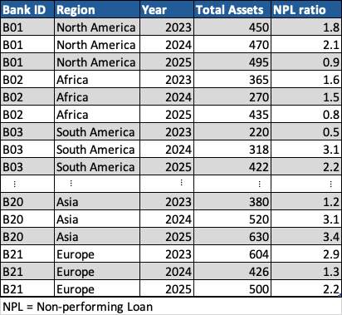
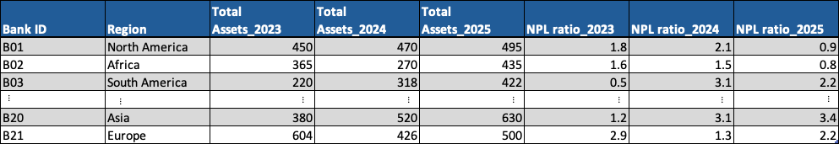
What Does Panel Dataset Look Like?
Long Format
Note: The long and wide formats contain the same information. The difference lies only in how the data are organised. Most statistical software for panel data analysis use the long format.
Wide Format

