Slide 1
Uplift
AI-Powered Student Success Assistant
Early warning, similar past students and supportive action plans for Open University module teams: hybrid RAG, a multi-agent workflow, calibrated prediction models and LLM-as-judge evaluation.
Capstone project · Education domain · Open University Learning Analytics Dataset (OULAD)
Nishanth
Notes:
Uplift is an AI student-success assistant for Open University module teams. It finds students who may withdraw or fail while there is still time, shows what happened to similar students before, and drafts a supportive plan that an advisor reviews.

Slide 2
PROBLEM STATEMENT
Advisors cannot read thousands of records in time
Students who disengage or fall behind are found too late, and dashboards say who, not why or what to do.
• Module teams hold rich data: profiles, assessment results, daily online activity, registration history, outcomes.
• Reviewing it by hand is slow and inconsistent; warning signs are spread across tables and weeks.
• By the time a student formally withdraws, it is too late to help: 75% of withdrawals in the test presentation happened before week 15.
• Teams need early, explainable, prioritised and supportive guidance, with evidence.
Q1
Has a student with similar patterns struggled or withdrawn before?
Hybrid RAG over historical cases
Q2
What factors are associated with poor performance or withdrawal?
Explainable models and insights
Q3
Which students should be prioritised for support?
Capacity-aware ranking and agent plans
Uplift · Student Success Assistant
2
Notes:
Advisors have thousands of records and little time. The brief asks three questions: have similar students struggled before, which factors are behind poor outcomes, and who should be supported first.

Slide 3
BUSINESS NEED
Reach the right students early, with reasons
Capacity is limited, so the top of the list must be right, and every recommendation must be defensible.
25,204
11.3%
98%
50%
students still enrolled at week 15 (all modules)
of them will still withdraw: the students an early warning can help
of students contacted from the top 10% later fail or withdraw (random: 34%)
of withdrawals are in the High tier, which flags 24% of students
Early: warnings from week 5, not after the student has gone
Explainable: drivers per student and what happened to similar students
Capacity-aware: a ranked list for the time advisors actually have
Supportive and safe: never punitive, no sensitive attributes, human review
Measurable: every model and AI output evaluated, cost tracked
Uplift · Student Success Assistant
3
Notes:
Early contact is what changes outcomes, but capacity is limited: if an advisor can call 10% of a cohort, the list must be right at the top. Advisors also need reasons they can defend and supportive messages.

Slide 4
SOLUTION OVERVIEW
One console, six capabilities, as of a course week
Built at weeks 5, 9, 15, 22; only students still enrolled are scored. The LLM narrates, code decides facts.
01
02
03
Early warning
Who to contact first
Similar students (RAG)
Calibrated withdrawal risk, tier, TreeSHAP drivers and outcome probabilities
Ranking learned for advisor capacity, with the reasons for each student
Hybrid search over past cohorts by student or plain English, with metadata filters
04
05
06
Support plan (agents)
Copilot
Insights and evaluation
LangGraph agents: performance, risk, intervention, critic; outreach draft
Questions answered by tool calls over the same computed functions, streamed and checked
Factors, trends, fairness; DeepEval, RAGAS, judge; approved updates
Uplift · Student Success Assistant
4
Notes:
Early warning with reasons, a ranked contact list, similar historical students, a multi-agent support plan with an outreach draft, a copilot, and evaluation with a feedback loop.

Slide 5
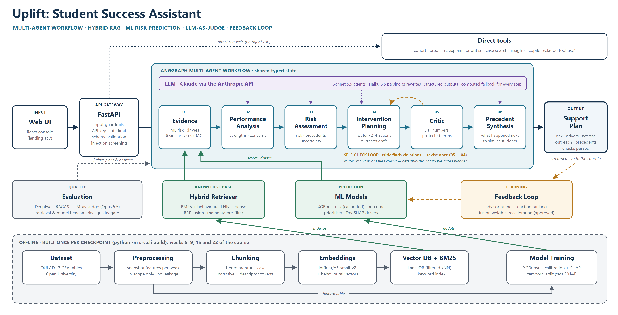
ARCHITECTURE
Offline build per checkpoint, online agents behind FastAPI
Uplift · Student Success Assistant
5
Notes:
Bottom: dataset, preprocessing, one document per enrolment, embeddings, LanceDB plus BM25, model training. Middle: React console, FastAPI with input guardrails, the LangGraph workflow. Claude drafts text; code decides facts; every step has a computed fallback. Evaluation and the feedback loop alongside.

Slide 6
DATA FLOW
From seven OULAD tables to a checked support plan
Only data dated before the checkpoint is used, and only students still enrolled are scored.
OFFLINE · python -m src.cli build
Dataset
Preprocess
Chunk
Embed
Index
Train
7 CSV tables
snapshot features, in scope
1 enrolment = 1 case
e5-small-v2 + behavioural
LanceDB + BM25
XGBoost, calibrate, SHAP
ONLINE · draft a support plan for one student
Console
Validate
Score
Retrieve
Agents
Plan
POST /api/jobs/analyze
schema, scope, auth
risk, outcome, drivers
6 cases + outcome mix of 50
LangGraph, critic, fallback
streamed, labelled, feedback
The leakage rule
Scoring every enrolment, including students who had already left, gives ROC-AUC 0.749. Scoring only students still enrolled gives 0.726: lower, but it is the number an advisor actually gets. `date_unregistration` defines scope only; it is never a feature.
Uplift · Student Success Assistant
6
Notes:
OULAD becomes snapshot features at each checkpoint. Scoring students who already left would inflate ROC-AUC to 0.749 instead of 0.726.

Slide 7
TECHNOLOGY STACK
Each choice was measured or justified against an alternative
Layer | Choice | Why
LLM | Claude: claude-haiku-5-5 · claude-sonnet-5-5 · claude-opus-5-5 (judge) | Measured per task: small model parses as well; main model writes most faithfully; different judge
Embeddings | intfloat/e5-small-v2 | Best of five models on precedent quality at MiniLM latency
Vector DB | LanceDB (embedded) | No server; metadata pre-filter; exact kNN; parity with brute force
Agents | LangGraph state graph | Explicit router, critic and revision; parity with plain Python
Prediction | XGBoost + calibration + TreeSHAP | ROC-AUC 0.726 vs 0.703 logistic; exact explanations
Retrieval | BM25 + behavioural kNN + dense, RRF | Numbers need numeric similarity; text needs keywords and meaning
API | FastAPI + Uvicorn, pydantic | Typed validation, OpenAPI docs, streaming, background jobs
UI | React 19 + TypeScript (Vite) | Beyond Streamlit: URLs, virtual tables, streaming; served by FastAPI
Evaluation | DeepEval · RAGAS · LLM judge · pytest | Each layer catches a different failure
Uplift · Student Success Assistant
7
Notes:
Claude in three tiers by measured need; e5-small-v2 won a five-model comparison; LanceDB embedded with filters pushed into the search; LangGraph for the agent graph; XGBoost with TreeSHAP; FastAPI and React.

Slide 8
AGENT WORKFLOW
Agents on a shared state; code checks every draft
Agents cite numbered evidence; the critic rejects unknown IDs, ineligible actions, ungrounded numbers and unsafe words.
Evidence
Performance
Risk
Router
Intervention
Critic
Synthesis
scores · drivers
6 similar cases
strengths, concerns
risk, precedents,
uncertainty
intervene or
monitor (rule)
2-4 eligible actions
outreach draft
IDs, numbers,
terms (code)
what happened
next (RAG)
violations → revise once, else fallback
Purple = Claude drafts (structured JSON output)
Grey = code only, deterministic
Green = ML models and hybrid retriever
Every LLM step has a computed fallback: the workflow runs with the LLM switched off.
monitor / failed checks → deterministic planner
100%
plans pass every guardrail
96%
judge pass rate (claude-opus-5-5)
Uplift · Student Success Assistant
8
Notes:
Performance and risk agents, a router, the intervention agent choosing 2 to 4 eligible actions and drafting the message, a critic in code, one revision, then a deterministic fallback. Precedent synthesis afterwards.

Slide 9
HYBRID RAG
Three channels, fused with RRF, filtered in LanceDB
Earlier presentations only, never the student's own rows; one document per enrolment; numbers banded, not embedded.
Behavioural kNN
snapshot features weighted by the model's attributions
RRF
fusion
BM25 keywords
descriptor tokens: missed_most, engagement_declining ...
Dense (e5-small-v2)
narratives for plain-English search
• Metadata filters: course, region, education, age band, credits, previous attempts, outcome
• Plain English understood as filters + behaviours (Claude Haiku, rule fallback)
• Context: 6 closest stories; outcome mix of the 50 nearest
Do the retrieved students' real outcomes predict this student's? 600 test students vs earlier cohorts (not circular).
0.862
precision@10, plain-English case search (AI parser)
Uplift · Student Success Assistant
9
Notes:
Behavioural vectors weighted by what predicts outcomes, BM25 over descriptor tokens, e5 dense embeddings of narratives; weighted reciprocal rank fusion; filters pushed into LanceDB.

Slide 10
PREDICTION MODELS
Calibrated risk that holds on a later, untouched cohort
Trained on 2013B + 2013J, tuned on 2014B, tested once on 2014J.
0.726
0.009
ROC-AUC at week 15 (95% CI 0.708 to 0.740)
calibration error: a 20% risk means about 20%
0.703
0.263
logistic regression baseline
PR-AUC vs base rate 0.113
Tier | Share of students | Observed withdrawal rate | Share of withdrawals
High | 24% | 23.6% | 50%
Medium | 28% | 11.7% | 29%
Low | 48% | 4.9% | 21%
Outcome model macro-F1 0.485 (logistic 0.460); P(fail or withdraw) ROC-AUC 0.852. Ranking precision at 10%: 98%.
Uplift · Student Success Assistant
10
Notes:
ROC-AUC on a later presentation, calibrated, the High tier catches half the withdrawals; accuracy rises through the course while fewer students remain to help.

Slide 11
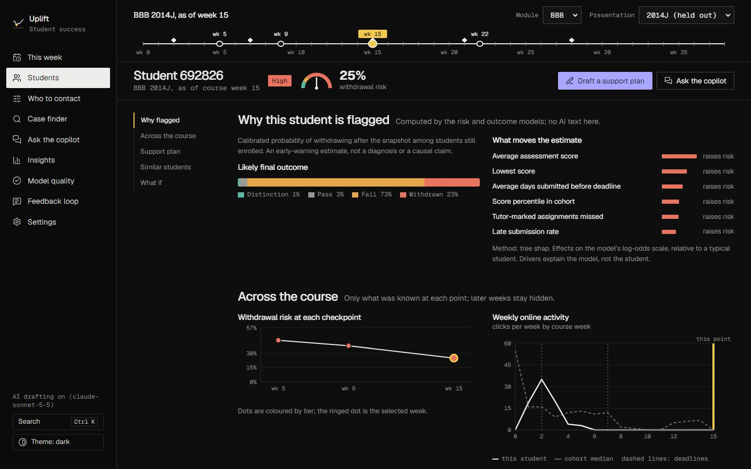
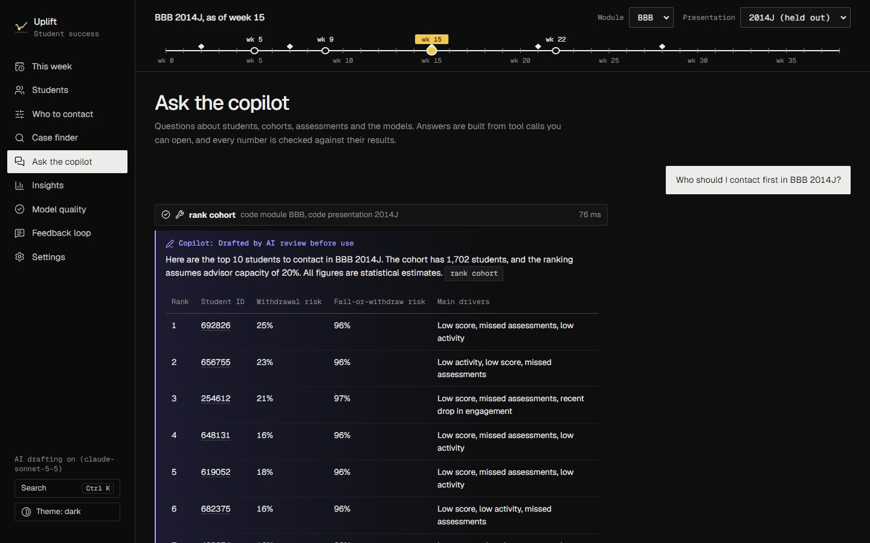
DEMO
Live: week, student, support plan, case search, copilot
Student case file: why flagged, risk across the course, support plan
Copilot: tool calls, streamed answer, every number checked
1. uvicorn src.main:app --reload → http://127.0.0.1:8000
2. This week: course clock, week 5 → 15, who to reach first
3. Student: drivers, risk trail, Draft a support plan (agent steps), rewrite as SMS
4. Case finder: plain-English search
5. Copilot: 'Who should I contact first in BBB 2014J?'
Uplift · Student Success Assistant
11
Notes:
Follow the demo script in docs/Presentation_Guide: This week, student case file and support plan, case finder, copilot, model quality.

Slide 12
EVALUATION RESULTS
Five layers of evaluation, each catching what the others miss
AI evaluation: generators claude-sonnet-5-5 / claude-haiku-5-5; judge claude-opus-5-5; release gate passed.
Layer | Measure | Result
1 Code checks | plans passing every guardrail | 100%
2 LLM-as-judge | judge pass rate · AI plan preferred (order-swapped A/B) | 96% · 89%
3 DeepEval | faithfulness · answer relevancy · actionable (pass rate) | 100% · 100% · 75%
4 RAGAS | faithfulness of precedent synthesis (hallucination rate) | 0.964 (3.6%)
5 Copilot | golden questions correct · adversarial prompts handled safely | 100% · 88%
Retrieval | neighbour-vote AUC hybrid vs random | 0.835 vs 0.512
Tests | pytest suite: no network, no LLM | 139 tests
DeepEval mean scores (0 to 1)
Uplift · Student Success Assistant
12
Notes:
Code checks on every output; LLM-as-judge with an order-swapped A/B; DeepEval; RAGAS; human review and tests.

Slide 13
RESPONSIBLE AI
Supportive by design, checked in code, fair by audit
Input guardrails
Output guardrails
Human in the loop
API key and admin key
Rate limit, request-size limit
Strict schemas and vocabularies
Prompt-injection screening
IDs must exist, numbers must be in the evidence
Only eligible, supportive actions
No protected, punitive, clinical or stigma terms
Revise once, else computed fallback
AI text labelled; advisor edits every message
Never for grading, admissions or sanctions
Feedback changes nothing until approved
• Sensitive attributes (gender, region, deprivation, age, education, disability) are never model inputs and never sent to the LLM; adding them would change ROC-AUC by only 0.002.
• Fairness audit: each group gap is tested against the gap random labels would give at the same group sizes (permutation test, overall and within module).
• Region and deprivation gaps are within chance. The disability gap (0.23) is real and reported, with a per-group threshold review for the equity office, not applied automatically.
Uplift · Student Success Assistant
13
Notes:
Sensitive attributes never model inputs and never sent to the LLM; every output checked for protected, punitive and clinical wording; fairness gaps tested against chance and reported.

Slide 14
CHALLENGES AND LEARNINGS
What was hard, and what changed because of it
Challenge | What we did | Learning
Inflated accuracy (0.90 AUC) from scoring students who had left | Score in-scope students only; temporal split | Evaluate the decision the user actually faces
Numbers in text made keyword and dense search random | Band numbers into descriptors; numeric similarity in its own channel | Hybrid retrieval must match the data type
LLM drafts invented numbers and IDs | Evidence IDs, code checks, one revision, fallback | Let the LLM narrate and select; code decides facts
Self-grading and position bias | Different judge model, computed verdict, order-swapped A/B, human review | Evaluate the evaluator
Validation gains that did not hold on test | Rejected the feature set instead of tuning on test | Keep the test set untouched
RAGAS dependencies broke the pinned service | RAGAS in its own environment | Isolate evaluation tooling
Uplift · Student Success Assistant
14
Notes:
Honest evaluation first; numbers do not belong in text embeddings; LLM narrates, code decides; reject improvements that do not hold on the test set.

Slide 15
Thank you
Questions, or a live look at any part of Uplift.
Run it: uvicorn src.main:app --reload → http://127.0.0.1:8000
Architecture_Diagram.pdf · Design_Document.pdf · API_Documentation.pdf · Evaluation_Report.pdf · Dataset_Details.pdf
API reference live at /api/docs · model card: docs/MODEL_CARD.md
Notes:
Invite questions; offer to show any part live.

