Slide 1
AI-powered Student Success Assistant
Early warning, comparable historical cases and supportive action plans for advisors
OULAD · 32,593 enrolments · evidence profile: official · quality gate passed
Notes:
Ten-minute walkthrough: the problem, how the system works, honest evidence, and how it stays safe and improves.

Slide 2
The question an advisor actually has
At ~40% of the course, which students who are still enrolled are likely to fail or withdraw?
Why — in terms an advisor can act on?
Have students with similar patterns struggled before?
What supportive, non-punitive action should we take, and who first given limited capacity?
25,204
7,389
students still enrolled at the snapshot (in scope)
had already unregistered — excluded
11.3%
35%
of in-scope students later withdraw (test)
later fail or withdraw
Notes:
Frame the problem around the advisor at week 15: who still enrolled needs help, why, and what to do.

Slide 3
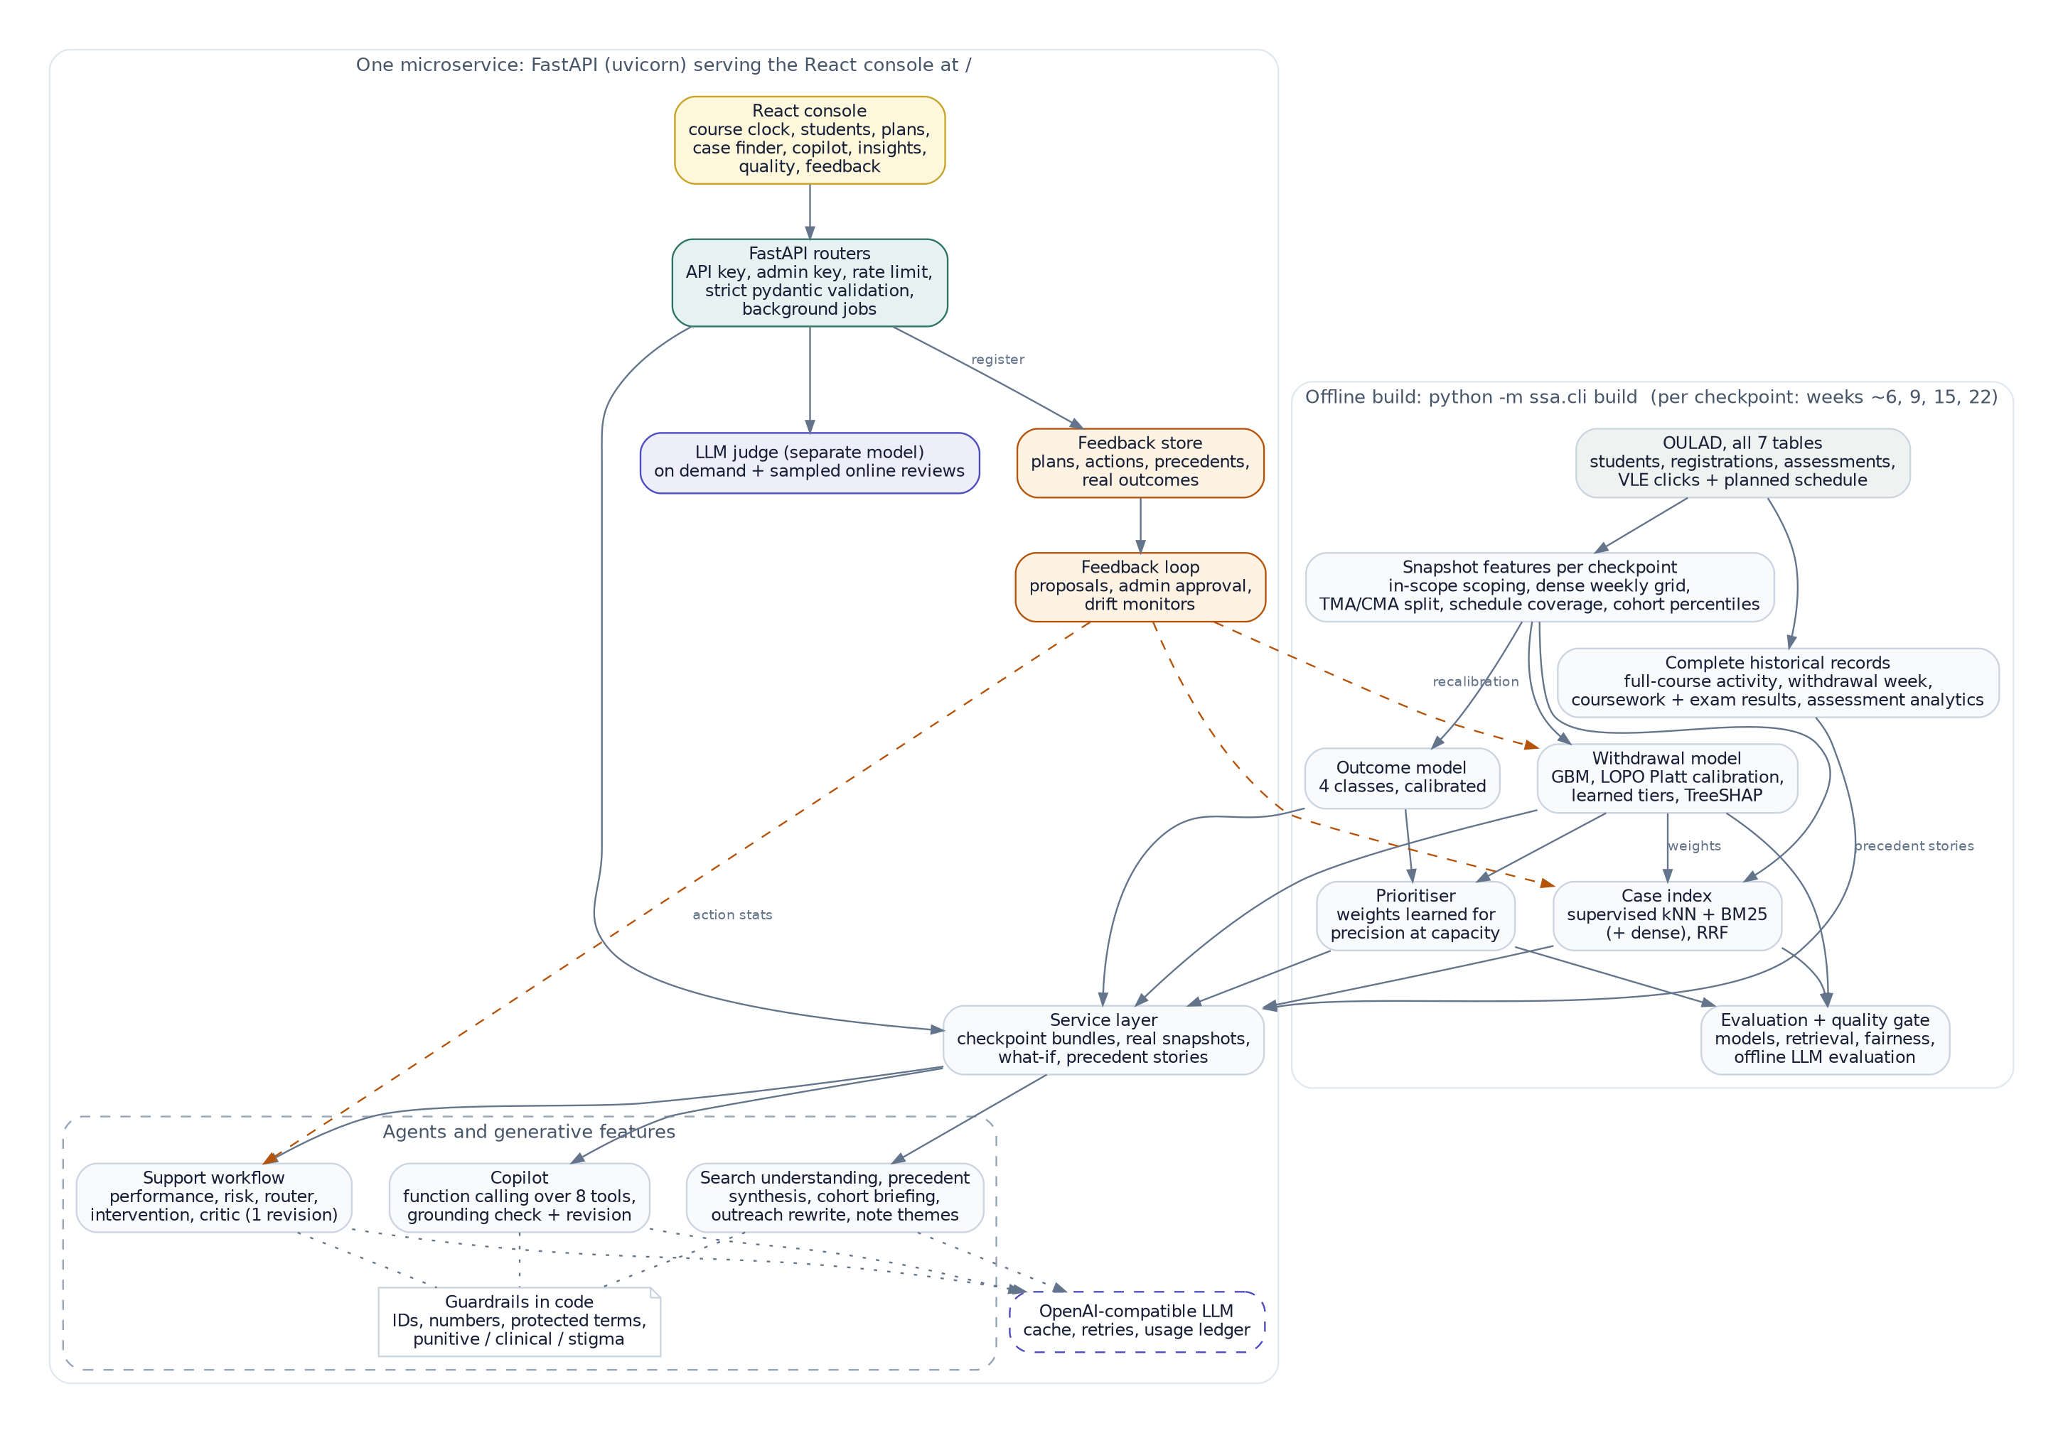
Architecture
Offline build: features → calibrated models → prioritiser → historical-case index → evaluation and quality gate.
Online: API (auth, rate limit, strict validation) → service (real snapshots, what-if with imputation flags) → agent workflow.
LLM is optional and narrates only; facts, scores, priorities and eligible actions are computed in code.
Feedback store and loop (amber) feed approved changes back into actions, retrieval weights and calibration.
Notes:
Offline build produces calibrated models, the case index and evaluation; the online API serves lookups, scores, retrieval and the agent workflow; feedback closes the loop with human approval.

Slide 4
Honest evaluation: removing the leakage
75% of test-presentation withdrawals had already happened by the snapshot.
Temporal protocol: train on earlier presentations, calibrate out-of-fold by presentation, test once on the latest.
Missing scores stay missing; zero-activity weeks count; peer-relative percentiles make modules comparable.
Sensitive attributes are excluded from the model — the ablation shows they add essentially nothing.
Notes:
v4 trained and tested on students who had already left, so silence in the logs 'predicted' withdrawal. We score only students still enrolled, on a later, untouched presentation.

Slide 5
Withdrawal risk: calibrated and useful at advisor capacity
0.726
0.009
ROC-AUC (95% CI 0.708–0.740); logistic baseline 0.703
calibration error (ECE)
2.6×
44%
lift when contacting the top 10%
of eventual withdrawals reached at 20% capacity
Notes:
Explain ROC-AUC with CI, the logistic baseline, calibration, and that tiers really separate risk.

Slide 6
How early can we tell?
Later points see more evidence but fewer students remain to help.
Week 6: 27,157 still enrolled; week 22: 23,926.
The console's course clock switches every view between these points.
Notes:
Separate calibrated models at four points in the course; each is tested on the later, untouched presentation using only what was known at that point.

Slide 7
What is associated with failing or withdrawing
Engagement trends
Week at which eventual withdrawers fall below 60% of passers' activity:
AAA: week 22
BBB: week 9
CCC: week 5
DDD: week 5
EEE: week 6
FFF: week 8
GGG: week 6
Notes:
Factor analysis on historical in-scope students; associations not causes. TreeSHAP gives per-student drivers.

Slide 8
Similar historical students — retrieval that beats chance
Metadata filters: module, presentation, region, education, age band, credits (range), previous attempts, outcome.
Each answer reports the outcome mix of the 50 nearest precedents with a 95% CI.
v4's index shipped with 2 test records and scored at random level.
Notes:
Behavioural kNN weighted by model attributions + BM25 over qualitative descriptors (+ optional dense). Only earlier presentations are searchable. Evaluated against real outcomes and a random baseline.

Slide 9
Who first? Prioritisation learned for limited capacity
Learned weights: p_withdraw 0.10, p_poor 0.75, academic_gap 0.05, engagement_gap 0.05, missed_work 0.05
Signals are cohort-relative so a click means the same in every module.
Every ranked student carries reason codes and top risk drivers.
Notes:
Weights chosen on the validation presentation to maximise precision at 10/20/30% capacity; compared on test.

Slide 10
Agents that cannot make things up
Performance → Risk → Router → Intervention ⇄ Critic, or Monitoring for low-risk students.
Facts are computed in code; the LLM only narrates and must cite observation IDs.
Critic checks: catalogue eligibility, numeric grounding, protected attributes, punitive or clinical language, and no risk scores in messages to students.
Sensitive attributes are never sent to the LLM; priorities come from calibrated models, not the LLM.
Copilot answers through 8 tools and must back every number with a tool result; search, precedent summaries, briefings and outreach rewrites follow the same checks.
Each AI feature has its own offline evaluation; LLM-as-Judge uses a separate model and verdicts are computed in code.
100%
of 24 golden-set plans pass every guardrail
96%
LLM-judge pass rate (python -m ssa.cli llm-eval)
Notes:
Agents select and narrate ID-tagged evidence; actions come from an eligibility-gated catalogue; the critic enforces guardrails in code with one revision, else a deterministic plan.

Slide 11
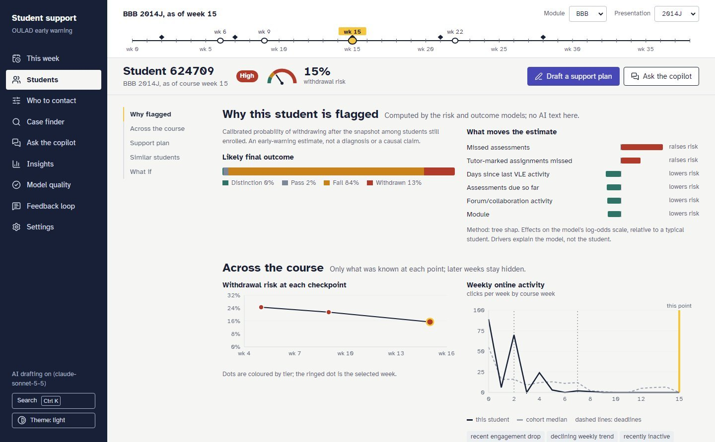
The advisor console
Course clock across the top: every view is as of one point in the course.
Computed facts in ink; AI-drafted text marked in indigo.
Copilot, case finder, insights, model quality and the feedback loop use the same API.
Notes:
React console served by the FastAPI service. Walk through: course clock, why flagged, risk across the course, live agent plan, outreach rewriting, precedents with what happened next, feedback.

Slide 12
Fairness and limits — stated, not hidden
Sensitive attributes are excluded from the model and from agent prompts, yet gaps persist through proxies and base-rate differences.
The quality gate warns above 0.15; deployment needs equity review.
One institution, 2013–14 data: revalidate before use elsewhere.
Notes:
Gaps remain via proxies; they are flagged by the gate and need institutional review.

Slide 13
Closing the loop
Advisors rate plans, individual actions and individual precedents, and later record real outcomes.
Learners re-rank actions (Beta-Binomial), re-learn retrieval fusion weights, and recalibrate risk when enough outcomes exist.
Changes are proposals until approved with --apply; drift monitors flag tier precision changes and retraining needs.
Everything in this deck is regenerated from artifacts: python -m ssa.cli report
Notes:
Feedback becomes versioned, human-approved changes; then re-evaluate.

