Slide 1

Notes:
Introduce Steam

Slide 2
Web Application Frameworks
Pros
eliminate repetitive tasks associated with creating web applications
reduce the amount of training required to add new developers
Cons
Easy-to-use frameworks are very restrictive
Very flexible frameworks are hard to use
Some try to do too much
Others do not do enough
they lead to inefficient applications
Notes:
Explain Frameworks

Slide 3
Project Goals
Facilitate the rapid development of PHP applications
Introduce the least number of restrictions to developers
Provide the flexibility to support complex, high-traffic web applications
Incorporate existing projects to reduce learning curve and increase reliability
Accomplish the goals with the least amount of new code
Using a minimalist approach
Notes:
Explain development strategy

Slide 4
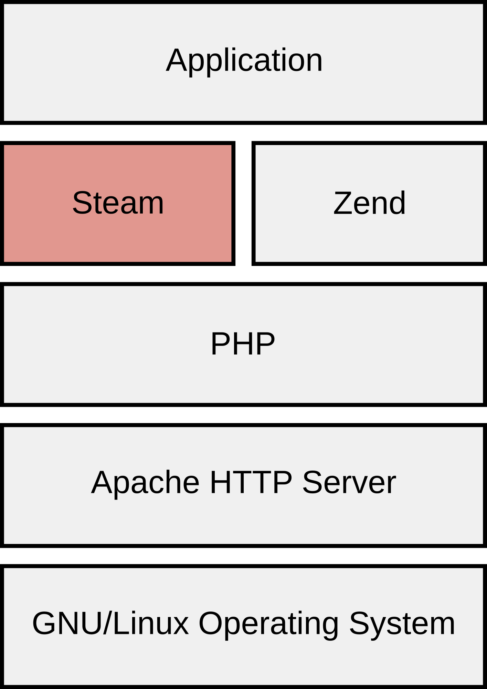
The Software Stack
Written in PHP 5.3 (namespaces)
Powered by the Zend Framework
Depends only on free software
Notes:
Explain server setup

Slide 5
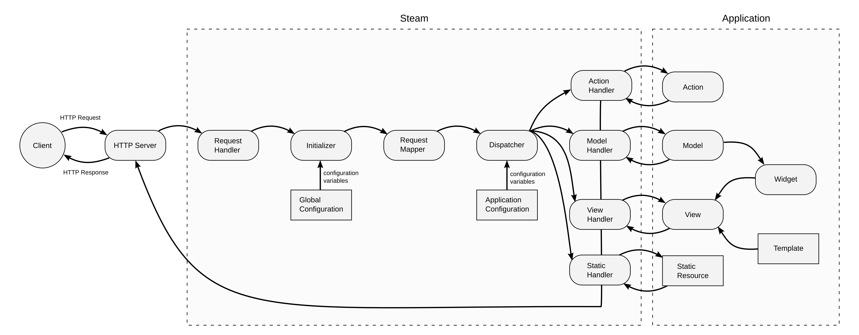
Operation Overview
Steam is initialized, making its features available to the application
The request is dispatched to an application resource based on URI routing rules
Notes:
Step through the system's operation

Slide 6
Model Interface
Native Methods
\Steam\Model::create(model, data)
\Steam\Model::retrieve(model, [data])
\Steam\Model::update(model, data)
\Steam\Model::delete(model, [data])
EXAMPLE
$books = \Steam\Model::retrieve("book")
foreach ($books as $book)
{
print $book->title;
}
Notes:
Step through the system's operation

Slide 7
Javascript Model Interface
Javascript Methods
Steam.create(model, data, callback)
Steam.retrieve(model, data, callback)
Steam.update(model, data, callback)
Steam.delete(model, data, callback)
EXAMPLE
Steam.create("book", {
title: “Of Mice and Men”,
author: “John Steinbeck”,
Year: 1937
}, function(request, status) {
if (status == "success") {
alert(“Book Created”)
} else {
alert(request.responseText)
}
}
)
Notes:
Step through the system's operation

Slide 8
RESTful API
Data Manipulation Methods (CRUD)
Create --->
Retrieve --->
Update --->
Delete --->
EXAMPLES
GET /data/user --->
POST /data/user --->
Corresponding HTTP Methods
POST
GET
PUT
DELETE
\Steam\Model::retrieve('user')
\Steam\Model::create('user')
Notes:
Step through the system's operation

Slide 9
Model XML
<?xml version="1.0" encoding="utf-8"?>
<data>
<status>200</status>
<error/>
<total_items>1</total_items>
<start_index>1</start_index>
<items>
<item>
<book_id>1</book_id>
<title>Of Mice and Men</title>
<author>John Steinbeck</author>
<year>1937</year>
</item>
</items>
</data>
<--- corresponds to HTTP status codes
Notes:
Step through the system's operation

Slide 10
Features
Improved error handling
converts PHP errors to exceptions, FireBug/FirePHP integration
Data caching with file or memory based backend
simple to use with automatic per application partitioning
Simple database server load balancing
transparent random server load balancing for future proofing
Simple component organization
clearly organized and named directories corresponding to various components
Uniform data manipulation interface
familiar interfaces for PHP, javascript (over HTTP), and command line
Automatic static resource management
caching, fingerprinting, combination, minification
Object oriented design
takes advantage of the latest PHP features including namespaces
Simple view creation system
leverages PHP's native templating capabilities
Notes:
Explain the features

Slide 11
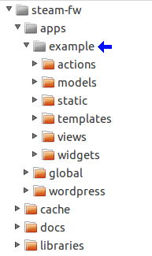
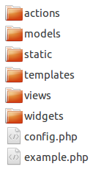
Getting Started
Step 1 – Create an Application Directory
directory contents:

Slide 12
Getting Started
Step 2 – Create the Application Class
<?php
class ExampleApplication extends \Steam\Application
{
public function __construct()
{
}
public function initialize()
{
}
}
?>

Slide 13
Getting Started
Step 3 – Create Portals
array(
'app' => 'example',
'domain' => '~^.*$~',
'path' => '~^/static/(.*)~',
'type' => 'static',
),
array(
'app' => 'example',
'domain' => '~^.*$~',
'path' => '~^.*~',
'type' => 'view',
),

Slide 14
Getting Started
Step 4 – Create a View
<html>
<head>
<title>Hello World!</title>
</head>
<body>
<p>Hello World!</p>
</body>
</html>

Slide 15
Extending Your Application
Models
class DataModel extends \Steam\Model
{
protected static function is_allowed($method, $item = NULL) {
return true;
}
protected static function _create(&$request, &$response) {
// code
}
protected static function _update(&$request, &$response) {
// code
}
protected static function _retrieve(&$request, &$response) {
// code
}
protected static function _delete(&$request, &$response) {
// code
}
}

Slide 16
Extending Your Application
Widgets
<?php
$book = \Steam\Model::retrieve('book?id=' . $_GET['id']);
$book = $book[0];
?>
<p>written by <?php print $book->author ?><br/>published in <?php print $book->publication_year ?></p>
<a href="<?php print \Steam::uri('/') ?>">back</a>

Slide 17
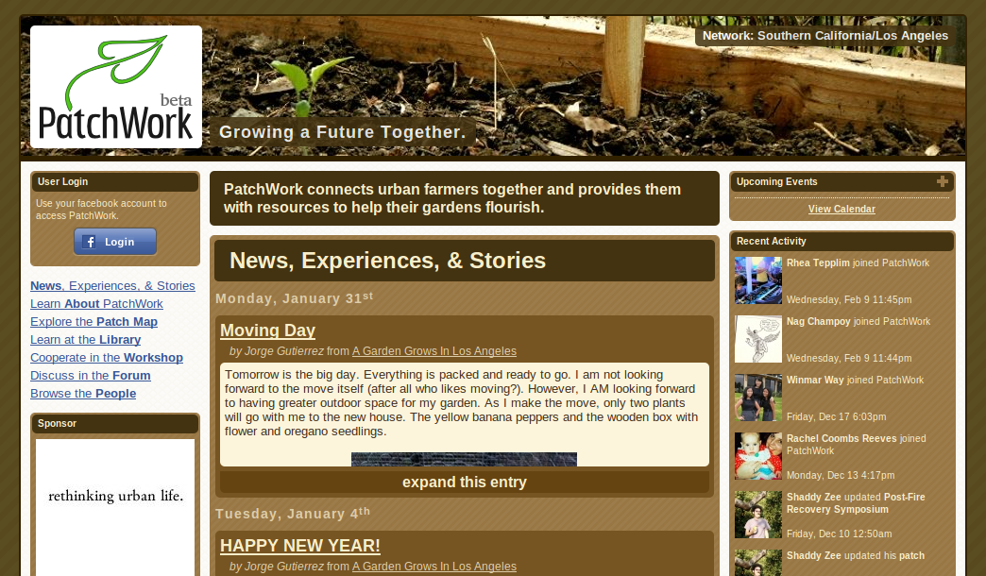
Steam in Action
http://patchwork.unityla.org

