Slide 1

A light-based device for solving the Hamiltonian path problem
Mihai Oltean
Babes-Bolyai University,
Cluj-Napoca, Romania
moltean@cs.ubbcluj.ro

Slide 2

Outline
Related work
Hamiltonian path problem
The light-based device
  Basic ideas
  Marking / labelling system
  Hardware implementation
  Complexity
  Drawbacks and possible solutions
  Improving the device
  Further work

Slide 3
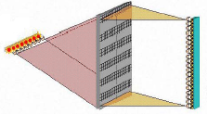
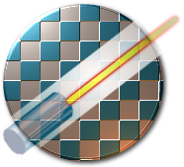

Other light-based devices
Lenslet
  A very fast processor for vector-matrix multiplications. This processor can perform up to 8000 Giga Multiple-Accumulate instructions per second.
Intel
  Siliconized photonics.
Rainbow sort
  Sorts wavelengths based on physical concepts of refraction and dispersion.

Slide 4
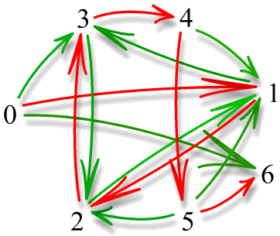
Hamiltonian path
HP =
0,
1,
2,
3,
4,
5,
6
We solve the YES / NO decision problem.

Slide 5


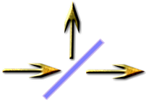
Useful properties of light
The speed of light has a limit.
The ray can be delayed by forcing it to pass through an optical fiber cable of a certain length.
The ray can be easily divided into multiple rays of smaller intensity/power.

Slide 6
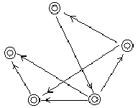

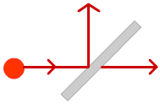

Basic ideas
The device has a graph-like structure. In each node we have some cables which delay the rays and the nodes are connected by cables.
Initially a light ray is sent to the start node.
Two operations must be performed when a ray passes through a node :
  The light ray is marked (labeled, delayed) uniquely so that we know that it has passed through that node.
  The ray is divided and sent to the nodes connected to the current node.
At the destination node we will search only for particular rays that have passed only once through each node.

Slide 7

Labelling system
! ! ! E S S E N T I A L S T E P ! ! !
We need a way to mark a ray when it pass through a node.
No other ray should be marked in the same way as the Hamiltonian one.
WE MARK THE RAYS BY DELAYING THEM.
  No other ray should arrive in the destination node in the same time with the ray which represents the Hamiltonian path !

Slide 8
Property of the delaying system
d₁, d₂, ..., d_{n} the delays introduced by each node.
A correct set of values for this system must satisfy the condition:
d₁ + d₂ + ... + d_{n} ≠ a₁ * d₁ + a₂ * d₂ + ... + a_{n} * d_{n},
where a_{k} (1 ≤ k ≤ n) are natural numbers and cannot be all 1 in the same time.
If a given value a_{k} is strictly greater than 1 it means that the ray has passed at least twice through node 1.

Slide 9
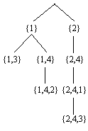


Theoretical background for the labeling system
3-step process:
  A backtracking procedure. We generate numbers such that the highest number in a system is the smallest possible.
  Extracting the general formula.
  Proving the correctness.

Slide 10
Backtracking procedure
Complete graph – the most interesting for our purpose because any path / cycle is possible.
N | Labels
1 | 1
2 | 2, 3
3 | 4, 6, 7
4 | 8, 12, 14, 15
5 | 16, 24, 28, 30, 31
6 | 32, 48, 56, 50, 62, 63

Slide 11
General formulas
Node 1: Delay = 2^{n}-2^{n-1},
Node 2: Delay = 2^{n}-2^{n-2},
Node 3: Delay = 2^{n}-2^{n-3},
... ,
Node n: Delay = 2^{n}-2⁰.

Slide 12
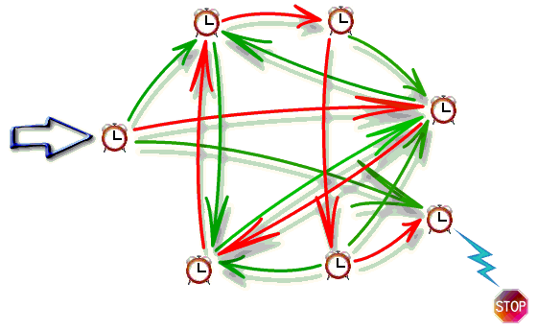
How the system works
We work with continuous signal. At the destination there will be fluctuations when a ray that has passed through a particular path will arrive there.

Slide 13
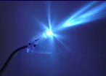
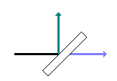

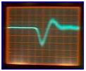

Hardware implementation
A source of light (laser),
Several beam-splitters for dividing light rays into multiple subrays.
A high speed photodiode for converting light rays into electrical power. The photodiode is placed in the destination node.
A tool for detecting fluctuations in the intensity of electric power generated by the photodiode (oscilloscope).
A set of optical fiber cables having certain lengths. Used for connecting nodes and for delaying the signals within nodes.

Slide 14
Complexity
O(n) complexity – n is the number of nodes.
The delay increases exponentially with the number of nodes !
  The length of the optical fibers, used for delaying the signals, increases exponentially with the number of nodes,
The intensity of the signal decreases exponentially with the number of nodes that are traversed.
Other paradigms for NP-complete problems: a DNA computer requires a mass equal to the Earth for solving a 200 cities problem.

Slide 15
Problem size
Heavily depends on:
  the response time of the photodiode.
  the accuracy of the measurement tools (picoseconds).
33 nodes requires 1 second.
  Cable length 3*10⁸ meters !
Cables of 300 km can be used to solve up to 17 nodes.
  Time = 10⁻⁶ seconds.

Slide 16
Drawbacks (and possible solutions)
Cannot compute the actual Hamiltonian path even in the case of YES answer.
  No solution to that (yet).
The intensity of the signal will decrease each time it is divided by the beam splitter. Exponential decrease in the intensity !
  Solution : use a photomultiplier which is able to amplify even from individual electrons.
Finding the optimal delaying system for a particular graph.
  might be NP-complete !

Slide 17
Improving the device
Light is too fast ! We have to use too long cables to delay it. We have to reduce it because we don’t have a too high precision oscilloscopes !
The speed of light traversing a cable is smaller (60%) than the speed of light in the void space.
Lab experiments have reduced the speed of light by 7 orders of magnitude. By using that speed we can reduce the length of the cables by a similar order.

Slide 18

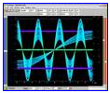
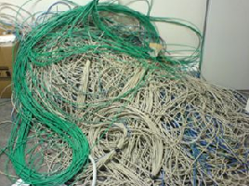
Technical challenges
Cutting the optic fibers to an exact length with high precision.
Finding a high precision oscilloscope and fast-response time photodiode.
Finding cables long enough so that larger instances of the problem could be solve.
  Use the internet cables (might be a problem with the correct length).

Slide 19
Further work
Implementing the proposed hardware,
Finding optimal labeling systems for particular graphs. This will reduce the length of the involved cables significantly,
Finding other non-trivial problems which can be solved by using the proposed device,
Finding other ways to introduce delays in the system. The current solution requires cables that are too long and too expensive,

Slide 20

More further work…
Using other type of signals instead of light. A possible candidate would be electric power,
Finding other ways to implement the system of marking the signals which pass through a particular node. The current one, based on delays, is too time consuming.
  Changing other properties of light: wavelength.

