Slide 1
Analysing Purkinje Cells Dynamics
19-04-2021
Stefano Bettani

Slide 2
Outline of the project
Project
The research was started by Hong Ying Gao, Christophe Poutzatf, Maria Spolidoro and Clément Léna
Objective
Characterize the activity of small groups of Purkinje cells in the cerebellar cortex
My job
Validate the already existing pipeline for analysing the data
Write reproducible code

Slide 3
1.
The Paradigm

Slide 4
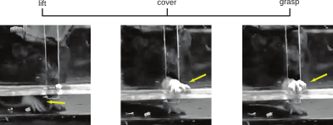
13 rats
1 to 4 tetrodes on paramedian cerebellar cortex
At least 2 clean cells for most sessions
~150 cells recorded in total
50Hz camera recordings

Slide 5
2.
Analyses

Slide 6
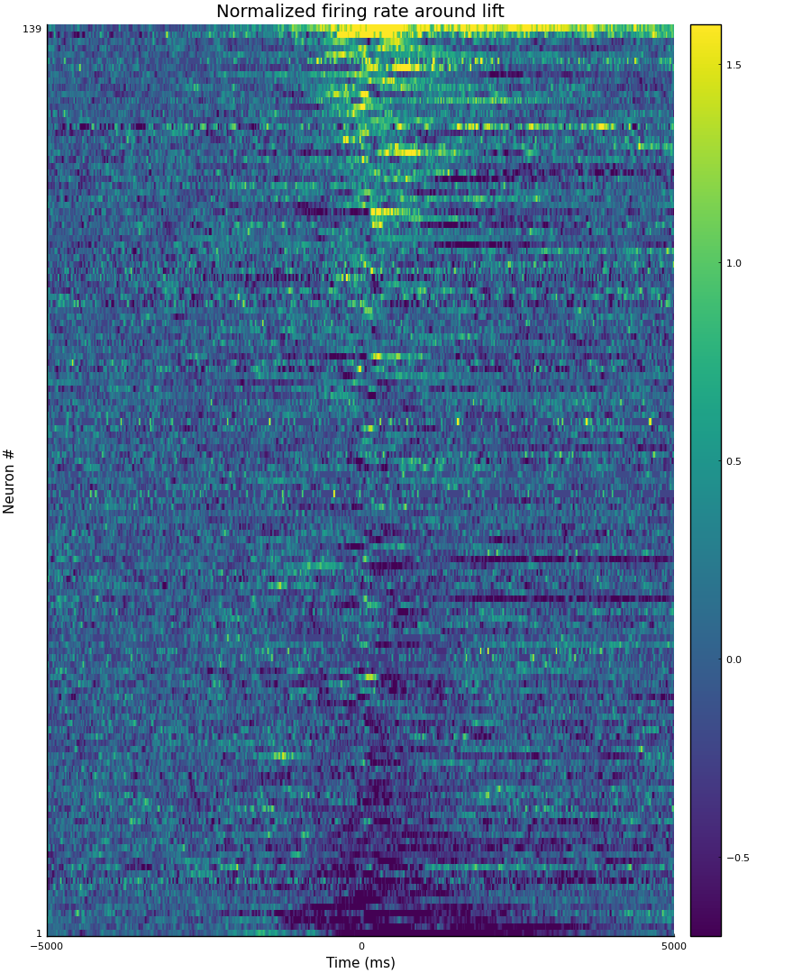
PSTH
Almost all neurons are modulated around at least one landmark
The PSTH doesn’t really show more than that
Namely making it possible to absorb large amounts of data quickly.
PSTH: Peri-Stimulus Time Histogram

Slide 7
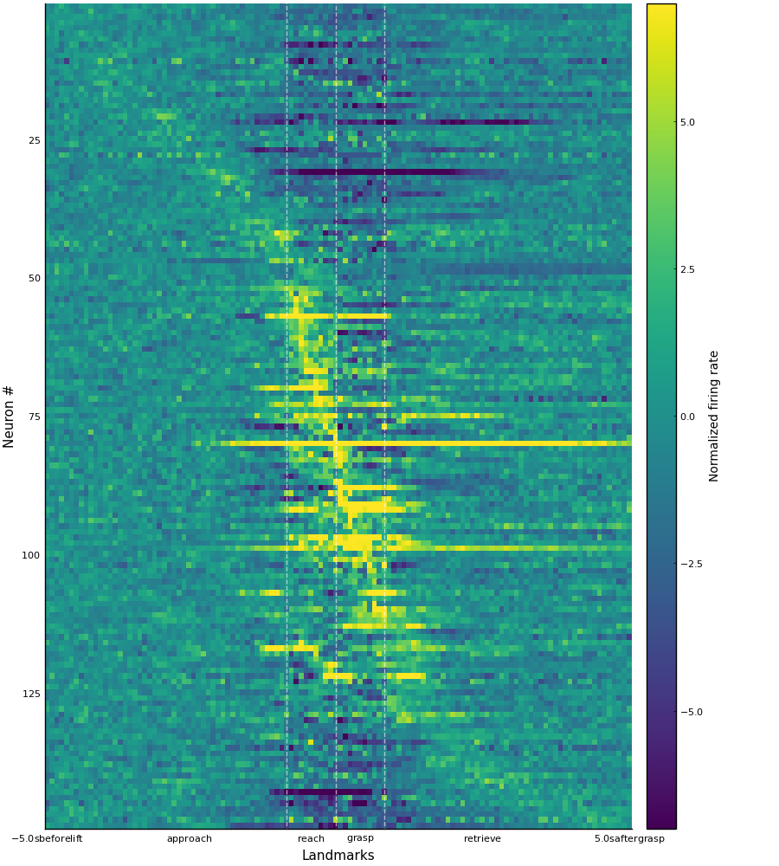
Multi-PSTH
Almost all neurons are modulated around at least one landmark
⅔ at all landmarks
⅓ at one or two landmarks
PSTH: Peri-Stimulus Time Histogram

Slide 8
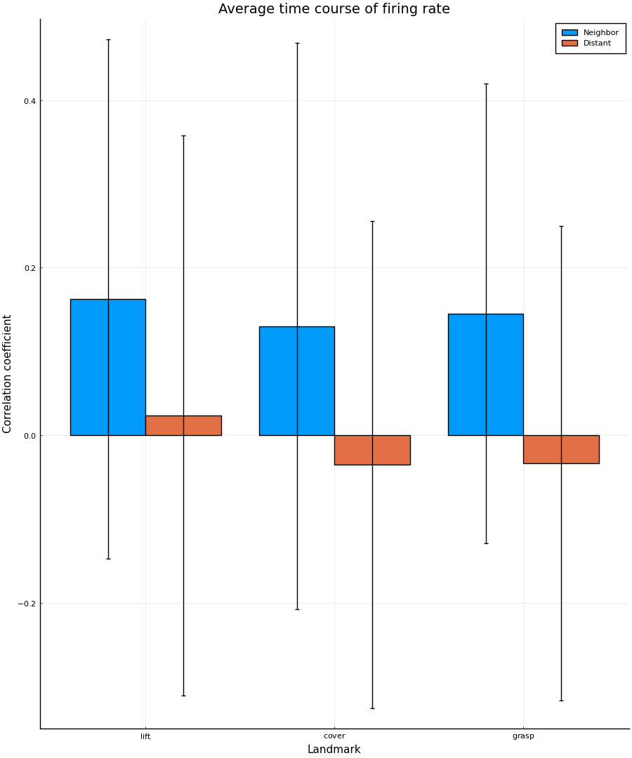
Correlations
Weak but significantly correlated time courses
Very high variability
Time precision lost
Discrimination between time lost
This does not indicate whether the timing of individual spikes is coordinated between cells.

Slide 9
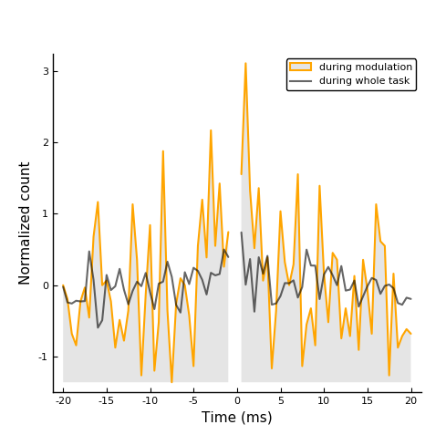
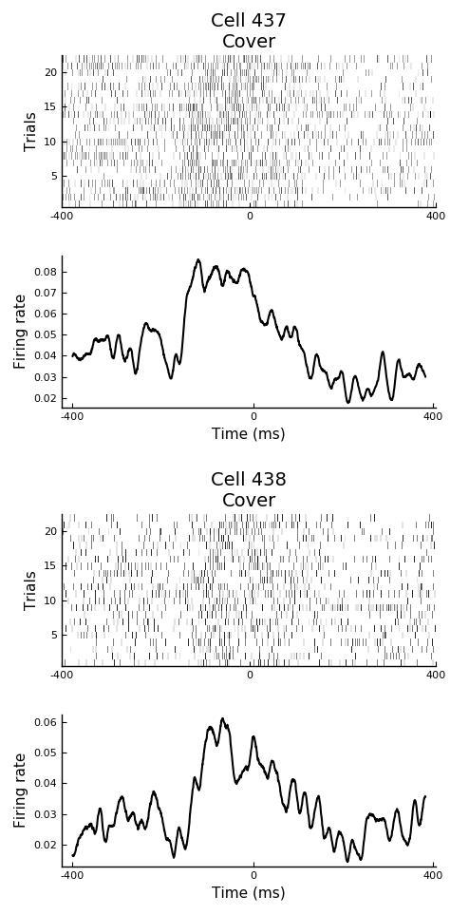
Cross-correlations
Narrow peak corresponding to an excess of ~20% of near-coincident spikes given:
Modulated firing rate

Slide 10
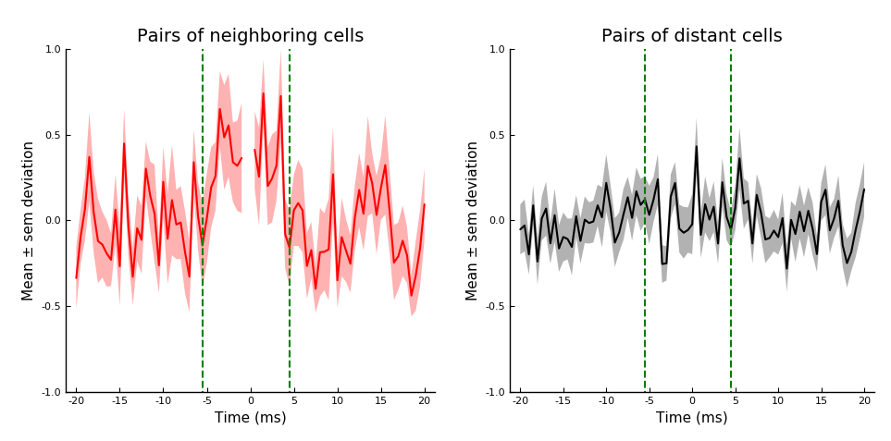
Cross-correlations
Narrow peak corresponding to an excess of ~20% of near-coincident spikes given:
Modulated firing rate
Cells are neighbors
Neighbors: cells recorded on the same tetrode
Sem: standard error of the mean

Slide 11
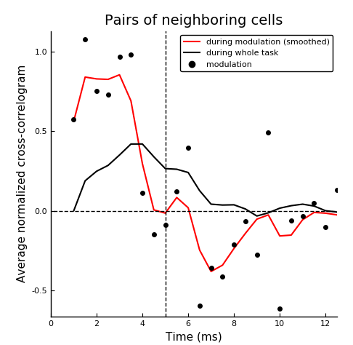
Cross-correlations
Narrow peak corresponding to an excess of ~20% of near-coincident spikes given:
Modulated firing rate
Cells are neighbors
Not significant otherwise
Neighbors: cells recorded on the same tetrode
Sem: standard error of the mean

Slide 12
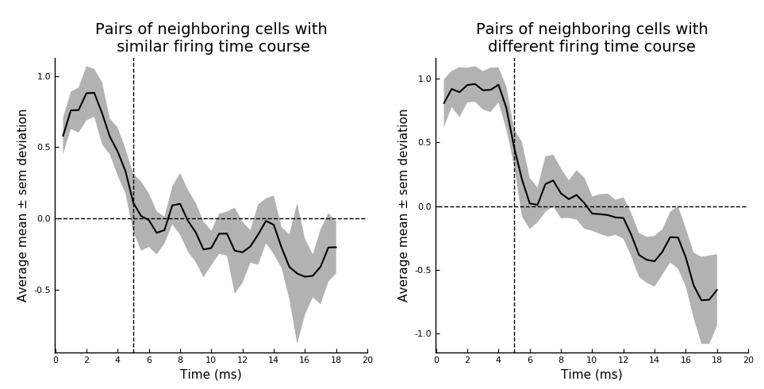
Cross-correlations
The presence short-timescale correlations doesn’t require high Pearson correlation

Slide 13
4.
Smoothing Splines

Slide 14
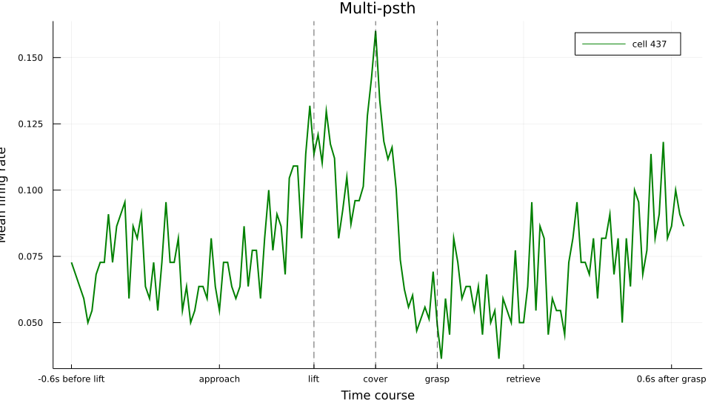
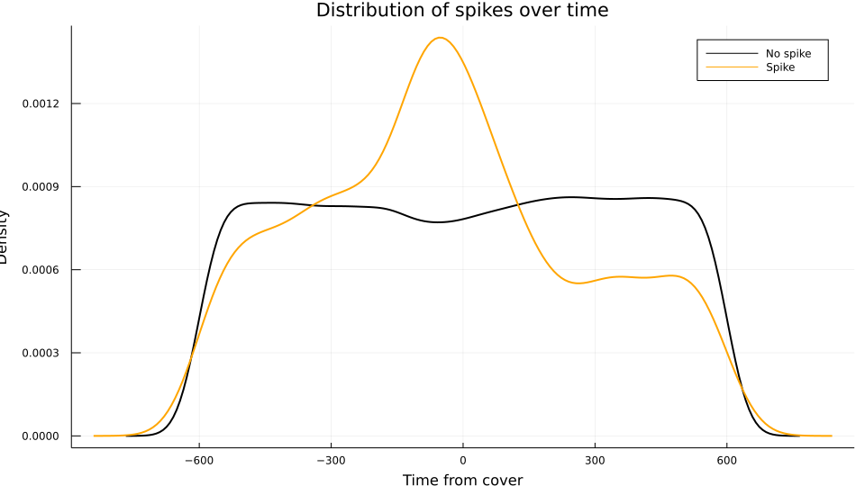
Significance of correlations
Let’s say we want to calculate the probability of a spike given the distance from ‘cover’
We can treat the spikes at each time as a binomial distribution

Slide 15
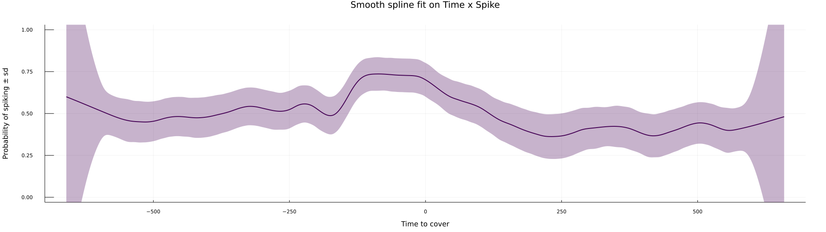
Significance of correlations
Smoothing splines use penalized likelihood to calculate the probability of firing at each point while forcing smoothness
We can also estimate Bayesian confidence intervals
But it’s very computationally expensive since it’s non-parametric

Slide 16
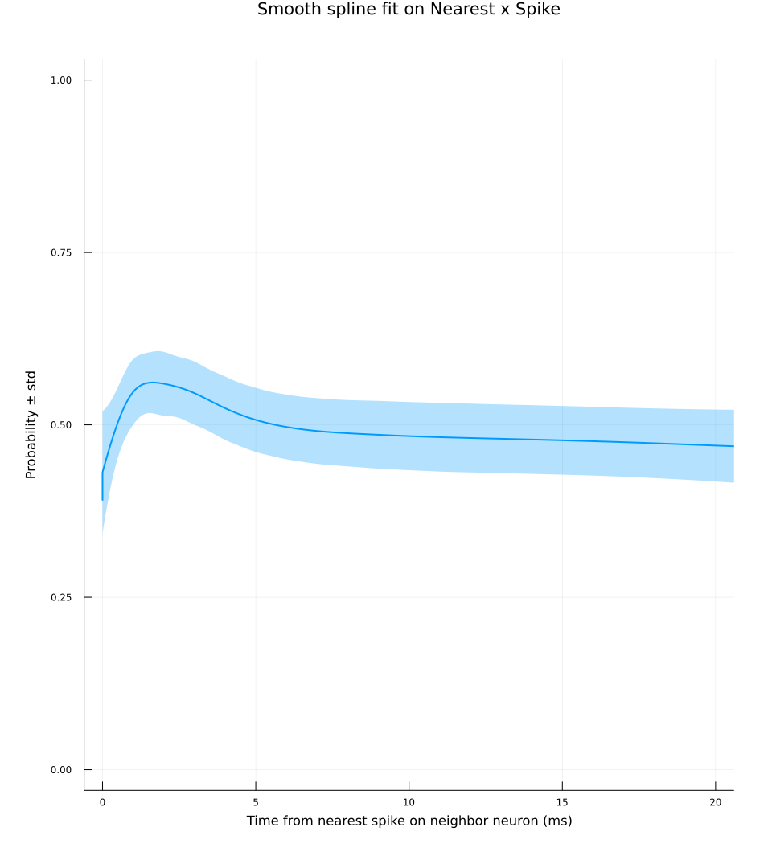
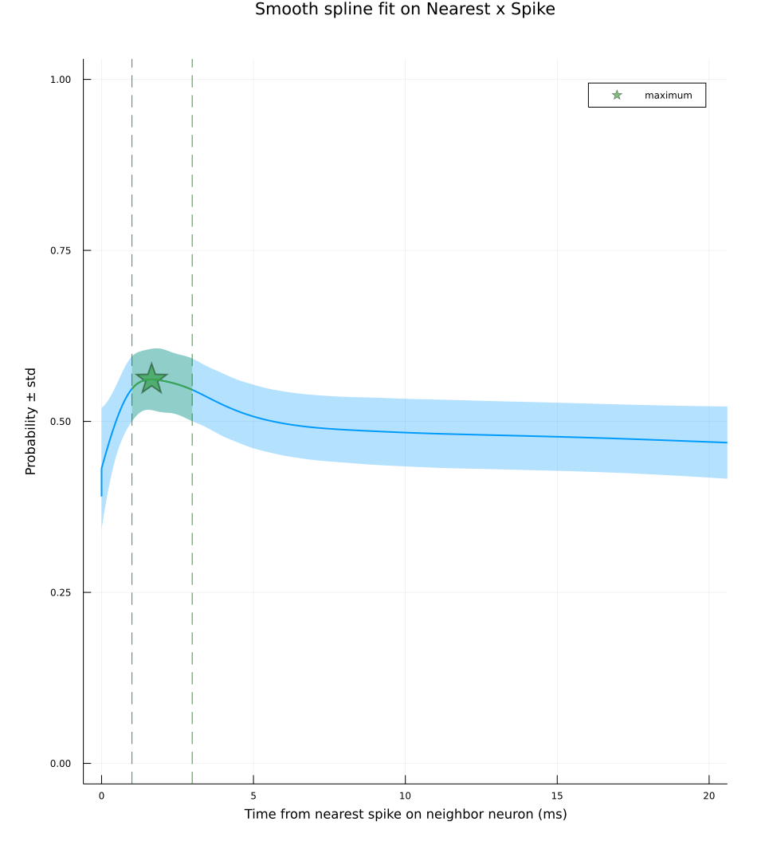
Significance of correlations
We can do the same thing using time from nearest spike on neighbor cell instead of time
We can do the same thing using time from nearest spike on neighbor cell
Then we can find the peak of probability and the range of significant positive interaction

Slide 17
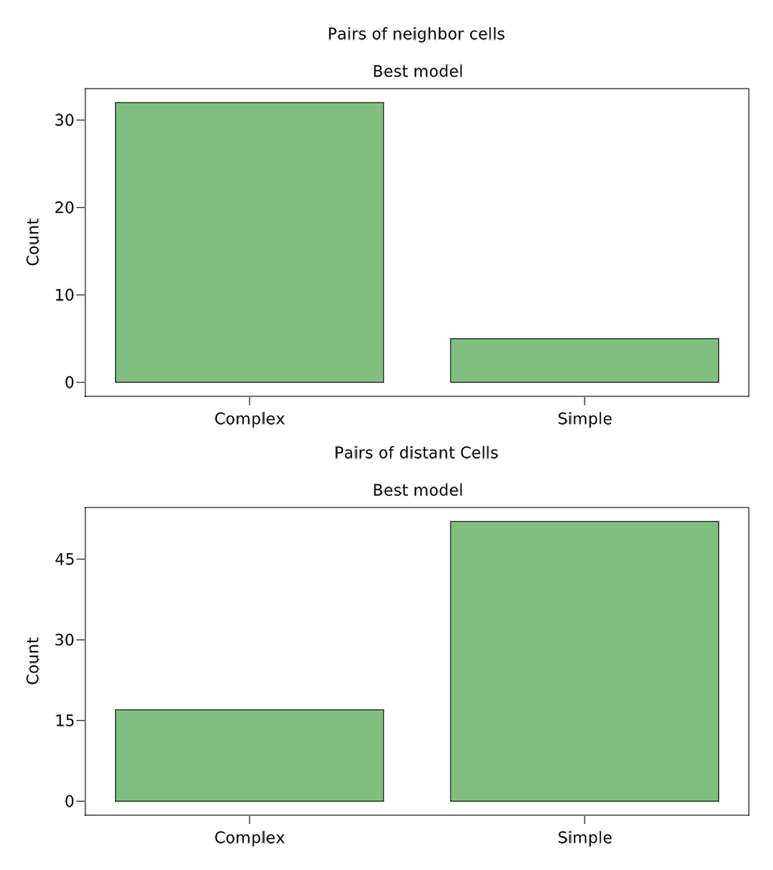
Significance of correlations
We fit all distant and neighbor couples of cells
We find the subset where the variable nearest significantly reduces prediction error
Distant: cells recorded on the same trial on different tetrodes
Nearest: time from nearest spike on coupled cell

Slide 18
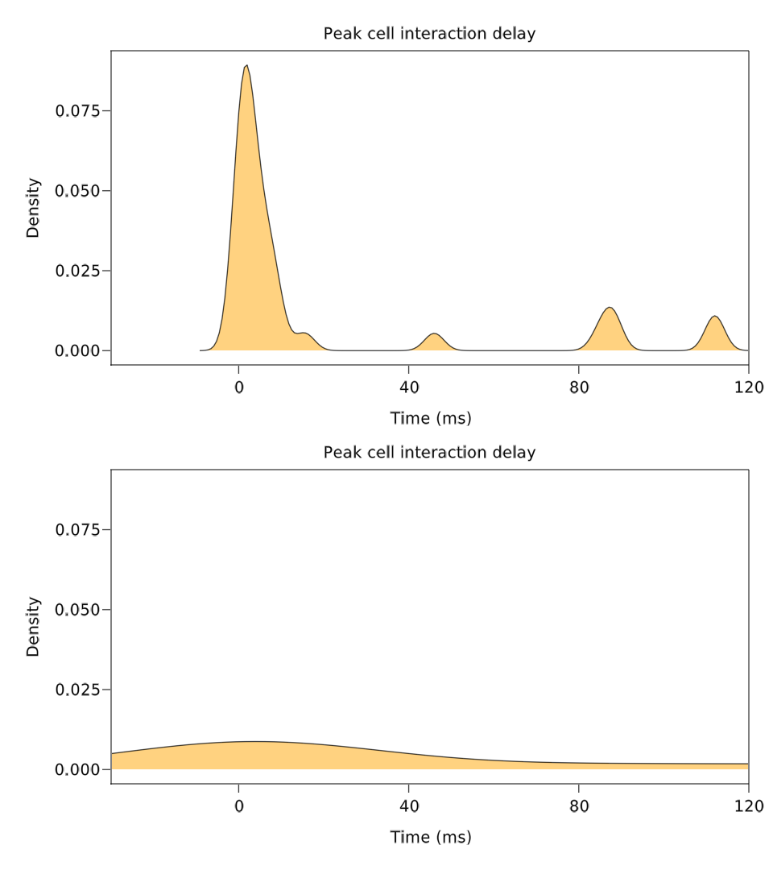
Significance of correlations
We fit all distant and neighbor couples of cells
We find the subset where the variable nearest significantly reduces prediction error
We find all peaks

Slide 19
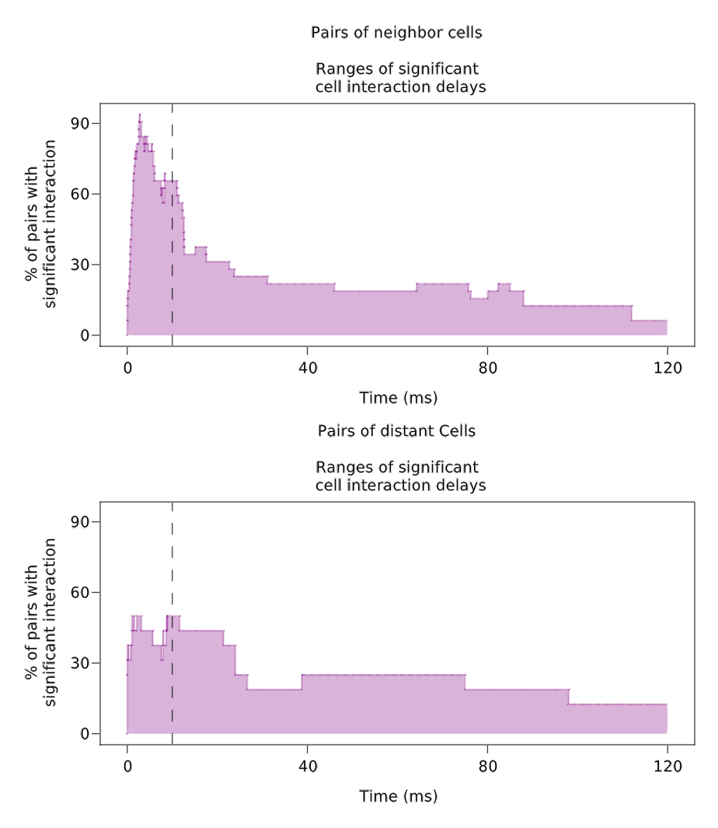
Significance of correlations
We fit all distant and neighbor couples of cells
We find the subset where the variable nearest significantly reduces prediction error
We find all peaks
And all ranges of significant interaction

Slide 20
The End
Thank you for the attention!

