Slide 1






Slide 2
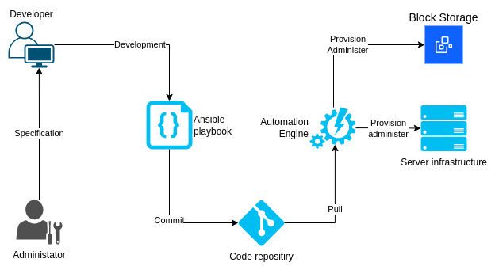
IaaC overview

Slide 3
Ansible summary
IaaC
Idempotent
Reusable
Vatiables
Templates
Roles
Ansible Galaxy (and other registries)
YAML based

Slide 4
IBM Modules for Ansible
List collections
~ ❯ ansible-galaxy collection list | grep ibm
ibm.qradar 4.0.0
ibm.spectrum_virtualize 2.0.0
ibm.storage_virtualize 2.6.0
Install collection
~ ❯ ansible-galaxy collection install ibm.power_aix
Starting galaxy collection install process
Process install dependency map
Starting collection install process
Downloading https://galaxy.ansible.com/api/v3/plugin/ansible/content/published/collections/artifacts/ibm-power_aix-2.0.3.tar.gz to /home/marcinek/.ansible/tmp/ansible-local-6696752grjkgd/tmpul9bih1e/ibm-power_aix-2.0.3-wz_xg604
Installing 'ibm.power_aix:2.0.3' to '/home/marcinek/.ansible/collections/ansible_collections/ibm/power_aix'
ibm.power_aix:2.0.3 was installed successfully
Use the force, read the docs!
https://galaxy.ansible.com/ui/repo/published/ibm/power_aix/
IBM Provides 45 modules and roles for its products.
https://galaxy.ansible.com/ui/namespaces/ibm/
Power and Stroage related:
ds8000
power_aix
power_hmc
power_vios
storage_virtualize

Slide 5
Sample playbook – FlashSystem/SVC
---
# Gather some information from IBM FlashSystem
- hosts: localhost # Task is executed on Ansible control host...
gather_facts: false # ... so no need to gather the facts
tasks:
- name: "Authenticate as {{ fs_user }} on {{ fs_cluster }}"
register: auth_info # auth_info.token - no need to re-authenticate on every task
ibm.storage_virtualize.ibm_svc_auth:
clustername: "{{ fs_cluster }}"
log_path: "{{ fs_log }}"
username: "{{ fs_user }}"
password: "{{ fs_pass }}"
- name: Gathering storage inforamation
register: svc_inf
ibm.storage_virtualize.ibm_svc_info:
clustername: "{{ fs_cluster }}"
log_path: "{{ fs_log }}"
token: "{{ auth_info.token }}"
gather_subset: system # Check the docs! Default `all` is a lot!
- name: Display discovered inforamation
debug:
var: svc_inf

Slide 6
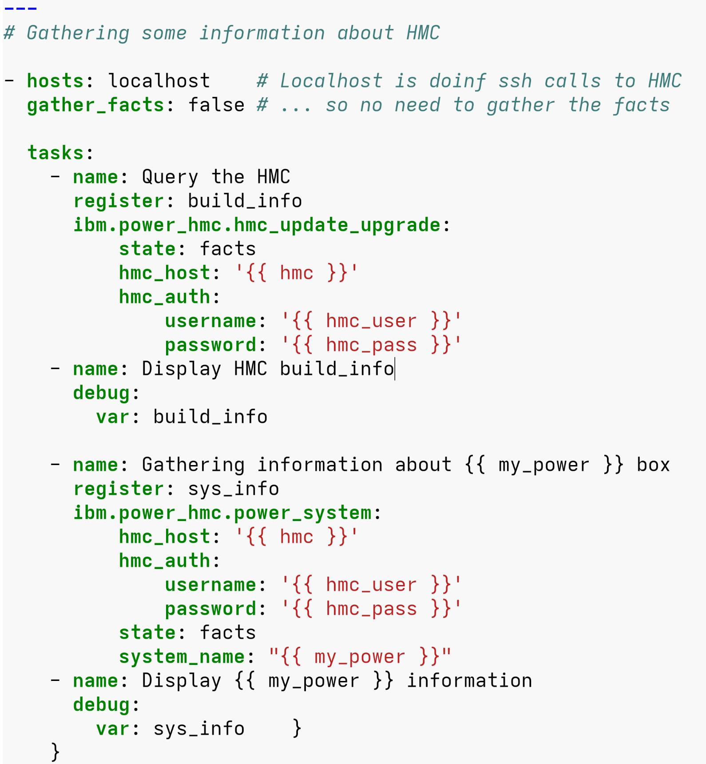
Sample playbook – POWER HMC
Control hosts executes ssh commands remotely on HMC.
No auth-token / REST API :-/
RMC connection to VIOS servers required to fully automate LPAR provisioning – No need to use ibm.power_vios module.

Slide 7
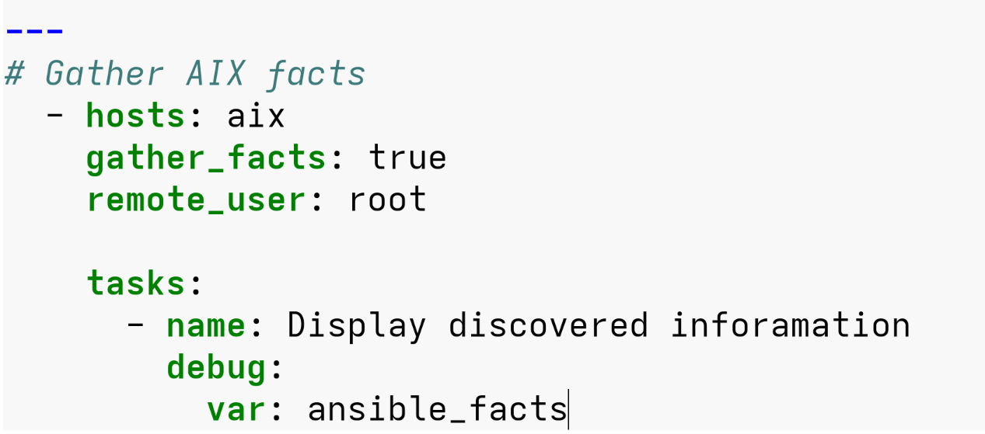
Ansible on AIX
Relatively new AIX
Python3
May need to show where the right python is... Inventoru is a good place for that:
[aix:vars]
ansible_python_interpreter=/opt/freeware/bin/python3.9

Slide 8

Demo time
IBM Flash System:
Information
Volume provision
Host mapping
HMC:
Information
LPAR provisioning (talk)
AIX
Facts
LVM provisioning
… Unprovision evertything :-D

Slide 9


