Slide 1

Recommendation
for multiple online shops
Stefanie Deckers

Slide 2
Outline
Introduction
Recommender systems
  Content-based
  Collaborative filtering
Boosting
Experiments
Conclusion

Slide 3
Introduction

Slide 4
Background
Braintags GmbH
Hosting online shops in various domains
Development of a recommender service
Notes:
Company for e-commerce
Recommender service should serve all shops
Written in Java

Slide 5
Research questions
Which types of recommendation algorithms are applicable to e-commerce data?
Notes:
Different types of algorithms
Performance depends on available data, i.e. size, distribution, kind of feedback
Find out which are suitable for e-commerce data

Slide 6
Research questions
Can logistic regression improve performance of model-based collaborative filtering?
Notes:
Go in detail later.
Investigated one algorihtm that used linear regression.
To adapt to e-commerce I tried to change it using logistic regression

Slide 7
Research questions
Can AdaBoost enhance model-based collaborative filtering on e-commerce data?
Notes:
AdaBoost: ensemble learning
Overcome problems of that appraoch by applying AdaBoost

Slide 8
Research questions
Can alternative prediction rules for AdaBoost improve prediction results?
Notes:
Recommendation is done by combining multiple models
Tried different methods to combine their results

Slide 9
Research questions
May hybrid recommenders of the presented approaches be able to improve recommendation performance?
Notes:
Different techniques have different weaknesses and strengths.
Maybe combining different recommenders can overcome weaknesses.
Errors of different recommmenders where investigated

Slide 10
Recommendation systems
Notes:
Basis recommendation systems
Content-based filtering
Collaborative filtering

Slide 11
Implicit feedback
In most recommender system (e.g. Netflix) user give explicit ratings
Shops only provide implicit feedback, like
  Purchases, shopping cart entries, views, …
Lack of negative feedback
Here: Binary values to indicate purchases
Notes:
Kind of feedback used to measure interest/usefulness
Supervised techniques
User purchases a printer once, but cartridges multiple times → does not mean cartridges are more useful than the printer, do not want to prefer recommending cartridges

Slide 12
Content-based recommendation
Using item features: categories or text
Items are represented as feature vectors
Categories: Binary values to indicate presence or absence
Text: Binary values, bag-of-words, tf-idf

Slide 13
Content-based recommendation
Apply k-nearest neighbors to find items similar to those user u purchased
Categories, binary text representation
→ Jaccard or cosine similarity
Text as bag of words or tf-idf
→ cosine similarity

Slide 14
Collaborative filtering (CF)
Recommendation based on other users
Neighborbased
  Using feedback matrix
  directly
Modelbased
  Learn some kind of model that is further used
 | Apple | Banana | Cherry | Dragon fruit
Alice | 1 | 1 | 0 | 0
Bob | 0 | 0 | 1 | 1
Carl | 1 | 1 | 0 | 1
Daisy | 1 | 0 | 1 | 1

Slide 15


Neighborbased
Find similar users by
and recommend items that were most purchased by them
Recommend similar items using
Similarity: Jaccard or Cosine
Notes:
[disadvantage of user-user: if users are too similar, there are not enough items to recommend]

Slide 16



Modelbased – Matrix factorization (SVD)
Purchase matrix A
Dimensionality reduction for users and item (latent factor features)
Recommendation using P and Q:

Slide 17
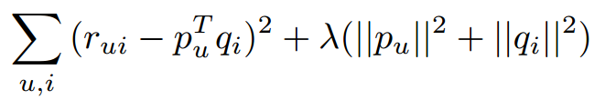

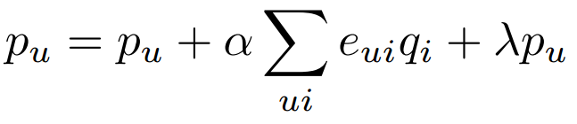
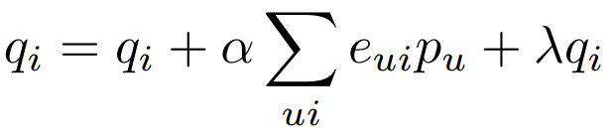
Modelbased – Matrix factorization (SVD)
Learn P and Q by least squares regression
Optimize:
For every r(u,i):
Update: (stochastic gradient descent)

Slide 18


Matrix factorization using logistic regression
is 0 or 1
Replace
with

Slide 19



Imbalanced class problem
Only positive instances available
Randomly choose negative ones
For every (u, i) pick (v, i) and (u, j)
Weight negative instances
So feature updates become
Notes:
One possibility using all unknown as negative → too many negative
When picking randomly, probability of finding correct negative instances quite high
Make sure every user and item features get about as many positive as negetaive updates

Slide 20
Problem with matrix factorization
Popular items receive more feature updates
Are more likely to be recommended
Need to emphasize rarely purchased items
AdaBoost

Slide 21
AdaBoost

Slide 22


AdaBoost
Ensemble learning for classification
Train models, combine their results
Emphasize instances, that are misclassified in the previous model
Instances are randomly sampled according to distribution

Slide 23



AdaBoost
Calculate distribution for next model:
: model error (average of all e(u,i))
Prediction:

Slide 24


AdaBoost for model-based CF
Instead of use weights
Feature updates become:
Instances with higher errors receive greater updates

Slide 25
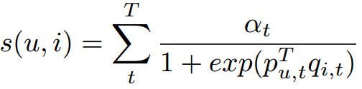




AdaBoost for model-based CF
Prediction:
Replace model error by user or item errors:
Or combine:

Slide 26
Experiments

Slide 27
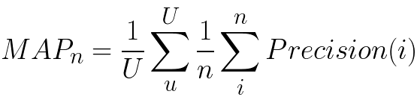
Evaluation
80% percent training instances
Mean average precision (MAP):
n: number of recommendations
U: number of users
Precision(i): precision of recommendations cut off at position i

Slide 28
Dataset
Online pharmacy:
About 72,318 users, 11,666 items
Density about 0.077%
Average 9.05 purchases per user
Average 56.08 purchases per item

Slide 29
Experiments
 | MAP | User precision | Item precision
CFItemNN | 0.137 | 0.390 | 0.227
CFUserNN | 0.102 | 0.339 | 0.184
SVD | 0.050 | 0.241 | 0.129
CBNN (Categories) | 0.005 | 0.026 | 0.013
MostPop | 0.049 | 0.220 | 0.117
CFItemNN performs best
CBNN is weakest recommender
SVD only slightly better than unpersonalized recommendation

Slide 30
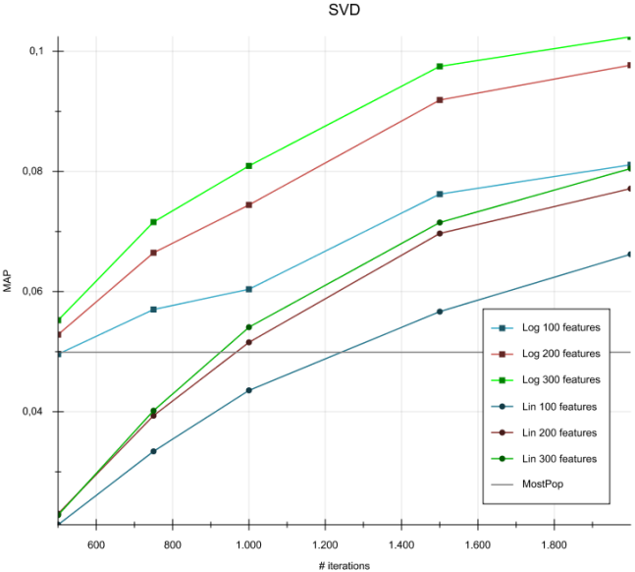

Slide 31
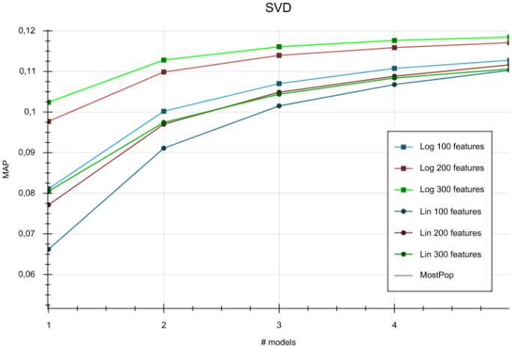

Slide 32
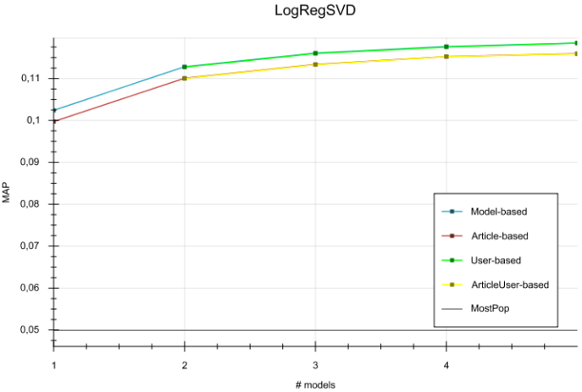

Slide 33
Error correlation
Compared true positives of different pairs of recommenders
If correct recommendations differ for both, a hybrid technique may improve results

Slide 34
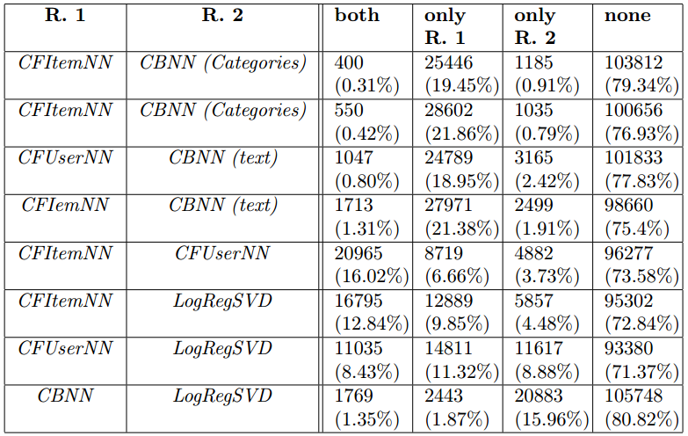

Slide 35
Conclusion

Slide 36
Research questions
Which types of recommendation algorithms are applicable to e-commerce data?
  Poor performance of content-based recommendation
  CFItem recommender performs best
  Model-based approaches need adjustment for implicit feedback
Notes:
Different types of algorithms
Performance depends on available data, i.e. size, distribution, kind of feedback
Find out which are suitable for e-commerce data

Slide 37
Research questions
Can logistic regression improve performance of model-based collaborative filtering?
  Yes.
Notes:
Go in detail later.
Investigated one algorihtm that used linear regression.
To adapt to e-commerce I tried to change it using logistic regression

Slide 38
Research questions
Can AdaBoost enhance model-based collaborative filtering on e-commerce data?
  Yes.
Notes:
AdaBoost: ensemble learning
Overcome problems of that appraoch by applying AdaBoost

Slide 39
Research questions
Can alternative prediction rules for AdaBoost improve prediction results?
  No.
Notes:
Recommendation is done by combining multiple models
Tried different methods to combine their results

Slide 40
Research questions
May hybrid recommenders of the presented approaches be able to improve recommendation performance?
  Hybrid of neighbor-based and model-based CF recommender may improve results.
Notes:
Different techniques have different weaknesses and strengths.
Maybe combining different recommenders can overcome weaknesses.
Errors of different recommmenders where investigated

Slide 41
    Thank you for your attention!

