Slide 1

Recommendation
for multiple online shops

Slide 2
Outline
Background
Collaborative recommender systems
Content-based recommender systems
Evaluation
Hybrid recommender systems
Conclusion

Slide 3
Background
Braintags GmbH
Hosting online shops in various domains
Development of a single recommender service
Reactive design using vert.x

Slide 4
Vert.x
Java toolkit for reactive applications
Asynchronous design using event handlers
For example instead of
ResultSet result = stmnt.executeQuery(query);
// Do anything with result
con.query(query, result -> {
  // Do anything with result
});

Slide 5
Implicit feedback
In most recommender system (e.g. Netflix) user give explicit ratings
Shops only provide implicit feedback, like
  Purchases, shopping cart entries, views, ...
Lack of negative feedback

Slide 6
Collaborative filtering (CF)
Recommendation based on other users
Neighborbased
  Using feedback matrix
  directly
Modelbased
  Learn some kind of model that is further used
 | Apple | Banana | Cherry | Dragon fruit
Alice | 1 | 1 | 0 | 0
Bob | 0 | 0 | 1 | 1
Carl | 1 | 1 | 0 | 1
Daisy | 1 | 0 | 1 | 1

Slide 7
Neighborbased recommendation
Basically k-nearest-neighbor
  (Unknown) feedback r(u, I): average feedback of the k-nearest user or items
Only ranking is needed
  Recommend those items that are liked/purchased by users most similar to current user
  Recommend those items that most similar to items the current user already liked/purchased

Slide 8

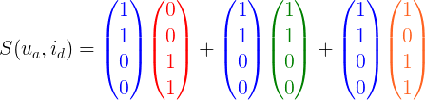
Neighborbased – User-User
Recommendation based on similar users
Recommend items with highest scores
Alternatively use e.g. cosine similarity
 | Apple | Banana | Cherry | Dragon fruit
Alice | 1 | 1 | 0 | 0
Bob | 0 | 0 | 1 | 1
Carl | 1 | 1 | 0 | 1
Daisy | 1 | 0 | 1 | 1

Slide 9

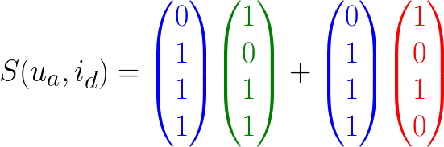
Neighborbased – Item-Item
Recommendation based on similar items
If |U| > |I|, Item-Item approach should work better
 | Apple | Banana | Cherry | Dragon fruit
Alice | 1 | 1 | 0 | 0
Bob | 0 | 0 | 1 | 1
Carl | 1 | 1 | 0 | 1
Daisy | 1 | 0 | 1 | 1

Slide 10


Modelbased – Matrix factorization
Based on linear regression
Find latent factor features
Learning feature vectors for every user and item:
Solve by alternating least squares, e.g. gradient descent

Slide 11

Content-based – Naive Bayes
Use some item features x
  Categories
  Descriptions (parsed into word vectors)
Naive Bayes:
p(y=1) probability that user likes/purchases item
p(x) probability of features x
Estimate for every user from past feedback
Recommend items with highest p(y=1|x)

Slide 12
Evaluation
Offline evaluation:
k-fold-cross validation
  Remove k purchases from the feedback matrix
  Calculate the average rank of those items in the list of recommendations
Online evaluation:
Click-Through-Rate
  Ratio of number of clicks on a recommended item to the number of recommendations

Slide 13
Hybrid recommender systems
Weighting hybrid
Switching hybrid
  Find some criteria to decide for one recommender
Combining features:
  E.g. add item features from matrix factorization to content-based features

Slide 14

Ideas for learning hybrid:
Learning weights for weighted hybrid by:
Decision tree on meta-data:
  Number of users, number of items, number of purchased, clicks, ...

Slide 15
Conclusion
Evaluation of basis algorithms
Try different models for implicit feedback
Develop hybrid
Find learning strategy for hybrid

Slide 16

    Thank you for your attention!

