Slide 1

KW Adapter
SerieM Interface

Slide 2
WHY ?
StreamServe Migration
- Re-use StreamServe configuration
- process non XML data : FieldIn, RecordIn, RDI
- Mapping fields for PDF, OTF
- Directory scanning
Integration Helper
- Any input format
- Pre-Process data (filter, stylesheet)
- Additional data (File, jdbc, script)

Slide 3
KW compliance
- Converts any data stream into XML
- Splits large Xml into individual documents
- Uses Rest API when available, Java API when needed
- Document individual settings :
- print to MOMS ?
- Save Tonic document ?
- export PDF ?
- MOMS parameters, template metadatas
StreamServe compliance
- FieldIn and recordIn description syntax
- PreformatIn syntax for PDFIn and OTFIn
- Document identification and triggering based on input data

Slide 4


Process Overview
Multithreaded
Multithreaded
M/TEXT TONIC
Document identification
Document identification
Document identification
Data stream
Document identification
Document datasources
KW APIs
M/OMS
Parsers:
Field, record, xml, jdbc, script

Slide 5

Modules
KW APIs
M/TEXT TONIC
Scandir
Parser
Jdbc/script/…
Actions (oms/Tonic/…)
Configuration
M/OMS
Configuration :
Description files : analyses input data, StreamServe syntax
Properties files : KW connection, Document settings (ie: template, datasources,…)
Can be synchronized from SerieM server periodically, supports hot changes

Slide 6
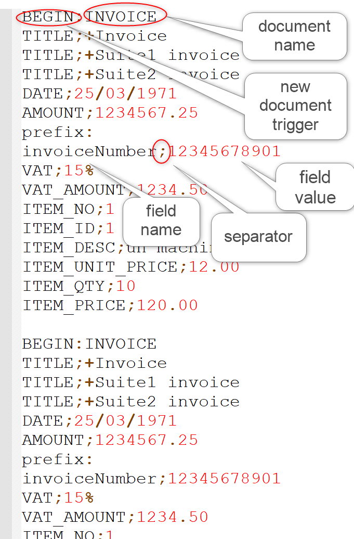
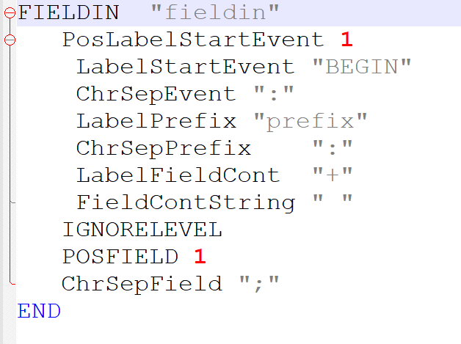
Field In example
Corresponding description file :

Slide 7
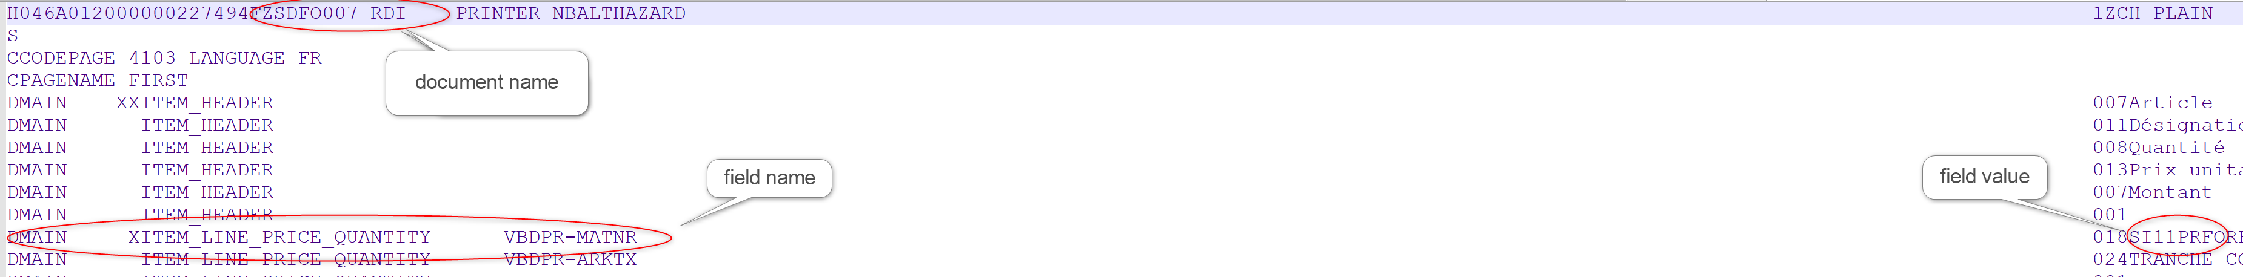
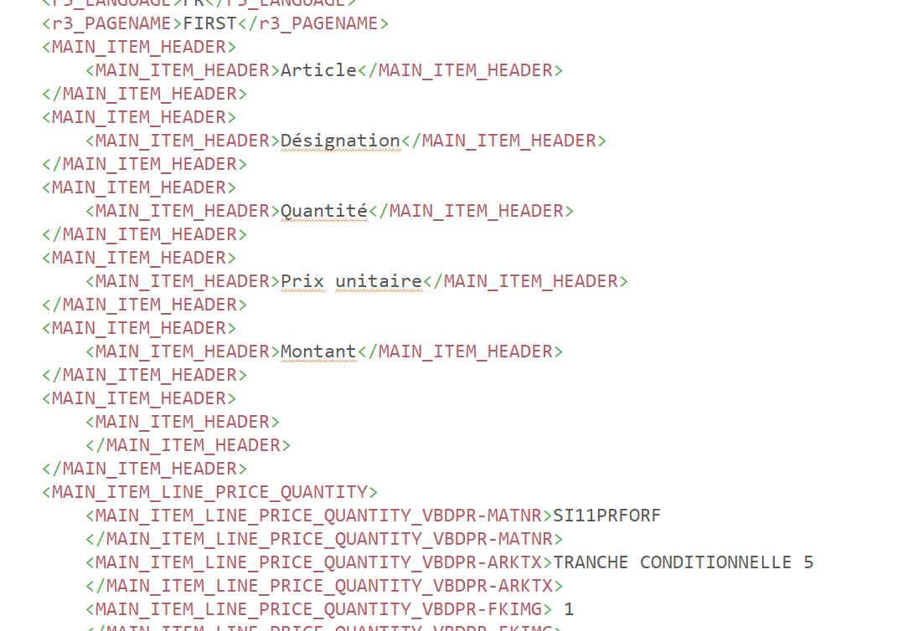
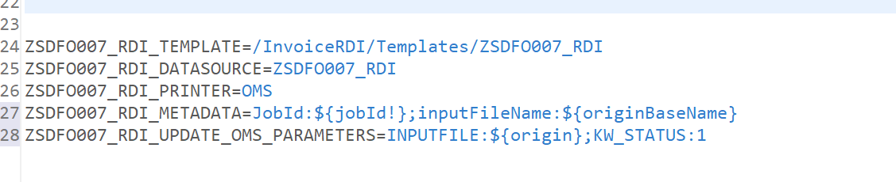
RDI example
XML result
Document settings
(here, just oms print, indicates some metadata and oms parameters)

Slide 8
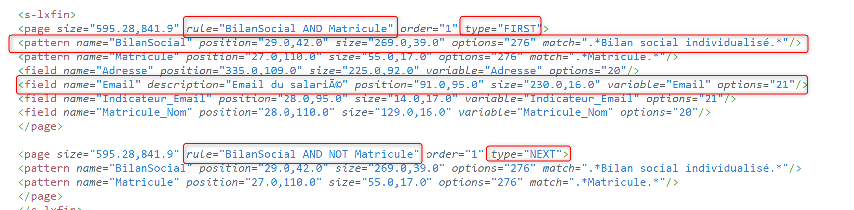
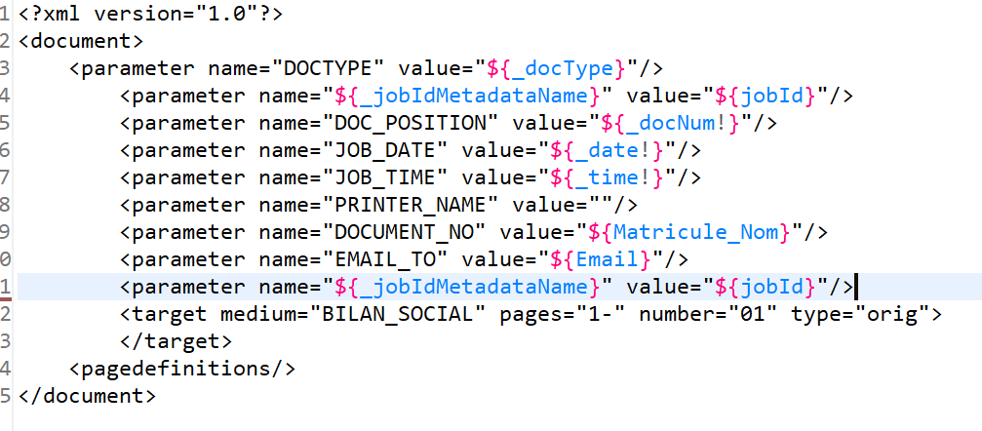
PDF or OTF
Pages are “typed” : FIRST/NEXT
Page FIRST identified -> NEW document
Patterns are used in Rules to identify pages
Fields have name, position, size. Depending on attribute “options”, OTF also supports moving or removing the field.
Field value can be calculated by javascript.
Freemarker template is used to create the OMS Control File :

Slide 9
Main Settings
//GENERIC
PARENT=parentSettings.properties
KW_SERVER=serieMAddress
KW_SERVER_PORT=443
SSL_ENABLED=true
KW_USER=mtext
KW_PASSWORD_PLAIN=mtext
KW_PASSWORD_CRYPTED=5B7A492A0050DA42
KW_SYNCHRO_SETTINGS_PROJECT=AdapterSettingsProjec
KW_SYNCHRO_SETTINGS_SCHEDULE=10mn
FILE_THREADS=4
DOCUMENT_THREADS=8
//SCAN
ENCODING=UTF-8
PARSERS=dsc/r3rdi.dsc;dsc/fieldIn.dsc;etc…
FOLDER=./scanTest
FILTER=*.*
SCHEDULE=1s
DELETE_FILES=true
PARSE_ONLY=true
//DOCUMENTS
<docName>_TEMPLATE=/bsp_Anschreiben/Vorlagen/Willkommen.template
<docName>_XML_SPLITTER=//Configuration/Batch.splitting
<docName>_DATASOURCE=Brief
<docName>_PRINTER=OMS
<docName>_TONIC_PATH=Brief/${docId}
<docName>_RESPONSE_PATH=response/${docId}.pdf
<docName>_ADDITIONAL_FILES=routing/${origin}.route
<docName>_ADDITIONAL_DATASOURCES=ROUTING;jdbcData:JDBC(jdbcSettings.xml)
<docName>_FILTER=xsl/transform.xsl
<docName>_METADATA=JobId:${jobId};InputFile:${origin}
<docName>_UPDATE_OMS_PARAMETERS=MY_STATUS:READY

Slide 10
Context
Most of settings are parsed using freemarker syntax (https://freemarker.apache.org/) : ${variable}
For each document, the context is the following:
Variable | contents
<datasourceName> | XML content (see Freemarker documentation for XML data models)
Origin (or originFileName or jobId) | The input file name (ex : invoice.xml)
originBaseName | Ex: invoice
inputFileName | ex: scanFolder/invoice.xml
docId | Ex: invoice.xml_Invoice_0000001
docIdx (or docNum) | The document numer. Ex: 1, 2, 3, …
originExtension | Ex: txt, csv, …
Name | The document type (ex: Invoice)
timestamp | dateTime in milliseconds
<metadata> | Metadata defined in the settings for this document type

Slide 11
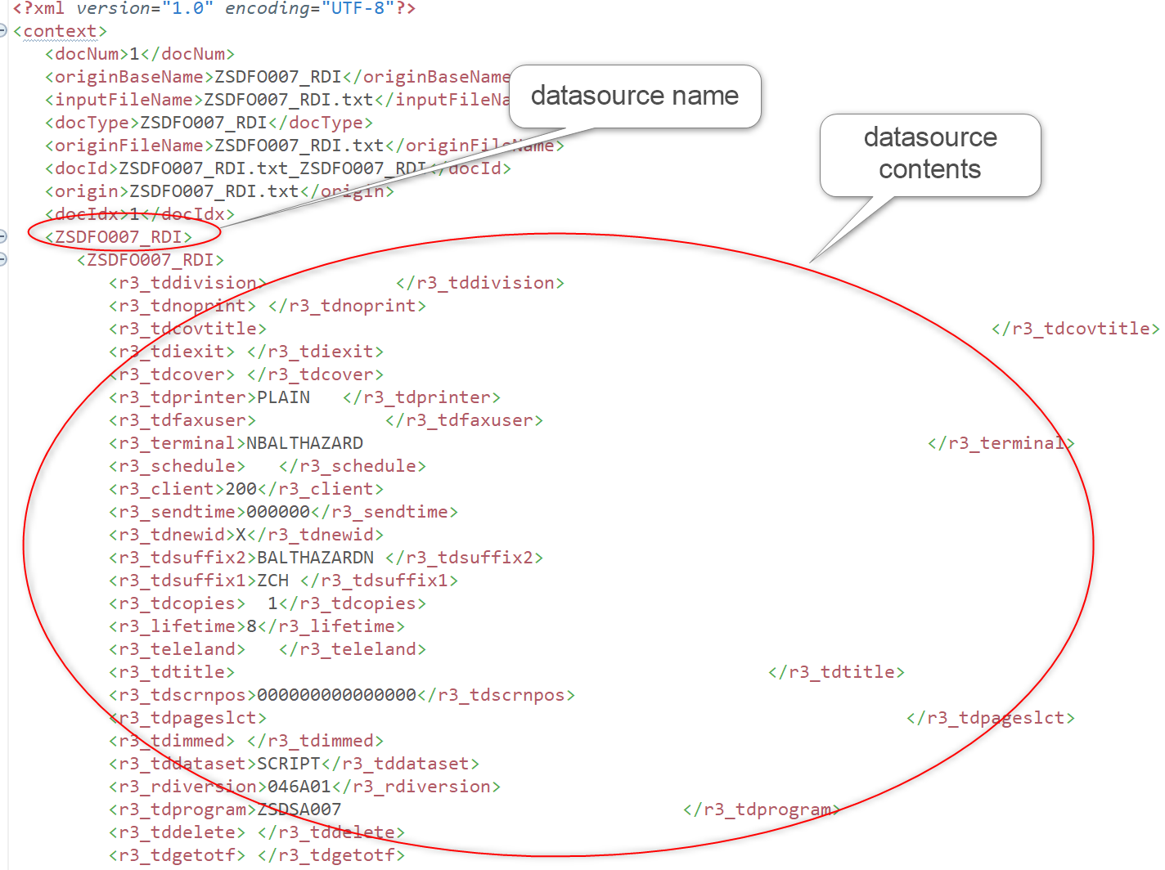
Context example

Slide 12
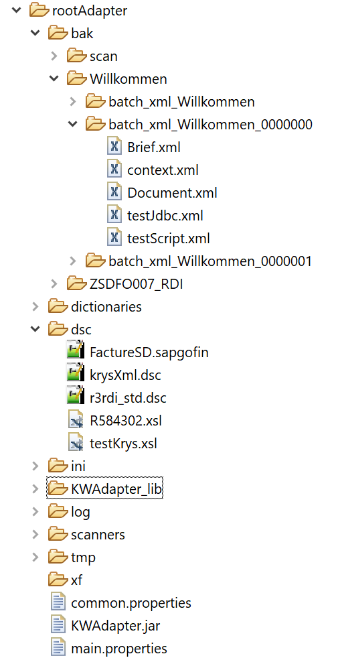
Settings folder structure
Settings are organized int the following way :
root : root folder for the setting, should contain the main properties file.
dsc : description files (*.dsc, *.pdfin, *.sapgofin)
dictionaries : xml structures definitions (blocks and fields organization)
scanners : directory scanning definitions (any number of folders can be scanned at the same time).
  <scannerName>.properties : each scanned folder is defined in its own properties file
  All properties files in « scanners » directory are loaded and started
xf : OMS control job definition for inputX (pdfIn, otfIn)
log : log files
bak : backup files

Slide 13
Start up
Daemon (scanning directories) :
Java –jar -cp KWAdapter.jar;KWAdapter_lib\* -Djava.io.tmpdir=tmp -Dkwsoft.env.globalcontext=ini\client.ini fr.kw.adapter.engine.scanner.StartScanners -config main.properties
One shot (process file and stop) :
Java –jar -cp KWAdapter.jar;KWAdapter_lib\* -Djava.io.tmpdir=tmp -Dkwsoft.env.globalcontext=ini\client.ini fr.kw.adapter.engine.ProcessFile [-baseConfig main.properties ] –config scanners/csvScanner.properties-in example\bigBatch.xml
 Take care ! The client.ini file also contains connection information to KW server (url, user, password). It must suit each environment and is automatically created during the installation (Assembly stage).

Slide 14
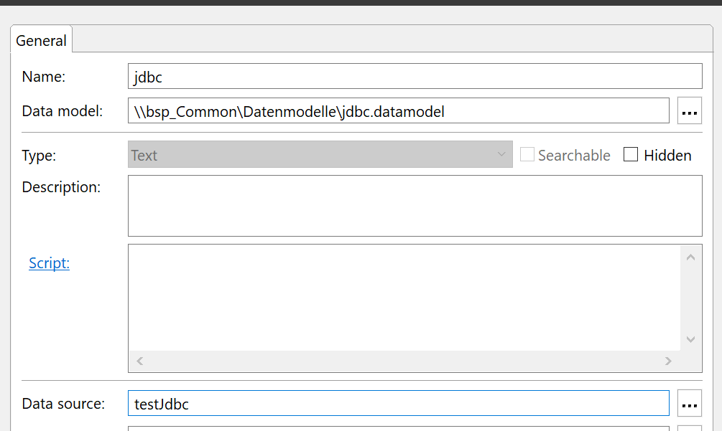
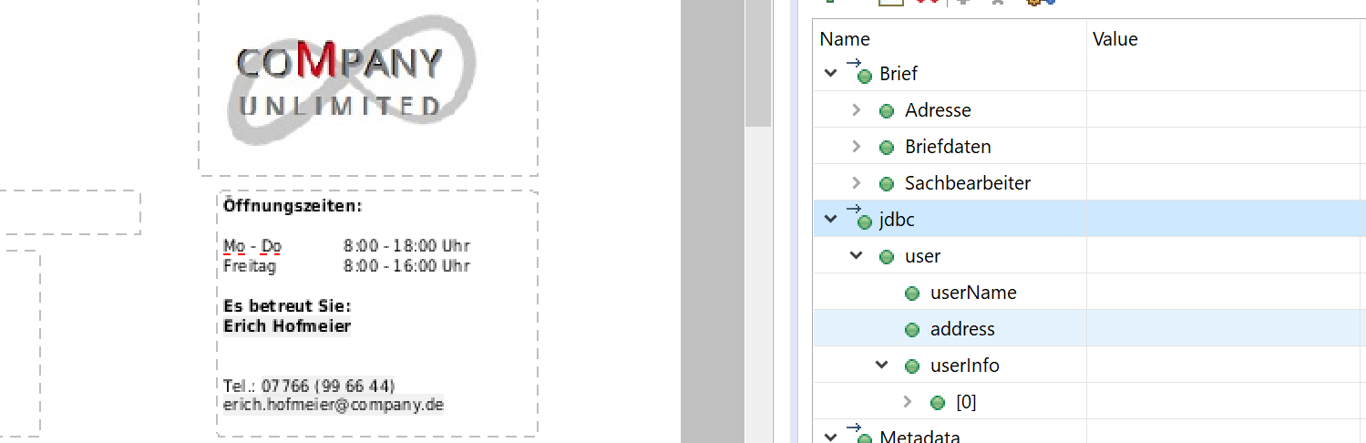
JDBC datasources
Declare additional datasource in document settings :
Willkommen_ADDITIONAL_DATASOURCES=testJdbc:JDBC(jdbc/test.jdbc)
The syntax is :
<docName>_ADDITIONAL_DATASOURCES=<dataSourceName>:JDBC(path to jdbc settings);other data source(s)…
The value for <dataSourceName> will be used to declare it in the KW template :

Slide 15
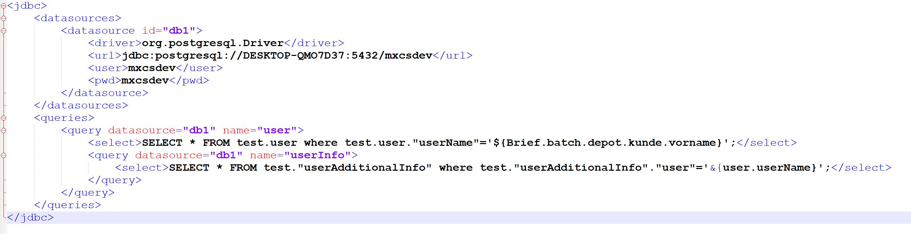
JDBC settings
The JDBC follows this syntax (See below). The settings are parsed with Freemarker, the XML data from main datasource is available.
Any number of datasources is possible, their “id” must be unique.
Queries can be interwined, the name will be used for the record that contains the values.
When interwined, the child query is run for each parent query record.
Child queries can refer to parent queries values using &{<parentQueryName>.<fieldname>}.
Values from document context can be used directly with Freemarker syntax.
Update queries can also be run for each query (globally of for each record returned).

