Slide 1
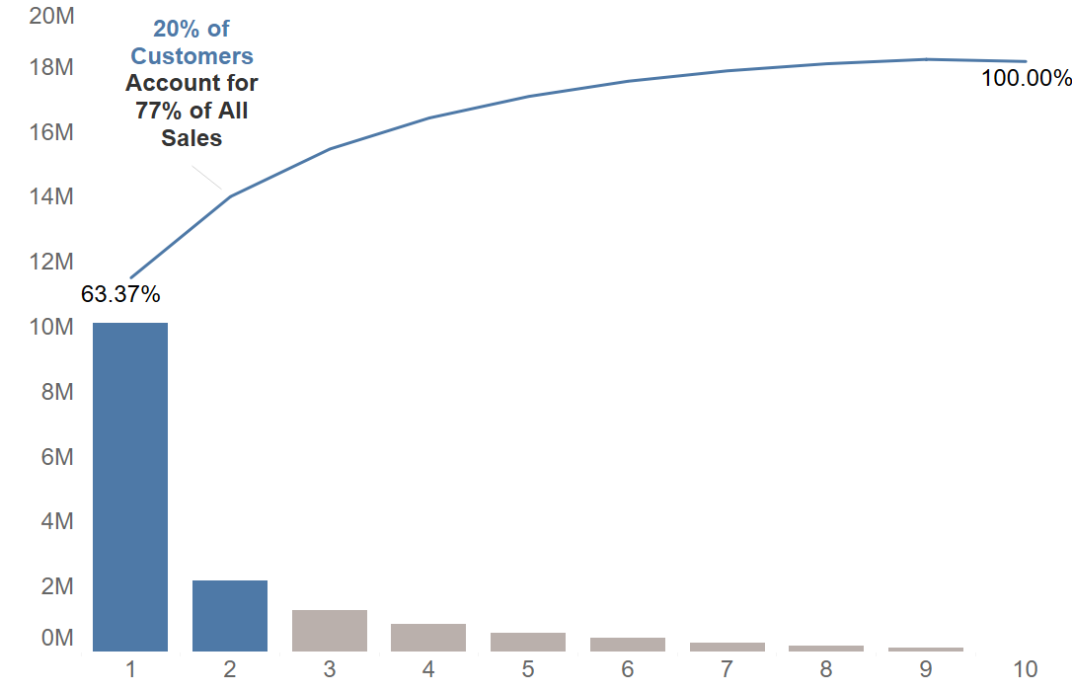
20% of customers account for 77% of sales
There may be opportunity for segmentation to improve customer retention and development
Sales Amount
584 Customers Per Decile

Slide 2
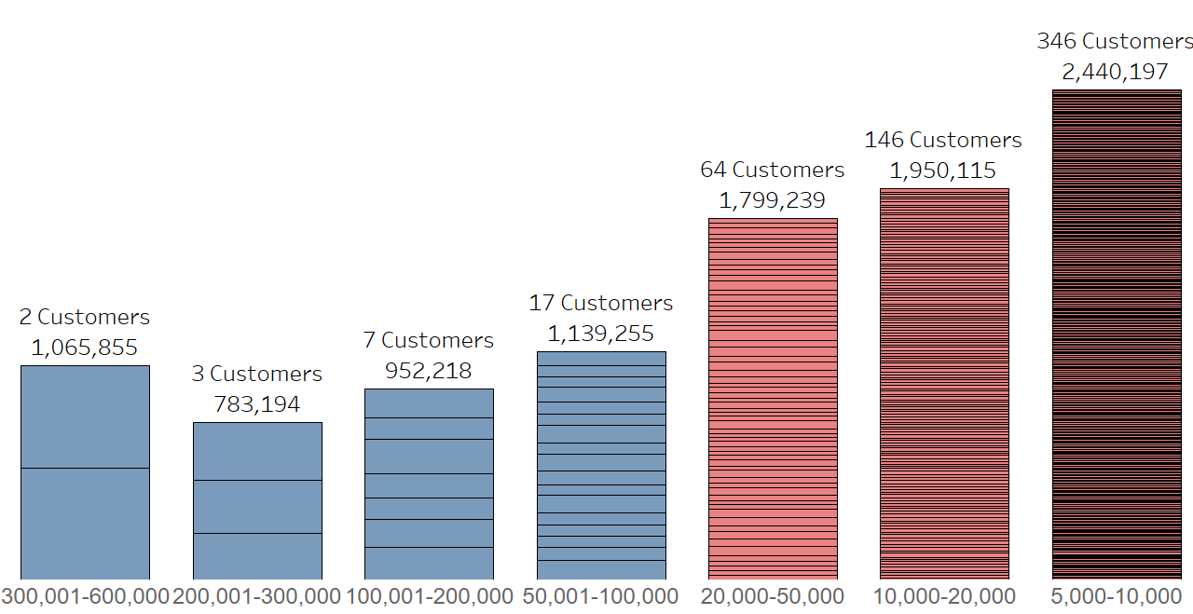
Customers in the top decile can be further segmented by value
A Customers are very high value
B Customers are more valuable overall, large number of customers means a role for analytics in strategy development
Customer Value Bands (£)

Slide 3
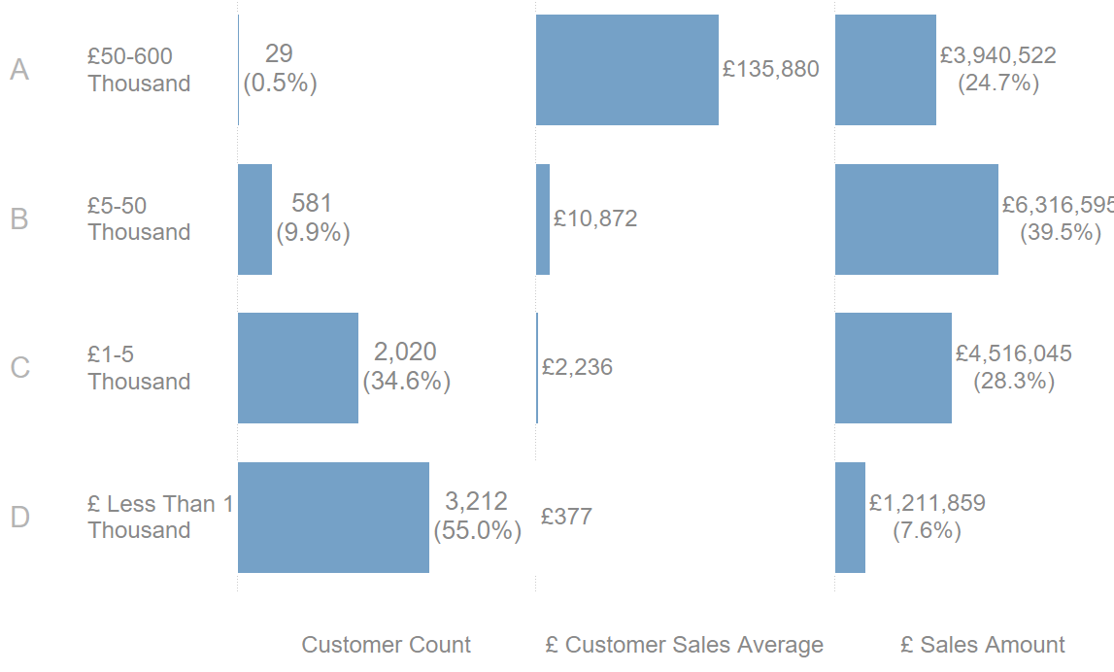
ABCD Analysis
Number of Customers
Average Customer Value
Total Sales

Slide 4
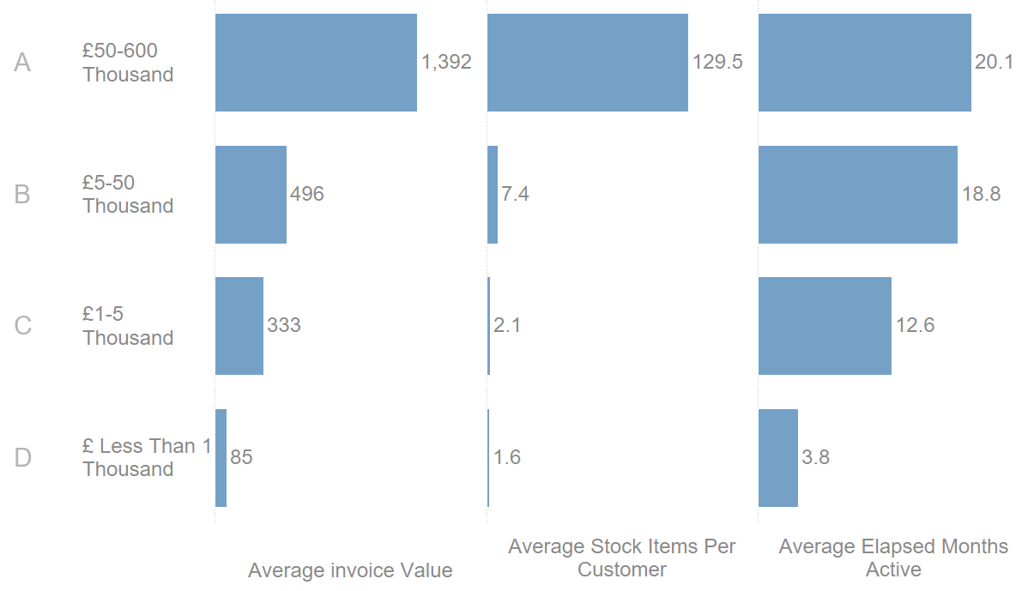
ABCD Analysis
Average Invoice
Value
Avg Stock Items / Customer
Avg Elapsed Months Per Customer

Slide 5
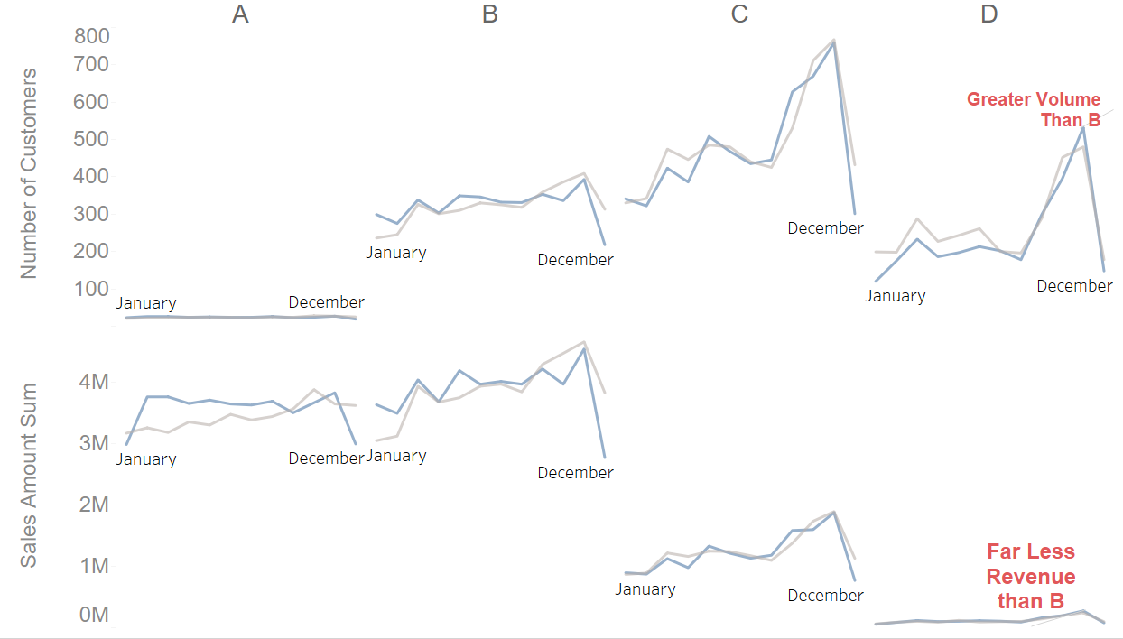
2011 sales similar to 2010 overall.
Segment D involves processing many customers in Autumn peak for relatively initial sales value. Can we cross sell to seasonal suppliers customers?

Slide 6
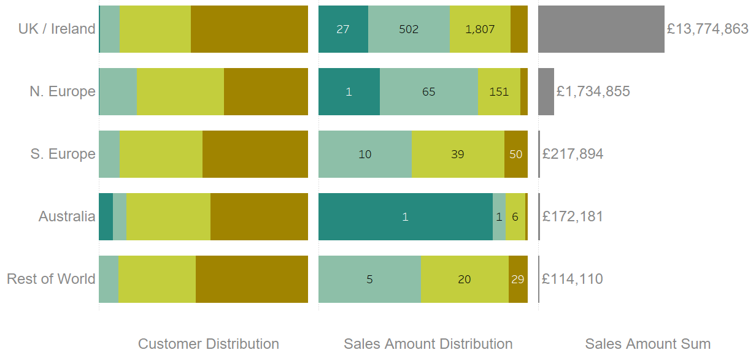
Business is dominated in UK/Ireland and N. Europe
Where customers are mostly A and B types. C and D type customers impact sales less

Slide 7
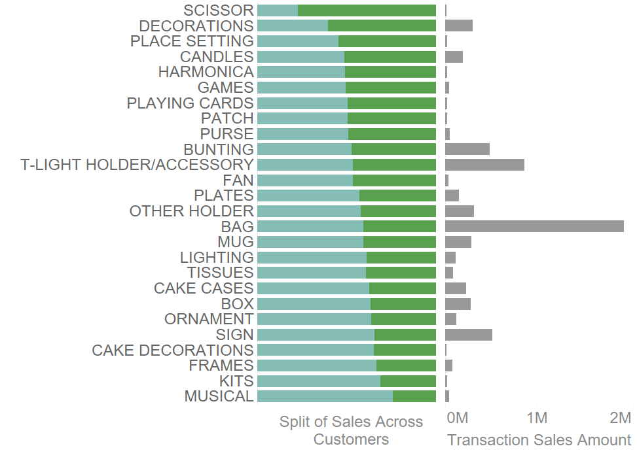
Certain Top Selling Product Groups Cluster In Different Types of Customers
Mostly sold
by C/D
Customers
Mostly sold by A/B Customers
Could bags and signs be further cross sold?

