Slide 1
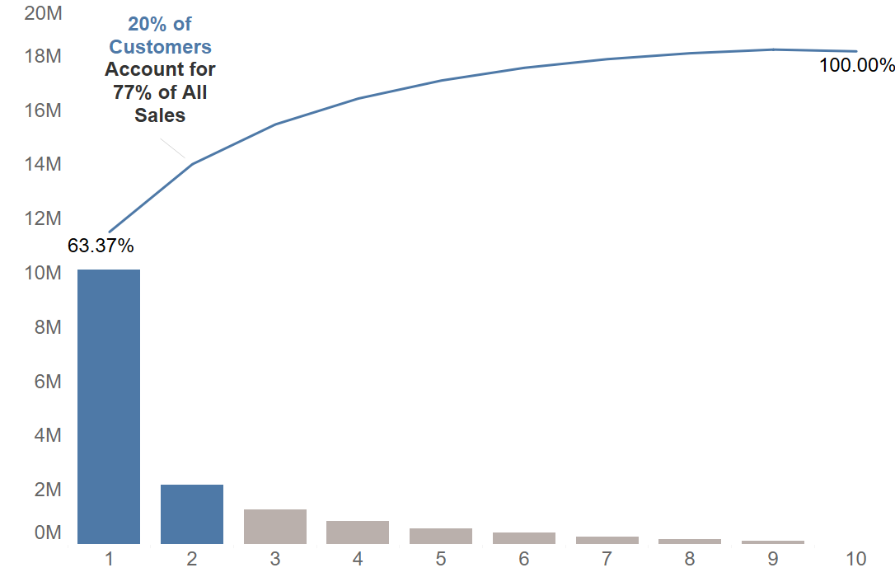
20% of customers account for 77% of sales
There is an opportunity for segmentation to improve customer retention and development
Sales Amount
584 Customers Per Decile

Slide 2
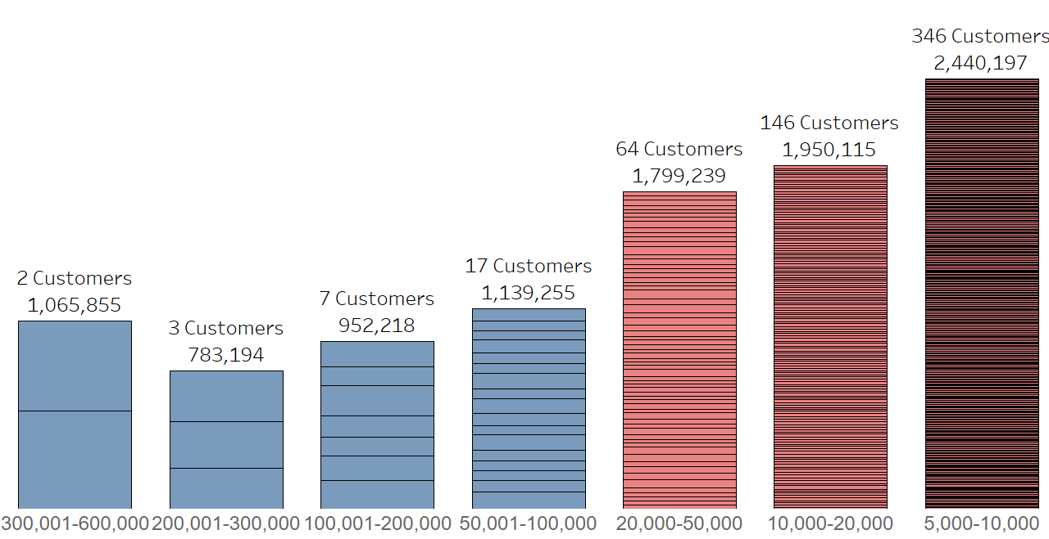
Customers in the top decile can be further segmented by value
A Customers are very high value
B Customers are more valuable overall, large number of customers means a role for analytics in strategy development
Customer Value Bands (£)

Slide 3
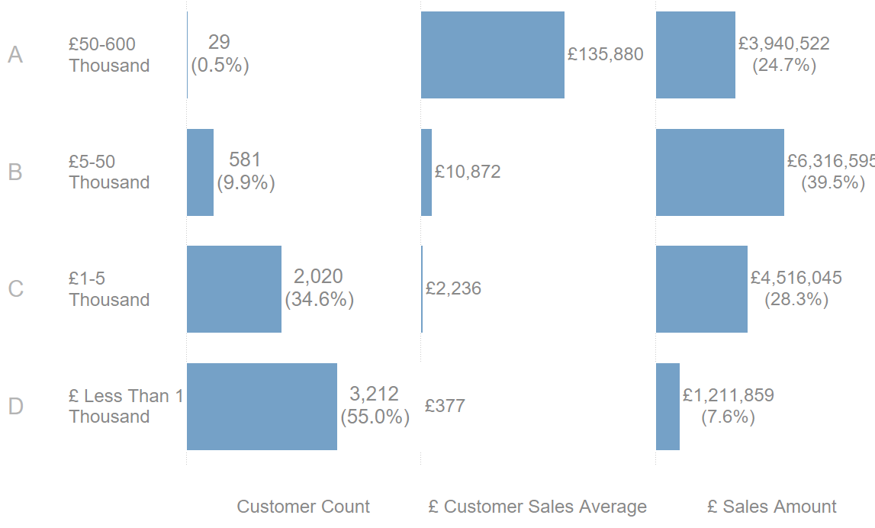
ABCD Analysis

Slide 4
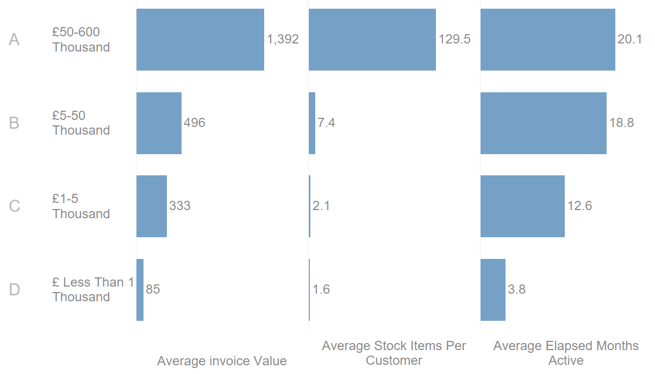
ABCD Analysis
Category

Slide 5
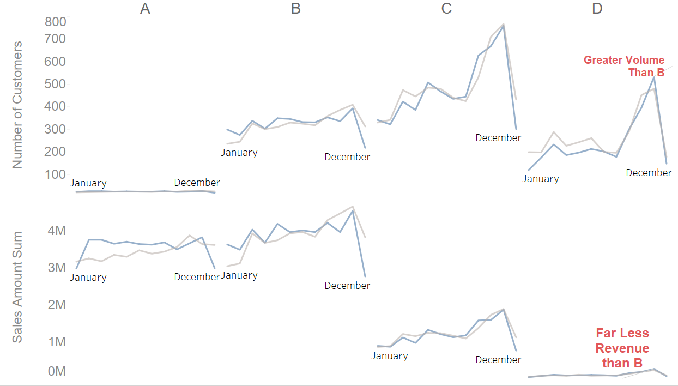
2011 sales similar to 2010 overall.
Segment D involves processing many customers in Autumn peak for relatively initial sales value. Can we cross sell to seasonal suppliers customers?

Slide 6
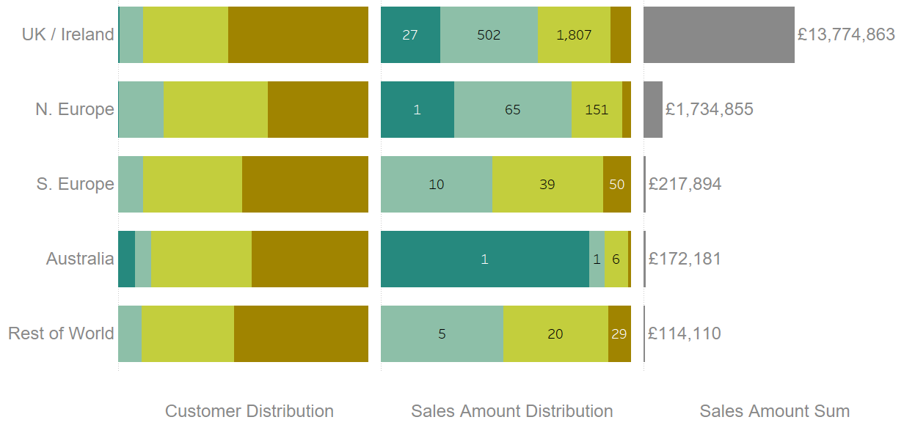
Business is dominated in UK/Ireland and N. Europe
Where customers are mostly A and B types. C and D type customers impact sales less

