Slide 1



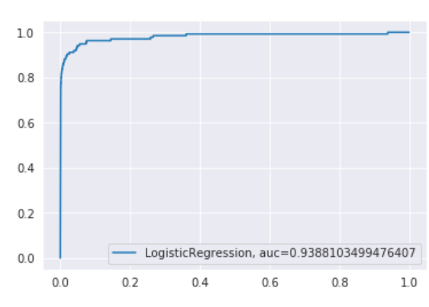
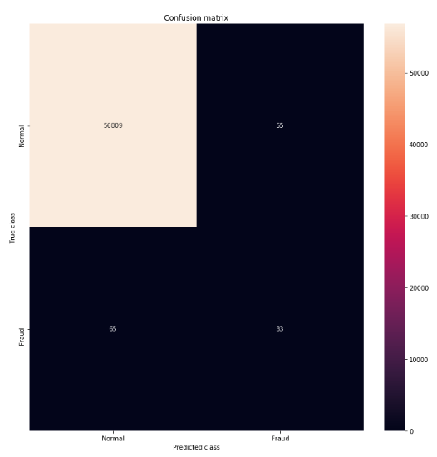
Credit Card Fraud Detection Using Machine Learning Stefany Alves | 2019307
Introduction
Data
Models
Implementation
Credit card fraud is a significant concern in today's financial landscape. This presentation showcases our efforts to combat the ever-evolving challenge of credit card fraud by applying advanced machine learning algorithms.
Simple logistic regression: interpretable linear classification algorithm
Stage 1: Different sampling strategies are employed to train variants of each model.
Stage 2: The best-performing model in each category is identified based on its performance on the validation subset. using a combined train/validation set and assessed against the test
Primary performance metric: AUPRC. This decision is motivated by the class imbalance present in the dataset.
Credit card dataset from Kaggle
Variable | Description
Time: | Time since the first transaction
V1-V28 : | Credit Card data protection (privacy)
Amount : | Transaction Amount
Class: | 1 = Fraud; 0=otherwise
N = 284,807 | D =31 variables
Objectives
Motivation
Combat the rising threat of credit card fraud
protect customers from fraudulent activities
improve trust and confidence in digital payment systems.
Objectives
Develop accurate and efficient machine learning models for fraud detection
implement and assess ML algorithms to detect credit card fraud
Address class imbalance to ensure balanced model performance.
Isolation Forest Classifier: detection of the algorithm based on decision trees
Class distribution
Discussion & Future Work
Data Volume |  | %
All Tx | 284,807 | 100
Fraud: | 492 | 0.17
Not fraud | 284,135 | 99.83
• Random forests are highly effective, easy to implement, and appear to be robust to class imbalance, for this dataset.
• Given that payments fraud is constantly evolving, future areas of work might include the application of reinforcement learning to a real-time data stream

