Slide 1
Edge-ai
PRESENTATION

Slide 2
Agenda
Project?
Rag
Lightrag
Demo

Slide 3
The Power of
Rag

Slide 4


Rag

Slide 5
Lightrag
Python module to do searches

Slide 6
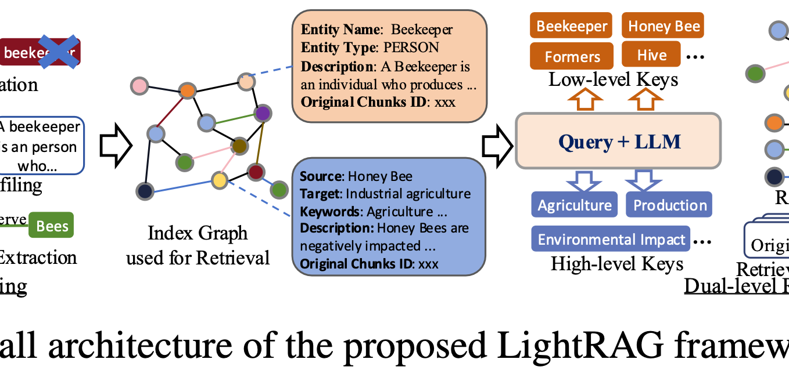

lightrag

Slide 7
shema
Docker
ragifyer
Docker
frontend
rag storage

Slide 8
BESLUIT

Slide 9
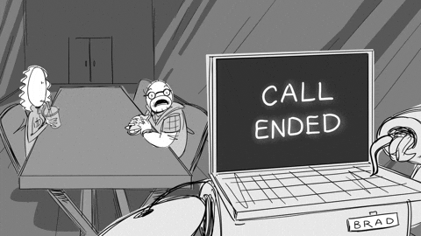
THANK YOU

