Slide 1
DevOps with AWS Final Project
Saleor E-commerce Deployment
Presenter: Dale Murphy
Code:You Final Project

Slide 2
Project Overview
Containerized Saleor with Docker
Automated CI/CD
Published images to Docker Hub
Deployed to AWS ECS (Fargate)

Slide 3
Technologies
Docker, Docker Compose
GitHub & GitHub Actions
Docker Hub
AWS ECS, Fargate, ALB
PostgreSQL, Redis, CloudWatch

Slide 4
Docker Compose
Saleor API
Dashboard
PostgreSQL
Redis
Mailpit
Jaeger

Slide 5
CI/CD Pipeline
Develop → Staging → Production
Ruff, pip-audit, Trivy
Automatic Docker builds & pushes

Slide 6
AWS Deployment
ECS Cluster
Task Definition
Service
Application Load Balancer

Slide 7
Architecture
GitHub → GitHub Actions → Docker Hub → ECS (Fargate) → Load Balancer → Saleor

Slide 8
Challenges Solved
YAML errors
Docker tags
Database migrations
Health checks
AWS roles

Slide 9
Project Evidence
Screenshots included in proof document.
Cluster, Service, Running Task, Task Definition, Docker Hub, GitHub Actions, Load Balancer, Dashboard

Slide 10
Lessons Learned
Docker simplifies deployment
CI/CD improves reliability
Troubleshooting is essential
Questions?

Slide 11
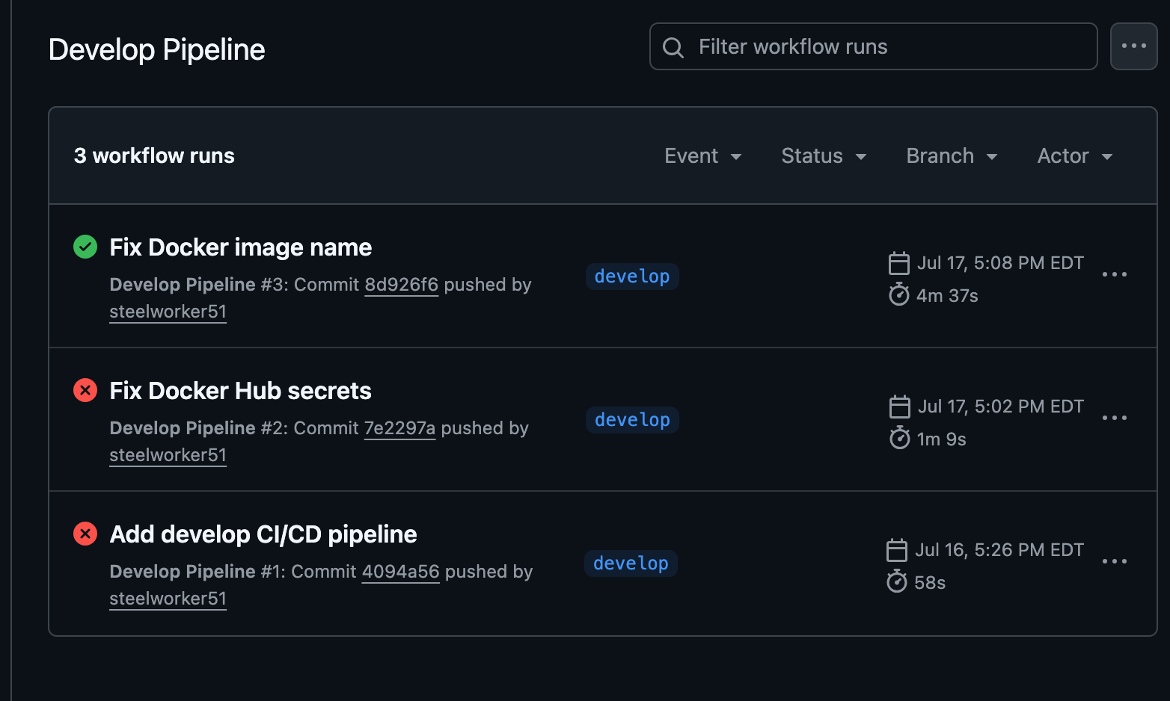
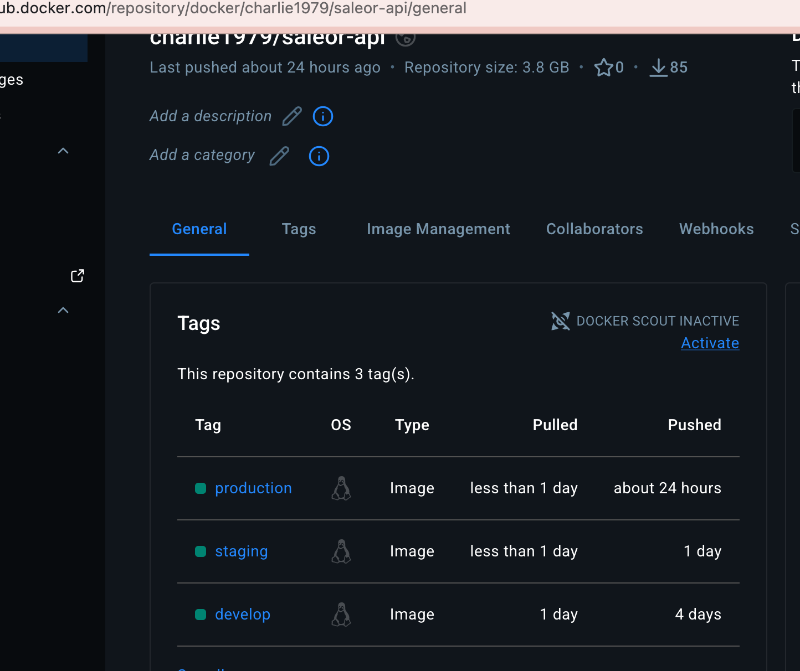
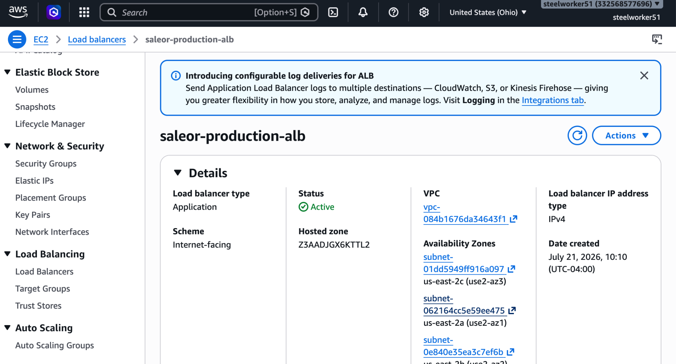
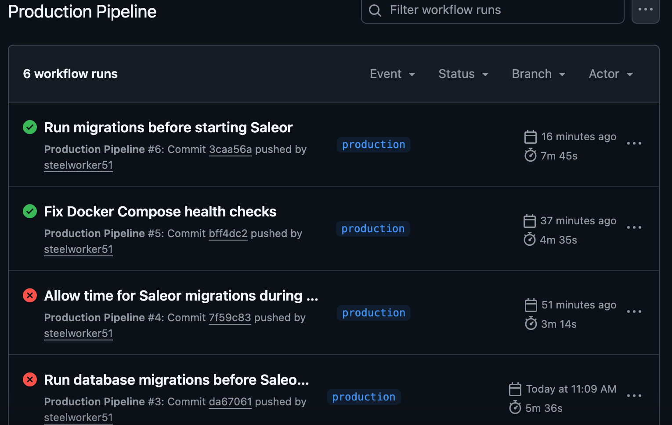
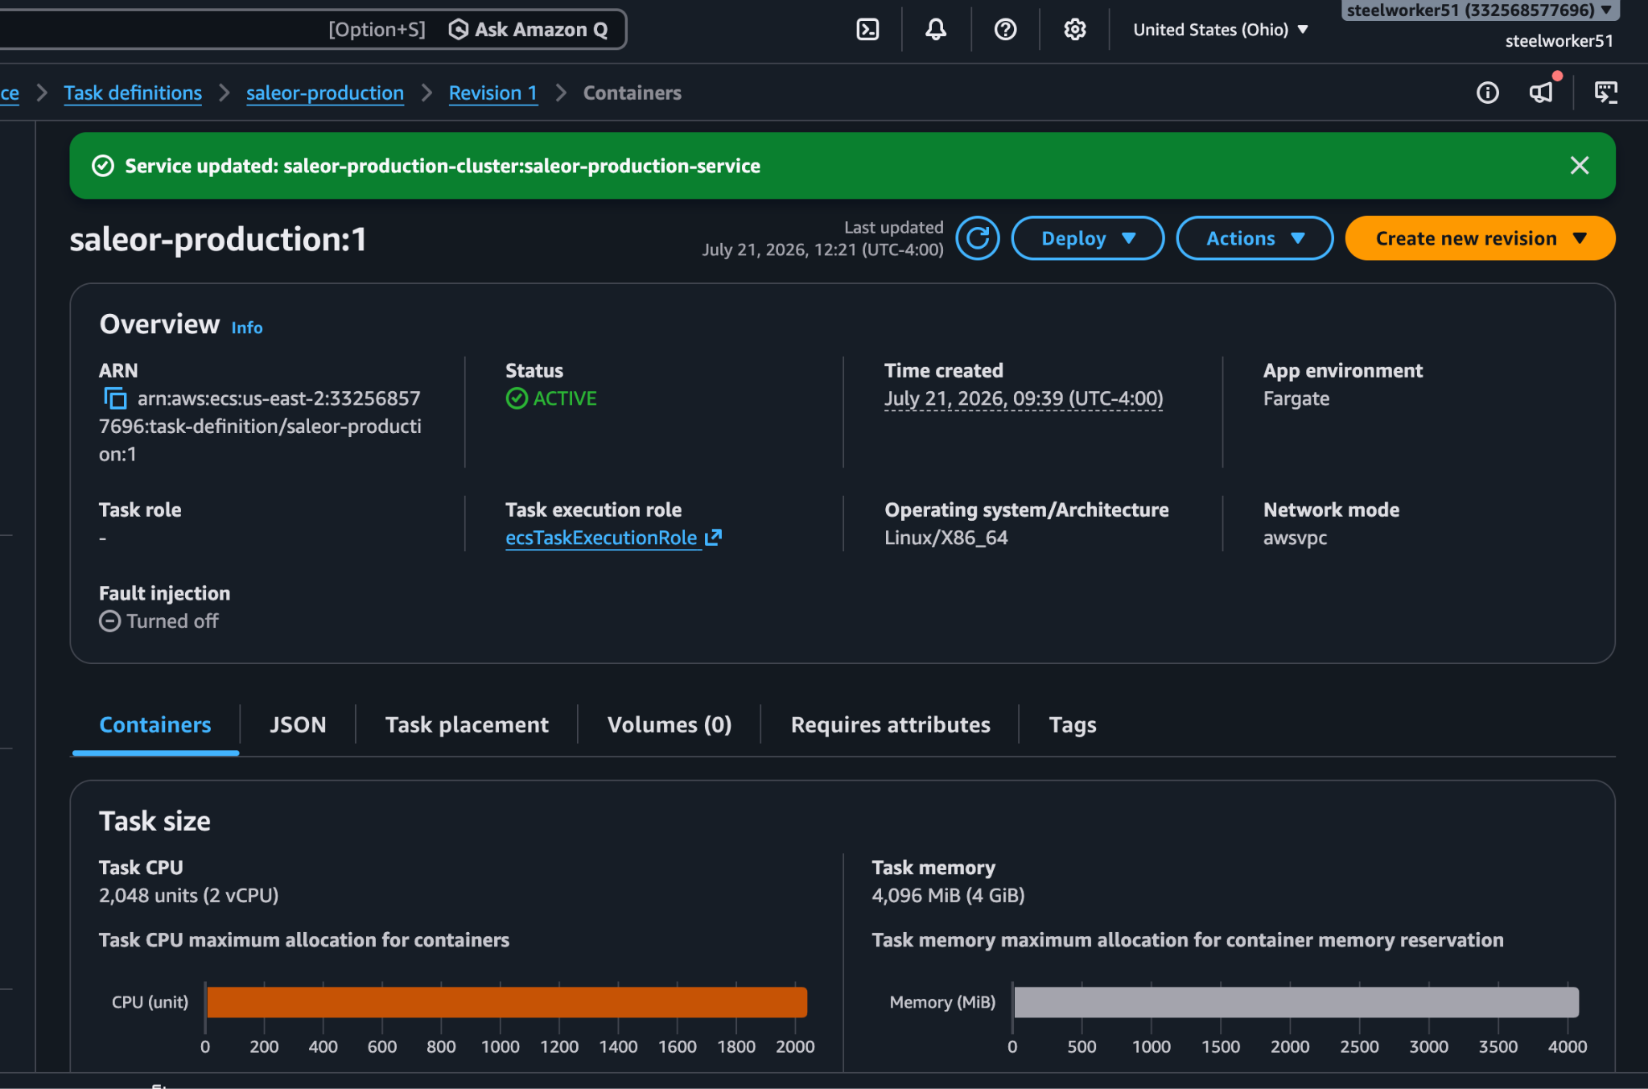
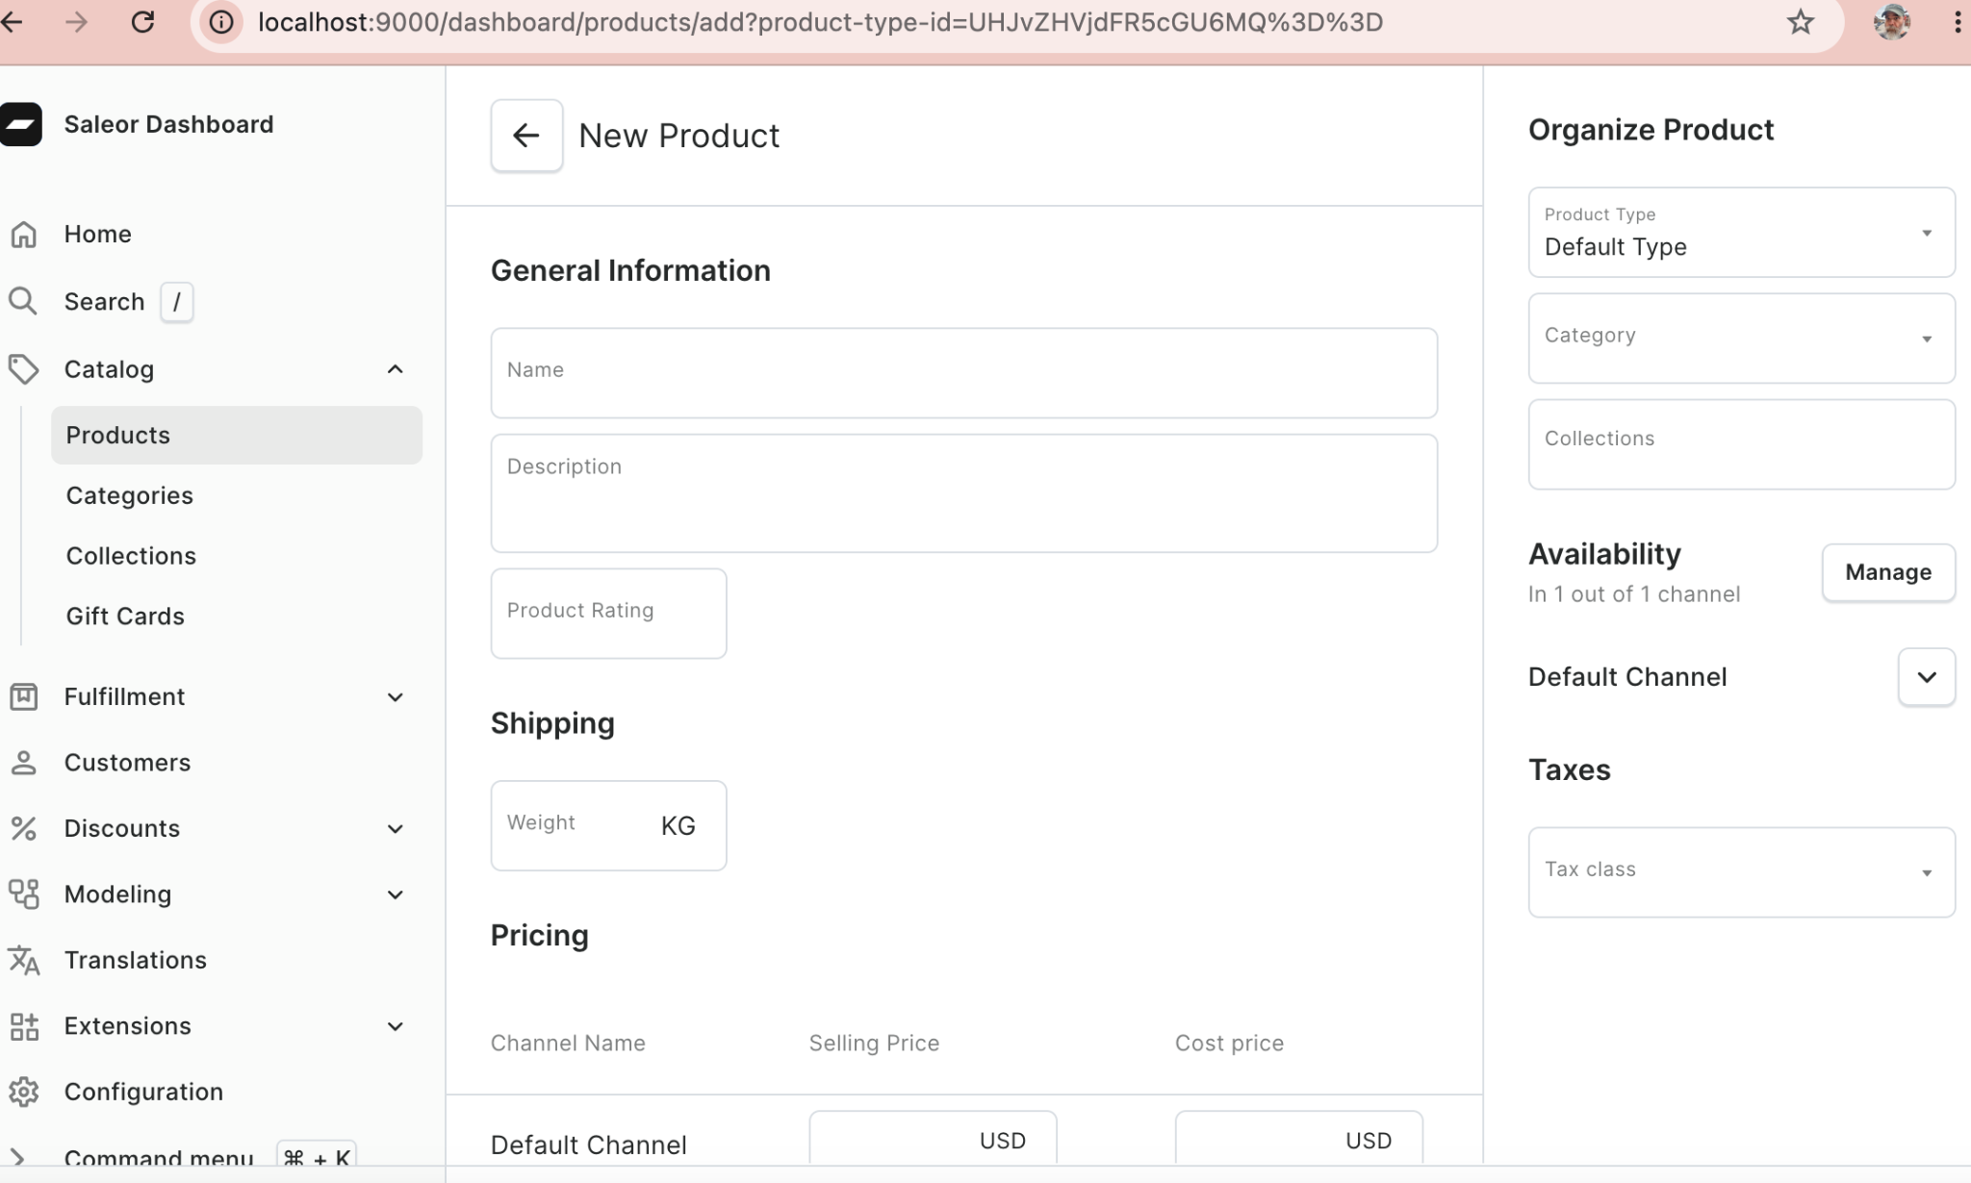
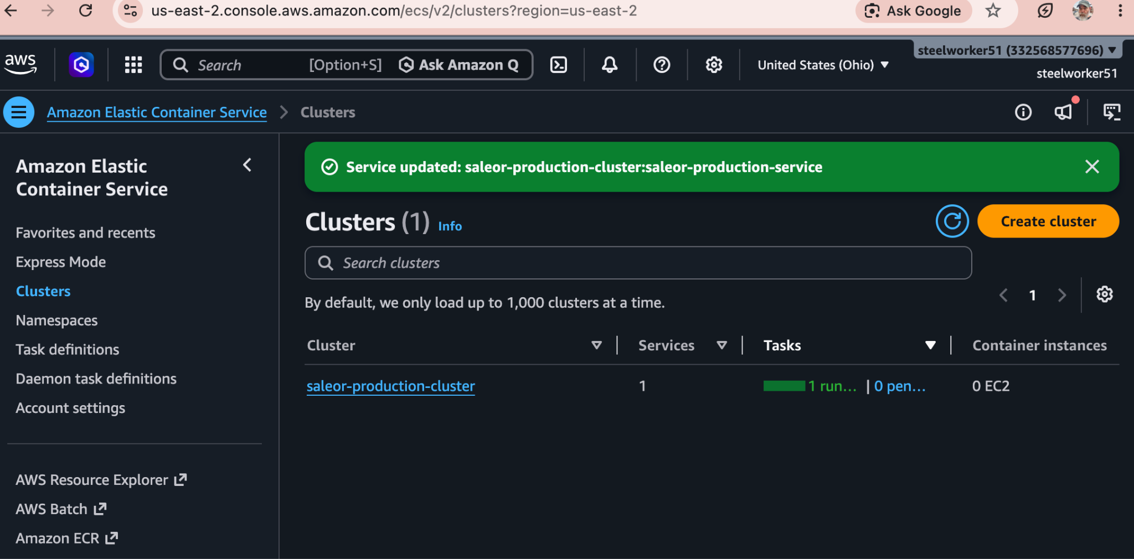
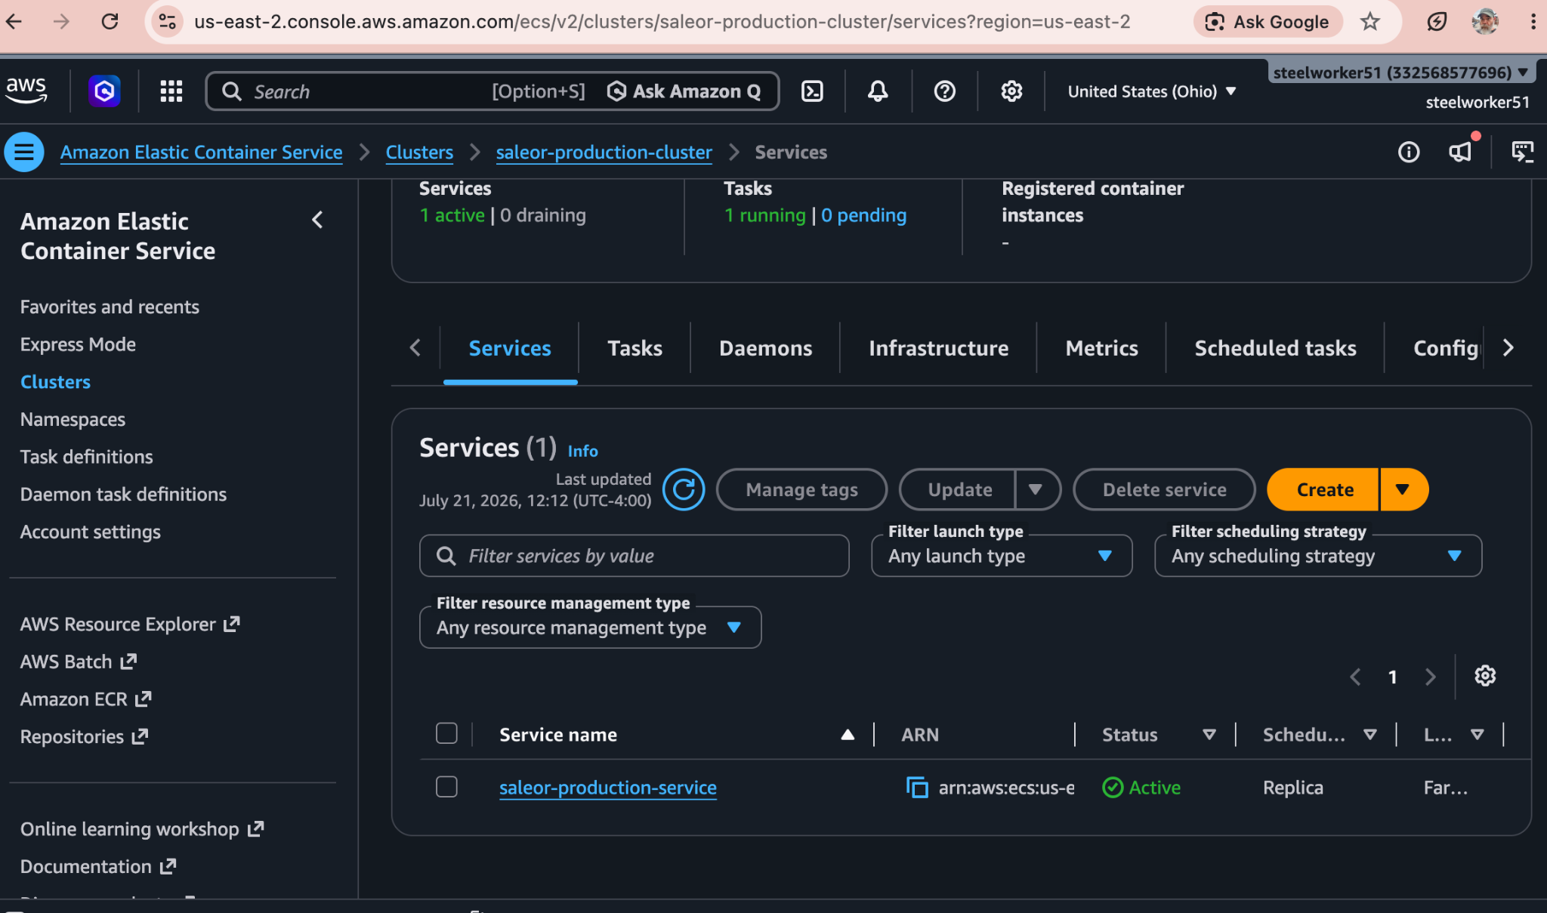
Deployment Screenshots

