Slide 1
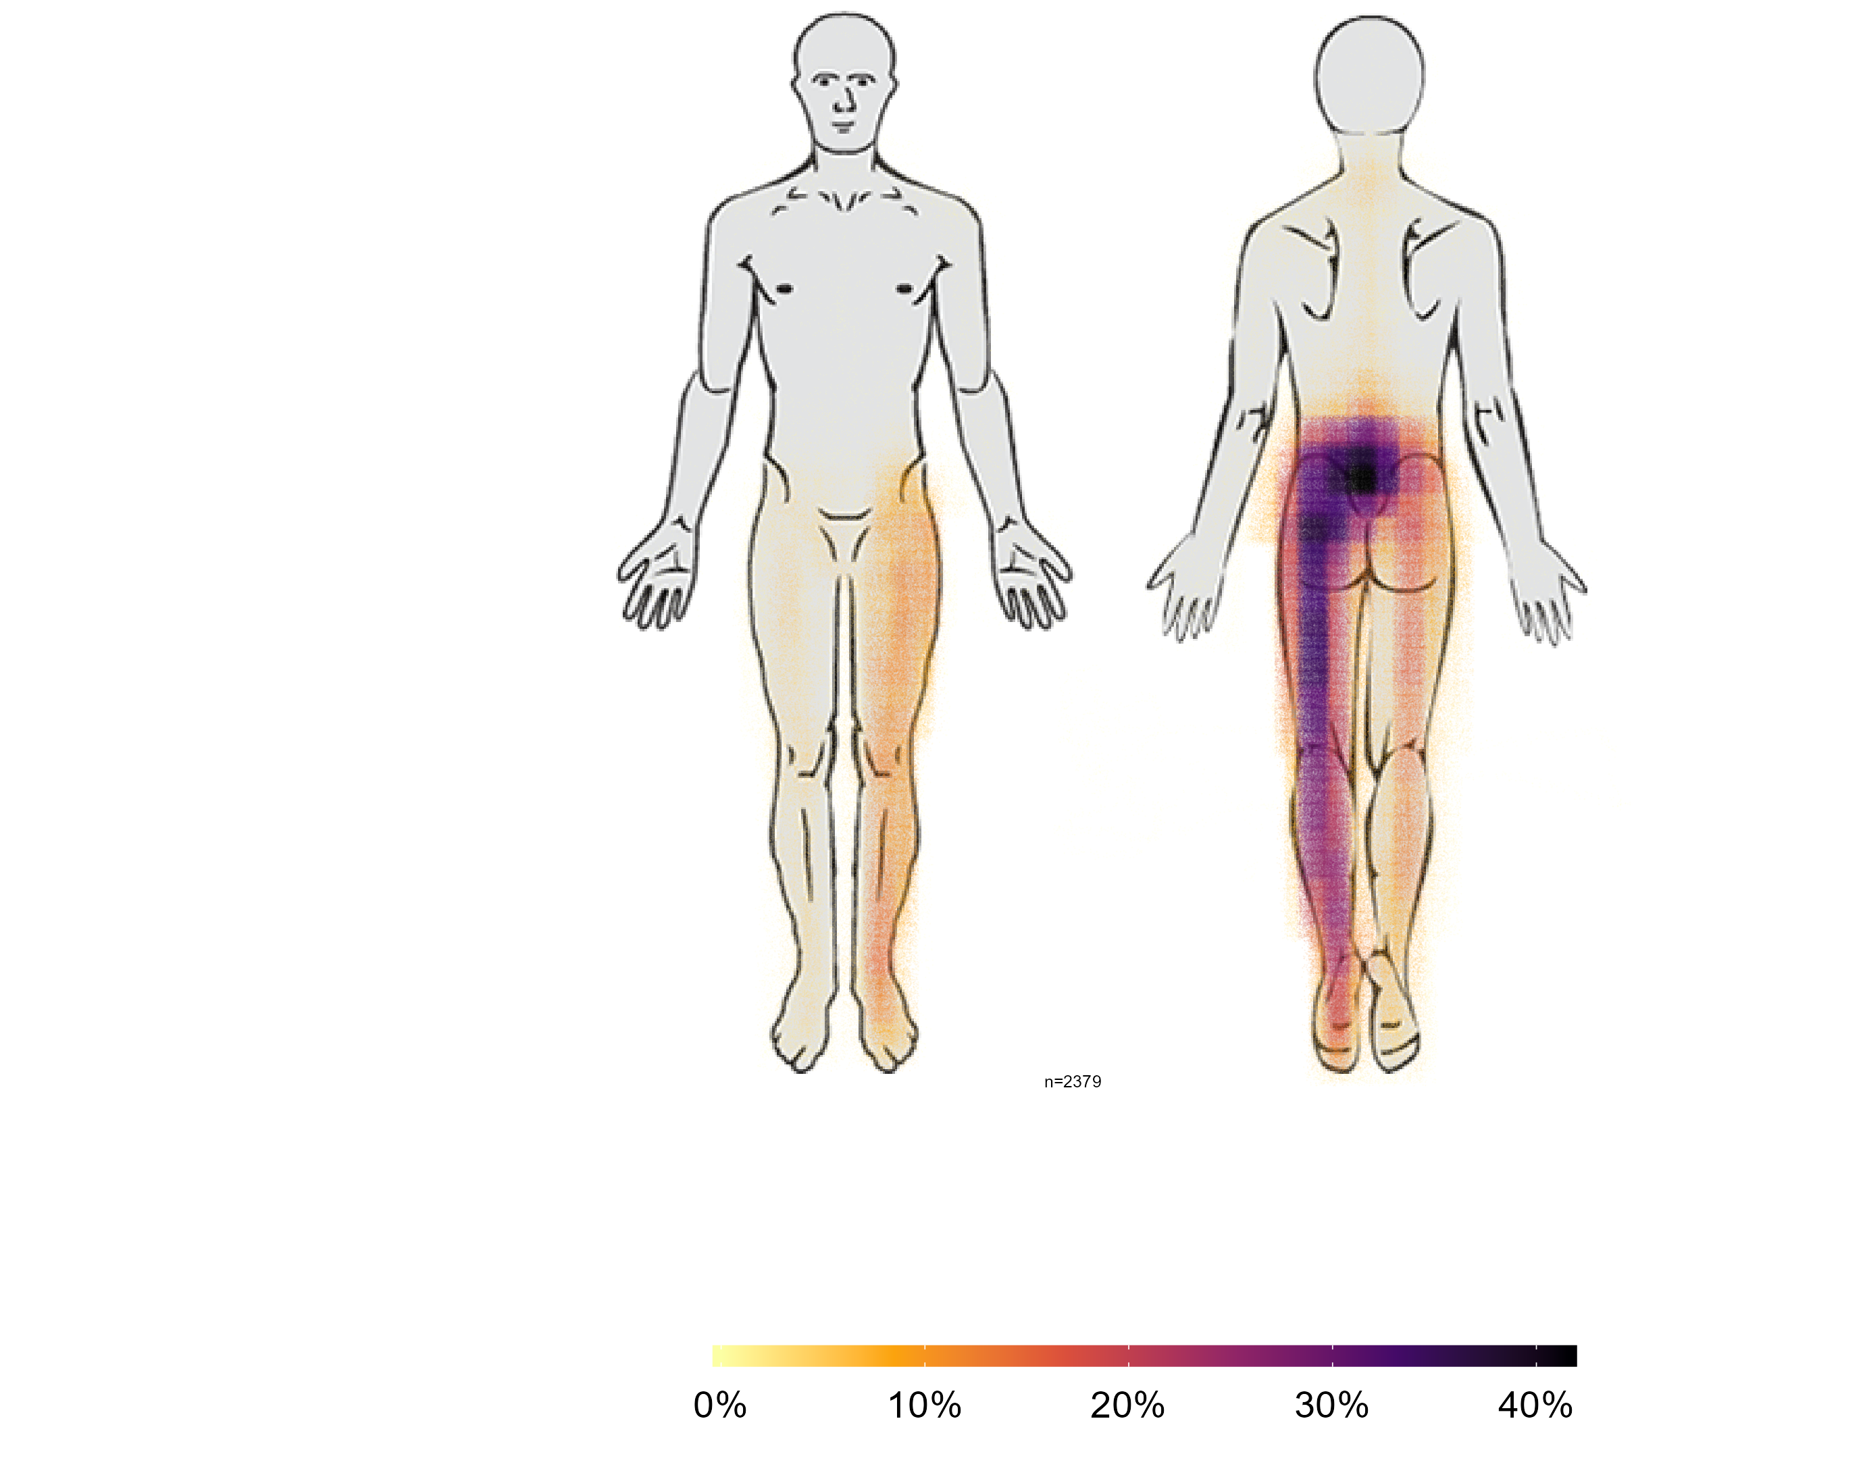
Software solutions to capture and analyze paindrawings paindraw and paindrawr
Steen Flammild Harsted
Søren O’Neill

Slide 2
Where does it hurt?

Slide 3
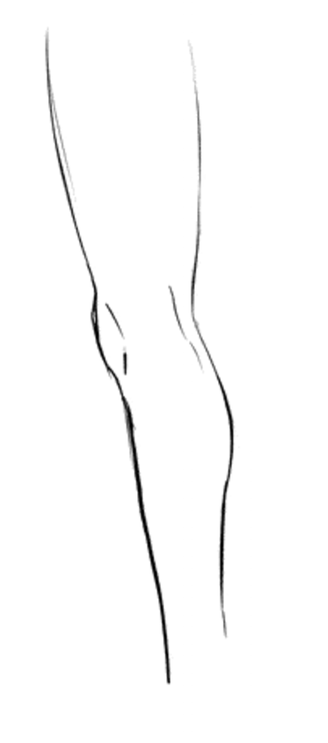

Slide 5
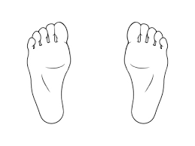
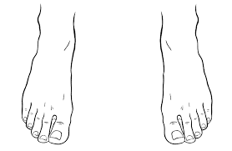

Slide 7
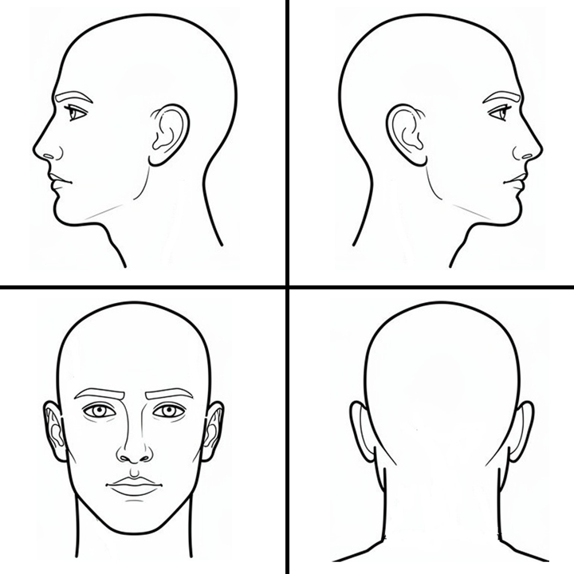

Slide 8
Two obstacles
To collect
To analyze

Slide 9

Collecting Freehand Pain Drawings paindraw

Slide 10

Collecting Freehand Pain Drawings paindraw
Anders Kristian Haakonsson

Slide 11
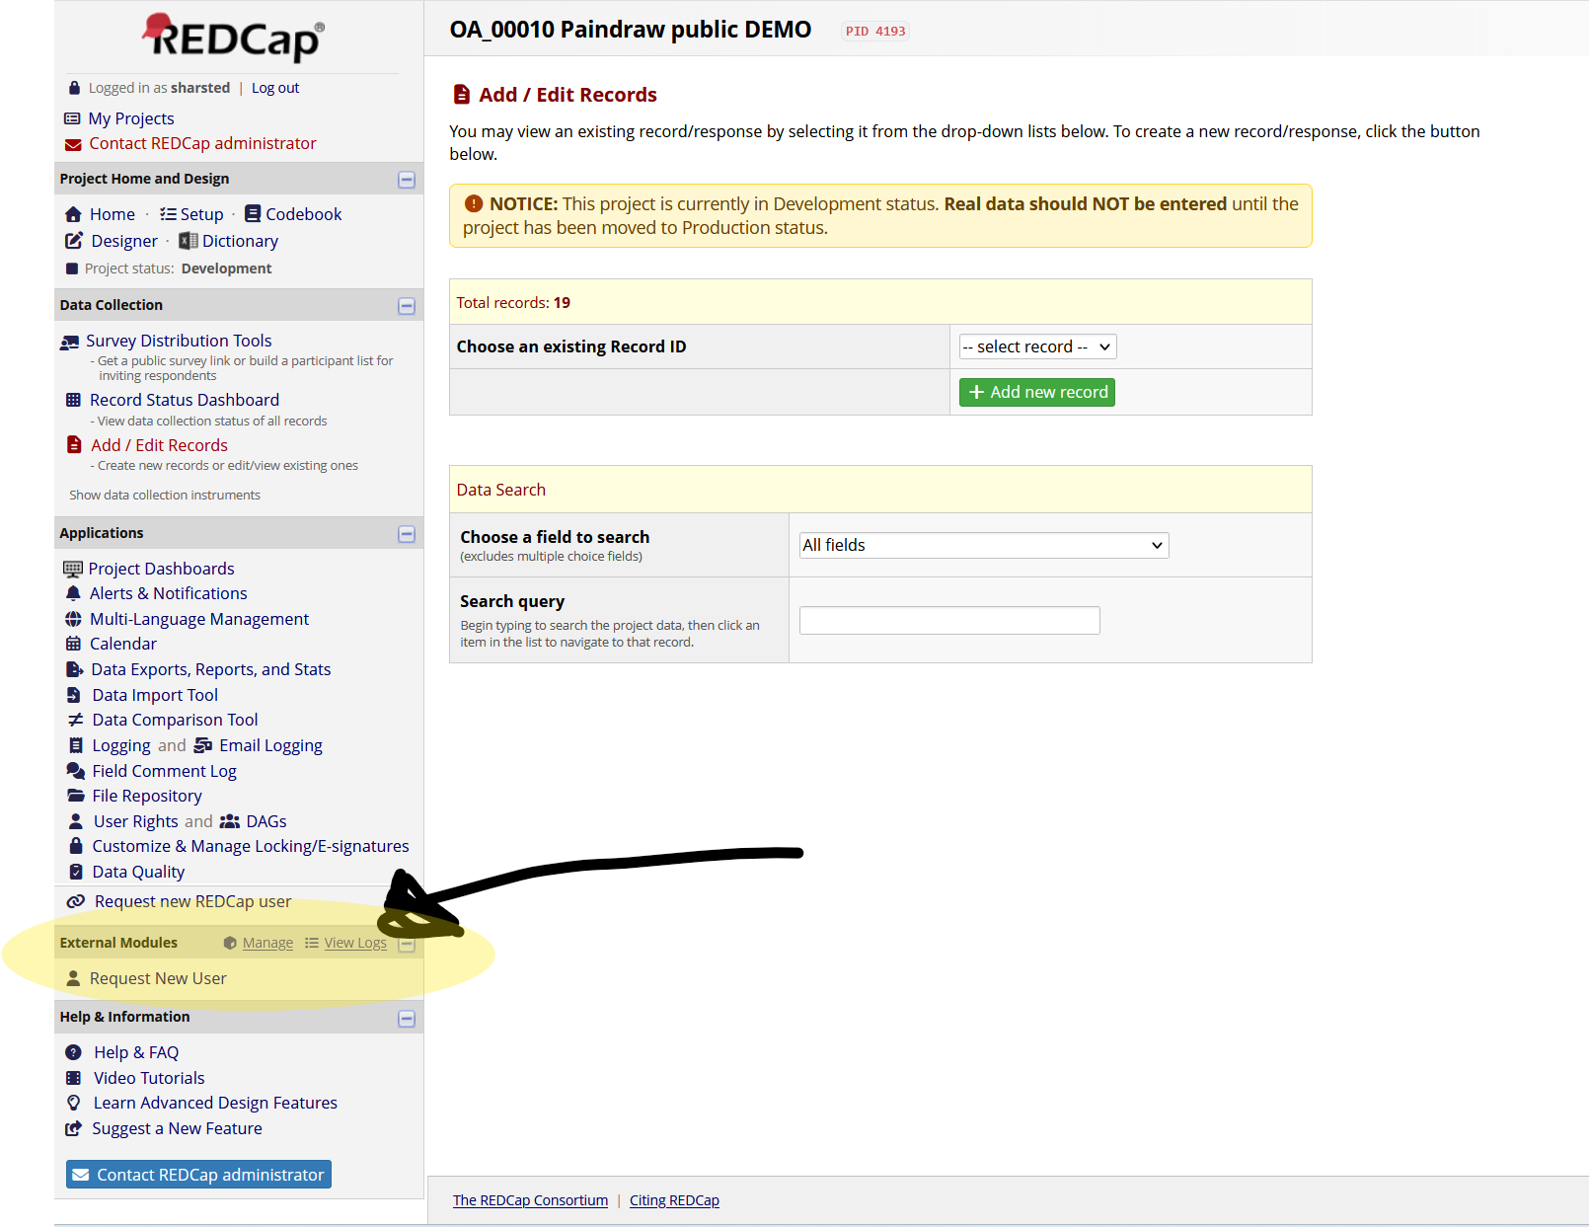

Slide 12
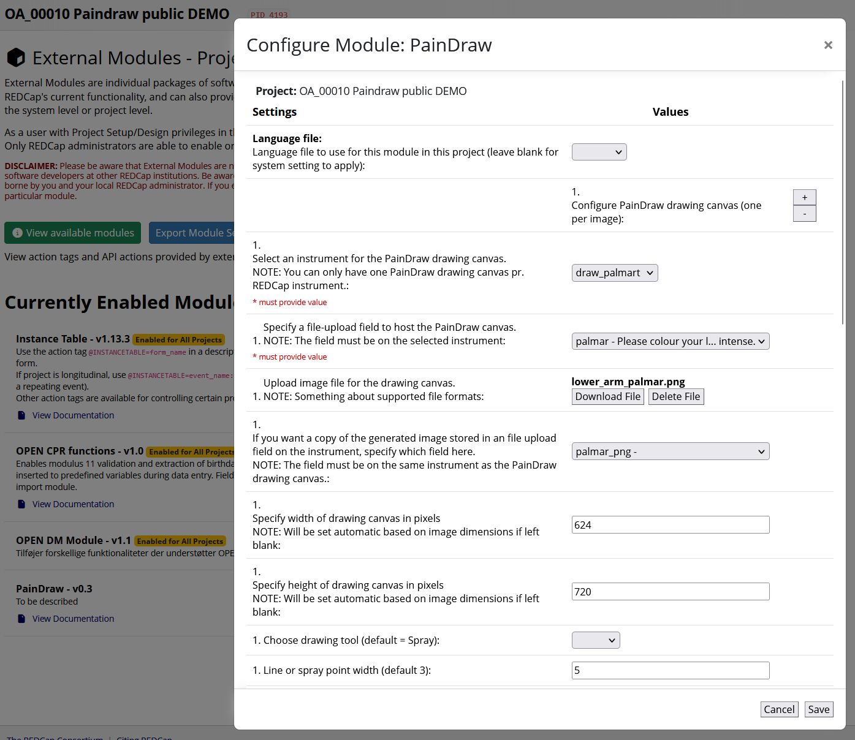

Slide 13
Two tools:
* spray
* pen

Slide 14
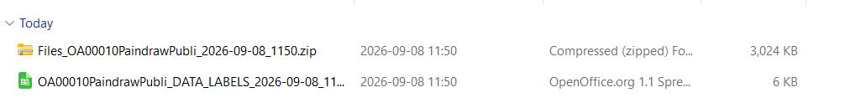
Data export from REDCap

Slide 15

paindrawr

Slide 16
Current experience and practice

Slide 17
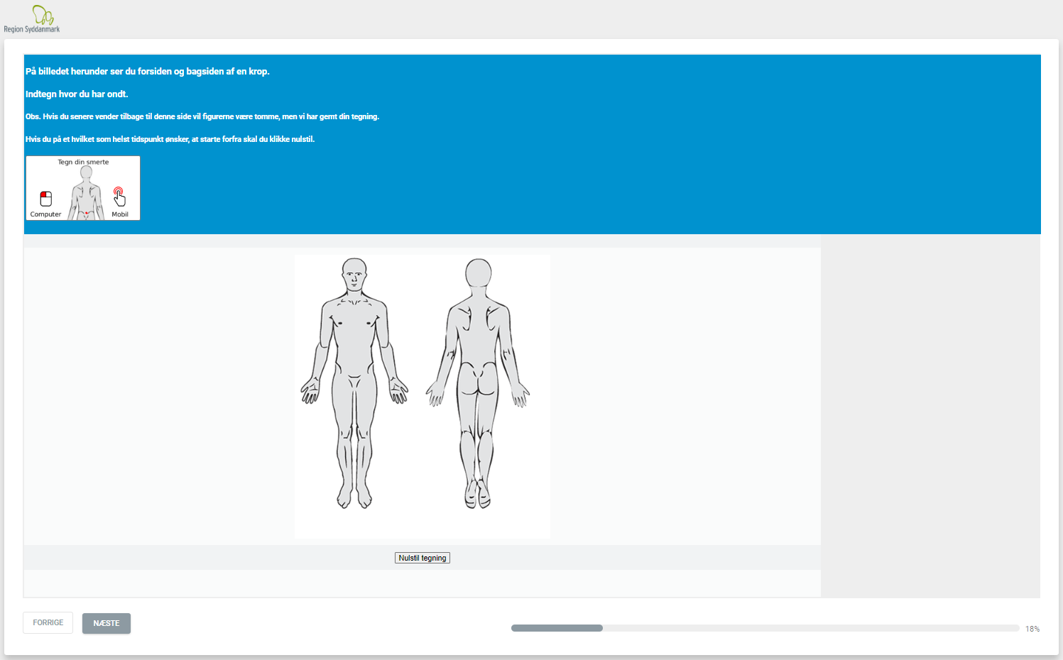
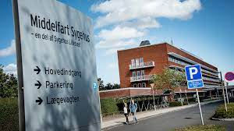

Slide 18
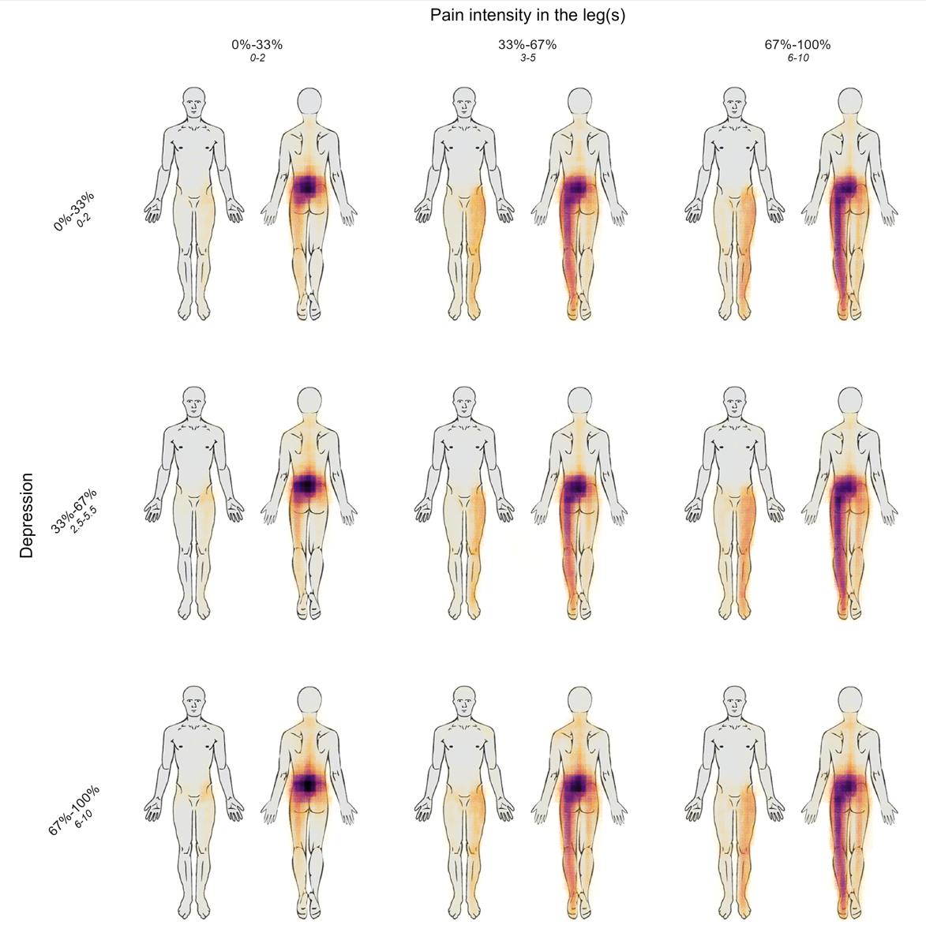

Slide 19
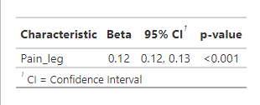
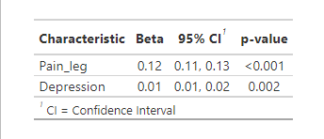
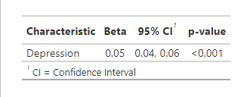
UNI – variable regression
~ 13%
MULTI – variable regression
~ 13%
~ 1%
~ 5%

Slide 20
Latent Class Analysis of Pain Drawings in Stenosis Patients: Identifying and Exploring Subgroup Patterns
James J. Young,
Casper Nim,
Natalie H. S. Chang,
Rikke Krüger Jensen,
Søren O’Neill,
Steen Harsted

Slide 21

N = 2379
Patients diagnosed with stenosis

Slide 22
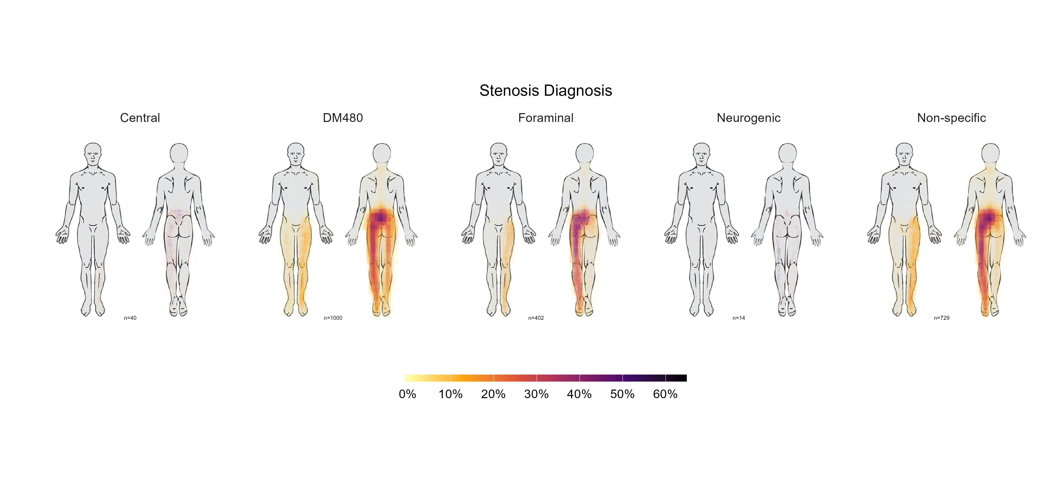

Slide 23
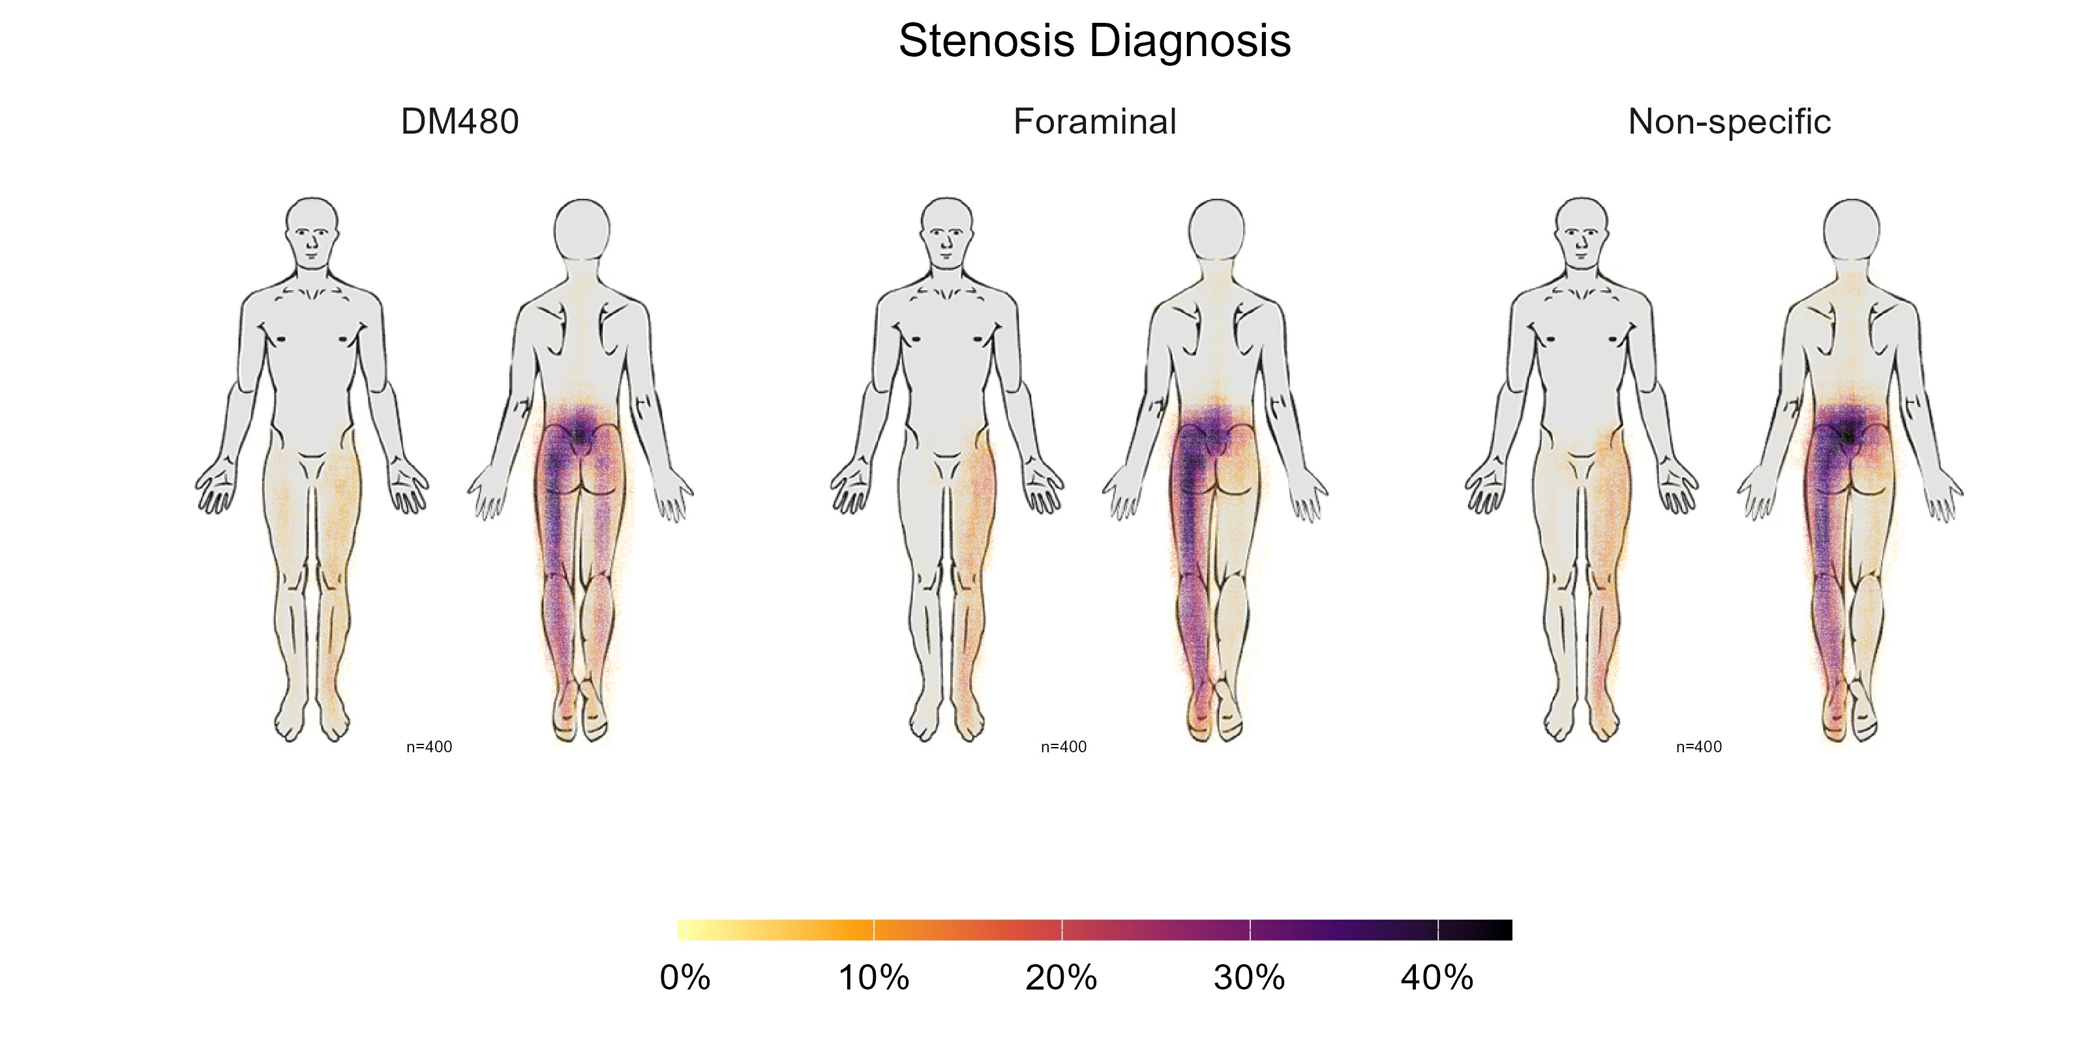

Slide 24
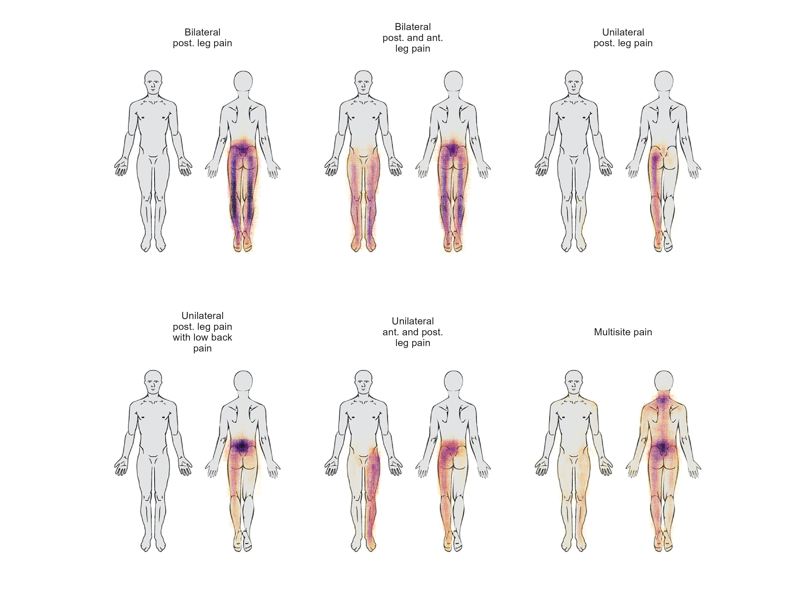
Groups based on Latent Class analysis

Slide 25
Further Potentials and Limitations

Slide 26
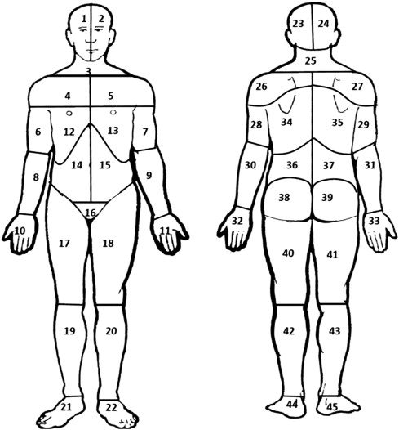

Slide 27
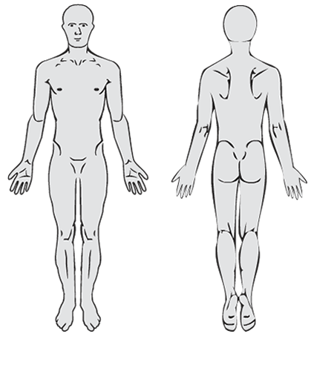
Freehand
Region
Id | pain_drawing
XXX | (,192,140,191,139,189,139,184,139,155,146,123,162,101,180,83,205,79,222,80,232,84,238,89,239,98,241,108,241,115,241,119,241,124,245,130,252,141,268,147,281,155,303,155,315,153,323,147,332,138,338,126,343,108,347,94,348,80,348,67,345,60,340,53,333,43,321,31,300,22,261,22,244,35,227,56,220,88,218,120,218,155,221,198,225,241,230,273,230,303,230,324,230,339,227,346,226,347,225,350,221,352,214,355,206,357,191,359,172,358,152,351,134,343,123,339,117,337,117,335,118,328,121,314,135,301,151,283,178,264,223,256,251,253,274,253,284,253,291,253,296,254,297,)
Id | area__1 | area__2 | area__3 | area__4 | area__5
XXX | 0 | 1 | 0 | 0 | 0

Slide 28
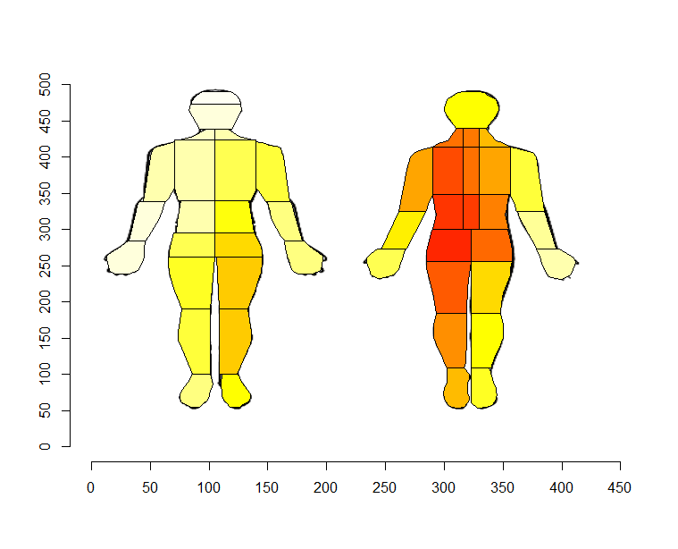
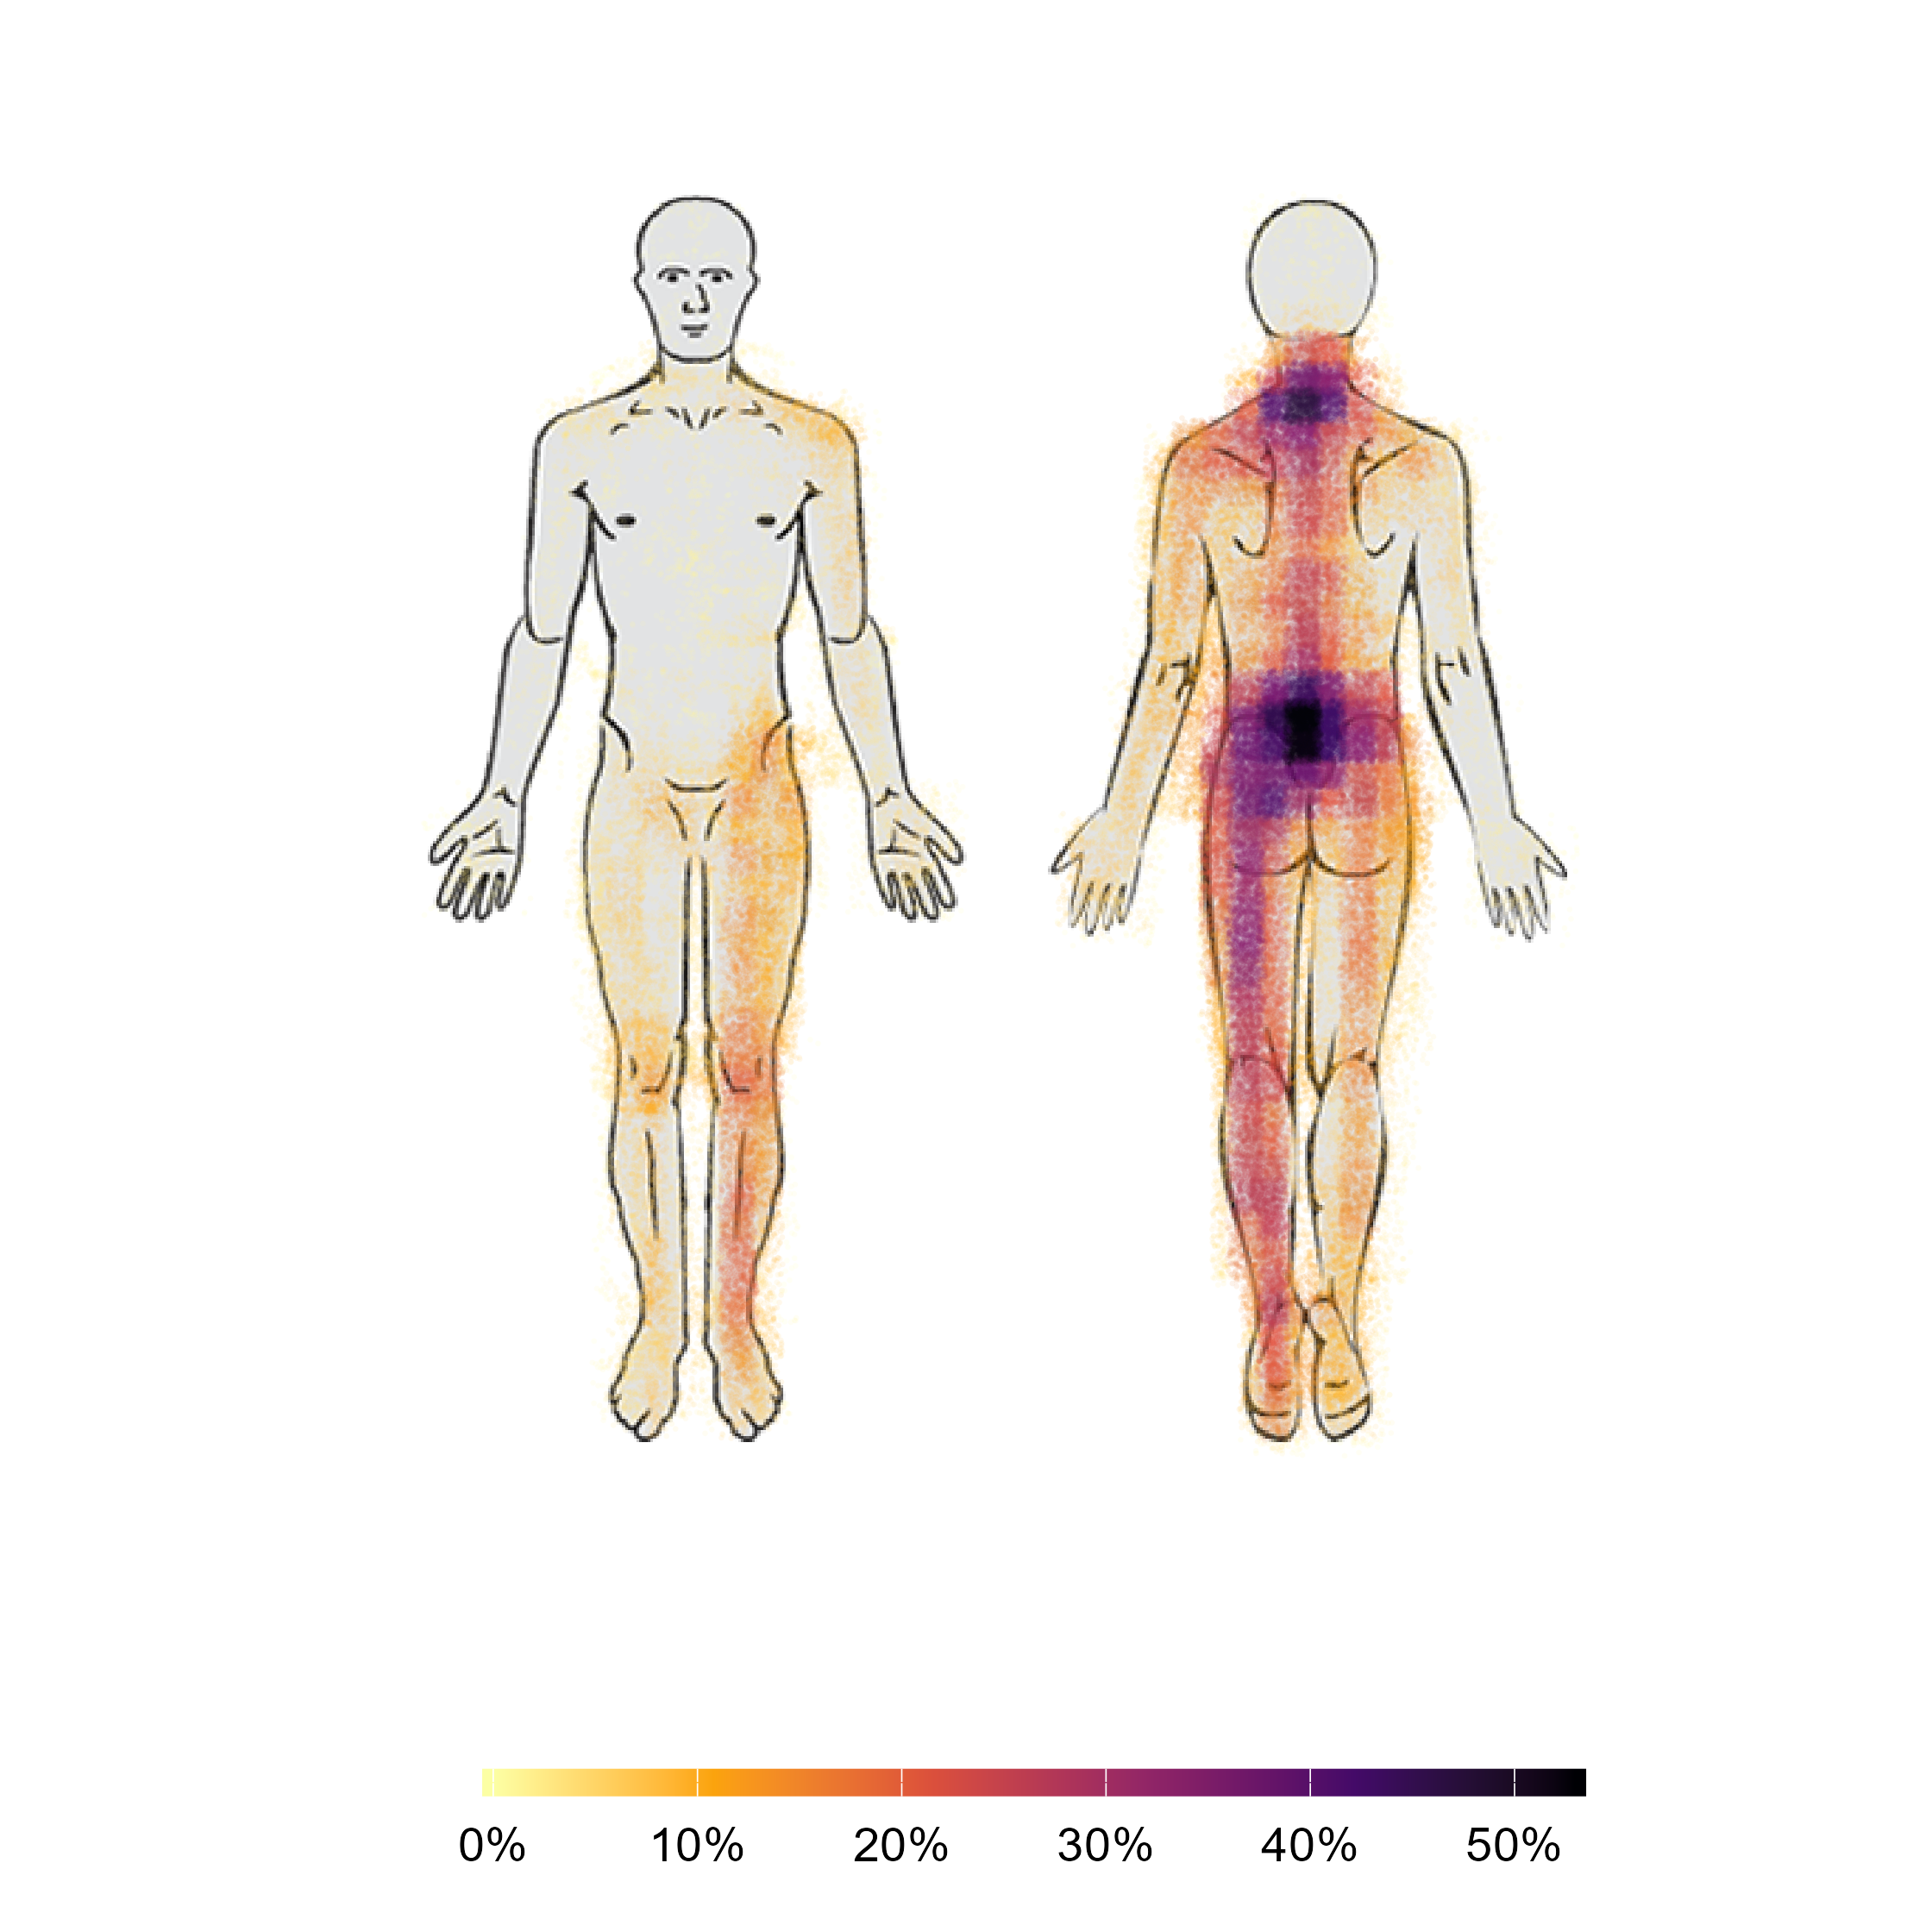
Multisite Pain Group
Freehand
Region

Slide 29
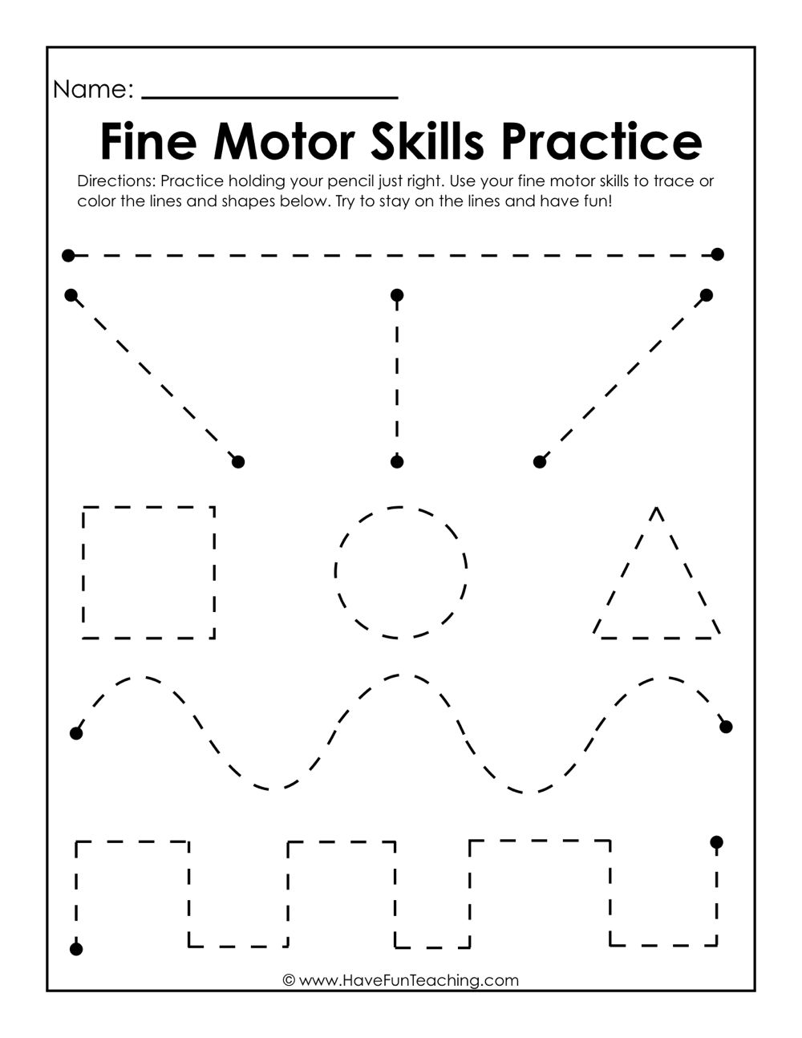

Slide 30
The Freehand Digital Pain Drawing
Coordinates + Background Image

