Slide 1
Li Lab Short Talk
Alec Steep

Slide 2
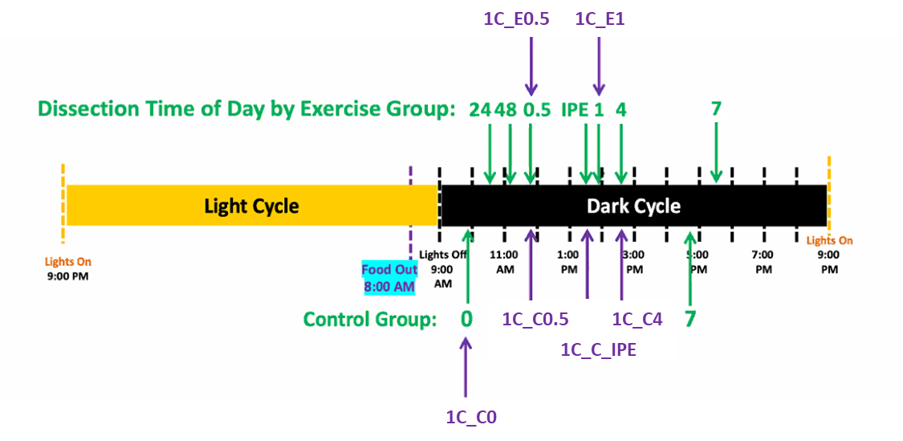
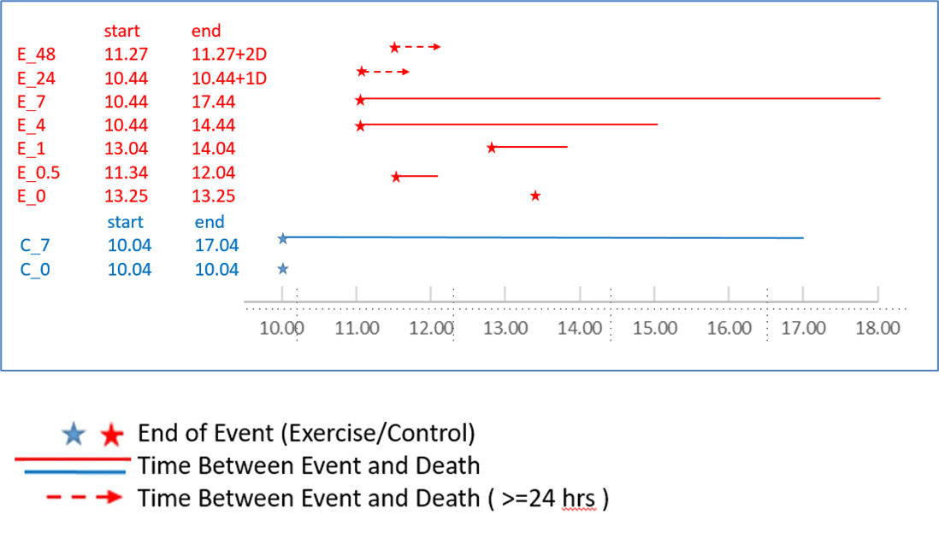
Two Time Frames: Time Post Exercise & Circadian Time
Data in green from original dataset (PASS1A)
Figures generated by
Jun Z. Li
Mathew Wheeler
Notes:
Explain the 9 Groups

Slide 3
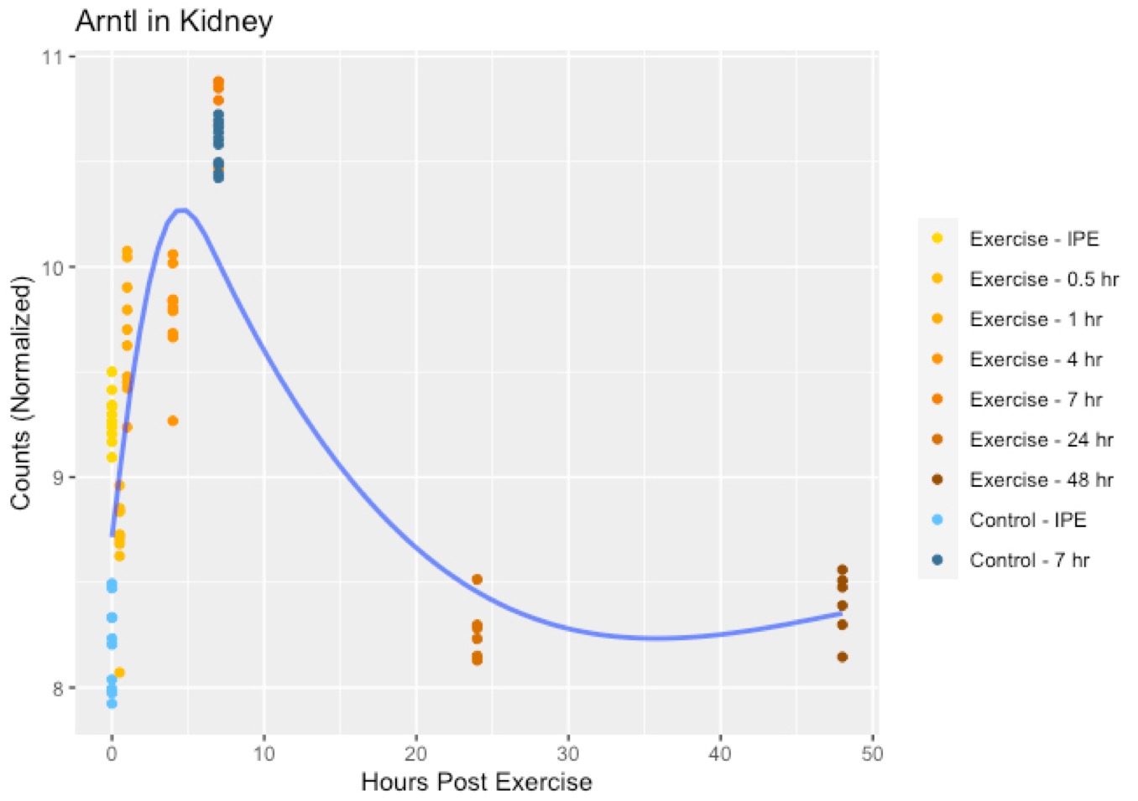
Two Time Frames: Time Post Exercise & Circadian Time
Figures generated by
Jun Z. Li
Mathew Wheeler
Notes:
Explain the 9 Groups

Slide 4
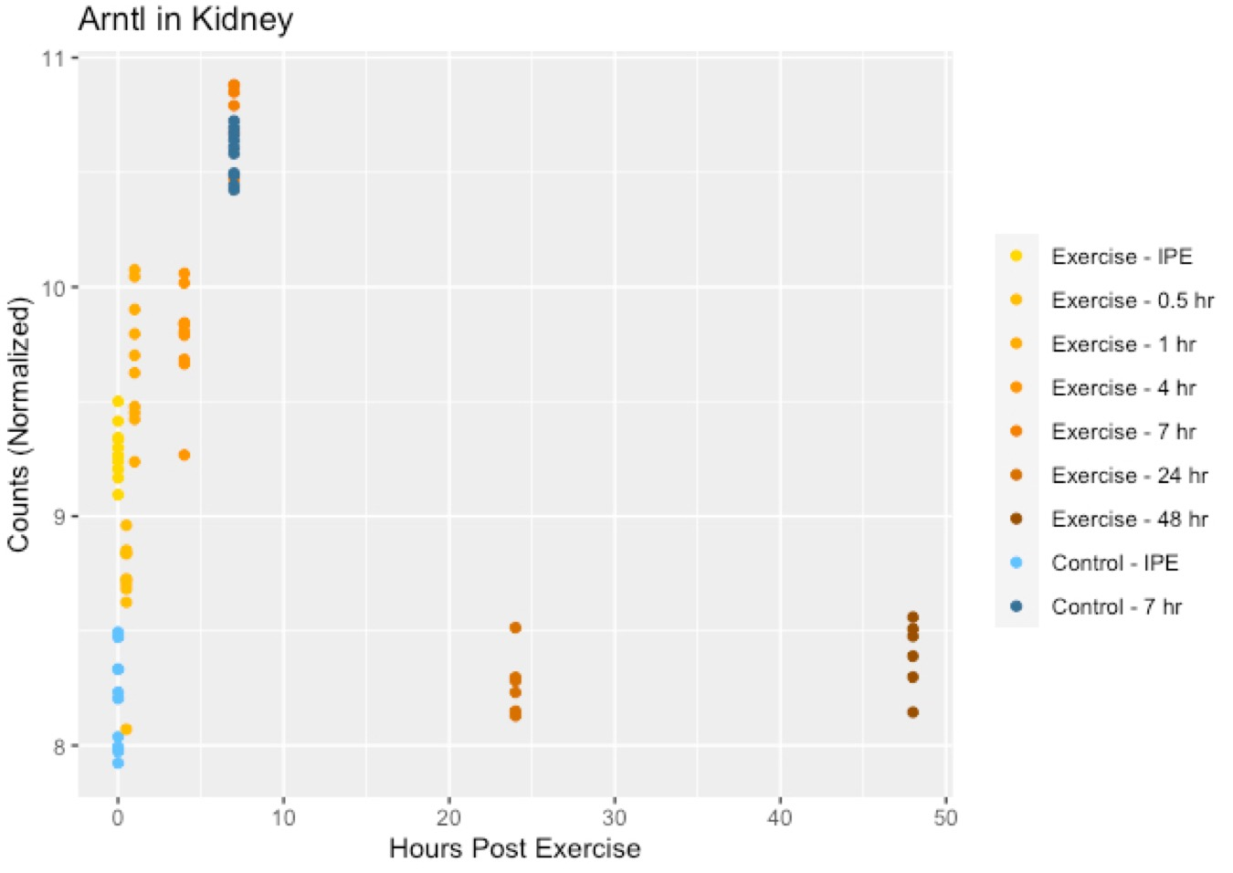
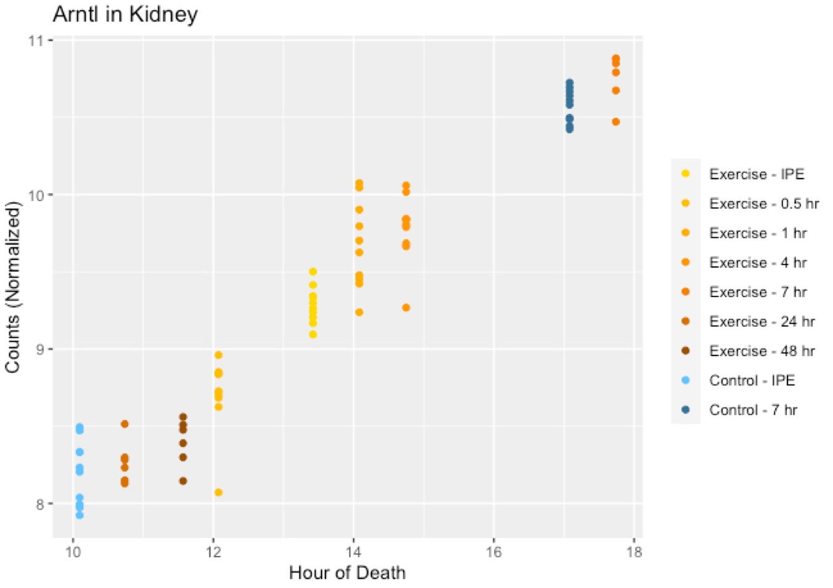
Measuring Exercised & Circadian Effects
Same data used to disentangle the two effects
Best modeled with 2 different time frames
Shuffle and rescale the x-axes
Hours Post Exercise
Time of Day

Slide 5
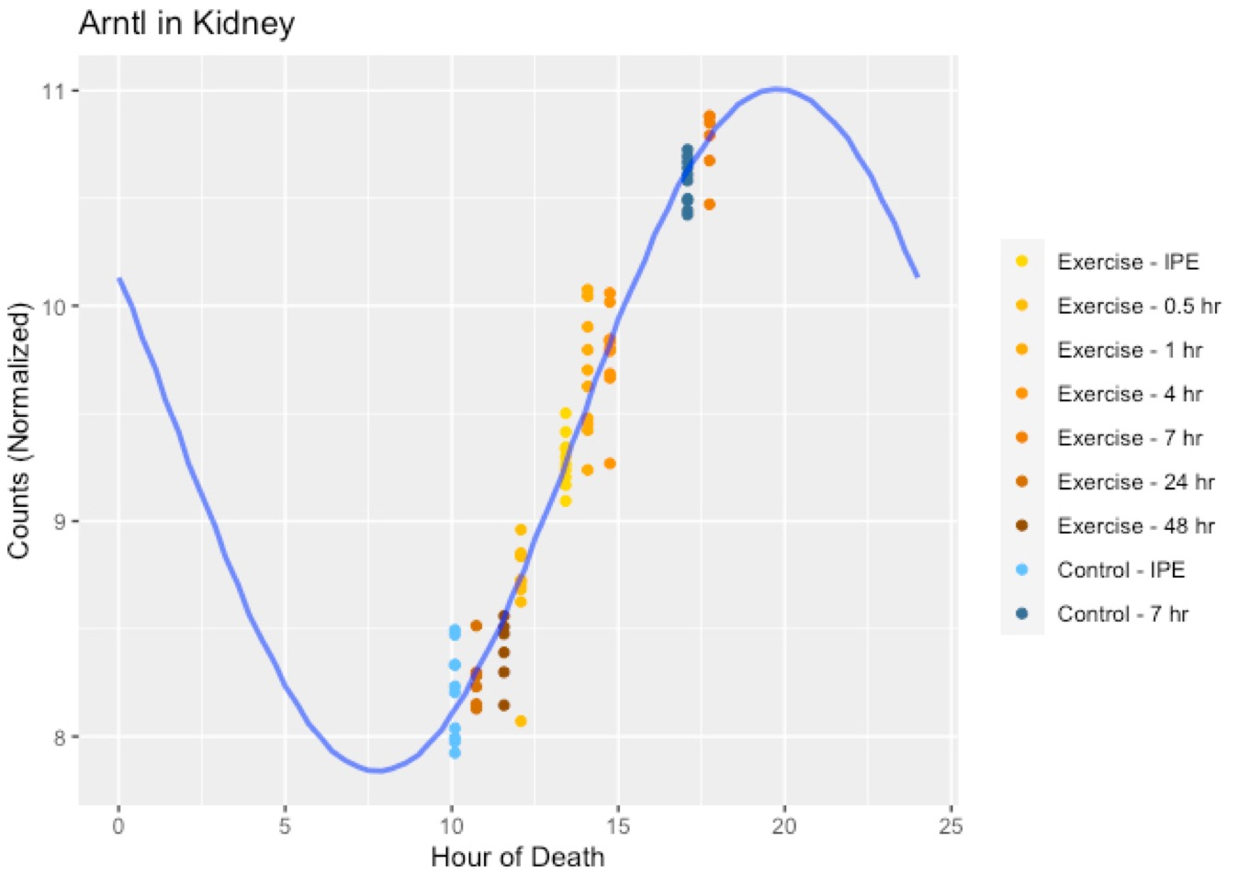

The Goal of this Study
We model contribution of circadian & exercise effects
Compare variance explained by each
We present experiments in data
We summarize results for each individual analyte across tissues
Notes:
In this study:
We evaluate the relative contribution of circadian and exercise effects by modeling the joint presence of both, and comparing the most likely amounts of variance explained by each.
We summarize the results for all genes, and compare across 15 tissues.

Slide 6
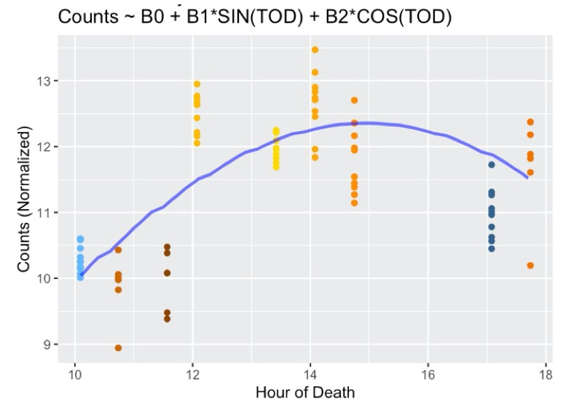
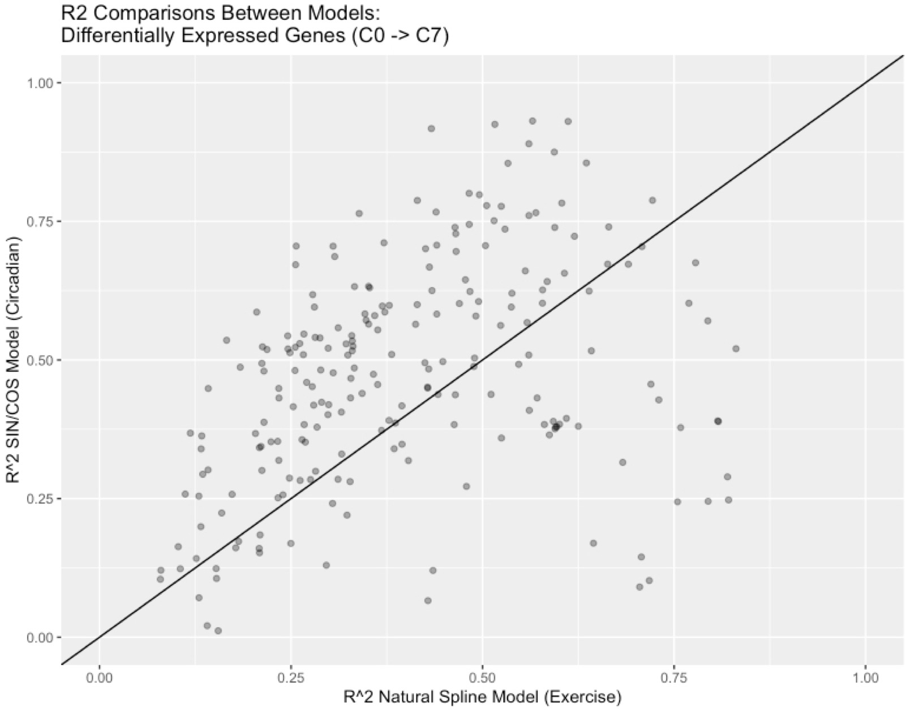
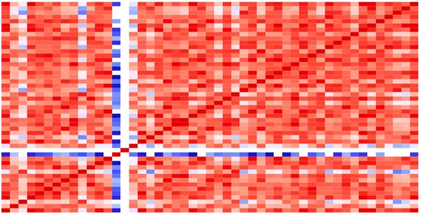
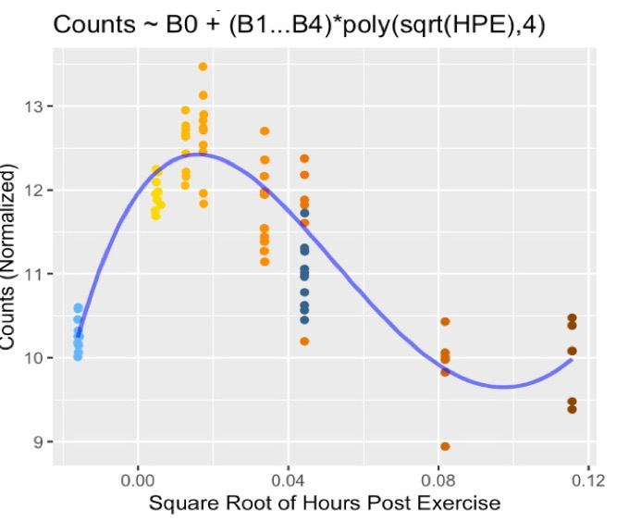
Tissue Specific
Gene Specific
Model Circadian Rhythm
Tissue Specific
Variance Explained
By Models
Tissue Specific
Data QC
Model Acute Exercise
Notes:
Add a list of major RNASeq QC Steps

Slide 7
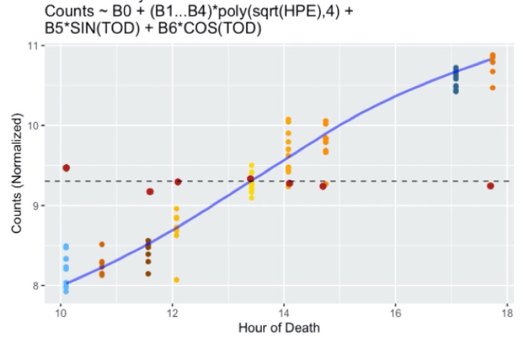
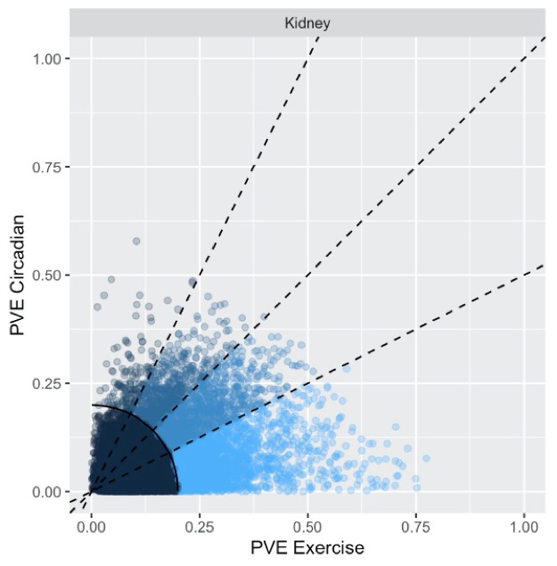
Combined Model
(Exercise + Circadian)
exp_{i} ~ B₀ + B₁(x_{e}) + B₂(x_{e})² + B₃(x_{e})³ + B₄(x_{e})⁴ + B₅SIN(x_{c}) + B₆COS(x_{c})
x_{e} = √ Hours Post Exercise
x_{c} = 2π*(Time of Day)/24
Tissue Specific
Gene Specific
Tissue Specific
Tissue Specific
Joint (Combined) Model
Circadian + Exercise
Variance Explained
By Joint Models
Data QC

Slide 8
Introduction of PASS1C Data PASS1A (Green) PASS1C (Purple)

Slide 9
Three Timepoints that “Match” Match = Identical Exercise Time, Time of Day, and Group All samples between PASS1A and PASS1A are different animals (no PASS1A samples rerun in PASS1C)

Slide 10
Three Timepoints that “Match” Match = Identical Exercise Time, Time of Day, and Group All samples between PASS1A and PASS1A are different animals (no PASS1A samples rerun in PASS1C)
Multi-omic
RNASeq
Metabolomics
Proteomics
…

Slide 11
Three Timepoints that “Match” Match = Identical Exercise Time, Time of Day, and Group All samples between PASS1A and PASS1A are different animals (no PASS1A samples rerun in PASS1C)
Multi-omic
RNASeq
Metabolomics
Proteomics
…

Slide 12
Analysis for Today
Examine the UM metabolomics PASS1A and PASS1C Datasets
Data Structure
Shares Samples and Features
Between PASS1A and PASS1C (PASS’s)
Between tissues (within PASS’s)
Between tissues (within and between PASS’s)
Data Cleaning and QC of example PASS1A and PASS1C dataset
Perform before exploring intersecting samples
Example: gastrocnemius rppos

Slide 13
Note: We will need to re-examine the data from the UM metabolomics core—red flags in data structure (can discuss later)

Slide 14
Data Structure (NxP)
Test + Ref Sams
Test Sams

Slide 15
Data Structure (NxP) (no refs)
Test Sams
Data Structure (N)
Data Structure (P)

Slide 16
Data Structure (NxP) (refs only)
Data Structure (N) (refs only)
Data Structure (P)

Slide 17
Data Structure (NxP) (+ refs)
Across Tissues (NxP) (+ refs)
Across Tissues/PASS’s
(NxP) (+ refs)

Slide 18
Analysis Workflow
Individual Dataset EDA/QC
Shared Dataset EDA/QC

Slide 19
Analysis Workflow
Individual Dataset EDA/QC
Shared Dataset EDA/QC

Slide 20
Examine Markdown File

