Slide 2
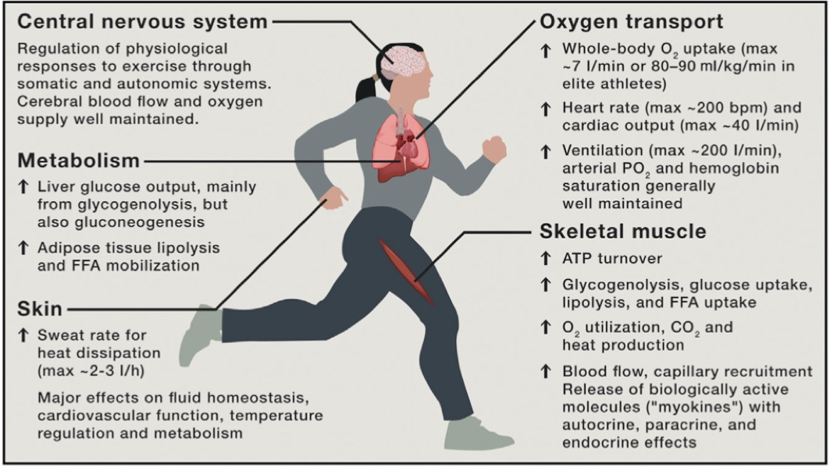
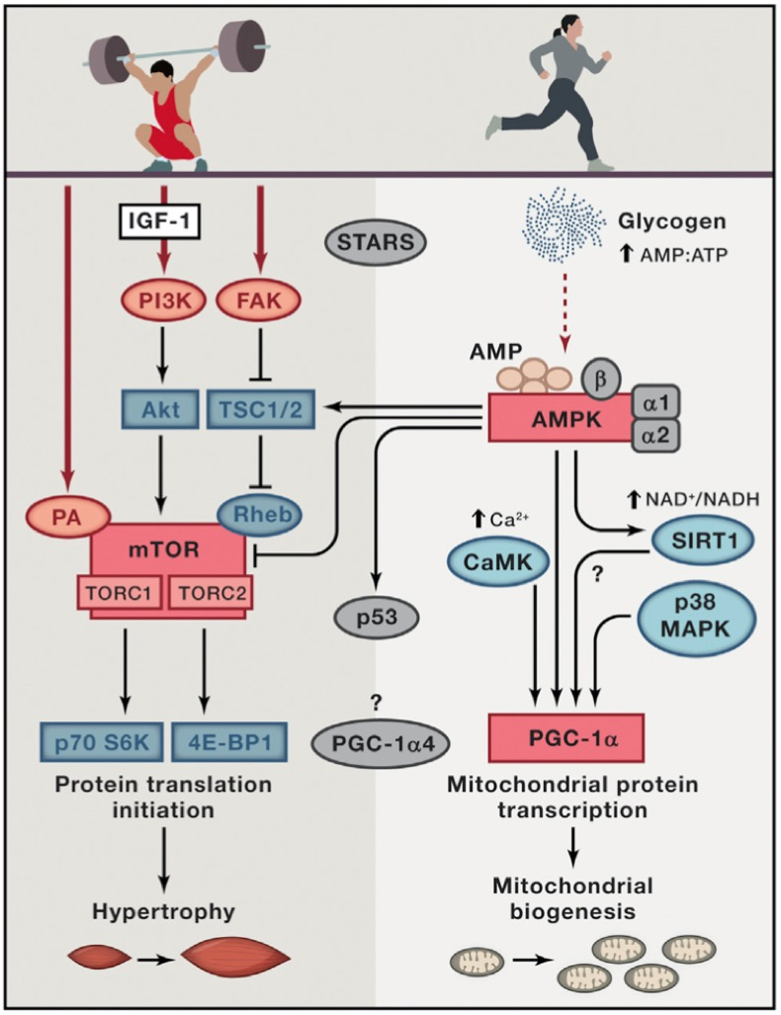
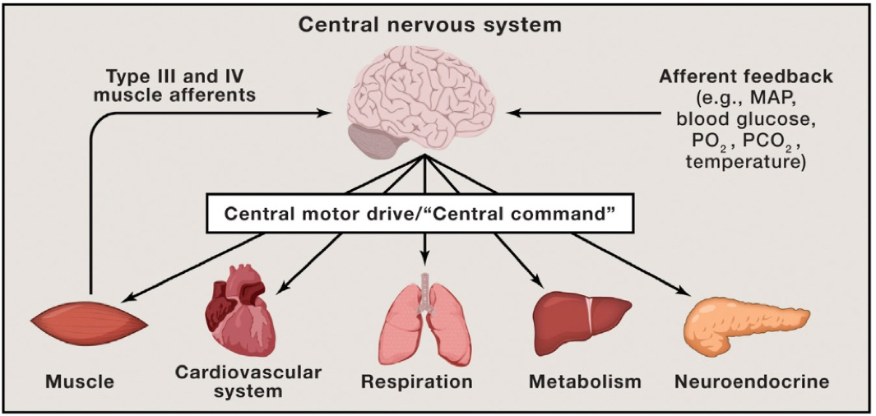
Why Study Exercise?
﻿Hawley, J. A., Hargreaves, M., Joyner, M. J. & Zierath, J. R. Integrative biology of exercise. Cell 159, 738–749 (2014).
Notes:
Why do we study exercise?
To give you just a few reasons...
-We'd like to know how different parts of the body react to exercsie
-How these organs communicate/interact with eachother
-And then how people respond to different types of exercsie
-And how people with different exercise habits react to exercsie

Slide 3
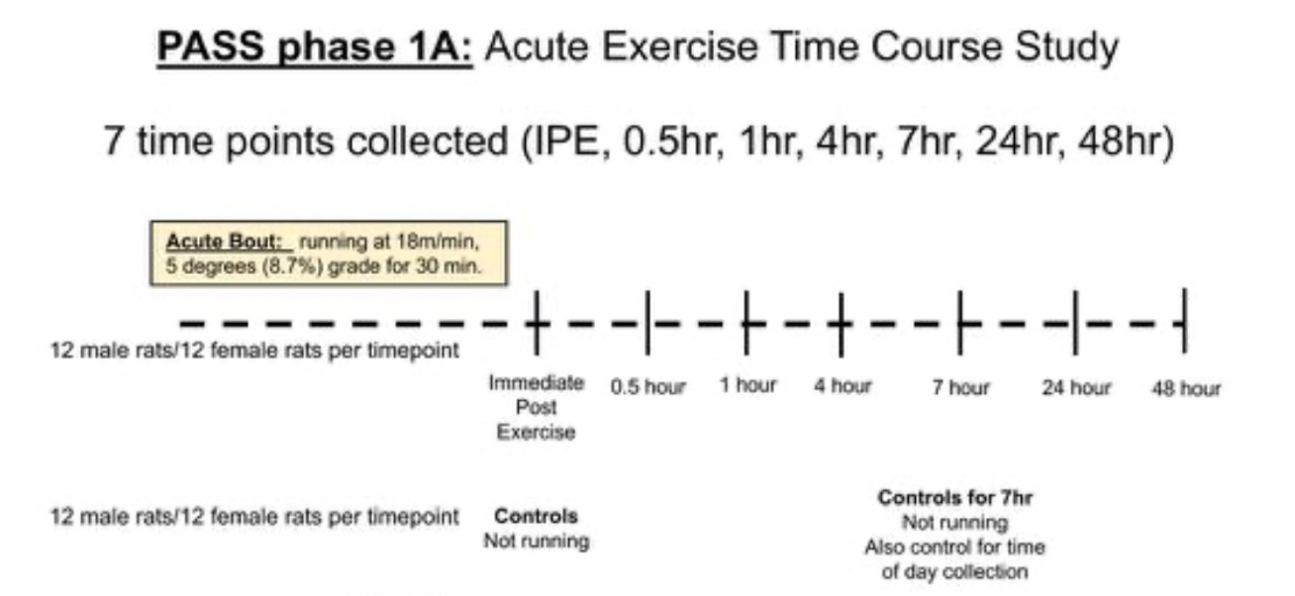
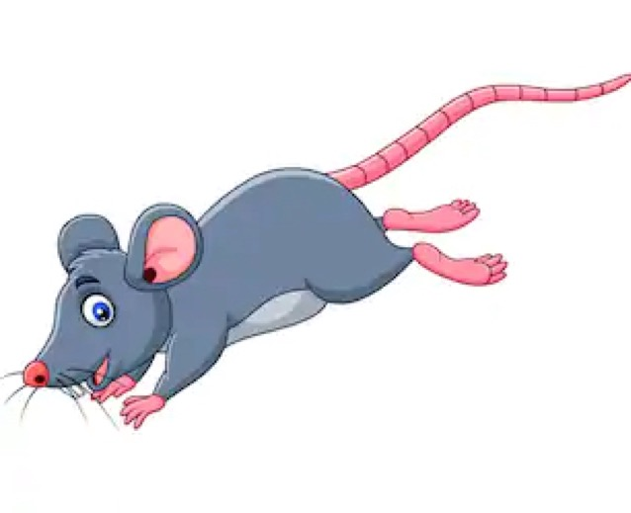
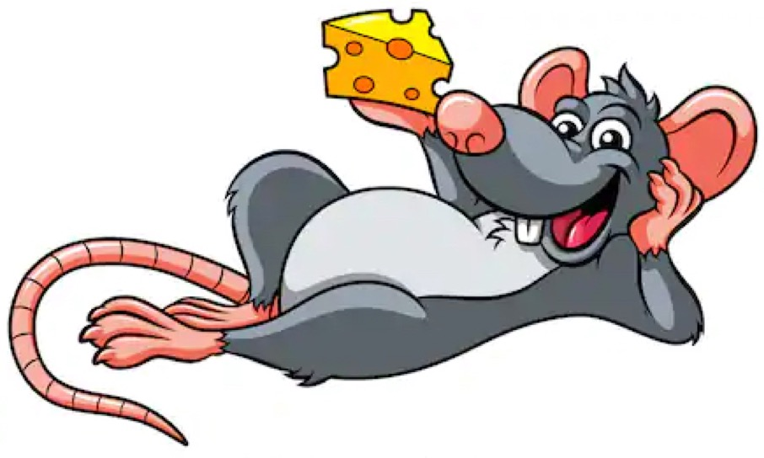
Study Design: PASS1A (Acute Exercise)
MoTrPAC Animal Protocol
Notes:
2 groups of rats
Exercise and sendentary
Exercise: 7 time points
Sendentary or Control Rats: (No Exercise) and were collected at only 2 times (0 hr and 7hr)

Slide 4
Study Design: PASS1A (Acute Exercise)
Adrenal
Hypothalamus
Aorta
Kidney
DNA
Brown Adipose
Liver
White Adipose
Lung
RNA
Cortex
Ovary
Proteins
Gastrocnemius
PaxGene
Heart
Spleen
Metabolites
Hippocampus
Testes
MoTrPAC Animal Protocol
Notes:
16 tissues were taken from each rat (
From each of those tissues, were collected DNA, RNA, Proteins, and Metabolomics

Slide 5
Preliminary Evidence for Circadian Rhythms
PCA Analysis
Differential Gene Expression Experiment
Control 0 hour cohort vs Control 7 hour cohort
Pathway Enrichment Analysis
1.
2.
3.

Slide 6
Study Design: PASS1A (Acute Exercise)
78 Rats x 15 Tissues
Adrenal
Hypothalamus
Aorta
Kidney
Brown Adipose
Liver
White Adipose
Lung
Cortex
Ovary
Gastrocnemius
Spleen
Heart
Testes
Hippocampus
MoTrPAC Animal Protocol
Notes:
78 by 15

Slide 7
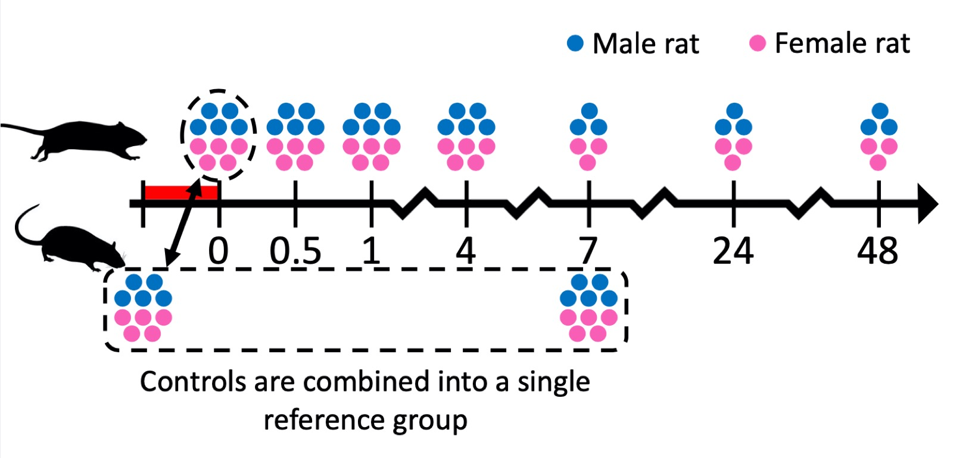
What Drives Variance Between Groups?
Acute endurance exercise induces widespread transcriptional changes across tissues, Nicole Gay
Notes:
So we want to know what drives variance across groups?
This is an approach that is commonly used, this is what Nicole Gay will be discussing today
A strategy to compare controls directly to each exercsie group
That's actually not what I'm going to talk about today, we did something a little different (based on Jun's advice)

Slide 8
Major Claims
New Hypothesis:
Circadian rhythms significantly influence the control-exercise comparisons
Experiment 1: DE genes between Control IPE vs Control 7hr
Circadian Rhythm Genes associated with DE genes
Circadian Rhythm Pathways enriched
Circadian Rhythm Genes Unique to Circadian Rhythm Pathway
Not some other pathway
Experiment 2: DE Gene between 2 comparisons:
Control 0 hr vs Exercise Response Groups
Control 7 hr vs Exercise Response Groups
Different Expression patterns influence comparisons between controls
Degree of exercise response (often) similar to degree of circadian response

Slide 9
Major Claims
New Hypothesis:
Circadian rhythms significantly influence the control-exercise comparisons
Experiment 1: DE genes between Control IPE vs Control 7hr
Circadian Rhythm Genes associated with DE genes
Circadian Rhythm Pathways enriched
Circadian Rhythm Genes Unique to Circadian Rhythm Pathway
Not some other pathway
Experiment 2: DE Gene between 2 comparisons:
Control 0 hr vs Exercise Response Groups
Control 7 hr vs Exercise Response Groups
Different Expression patterns influence comparisons between controls
Degree of exercise response (often) similar to degree of circadian response

Slide 10
C0 vs C7: Differential Expression
Norm/Transformation: Size factors & rlog
Remove Genes < 1 raw read count
One outlier removes in C0 to C7 comparison

Slide 11
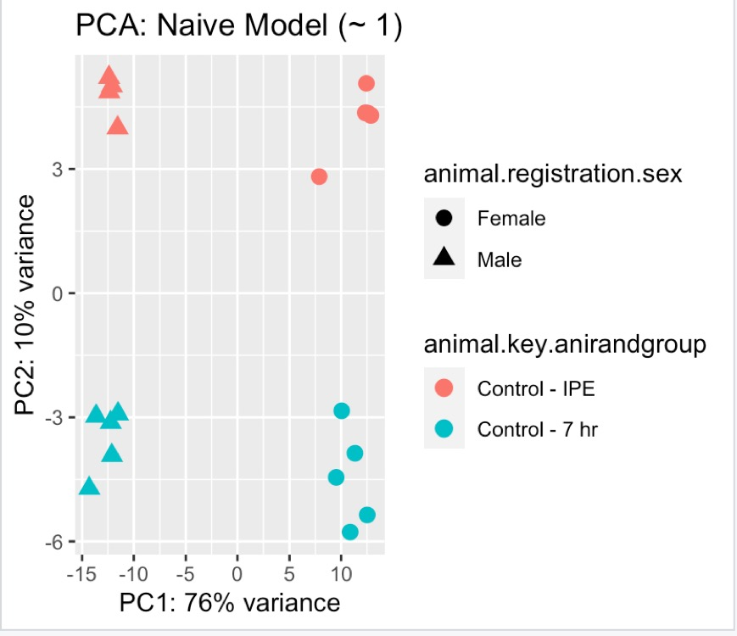
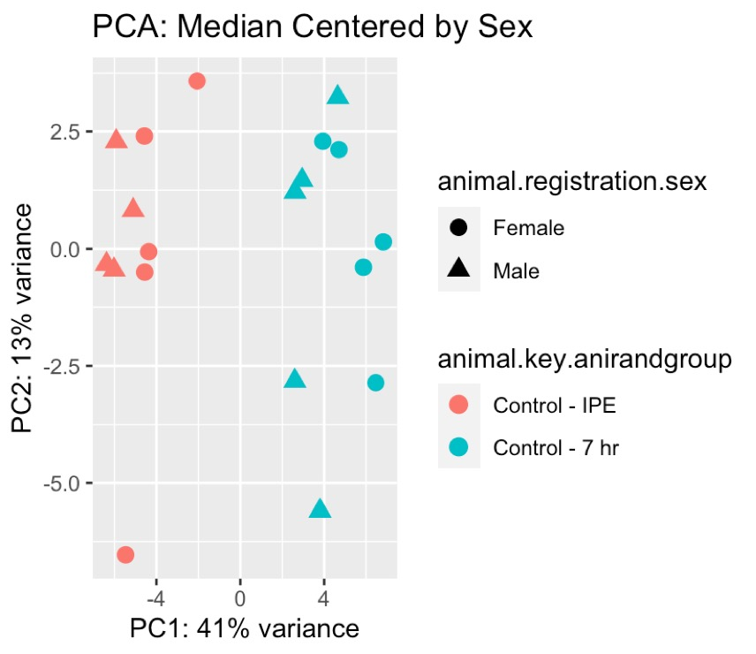
"To adjust for batch effects, we median-centered the expression levels of each transcript within each batch …"
~ Li, J. Z. et al. Circadian patterns of gene expression in the human brain and disruption in major depressive disorder. Proc. Natl. Acad. Sci. U. S. A. 110, 9950–9955 (2013).

Slide 12
2 Experiments
FDR <= 0.5, LFC > 0
Corrected for sex
FDR <= 0.5, LFC >= 0.5
Corrected for sex
LFC Norm (0.5-1.5)

Slide 13
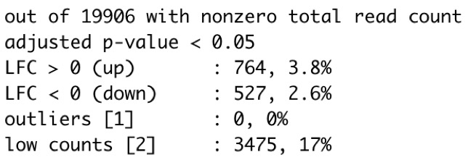
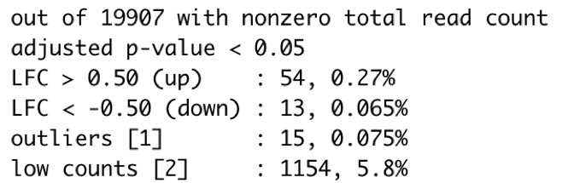
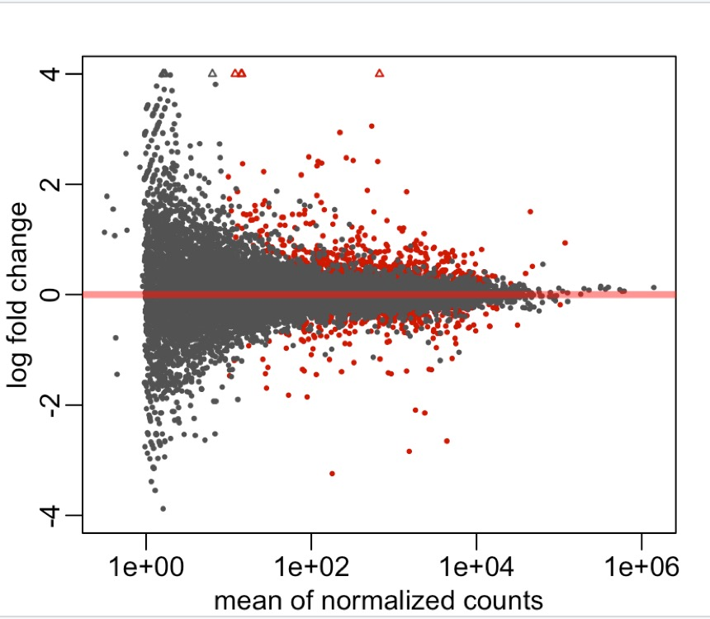
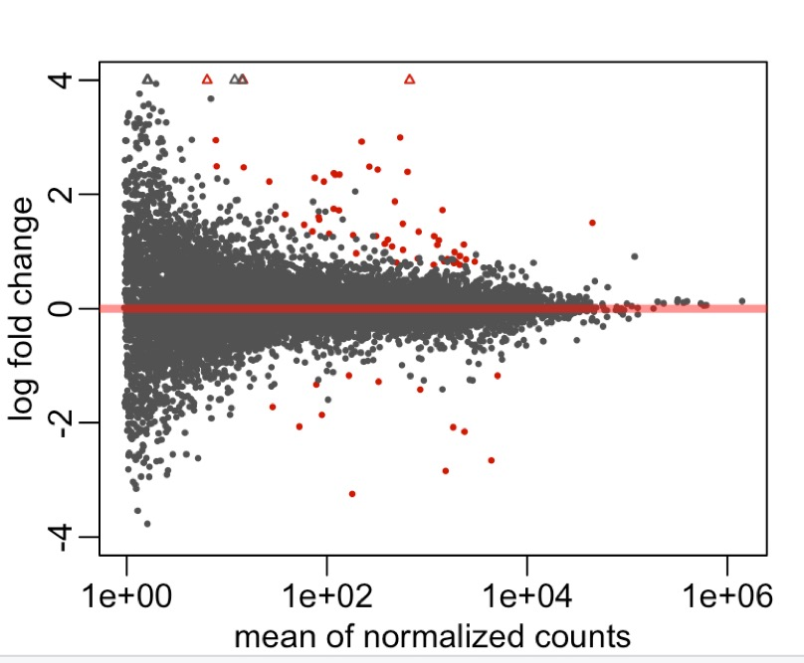
FDR <= 0.5, LFC > 0
FDR <= 0.5, LFC >= 0.5

Slide 14
Major Claims
New Hypothesis:
Circadian rhythms significantly influence the control-exercise comparisons
Experiment 1: DE genes between Control IPE vs Control 7hr
Circadian Rhythm Genes associated with DE genes
Circadian Rhythm Pathways enriched
Circadian Rhythm Genes Unique to Circadian Rhythm Pathway
Not some other pathway
Experiment 2: DE Gene between 2 comparisons:
Control 0 hr vs Exercise Response Groups
Control 7 hr vs Exercise Response Groups
Different Expression patterns influence comparisons between controls
Degree of exercise response (often) similar to degree of circadian response

Slide 15
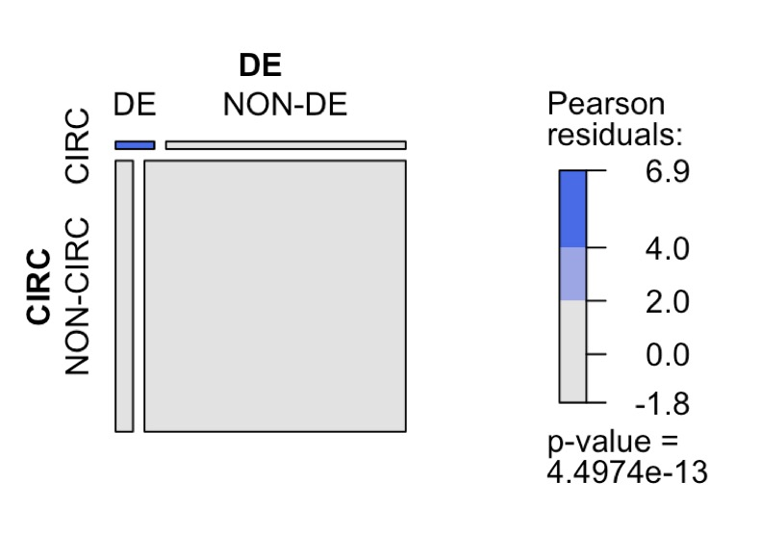
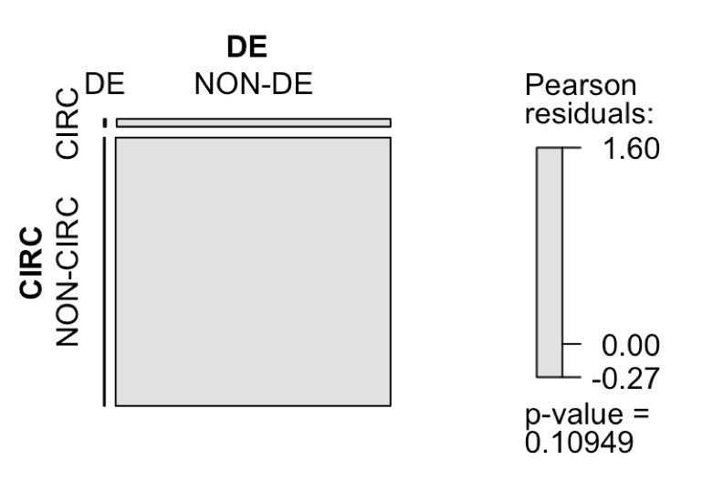
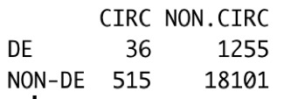
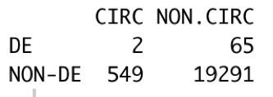
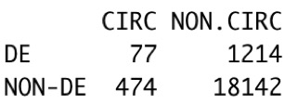
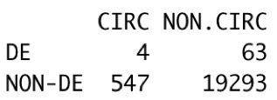
FDR <= 0.5, LFC > 0
FDR <= 0.5, LFC >= 0.5
Expected
Expected
Observed
Observed

Slide 16
Major Claims
New Hypothesis:
Circadian rhythms significantly influence the control-exercise comparisons
Experiment 1: DE genes between Control IPE vs Control 7hr
Circadian Rhythm Genes associated with DE genes
Circadian Rhythm Pathways enriched
Circadian Rhythm Genes Unique to Circadian Rhythm Pathway
Not some other pathway
Experiment 2: DE Gene between 2 comparisons:
Control 0 hr vs Exercise Response Groups
Control 7 hr vs Exercise Response Groups
Different Expression patterns influence comparisons between controls
Degree of exercise response (often) similar to degree of circadian response

Slide 17
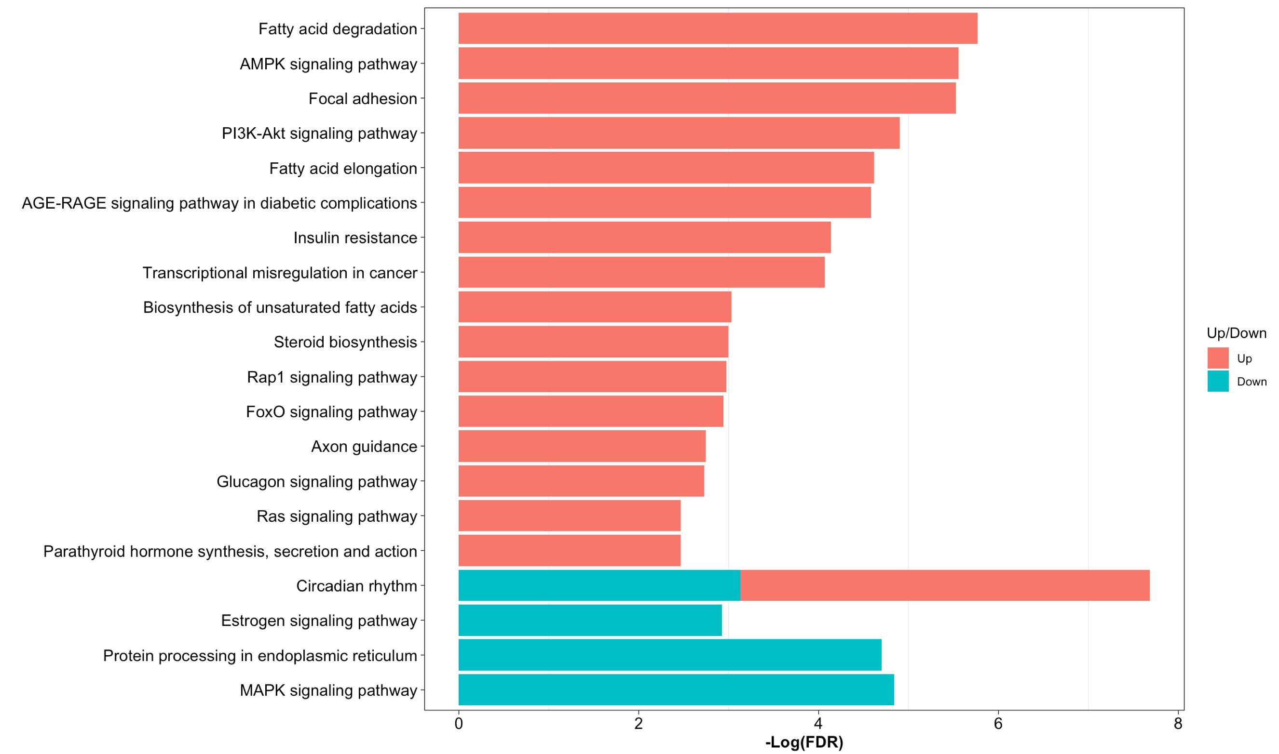
FDR <= 0.5, LFC > 0
FDR <= 0.5, LFC >= 0.5

Slide 18
Major Claims
New Hypothesis:
Circadian rhythms significantly influence the control-exercise comparisons
Experiment 1: DE genes between Control IPE vs Control 7hr
Circadian Rhythm Genes associated with DE genes
Circadian Rhythm Pathways enriched
Circadian Rhythm Genes Unique to Circadian Rhythm Pathway
Not some other pathway
Experiment 2: DE Gene between 2 comparisons:
Control 0 hr vs Exercise Response Groups
Control 7 hr vs Exercise Response Groups
Different Expression patterns influence comparisons between controls
Degree of exercise response (often) similar to degree of circadian response

Slide 19
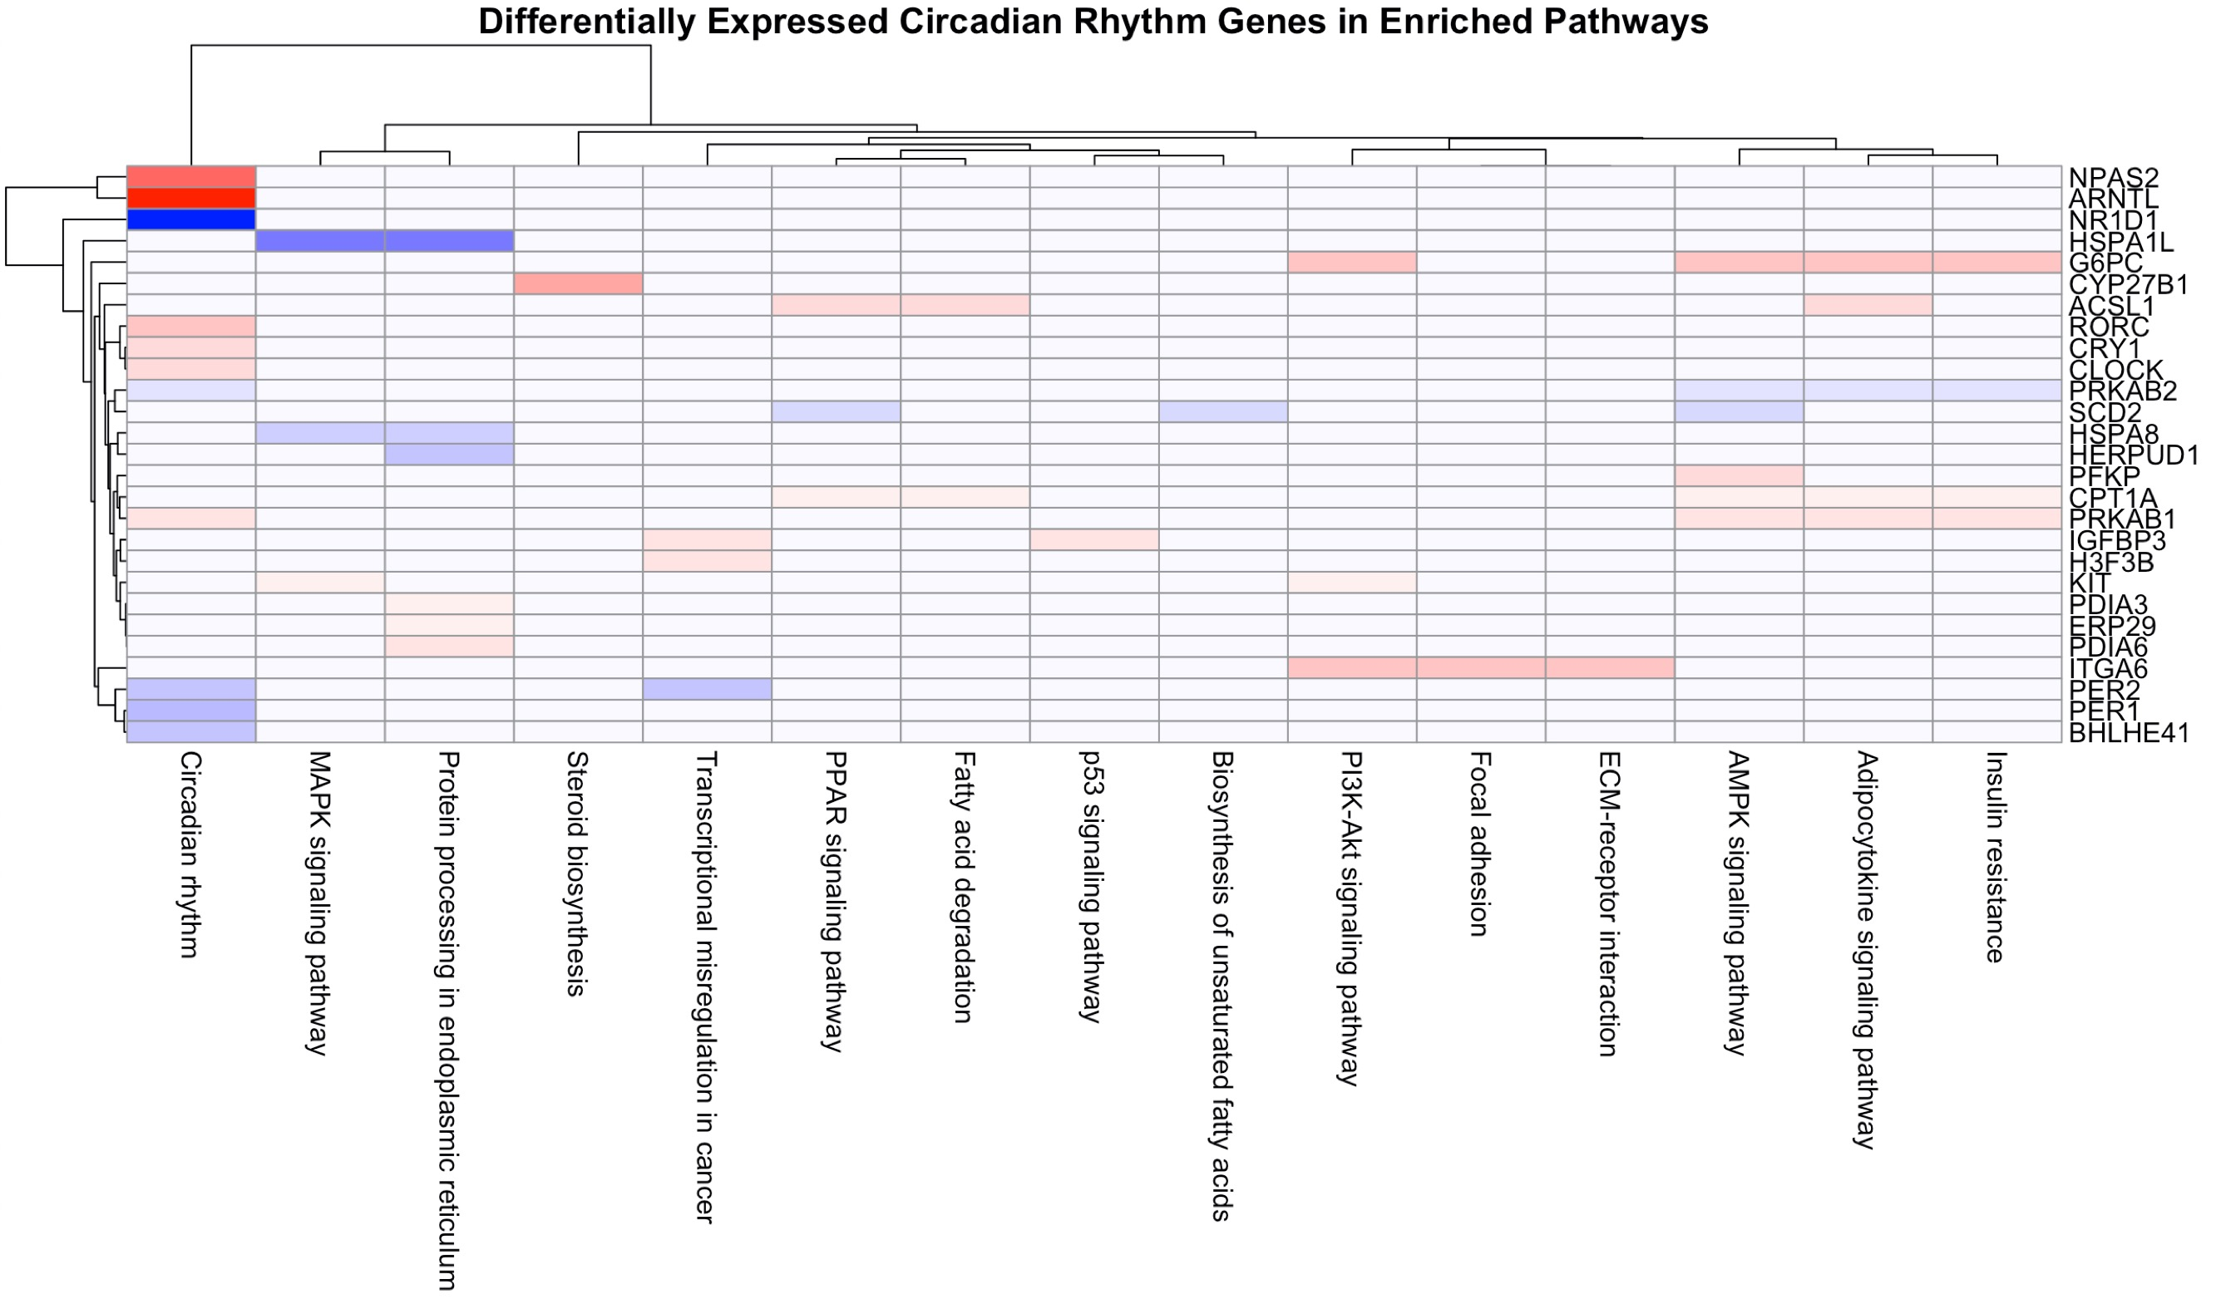
FDR <= 0.5, LFC > 0
FDR <= 0.5, LFC >= 0.5

Slide 20
Models of Exercise Effect vs Circadian Effect
Circadian Effect
SIN/COS Linear Model:
y ~ B₁SIN(TOD) + B₂COS(TOD) + B₀
Order of Samples: 10-11.25, 11.75-12.5, 13.25-14, 14.25-15, 17-18 (5 Time points)
Exercise Effect
Compare Linear Models:
Cubic: y ~ ax³ + bx² + cx + d
4-degree polynomial: y ~ ax⁴ + bx³ + cx² + dx + e
Order of samples: 48, 0, 0.5, 1, 4, 7, 24 (7 time points)
Compare Models
Calculate F-statistics and P-values for each gene
AKA How well does the model fit to expression?
Coefficients (a,b,c,d,e) can represent dimensions of hypercube … k-means clustering across tissues and sexes

Slide 21
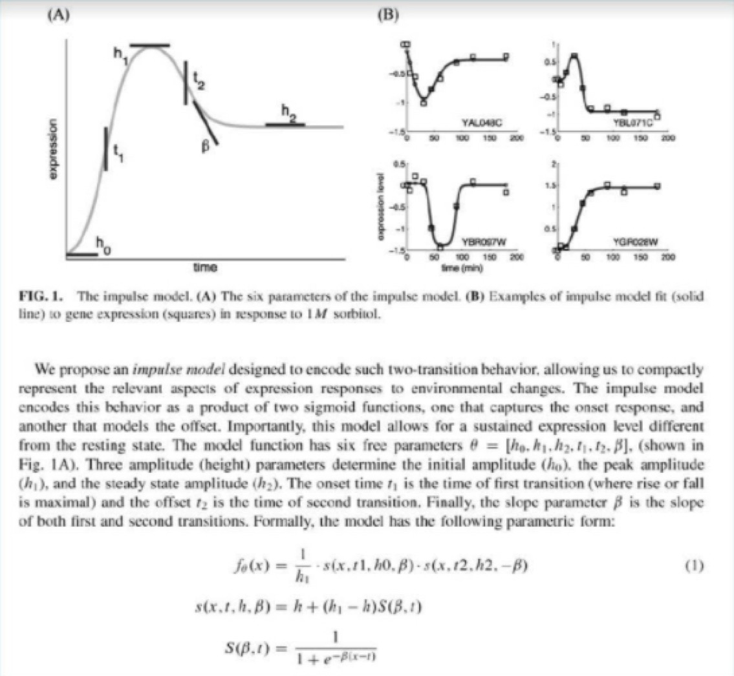

Slide 22
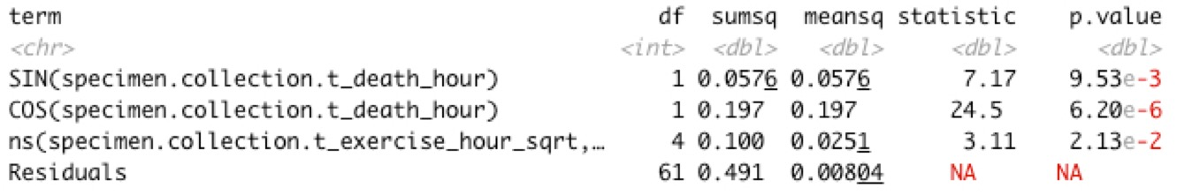
PVE by ANOVA (Combined Model: Circadian)
Combined Model
Normalized Counts ~ Circadian + Exercise
Example: Bcl10 (Kidney)
Circadian PVE = (SS_sin + SS_cos) / SS_total
0.3 = (0.0576 + 0.197) / (0.0576 + 0.197 + 0.1 + 0.491)

Slide 23
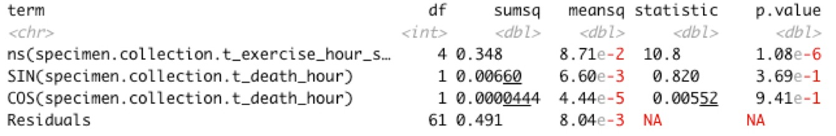
PVE by ANOVA (Combined Model: Exercise)
Combined Model
Normalized Counts ~ Exercise + Circadian
Example: Bcl10 (Kidney)
Exercise PVE = SS_ns / SS_total
0.41 = 0.348/ (0.348 + 0.00660 + 0.0000444 + 0.491)

Slide 24
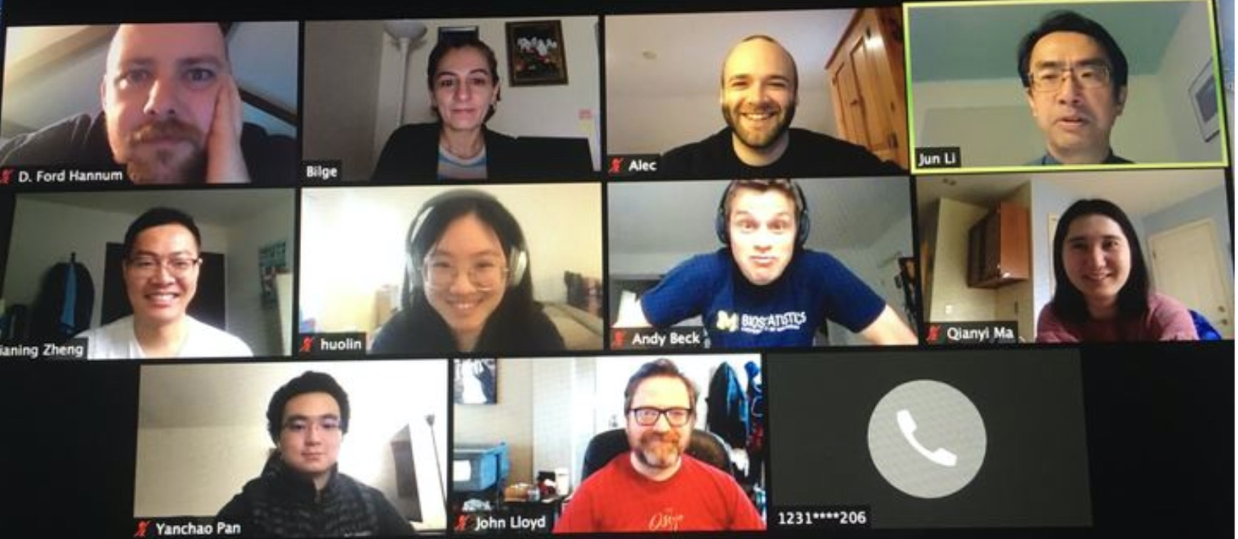
Thank You!

