Slide 1
PASS1A/PASS1C Preprocessing Umich Metabolomics (rppos, rpneg, ionpneg)
Alec Steep
Nov. 22, 2021

Slide 2
Overview
Step by step analysis tasks
Insights from data processing
Steps moving forward

Slide 3
Major Steps in Data Analysis
Raw PASS1A
Raw PASS1C
Structure Data
Structure Data
Document Data
Document Data
Data Preprocessing (part 1)
Data Preprocessing (part 1)
Data Preprocessing (part 2)
Data Preprocessing (part 2)
Combine Data
PASS1A/PASS1C Combined
Batch Correction
Biological Investigations

Slide 4
Batch Correction Should be Performed “Downstream”
Raw PASS1A
Raw PASS1C
Structure Data
Structure Data
Document Data
Document Data
Data Preprocessing (part 1)
Data Preprocessing (part 1)
Data Preprocessing (part 2)
Data Preprocessing (part 2)
Combine Data
PASS1A/PASS1C Combined
Batch Correction
Batch effects:
“unwanted variation in data caused by differences in technical factors across batches.”
ComBat-seq: batch effect adjustment for RNA-seq count data

Slide 5
Data Structure
Raw PASS1A
Raw PASS1C
Structure Data
Structure Data
Standardization of manifest files
Standardization of feature/sample nomenclature
Creation of NxP matrices
Document Data
Data Preprocessing (part 1)
Data Preprocessing (part 2)
Document Data
Data Preprocessing (part 1)
Data Preprocessing (part 2)
Combine Data
PASS1A/PASS1C Combined
Batch Correction
Biological Investigations

Slide 6
Complete/Incomplete Tasks
Raw PASS1A
Raw PASS1C
Structure Data
Structure Data
Standardization of manifest files
Standardization of feature/sample nomenclature
Creation of NxP matrices
Document Data
Data Preprocessing (part 1)
Data Preprocessing (part 2)
Document Data
Data Preprocessing (part 1)
Data Preprocessing (part 2)
Combine Data
PASS1A/PASS1C Combined
Batch Correction
Biological Investigations

Slide 7
Data Documentation
Raw PASS1A
Raw PASS1C
Structure Data
Structure Data
Document Data
Document Data
Data dimensions
Shared features/samples
Sample docs (references)
Feature docs (internal standards)
Data Preprocessing (part 1)
Data Preprocessing (part 2)
Data Preprocessing (part 1)
Data Preprocessing (part 2)
Combine Data
PASS1A/PASS1C Combined
Batch Correction
Biological Investigations

Slide 8
Complete/Incomplete Tasks
Raw PASS1A
Raw PASS1C
Structure Data
Structure Data
Document Data
Document Data
Data dimensions
Shared features/samples
Sample docs (references)
Feature docs (internal standards)
Data Preprocessing (part 1)
Data Preprocessing (part 2)
Data Preprocessing (part 1)
Data Preprocessing (part 2)
Combine Data
PASS1A/PASS1C Combined
Batch Correction
Biological Investigations

Slide 9
Data Structure (NxP)
Test + Ref Sams
Test Sams

Slide 10
Data Structure (NxP) (no refs)
Test Sams
Data Structure (N)
Data Structure (P)

Slide 11
Data Structure (NxP) (refs only)
Data Structure (N) (refs only)
Data Structure (P)

Slide 12
Data Structure (NxP) (+ refs)
Across Tissues (NxP) (+ refs)
Across Tissues/PASS’s
(NxP) (+ refs)

Slide 13
Complete/Incomplete/Partially Complete
Raw PASS1A
Raw PASS1C
Structure Data
Structure Data
Document Data
Document Data
Data Preprocessing (part 1)
Data Preprocessing (part 1)
IS normalization
Drift correction
Data Preprocessing (part 2)
Data Preprocessing (part 2)
Combine Data
PASS1A/PASS1C Combined
Batch Correction
Biological Investigations

Slide 14
Data Preprocessing (Part 2)
Raw PASS1A
Raw PASS1C
Structure Data
Structure Data
Document Data
Document Data
Data Preprocessing (part 1)
Data Preprocessing (part 1)
Data Preprocessing (part 2)
Data Preprocessing (part 2)
Impute zero/neg/missing values
Flag/remove sample outliers
Flag/remove feature outliers
Transform data
Log, feature-std, sample-std
Combine Data
PASS1A/PASS1C Combined
Batch Correction
Biological Investigations

Slide 15
Complete/Incomplete Tasks
Raw PASS1A
Raw PASS1C
Structure Data
Structure Data
Document Data
Document Data
Data Preprocessing (part 1)
Data Preprocessing (part 1)
Data Preprocessing (part 2)
Data Preprocessing (part 2)
Impute zero/neg/missing values
Flag/remove sample outliers
Flag/remove feature outliers
Transform data
Log, feature-std, sample-std
Combine Data
PASS1A/PASS1C Combined
Batch Correction
Biological Investigations

Slide 16
Exploratory Data Analysis (EDA)
Raw PASS1A
Explore Data
Raw PASS1C
Major variables:
Drift, sex, experimental group, time of day, feeding, batch, etc.
… associated with:
Sample medians
Sample correlations
Outlier samples (features?)
Structure Data
Structure Data
Document Data
Document Data
Data Preprocessing (part 1)
Data Preprocessing (part 1)
Data Preprocessing (part 2)
Data Preprocessing (part 2)
Combine Data
PASS1A/PASS1C Combined
Batch Correction
Biological Investigations

Slide 17
Complete/Incomplete/Partially Complete
Raw PASS1A
Explore Data
Raw PASS1C
Major variables:
Drift, sex, experimental group, time of day, feeding, batch, etc.
… associated with:
Sample medians
Sample correlations
Outlier samples (outlier features?)
Structure Data
Structure Data
Document Data
Document Data
Data Preprocessing (part 1)
Data Preprocessing (part 1)
Data Preprocessing (part 2)
Data Preprocessing (part 2)
Combine Data
PASS1A/PASS1C Combined
Batch Correction
Biological Investigations

Slide 18
IS/Drift Corrected Data Needed
Raw PASS1A
Explore Data
Raw PASS1C
Major variables:
Drift, sex, experimental group, time of day, feeding, batch, etc.
… associated with:
Sample medians
Sample correlations
Outlier samples (outlier features?)
Structure Data
Structure Data
Document Data
Document Data
Data Preprocessing (part 1)
Data Preprocessing (part 1)
IS normalization
Drift correction
Data Preprocessing (part 2)
Data Preprocessing (part 2)
Combine Data
PASS1A/PASS1C Combined
Batch Correction
Biological Investigations

Slide 19
Major Steps in Data Analysis
Raw PASS1A
Raw PASS1C
Structure Data
Structure Data
Document Data
Document Data
Data Preprocessing (part 1)
Data Preprocessing (part 1)
Data Preprocessing (part 2)
Data Preprocessing (part 2)
Combine Data
PASS1A/PASS1C Combined
Batch Correction
Biological Investigations

Slide 20
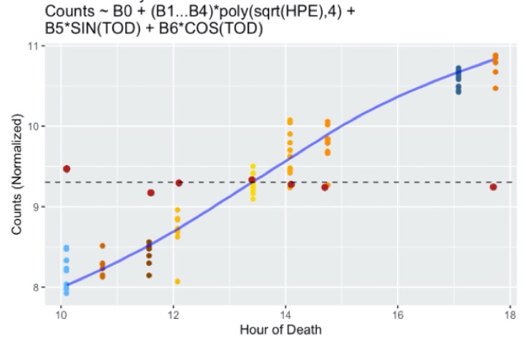
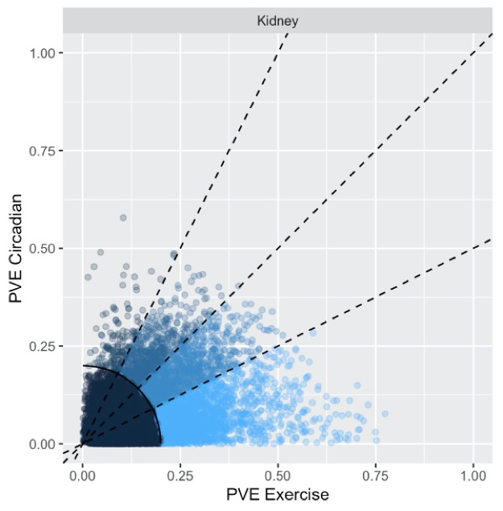
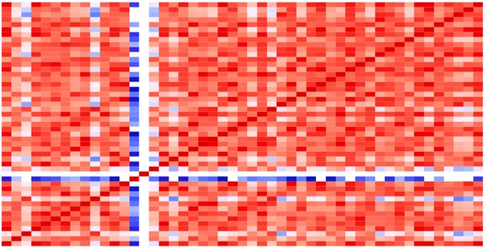

Combined Model
(Exercise + Circadian)
exp_{i} ~ B₀ + B₁(x_{e}) + B₂(x_{e})² + B₃(x_{e})³ + B₄(x_{e})⁴ + B₅SIN(x_{c}) + B₆COS(x_{c})
x_{e} = √ Hours Post Exercise
x_{c} = 2π*(Time of Day)/24
Tissue Specific
Gene Specific
Tissue Specific
Tissue Specific
Joint (Combined) Model
Circadian + Exercise
Variance Explained
By Joint Models
Data QC

Slide 21
Data Preprocessing/EDA Example
Raw PASS1A
Raw PASS1C
Explore Data
Structure Data
Major variables:
Drift, sex, experimental group, time of day, feeding, batch, etc.
… associated with:
Sample medians
Sample correlations
Outlier samples (features?)
Document Data
Data Preprocessing (part 1)
Data Preprocessing (part 2)
Impute zero/neg/missing values
Flag/remove sample outliers
Flag/remove feature outliers
Transform data
Log, feature-std, sample-std
Combine Data
PASS1A/PASS1C Combined
Batch Correction
Biological Investigations

Slide 22
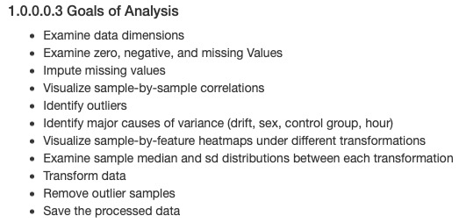
Example of Data Processing: Plasma rppos PASS1c

Slide 23
Real-Time Record of Processing Decisions

Slide 24
Real-Time Record of Processing Decisions
pla rppos pass1c

Slide 25
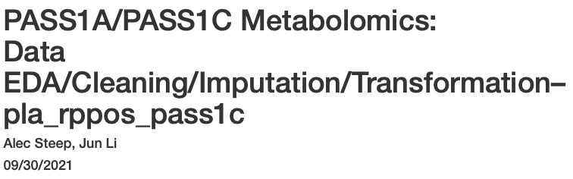
Processing is Documented for Each Dataset

Slide 26

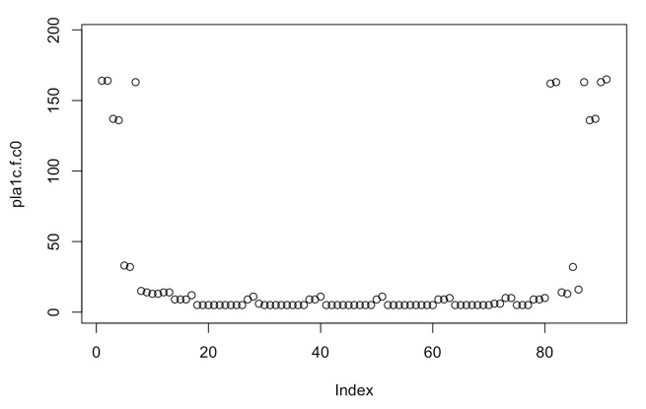
Missing Features (pla_rppos_1c)

Slide 27
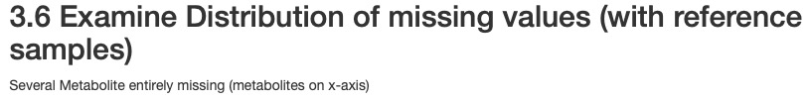
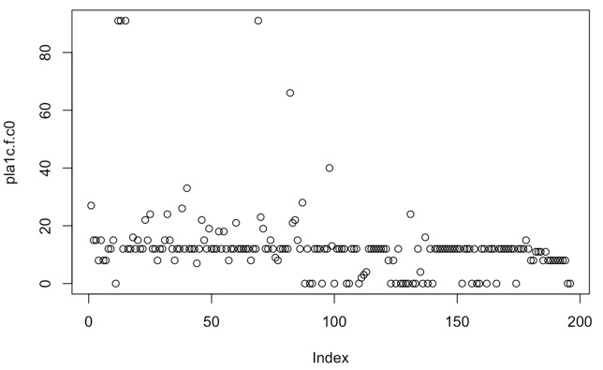

Slide 28
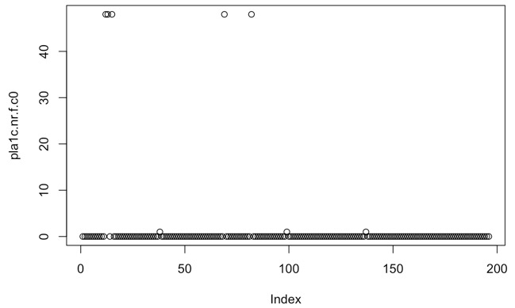

Slide 30
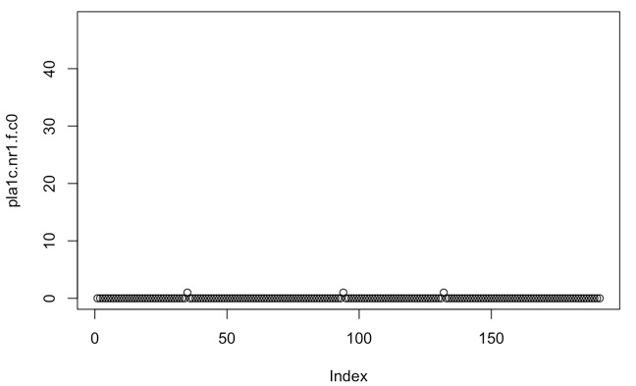
Imputation

Slide 31



Slide 32

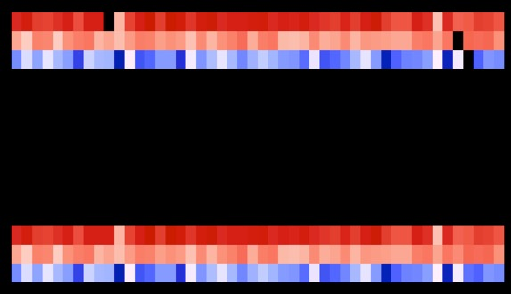

Slide 33
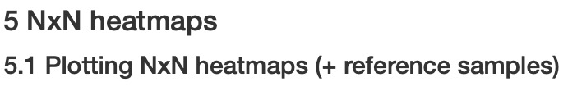
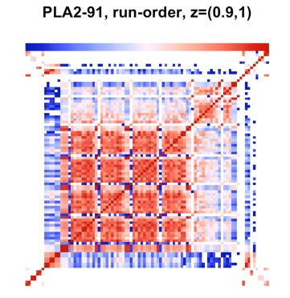

Slide 34
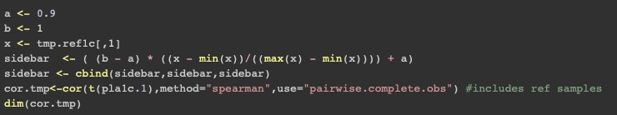

Slide 35
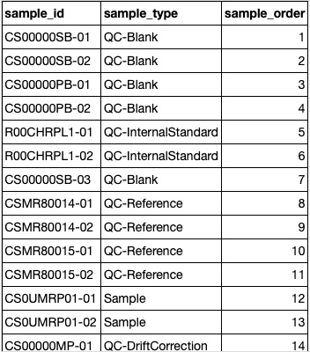
…

Slide 36
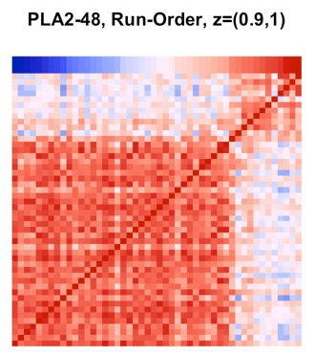

Slide 37

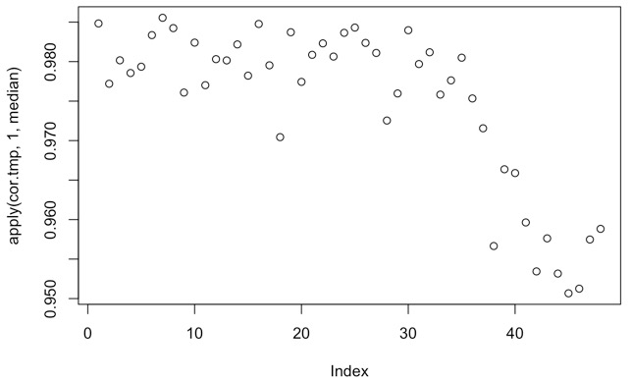

Slide 38
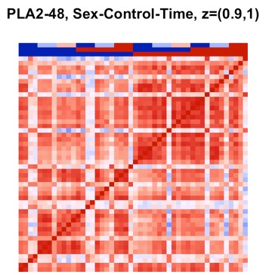
Time
Control
Sex

Slide 39
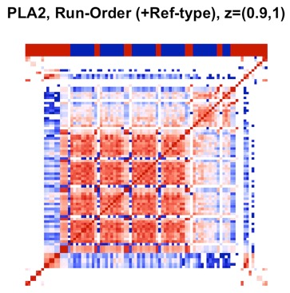

Slide 40
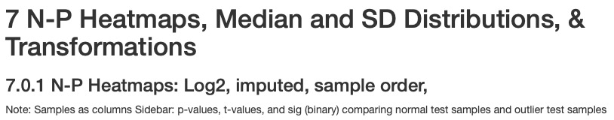
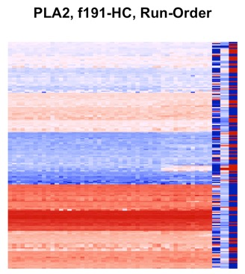
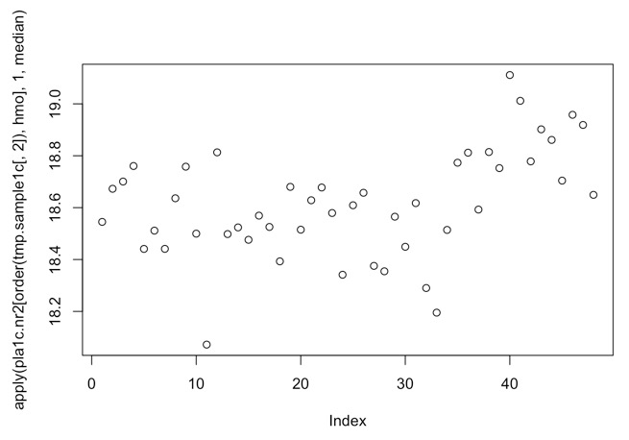

Slide 41
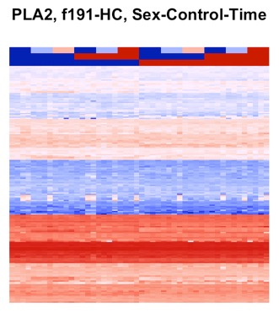

Slide 42

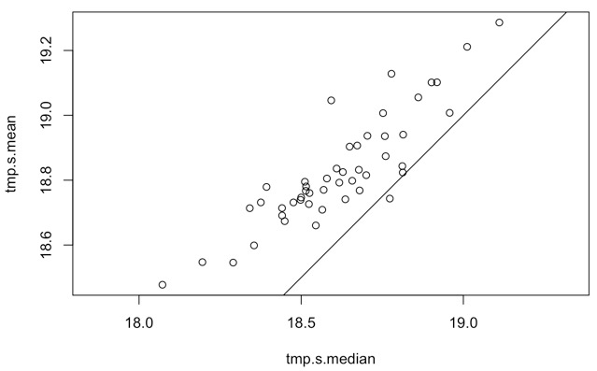

Slide 43
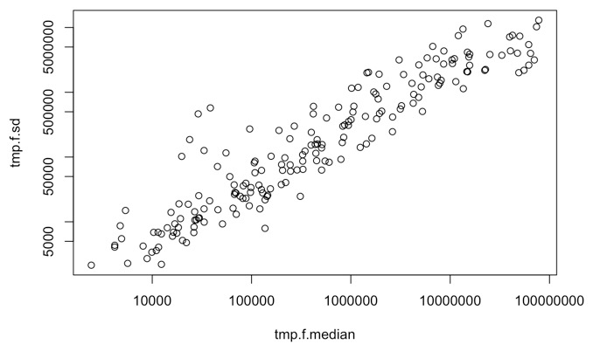

Slide 44
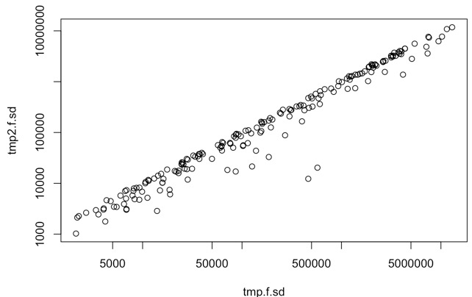
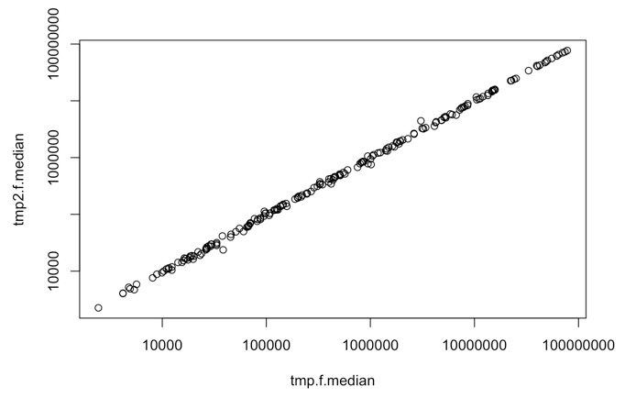

Slide 45
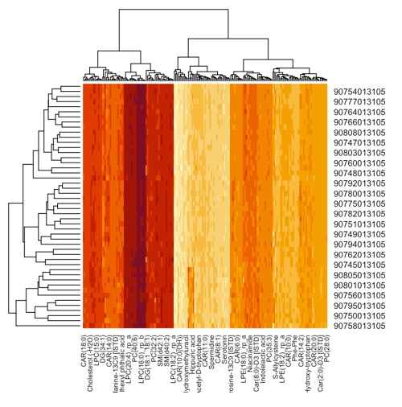
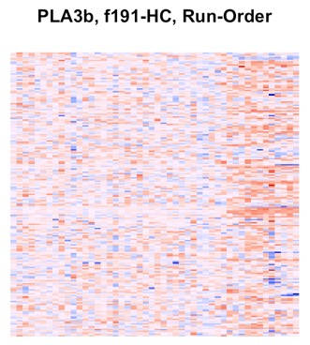
3b = Log2, imputed, median-centered (features), sd-scaled (features)

Slide 46
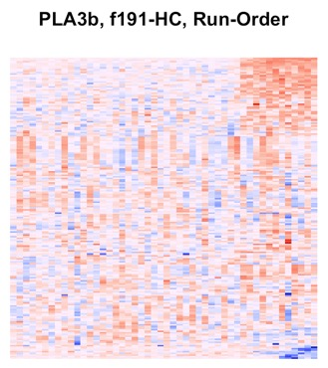
3b = Log2, imputed, median-centered (features), sd-scaled (features)

Slide 47

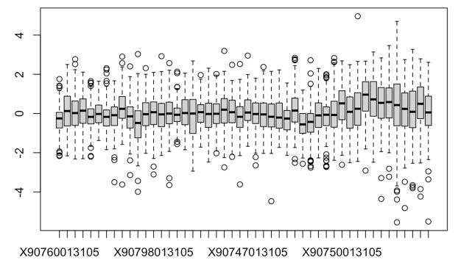
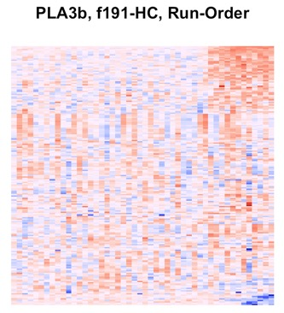
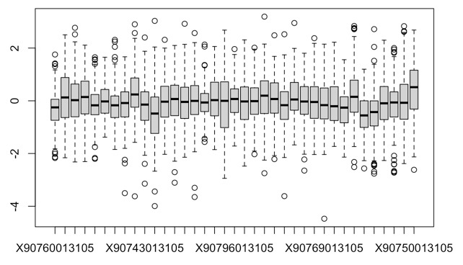

Slide 48
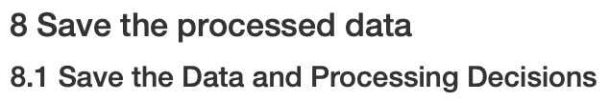


Slide 49
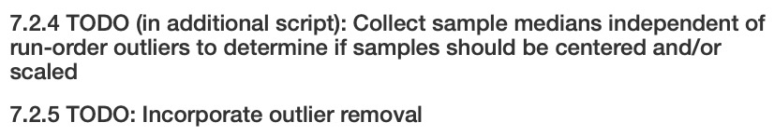

Slide 50
All Umich metabolomics Datasets Processed
Themes from Processing

Slide 51
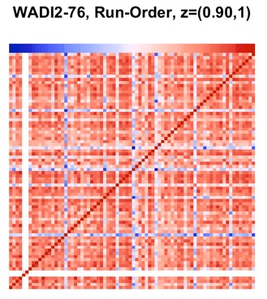
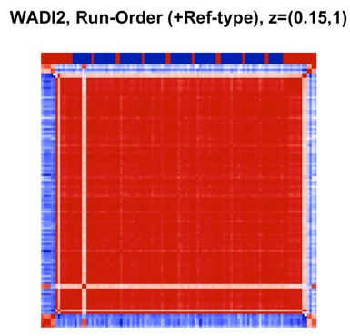
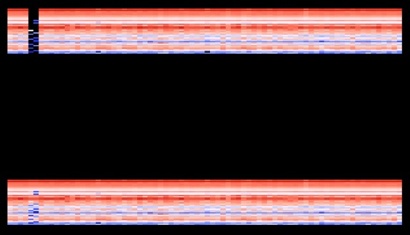
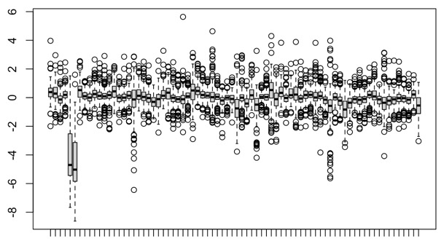
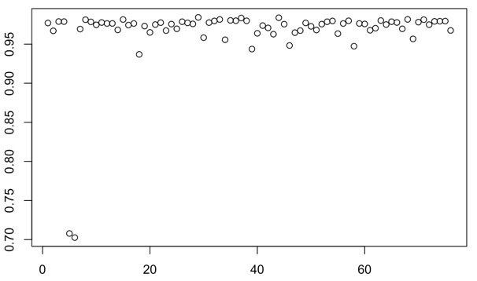
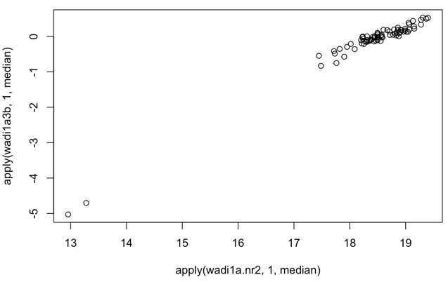
Samples with Low Sample Medians “less stuff”
Rppos (pass1a)
Lun, Wadi
Rppos (pass1c)
Wadi, Gas
Rpneg (pass1a)
Wadi
Rpneg (pass1c)
Wadi
Ionpneg (pass1a)
Wadi
Ionpneg (pass1c)
Lun, Liv, Wadi

Slide 52
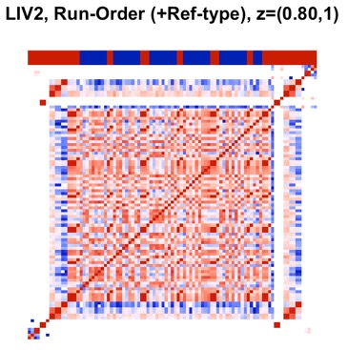
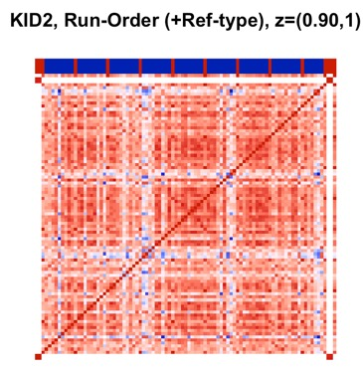
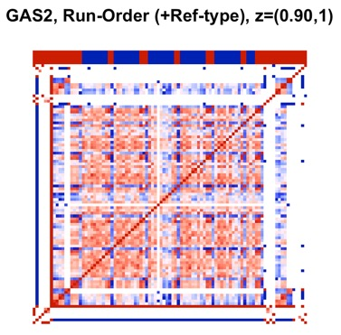
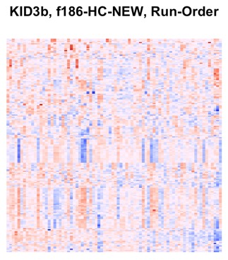
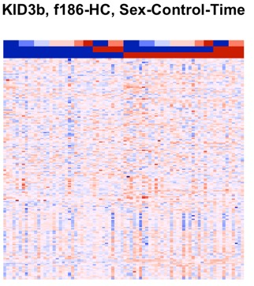
Subtle influence from run order
Rppos (pass1a)
Kid
Rpneg (pass1c)
Liv
Ionpneg (pass1c)
Gas

Slide 53
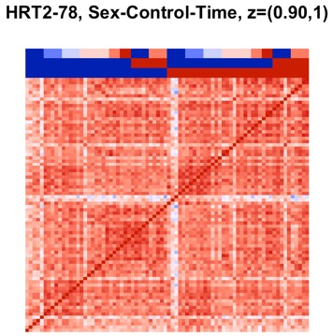
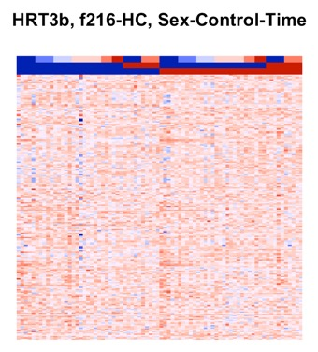
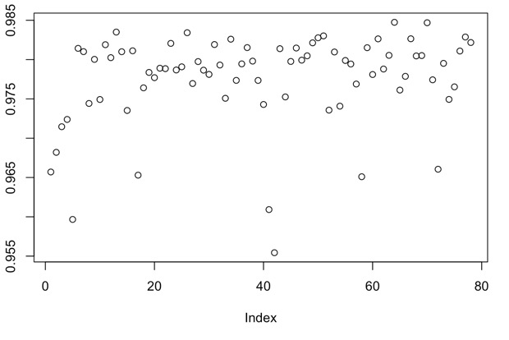
Outlier samples within similar sex/biological groups
Rppos (pass1a)
Hrt
Rpneg (pass1a)
Lun, Hrt, Liv, Kid, Gas
Rpneg (pass1c)
Hrt (sex)
Ionpneg (pass1a)
Wadi
Ionpneg (pass1c)
Pla, Kid, Badi
NxN
NxP

Slide 54
Sample missing from manifest file, present in official pass1c annotation documentation submitted to motrpac
Rppos (pass1c)
Lun
Hrt

Slide 55
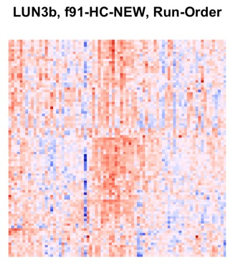


Sample correlations/medians associated with run order
Ionpneg (pass1a)
Pla, Lun, Hrt, Liv, Wadi, Kid, Gas, Badi
NxP (lun3b)
Sample medians
Sample medians

Slide 56









Sample correlations/medians (lin) associated with run order
Hrt2 ionpneg pass1a
Kid2 ionpneg pass1a

Slide 57
Sample Corrs/Medians From Drift Require Adjustment
Raw PASS1A
Raw PASS1C
Structure Data
Structure Data
Document Data
Document Data
Data Preprocessing (part 1)
Data Preprocessing (part 1)
Data Preprocessing (part 2)
Data Preprocessing (part 2)
Impute zero/neg/missing values
Flag/remove sample outliers
Flag/remove feature outliers
Transform data
Log, feature-std, sample-std
Combine Data
PASS1A/PASS1C Combined
Batch Correction
Biological Investigations

