Slide 1
PASS1A-Liver-RPPOS

Slide 2
Data Structure
Samples:
QC-DriftCorrection: a collection of all experimental samples from PASS1A
QC-InternalStandard: plasma samples from another study (CHEAR)
QC-Reference: a collection of all exercise samples or all sedentary samples
Sample: experimental samples
QC-Pooled: a collection of all experimental samples from PASS1A or PASS1C
QC-Blank: Blank or only IS-metabolites added
Features:
Metabolite
IS-Metabolite: same amount, manually added to each samples, labeled as [iSTD]

Slide 3
Data Process
Check missingness (remove QC-Blank first)
Remove features with >30% missingness in QC-Pooled samples
Check group distribution of features with >60% missingness in experimental samples
Present in specific groups; absent in other groups: keep (1/2 min value imputation)
>60% missingness in all groups: remove
Imputation
KNN or
½ min value
Pre-normalization visualization
IS-normalization:
Raw count/ specific IS metabolite
Select for IS metabolite for each feature
Minimize its QC-pooled RSD
Post-normalization visualization
PCA
QC-Pooled RSD distribution
Put back QC-Blank and features with high missingness; remove IS-metabolites

Slide 4
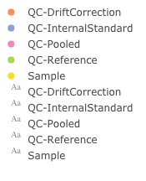
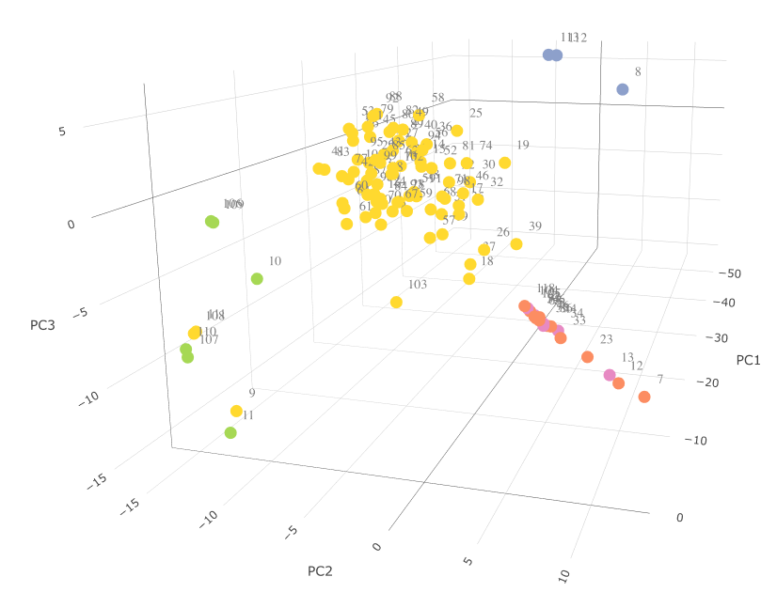
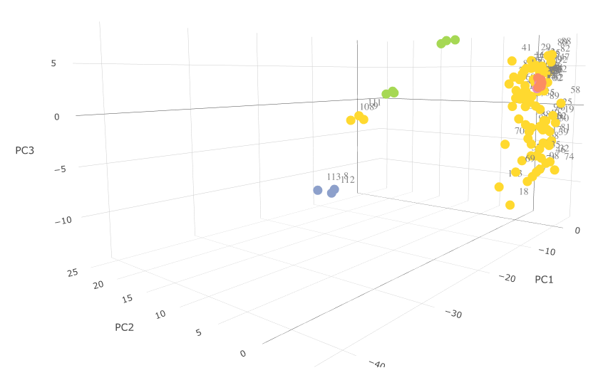
Before vs. after IS-normalization: Before: all QC-drift corrections samples spread out outside all samples (ideally them should be clustered closely together in the middle of all samples since they are all the same, collection of all samples); After: all QC-drift correction samples clustered together, in the middle of all samples.

Slide 5
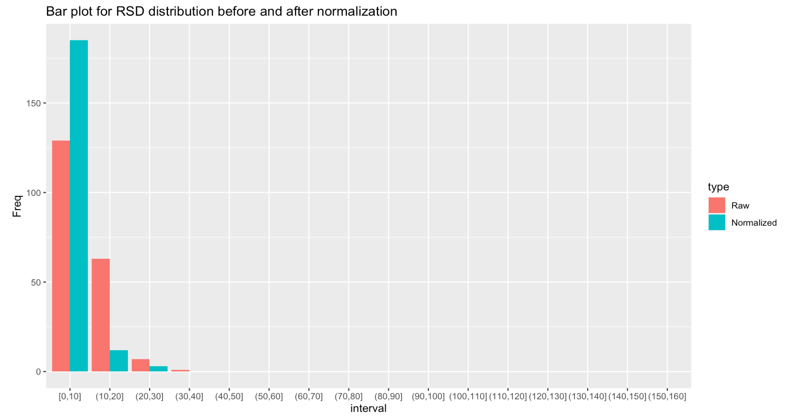
Before vs. after IS-normalization: this bar plot is the number of metabolites in each RSD (relative standard deviation) group ONLY for QC-drift correction samples. Since QC-drift correction samples were all the same, we expect the RSD to be the smaller the better. After IS-normalization, more metabolites had smaller RSD.

