Slide 1
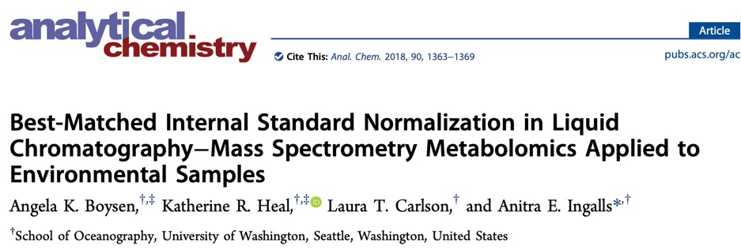
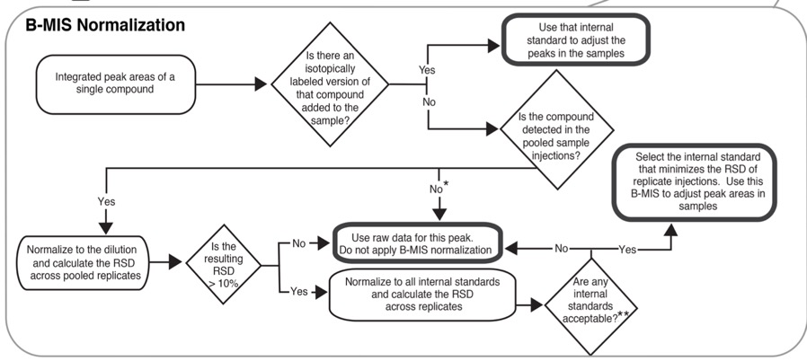

Slide 2
Data Structure
Samples:
QC-DriftCorrection: a collection of all experimental samples from PASS1A
QC-InternalStandard: plasma samples from another study (CHEAR)
QC-Reference: a collection of all exercise samples or all sedentary samples
Sample: experimental samples
QC-Pooled: a collection of all experimental samples from PASS1A or PASS1C
QC-Blank: Blank or only IS-metabolites added
Features:
Metabolite
IS-Metabolite: same amount, manually added to each samples, labeled as [iSTD]
Jiayu Zhang

Slide 3
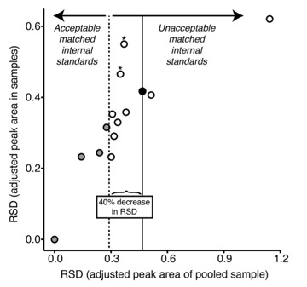
Paper’s Approach

Slide 4
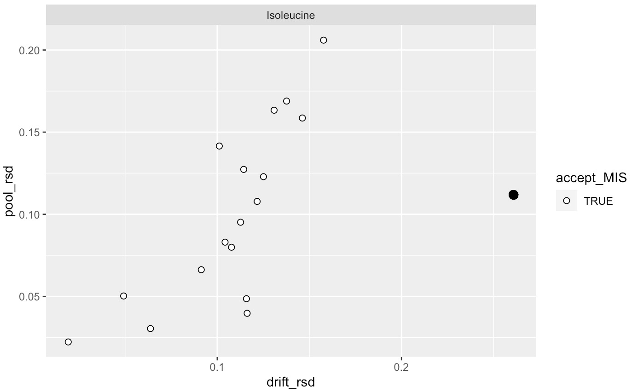
Paper’s approach seems to work on our data

Slide 5
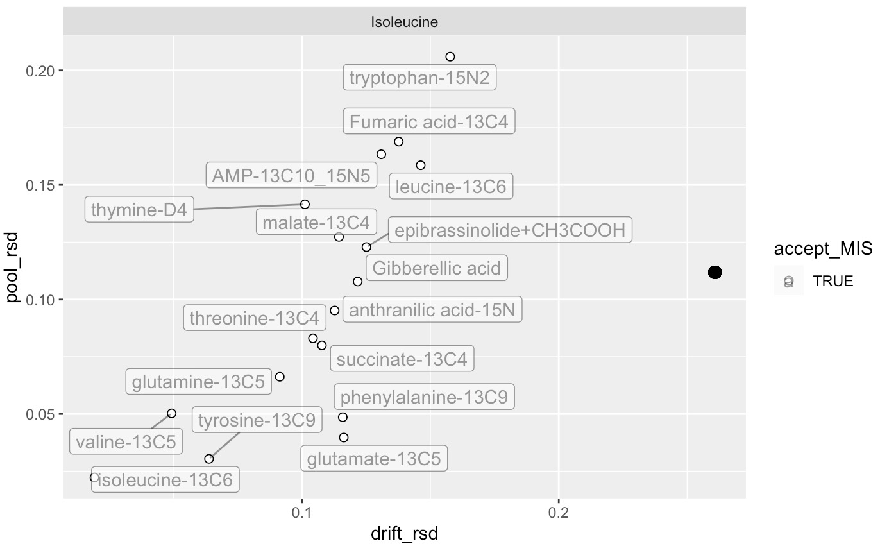
If there exists a feature (Isoleucine) & paired IS (Isoleucine-13C6), then the paired IS will outcompete for best IS

Slide 6
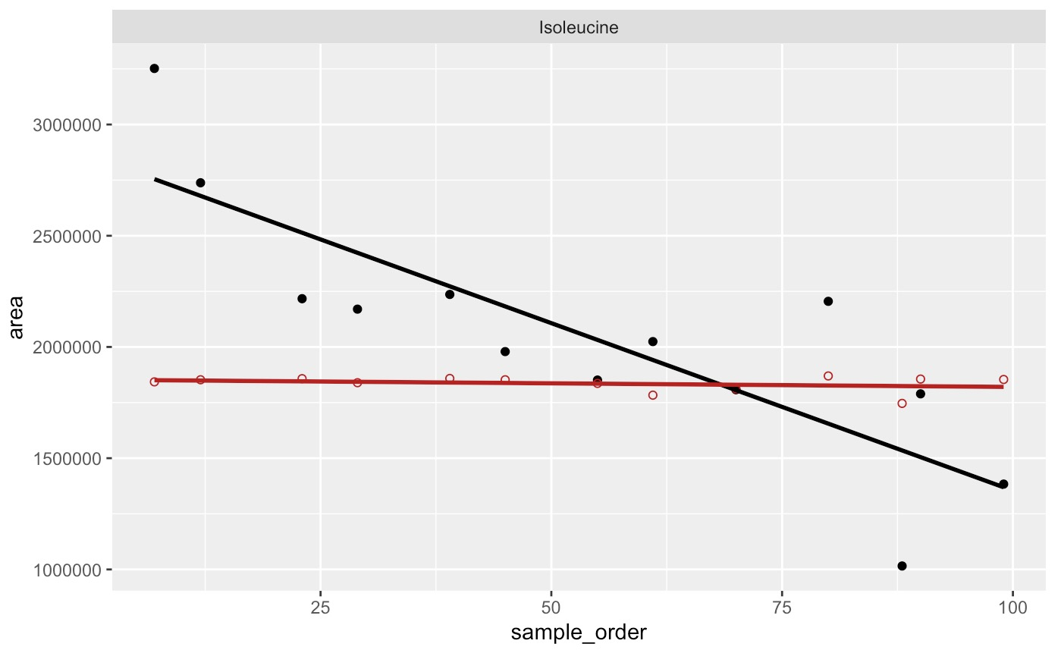
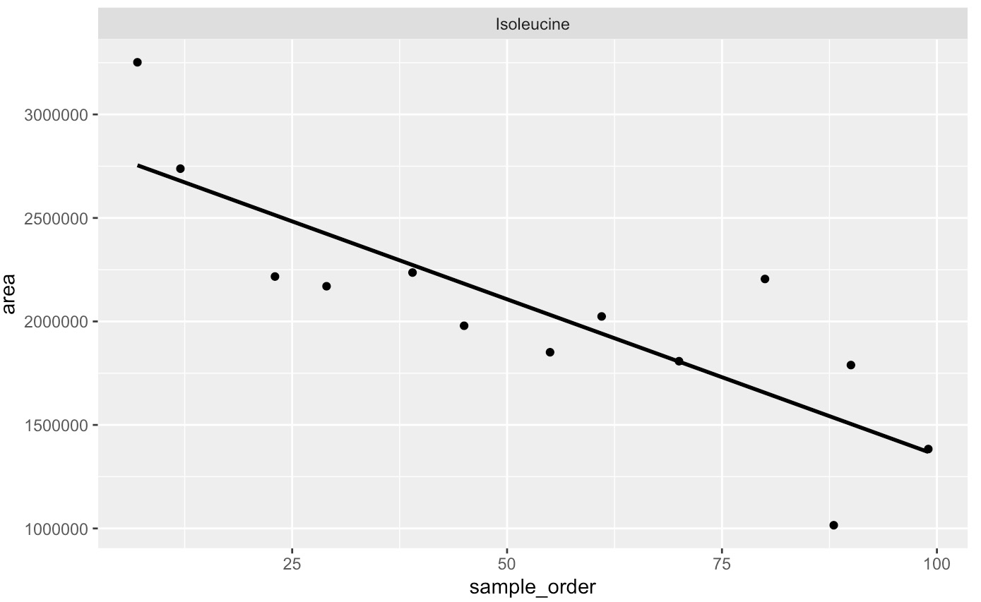
Pre-Post Drift Correction in QC-DriftCorrection Samples

Slide 7
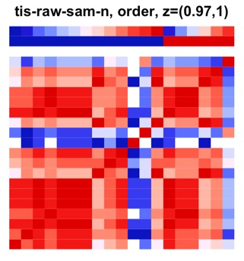
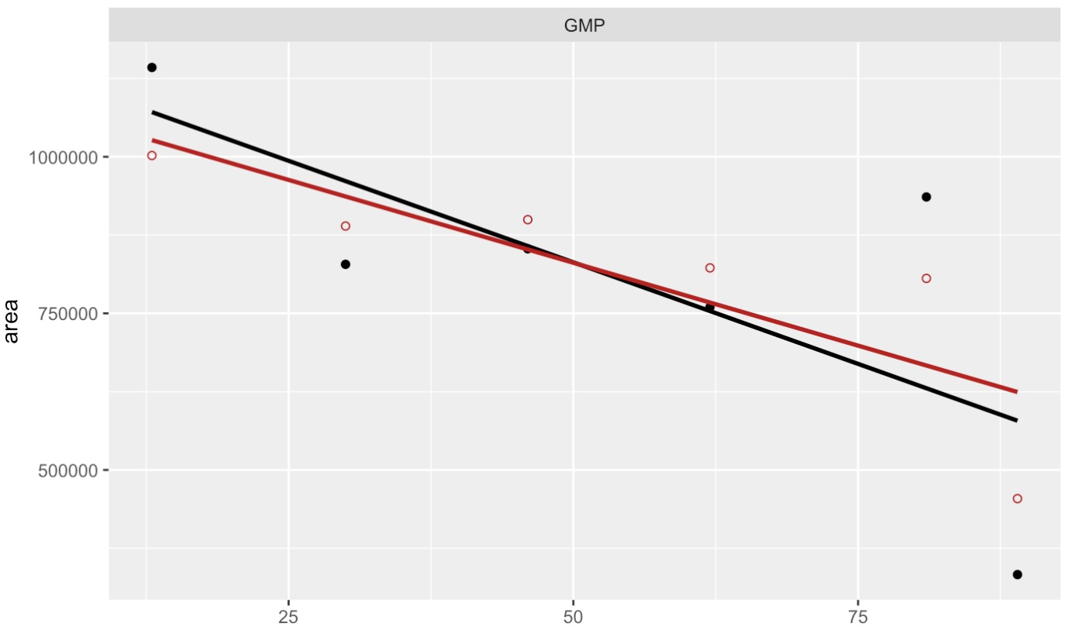
‘Drift’ Outlier Samples overpower drift-correction

