Slide 1
Example of B-MIS Drift Correction in WADI ionpneg PASS1A from UM
Alec Steep

Slide 2
Major Steps in Data Analysis
Raw PASS1A
Raw PASS1C
Structure Data
Structure Data
Document Data
Document Data
Data Preprocessing (part 1)
Data Preprocessing (part 1)
Data Preprocessing (part 2)
Data Preprocessing (part 2)
Combine Data
PASS1A/PASS1C Combined
Batch Correction
Biological Investigations

Slide 3
Complete/Incomplete Tasks
Raw PASS1A
Raw PASS1C
Structure Data
Structure Data
Standardization of manifest files
Standardization of feature/sample nomenclature
Creation of NxP matrices
Document Data
Data Preprocessing (part 1)
Data Preprocessing (part 2)
Document Data
Data Preprocessing (part 1)
Data Preprocessing (part 2)
Combine Data
PASS1A/PASS1C Combined
Batch Correction
Biological Investigations

Slide 4
Complete/Partially Complete Tasks
Raw PASS1A
Raw PASS1C
Structure Data
Structure Data
Document Data
Document Data
Data Preprocessing (part 1)
Data Preprocessing (part 1)
Drift correction
Data Preprocessing (part 2)
Data Preprocessing (part 2)
Combine Data
PASS1A/PASS1C Combined
Batch Correction
Biological Investigations

Slide 5
Update: Drift Correction (Completed)
Raw PASS1A
Raw PASS1C
Structure Data
Structure Data
Document Data
Document Data
Data Preprocessing (part 1)
Data Preprocessing (part 1)
Drift correction
Data Preprocessing (part 2)
Data Preprocessing (part 2)
Combine Data
PASS1A/PASS1C Combined
Batch Correction
Biological Investigations

Slide 6
Data Preprocessing (Part 2)
Raw PASS1A
Raw PASS1C
Structure Data
Structure Data
Document Data
Document Data
Data Preprocessing (part 1)
Data Preprocessing (part 1)
Data Preprocessing (part 2)
Data Preprocessing (part 2)
Impute zero/neg/missing values
Flag/remove sample outliers
Flag/remove feature outliers
Transform data
Log, feature-std, sample-std
Combine Data
PASS1A/PASS1C Combined
Batch Correction
Biological Investigations

Slide 7
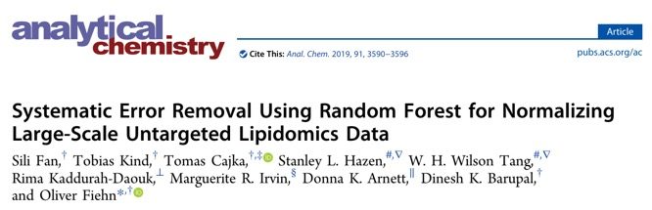
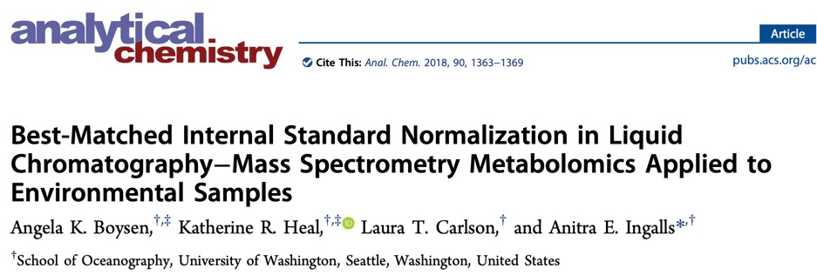
(SERRF)
(B-MIS)
Notes:
Met with the metabolomics core

Slide 8
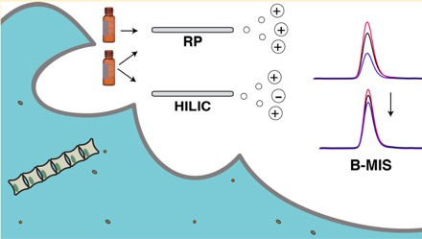
PASS1A Raw Data (example: WADI ionpneg Michigan)
Raw Data refers to the area of peak measurement from application of metabolomics technology (e.g. ionpneg)
DOI: 10.1021/acs.analchem.7b04400 Anal. Chem. 2018, 90, 1363−1369

Slide 9
PASS1A Pre/Post-IS Data (example: WADI ionpneg Michigan)
3 Comparable Datasets in WADI-pass1a
pre-IS (2.0)
post-IS (1.0)
post-IS (2.0)
DOI: 10.1021/acs.analchem.7b04400 Anal. Chem. 2018, 90, 1363−1369

Slide 10
PASS1A Pre/Post-IS Data (example: WADI ionpneg Michigan)
3 Comparable Datasets in WADI-pass1a
pre-IS (2.0)
post-IS (1.0)
post-IS (2.0) – B-MIS
DOI: 10.1021/acs.analchem.7b04400 Anal. Chem. 2018, 90, 1363−1369

Slide 11
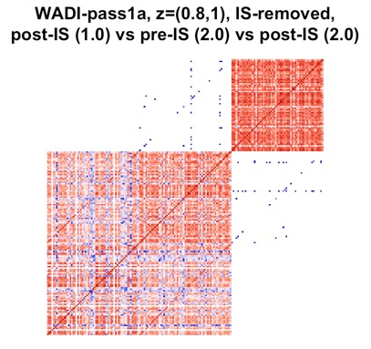
NxN Cross Rank Correlation Matrices (example: WADI ionpneg Michigan)
Post-IS (2.0)
3 Comparable Datasets in WADI-pass1a
Experimental Samples
IS-removed
61 shared samples (P)
61 shared features (N)
Pre-IS (1.0)
Post-IS (1.0)
Dim = 61 (N) x 61 (P)

Slide 12
NxN Cross Rank Correlation Matrices (example: WADI ionpneg Michigan)
Post-IS (2.0)
3 Comparable Datasets in WADI-pass1a
Experimental Samples
IS-removed
61 shared samples (P)
61 shared features (N)
Pre-IS (2.0)
Post-IS (1.0)
ATTN: PASS1A does not demonstrate considerable technical drift effects, rather PASS1C demonstrates strong effects from drift (compared to biology of interest). PASS1A is used here because of the comparable pre/post-IS datasets.
Dim = 61 (N) x 61 (P)

Slide 13
NxN Cross Rank Correlation Matrices (example: WADI ionpneg Michigan)
Post-IS (2.0)
3 Comparable Datasets in WADI-pass1a
Experimental Samples
IS-removed
61 shared samples (P)
61 shared features (N)
Pre-IS (1.0)
Post-IS (1.0)
Dim = 61 (N) x 61 (P)

Slide 14
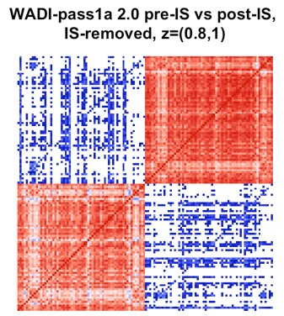
NxN Cross Rank Correlation Matrices (example: WADI ionpneg Michigan)
Post-IS (2.0)
Pre-IS (1.0)
Post-IS (1.0)
Dim = 61 (N) x 61 (P)
Dim = 62 (N) x 74 (P)

Slide 15
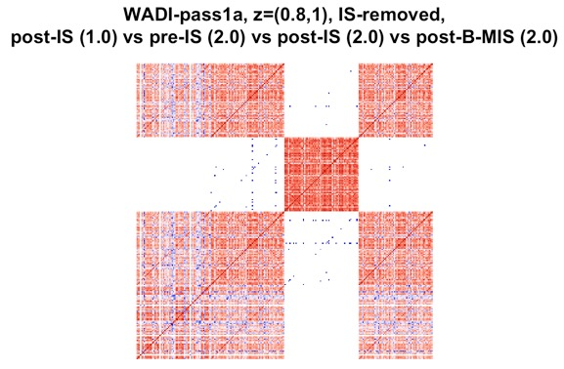
NxN Cross Rank Correlation Matrices (example: WADI ionpneg Michigan)
Post-B-MIS (2.0)
4 Comparable Datasets in WADI-pass1a
Experimental Samples
IS-removed
61 shared samples (P)
61 shared features (N)
Provided by UM metabolomics core (possibly) to be sent to BIC
Post-IS (2.0)
Pre-IS (1.0)
Post-IS (1.0)
Dim = 61 (N) x 61 (P)

Slide 17
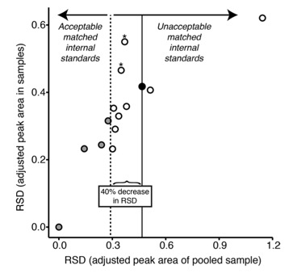
Examination of B-MIS with Only Internal Standards
D₃-alanine
Sample Cohorts
Experimental Samples
Pooled Samples (used for drift correction)
D₃-alanine area_adj adjusted by D₃-alanine
Internal Standards (IS) Only
Each IS B-MIS adjusted by another IS in 2 sample cohorts

Slide 18
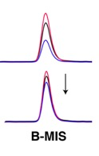
Examination of B-MIS with Only Internal Standards
D₃-alanine
Sample Cohorts
Experimental Samples
Pooled Samples (used for drift correction)
B-MIS Transformation:
Area_adj = Divide by IS peak area (per sample) and multiplying by average IS peak area (across samples)
Area_adj for pooled samples
Area_adj for all samples
RSD: Relative Standard Deviation
RSD = sd(Area_adj)/mean(Area_adj)
RSD for pooled samples
RSD for all samples
Internal Standards (IS) Only
Each IS B-MIS adjusted by another IS in 2 sample cohorts

Slide 20
Examination of B-MIS with Only Internal Standards
D₃-alanine
Sample Cohorts
Experimental Samples
Pooled Samples (used for drift correction)
B-MIS Transformation:
Area_adj = Divide by IS peak area (per sample) and multiplying by average IS peak area (across samples)
Area_adj for pooled samples
Area_adj for all samples
RSD: Relative Standard Deviation
RSD = sd(Area_adj)/mean(Area_adj)
RSD for pooled samples
RSD for all samples
D₃-alanine area unadjusted & RSD calculated
D₃-alanine area_adj adjusted by best IS candidate
D₃-alanine area_adj adjusted by D₃-alanine
Internal Standards (IS) Only
Each IS B-MIS adjusted by another IS in 2 sample cohorts

Slide 21
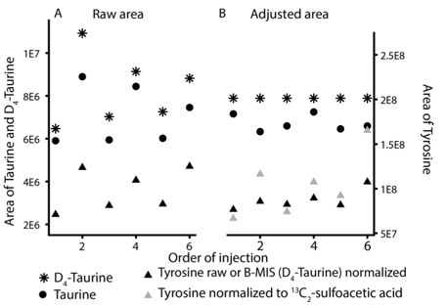
Diagnostic Plot (Pre/Post B-MIS)

Slide 22
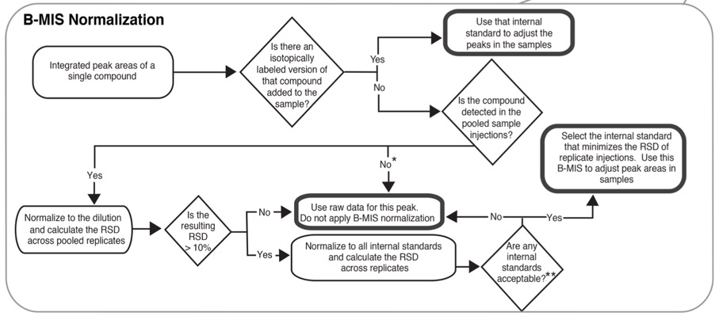
Some Features Should not Undergo B-MIS

Slide 23
B-MIS in WADI ionpneg Michigan Generation of Post-B-MIS (2.0)
Post-B-MIS (2.0)
Post-IS (2.0)
Pre-IS (1.0)
Post-IS (1.0)
Dim = 61 (N) x 61 (P)

Slide 24
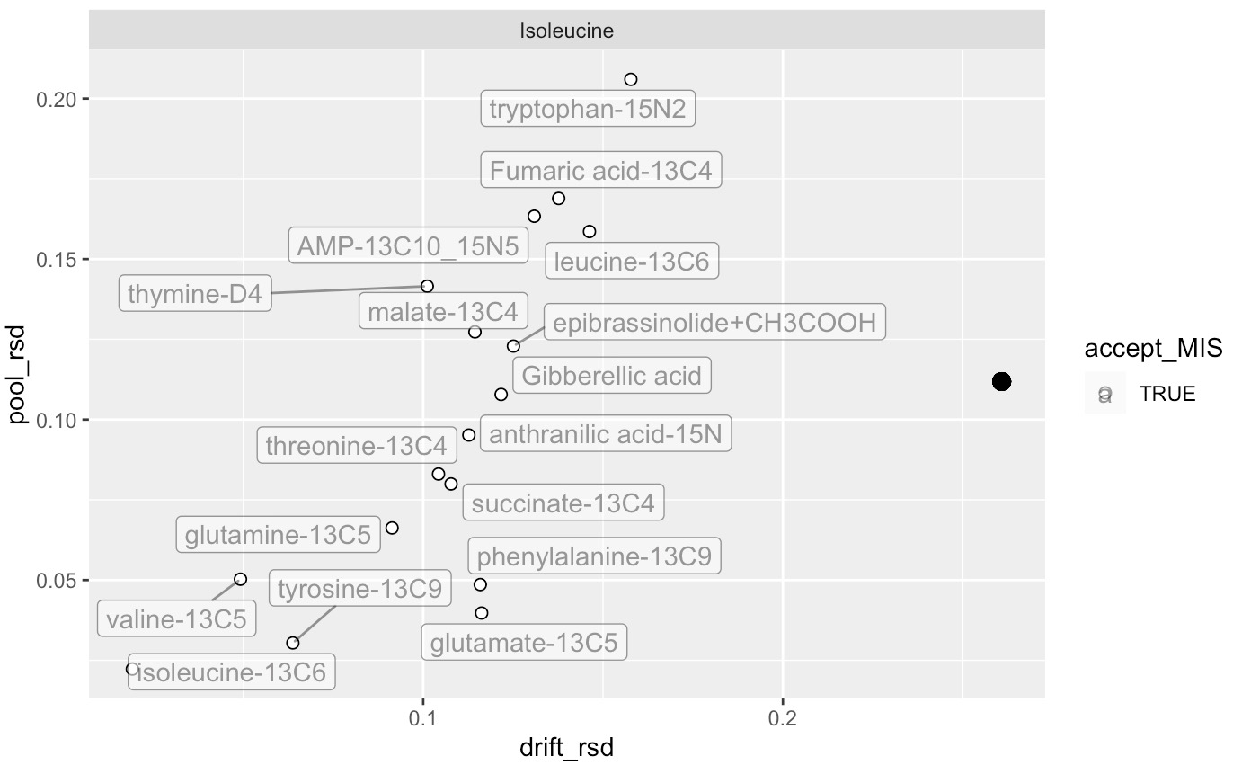
Examination of B-MIS with Only Internal Standards (WADI-1A)
area unadjusted & RSD calculated
Samples:
QC-DriftCorrection: a collection of all experimental samples from PASS1A (used for drift correction)
QC-InternalStandard: plasma samples from another study (CHEAR)
QC-Reference: a collection of all exercise samples or all sedentary samples
Sample: experimental samples
QC-Pooled: a collection of all experimental samples from PASS1A or PASS1C
QC-Blank: Blank or only IS-metabolites added
Features:
Metabolite
IS-Metabolite: same amount, manually added to each samples, labeled as [iSTD]
RSD in Drift Samples
by
RSD in Pooled Samples

Slide 25
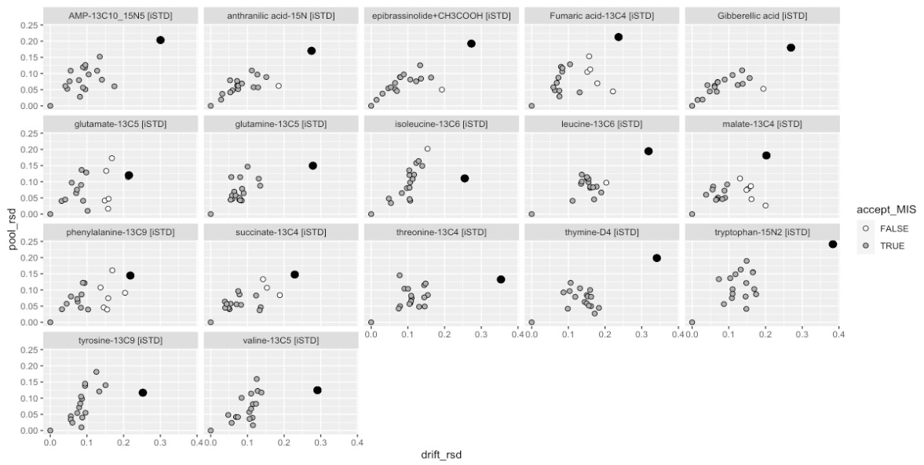
Examination of B-MIS with Only Internal Standards (WADI-1A)
Acceptable IS for B-MIS if reduction in RSD in drift samples exceeds 40%

Slide 26
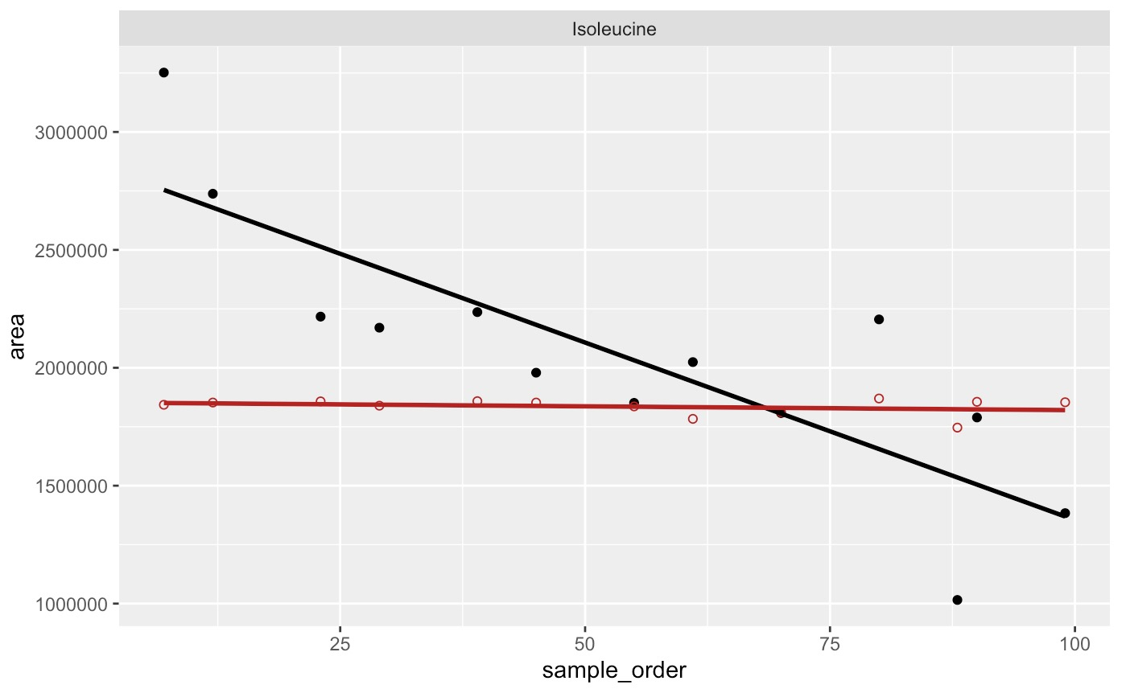
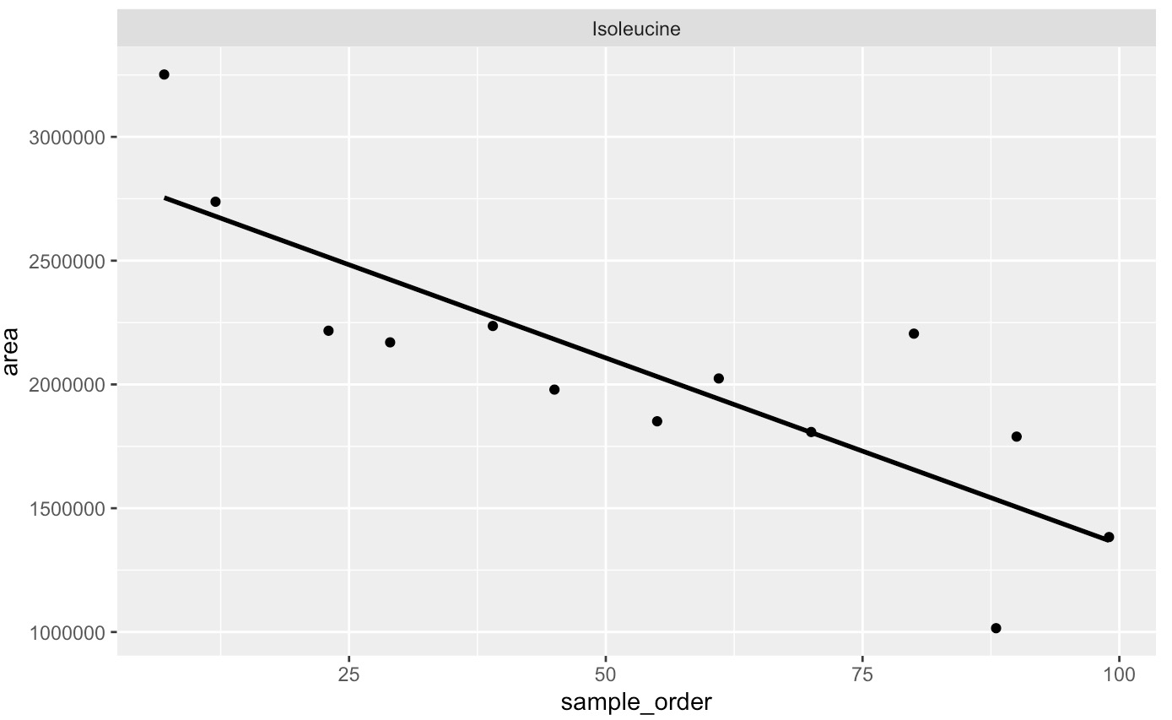
Pre-Post Drift Correction in QC-DriftCorrection Samples

Slide 27
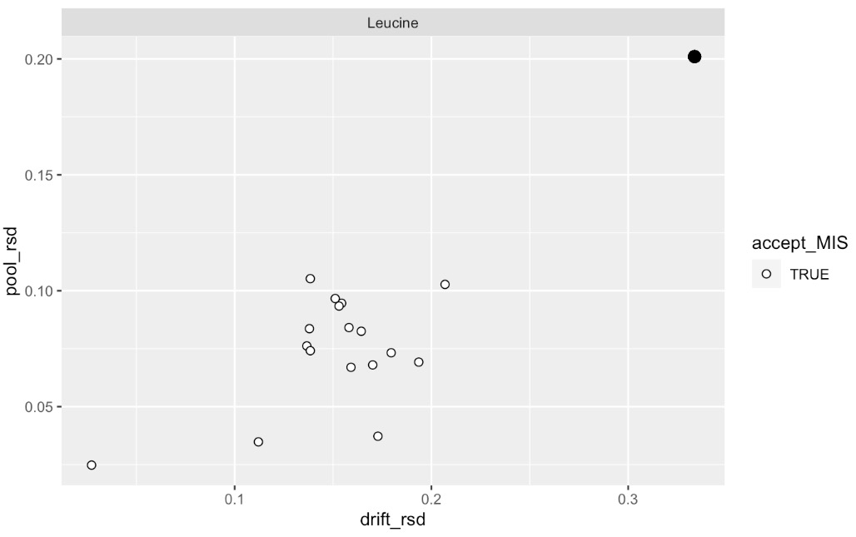
Identical IS metabolite will always be best B-MIS choice for paired metabolite
area unadjusted & RSD calculated
B-MIS from isoleucine-13C6 [iSTD]

Slide 28
Some Features Should not Undergo B-MIS

Slide 29
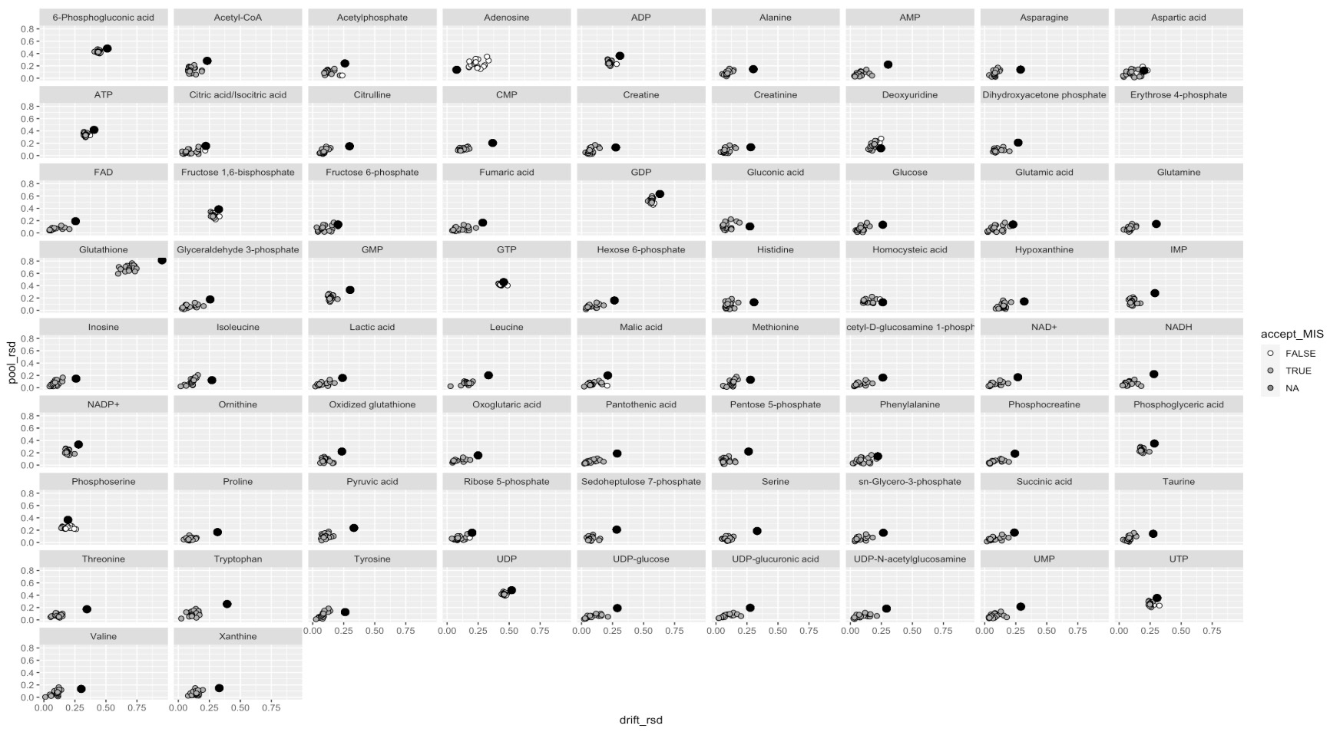
Examination of B-MIS with all Metabolites (WADI-1A)
Acceptable IS for B-MIS if reduction in RSD in drift samples exceeds 10%

Slide 30
Some Features Should not Undergo B-MIS

Slide 31
Features Not Present in Drift Samples
Acceptable IS for B-MIS if reduction in RSD in drift samples exceeds 10%

Slide 32
Some Features Should not Undergo B-MIS

Slide 33
Some Features Should not Undergo B-MIS

Slide 34
**Acceptable decrease in RSD

Slide 35
Sufficient Reduction in Drift Samples (RSD)
Acceptable IS for B-MIS if reduction in RSD in drift samples exceeds 10%

Slide 37
Features Not Present in Drift Samples
Acceptable IS for B-MIS if reduction in RSD in drift samples exceeds 10%

Slide 38
B-MIS in WADI ionpneg Michigan Generation of Post-B-MIS (2.0)
Post-B-MIS (2.0)
Post-IS (2.0)
Pre-IS (1.0)
Post-IS (1.0)
Dim = 61 (N) x 61 (P)

