Slide 1
Analysis of Variance in Sweep Regions Technical and Biological
Alec Steep
April 8th, 2022
Notes:
Thank them

Slide 2
What to Learn Today
Demonstration of Biological and Technical Variance
Biology does not capture variance at many levels (gene/transcript/variant)
Technical Variance is prime suspect, although not proven guilty
Finish with recommendation to reduce technical noise and bring out biology of interest
Notes:
At the end of this tyalk—you’re going to have a pretty good sense of the biological and technical factors
-Poke holes in my approach

Slide 3
Sample Cohort/Batch Structure
Cohort
Batch
N=21
N=94 (64)
N=24
N=17 (11)
Notes:
Batch cannot be corrected for

Slide 4
Technical Details and Caveats (Methodology)
gg4
genome
gg4
sweeps
gg5
sweeps
gg5 sweeps
annotated
GATK
SelectVariants
GATK
LiftOver
VEP
gg5
Notes:
Gg5 because of Docker

Slide 5
Biology Teaser

Slide 6
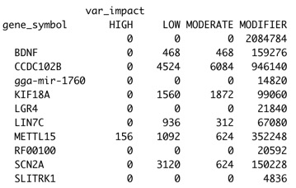
Variant Annotation in Sweep Regions

Slide 7
Back to Technical

Slide 8
Variants Called at Population Level
C1
Joint Genotyping Used All Datasets
Filters Applied to Cohorts Collectively
QD < 2.0 || FS > 60.0 || MQ < 40.0 || MQRankSum < -12.5 || ReadPosRankSum < -8.0
Population AKA 4 Cohort Statistics
Population
C2
C3
C4

Slide 9
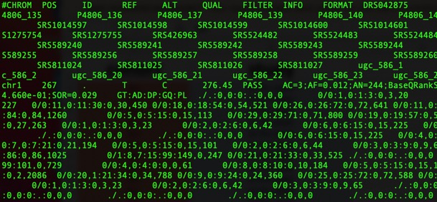
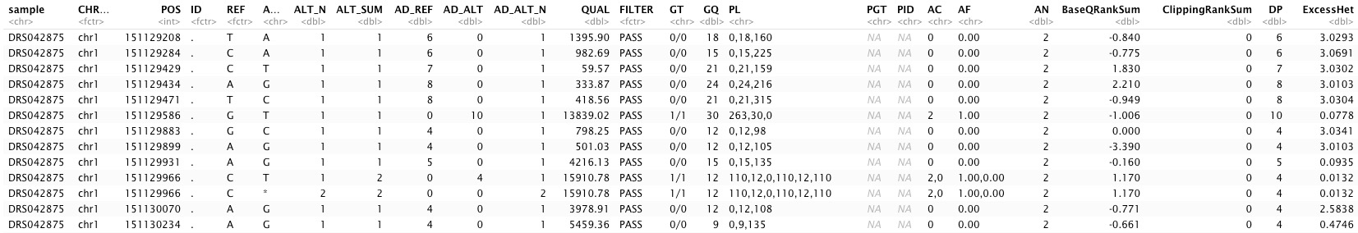
VCF → Tidy
Sample-Specific
GQ
DP

Slide 10
Some Samples Are Pooled
Cohort
Pooled
Batch
Notes:
Batch cannot be corrected for

Slide 11
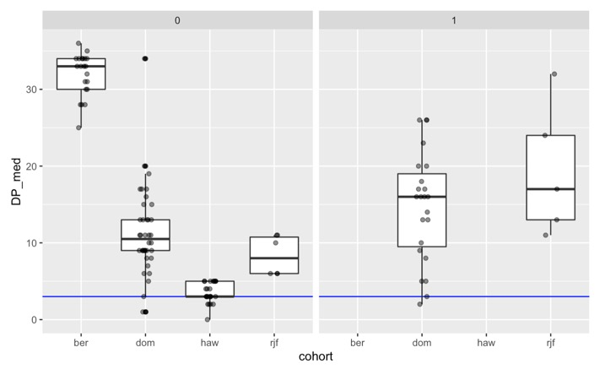
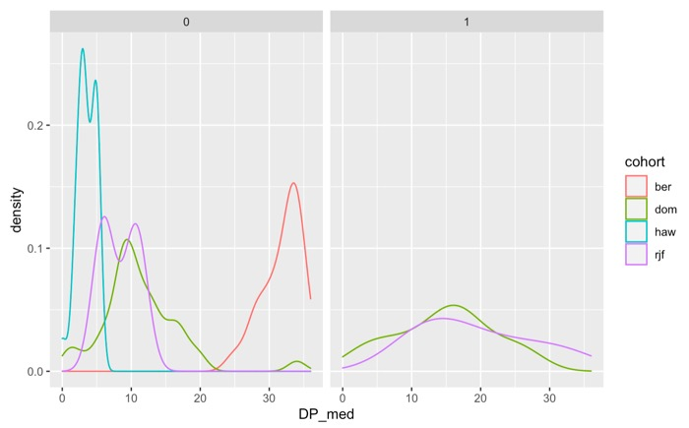

Depth Differs by Cohort/Pool
Pooled
Pooled

Slide 12
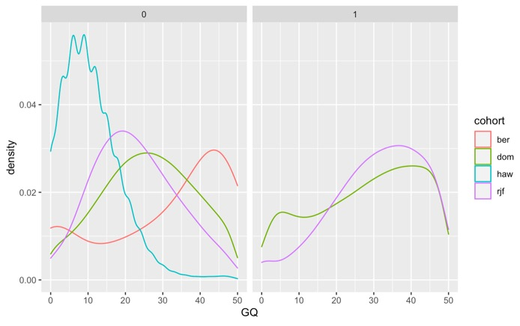
Genotype Quality Differs by Cohort/Pool
Pooled

Slide 13
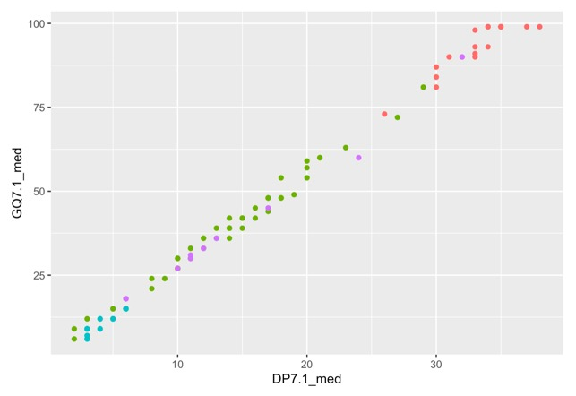
Depth & Coverage Correlated (good) Depth, Coverage, & Cohort Confounded (bad)
ber
dom
haw
rjf

Slide 14
Feature Structure
chr1:150,340,000-150,420,000
chr2:94,120,000-94,220,000
chr2:123,740,000-123,800,000
chr2:142,940,000-143,220,000
chr3:52,840,000-52,900,000
chr3:92,900,000-92,960,000
chr5:3,700,000-3,960,000
chr7:19,320,000-19,380,000

Slide 15

Quantification/Stratification of SNPs
4 cohorts X 7 chroms = 28 datasets
AA = 0
AB = 1
BB = 2
BC = 3

Slide 16
QC Steps
Rule out negative values
Missingness of Data
Cleanup should be done genome-wide prior to selective sweep and may already have been

Slide 17
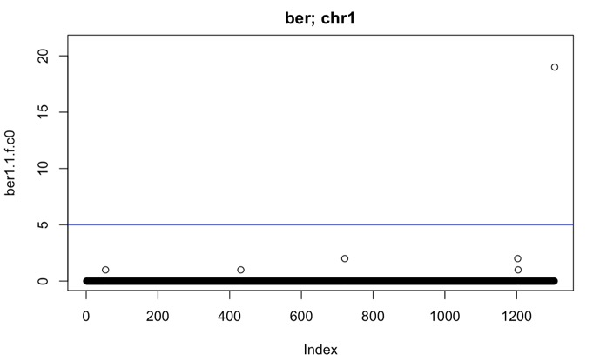
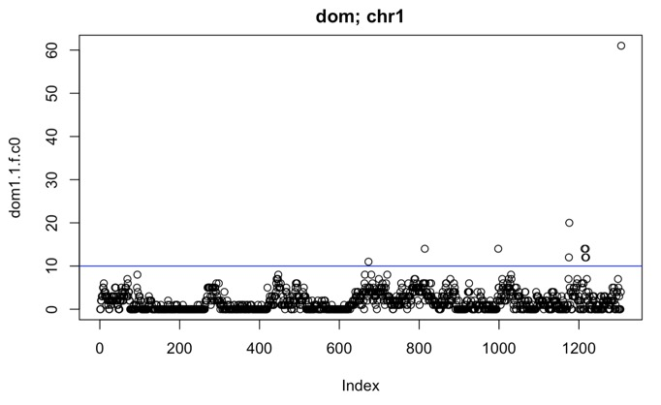
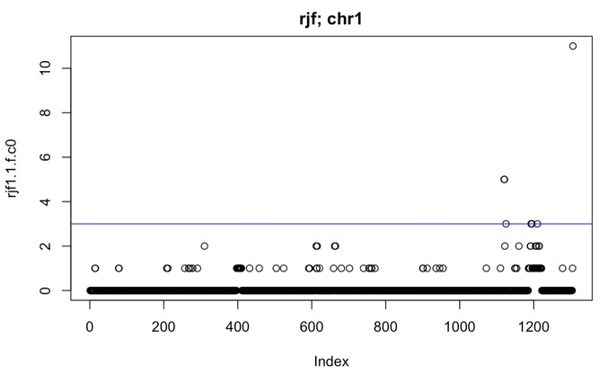
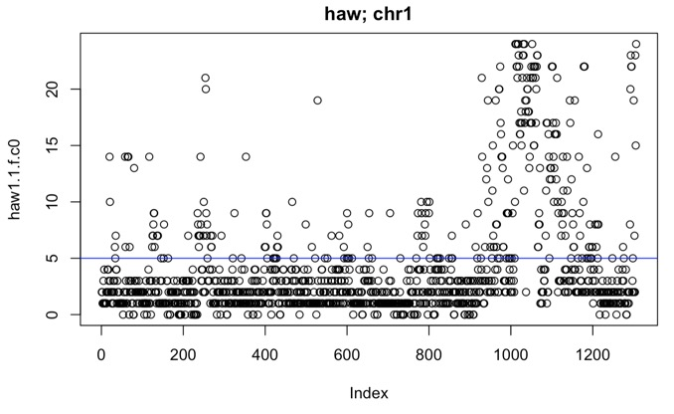
Missing Values/Feature Filter (Chrom 1)
ber
dom
haw
rjf

Slide 18
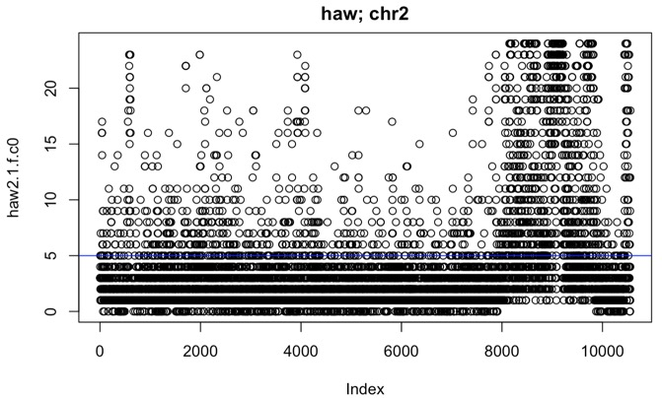
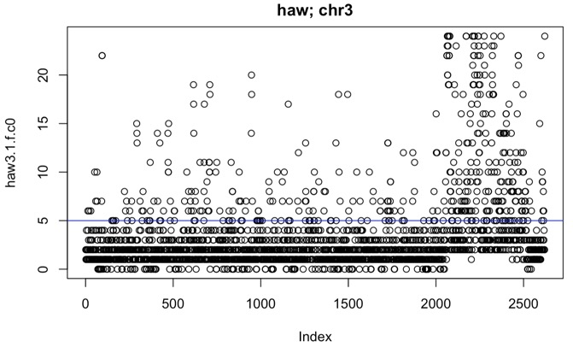
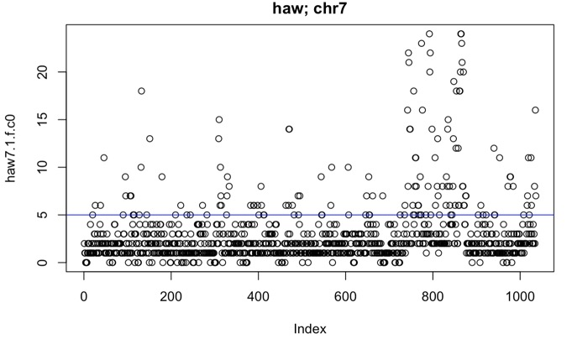
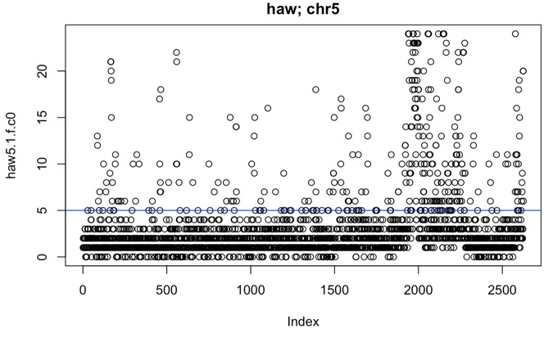
Hawaii High Missingness (All Sweeps)
ber
dom
haw
rjf

Slide 19
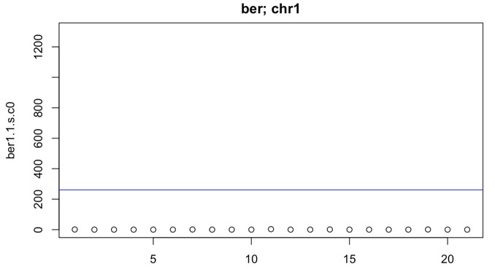
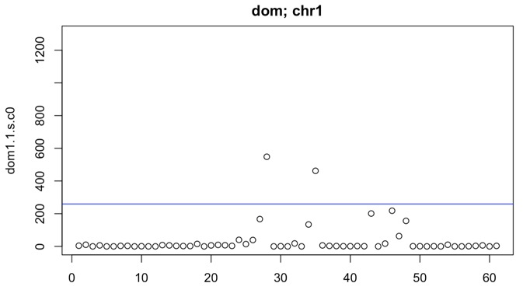
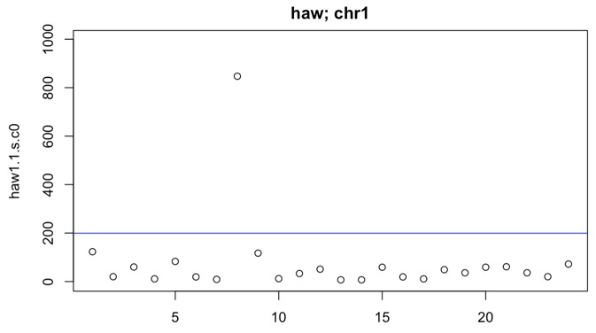

Missing Values/Sample Filter (Chrom 1)
ber
dom
haw
rjf

Slide 20
Shared Remaining Features and Samples

Slide 21
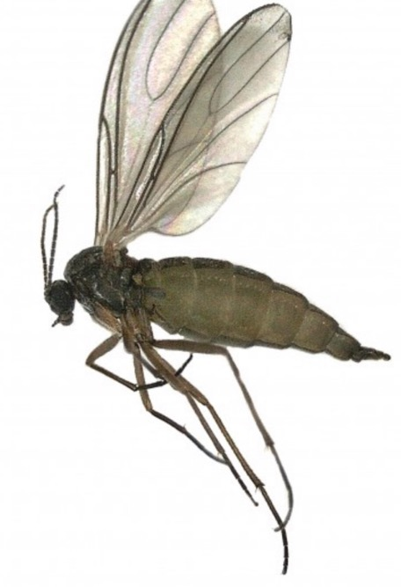
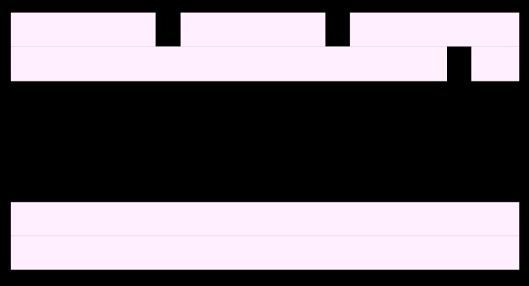
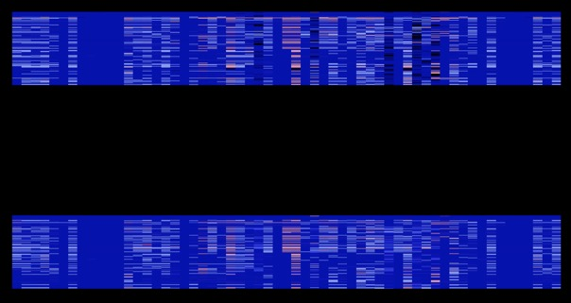
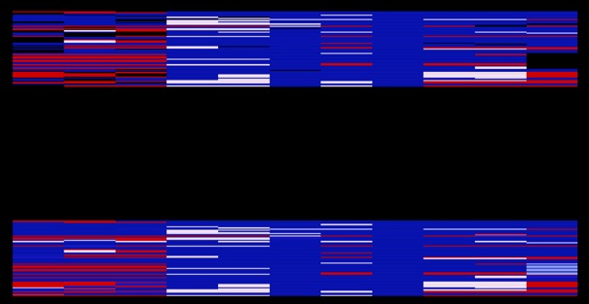
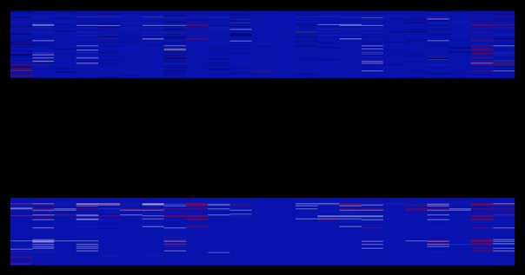
Minor Imputation via KNN (Chrom 1)
ber
dom
haw
rjf
Notes:
Gnat: https://insectlab.russell.wisc.edu/category/indoor-gnats/

Slide 22
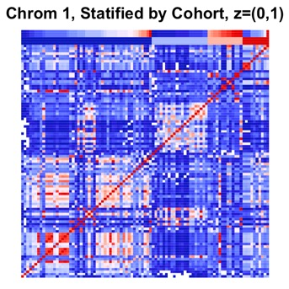
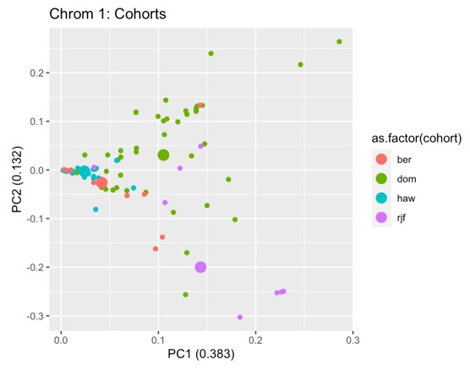
Sample by Sample (NxN) Correlation Matrix and PCA (Chrom 1)
Depth
Cohort
ber
dom
haw
rjf
Notes:
Low Variance/SD samples Removed

Slide 23
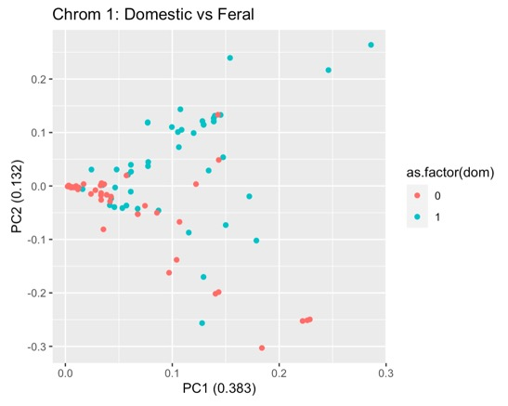
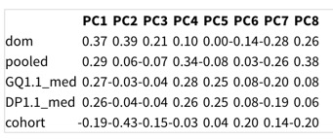
Sample by Sample (NxN) Correlation Matrix and PCA (Chrom 1)
Depth
Cohort
ber
dom
haw
rjf
Notes:
Low Variance/SD samples Removed

Slide 24
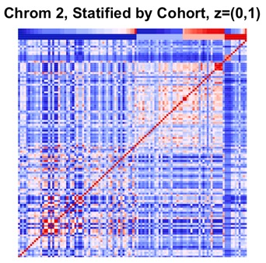
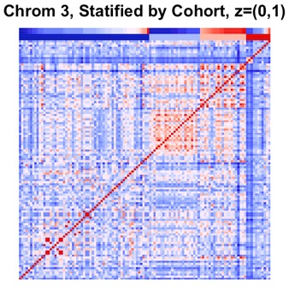
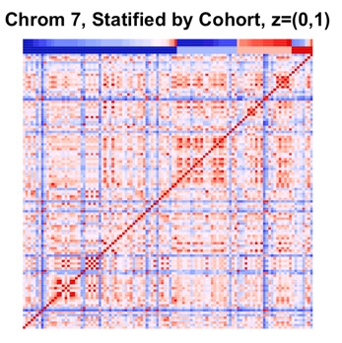
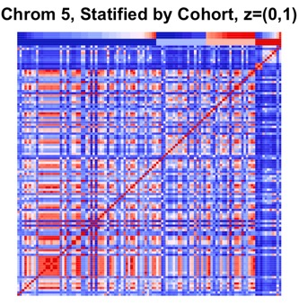
NxN Stratified by Cohort (All Regions)
Depth
Cohort
Notes:
Hawaii is distinct
Should expect Hawaii to demonstrate correlations with RJF and Domestic
Results are inconsistant

Slide 25
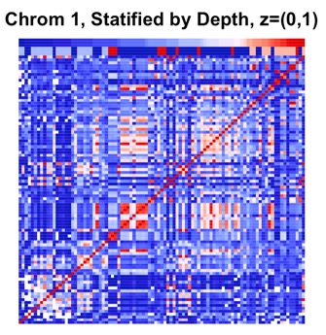
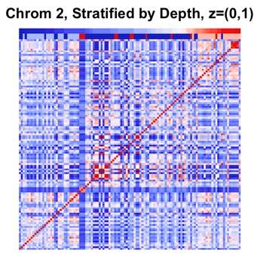
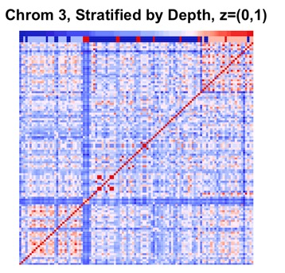
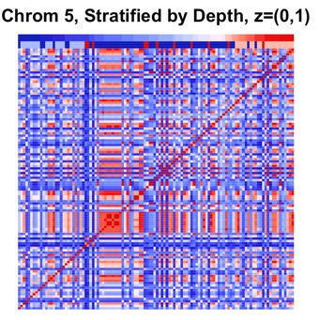
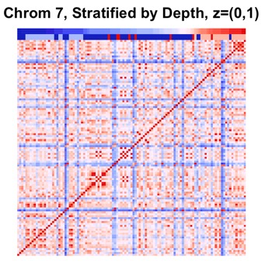
NxN Stratified by Depth (All Regions)

Slide 26
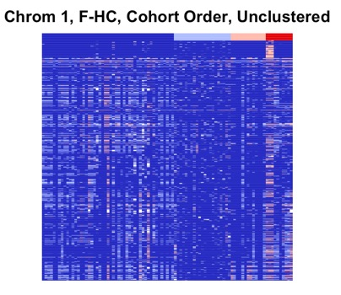
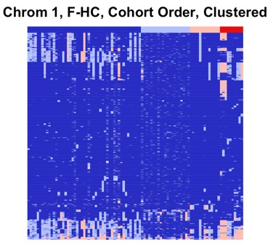
Sample by Feature (NxP) SNP Matrix (Chrom 1)
Cohort
ber
dom
haw
rjf
Notes:
Low Variance/SD samples Removed

Slide 27
Increase Resolution (Repeat Process)
Variant Type
NonSynonymous
(CCDC102B)
Chrome → Sweep → Gene
Transcript
Functionally Relevant Region

Slide 28
Increase Resolution (Example)
Variant Type
NonSynonymous
(CCDC102B)
Chrome → Sweep → Gene

Slide 29
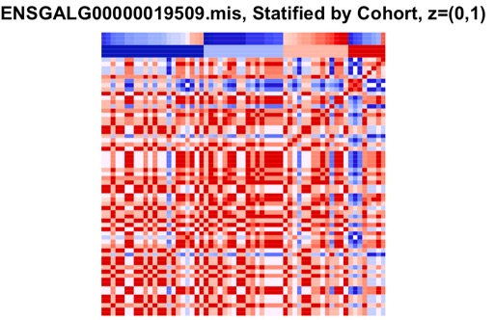
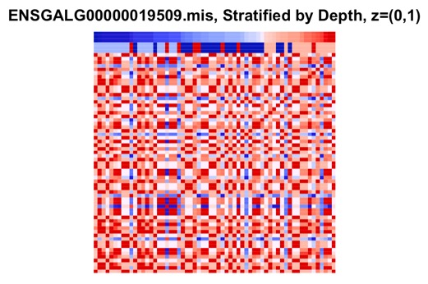
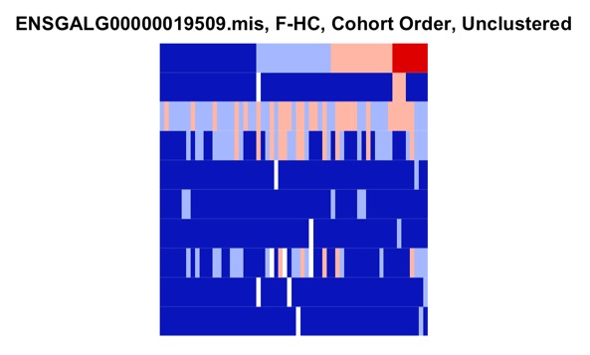
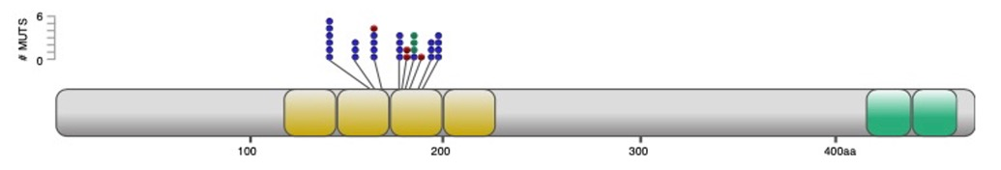
Nonsynonymous CCDC102B Mutations
NxN
NxN

Slide 30
Contributions
Technical Variance is Primary Suspect
Biology does not capture variance at many levels (gene/transcript/variant)
Recommendation to adjust

Slide 31
Recommendations
Call/Filter SNPs at cohort level separately (esp. Hawaii)
Compare to existing results
Determine if sweeps are reproduced

