Slide 1
SNP Allelic Differences (Bermuda vs Domestic): 2-Sided Wilcoxon T-tests
Alec Steep
04/20/2022

Slide 2
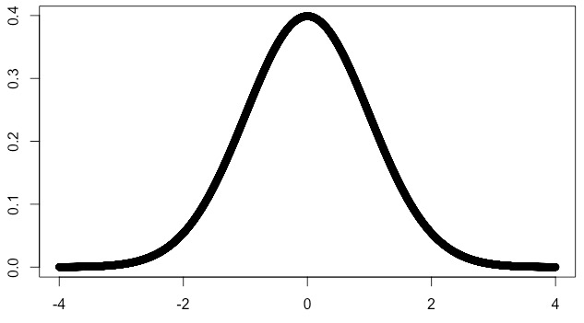
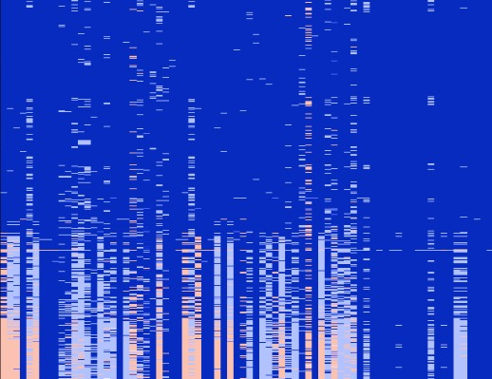
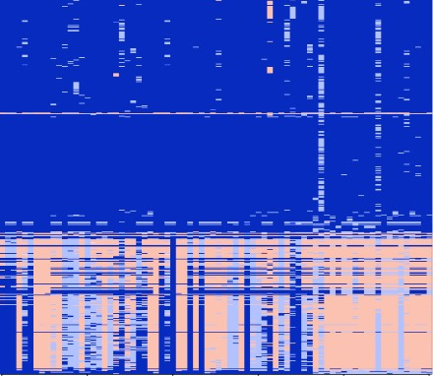

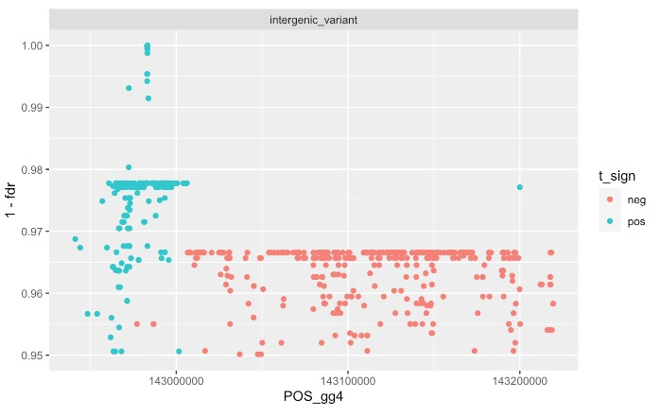
SNP-Specific Significance Tests
T-score Distribution
NxP (- T)
NxP (+ T)
0 (AA)
Ber 1
Ber 2
Ber 3
Ber 4
1 (AB)
2 (BB)
…
Hypothesis Test of Difference:
Wilcoxon T-Test
T-score → P-value → FDR
Dom 1
Dom 2
Dom 3
Dom 4
1.00
…
1 - FDR
0.95

Slide 3
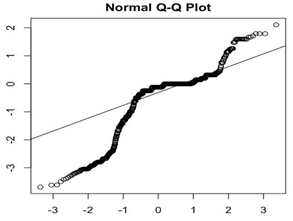
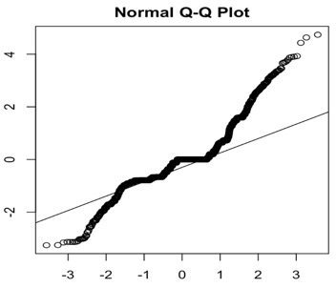
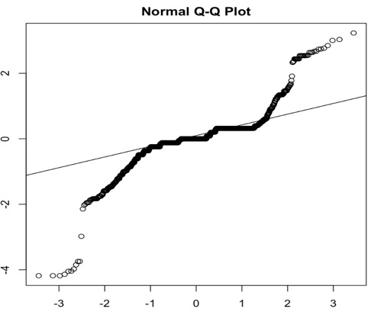
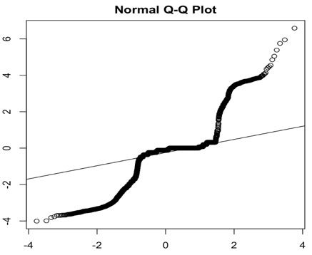
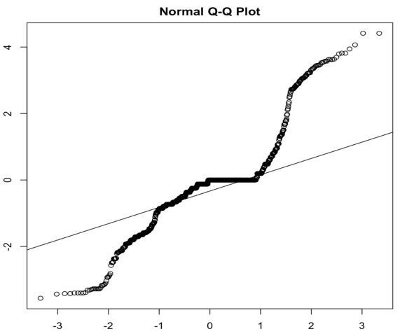
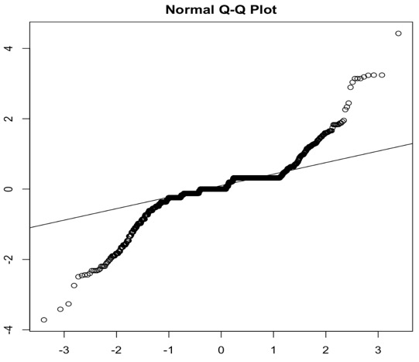
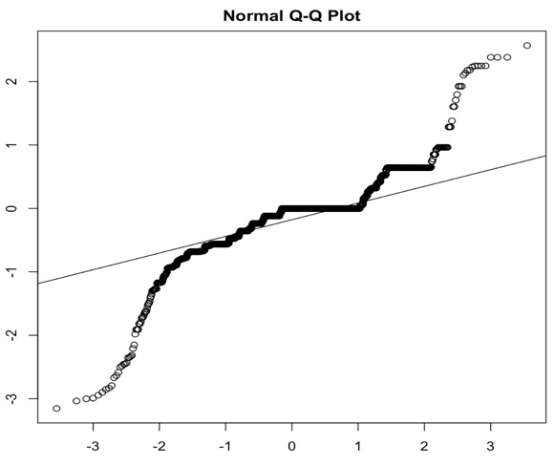
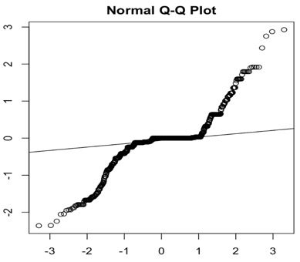
T-Score QQPlots
chr1:150,340,000-150,420,000
chr2:94,120,000-94,220,000
chr2:123,740,000-123,800,000
chr2:142,940,000-143,220,000
Sample Quantiles
chr7:19,320,000-19,380,000
chr3:52,840,000-52,900,000
chr3:92,900,000-92,960,000
chr5:3,700,000-3,960,000
Theoretical Quantiles
Notes:
The deviation from 0 on the y axis demonstrates strength of t-score (proxy to significance)

Slide 4
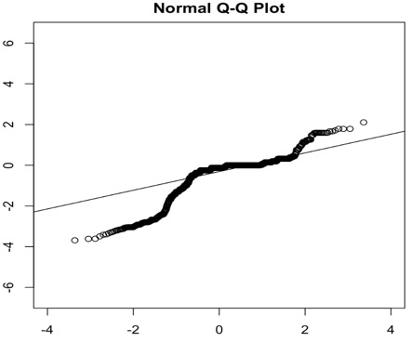
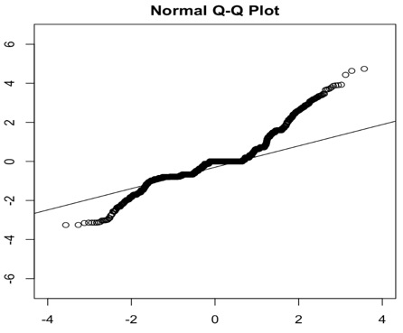
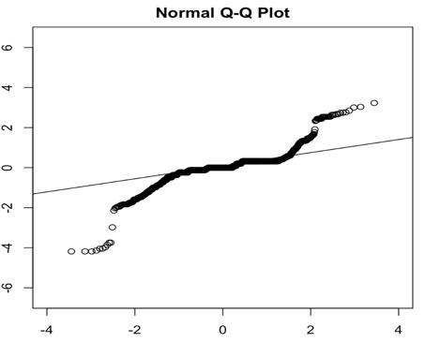
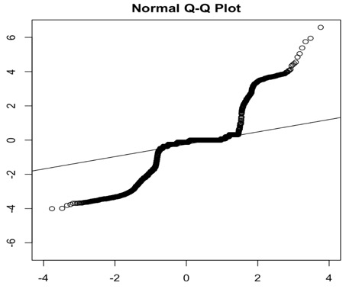
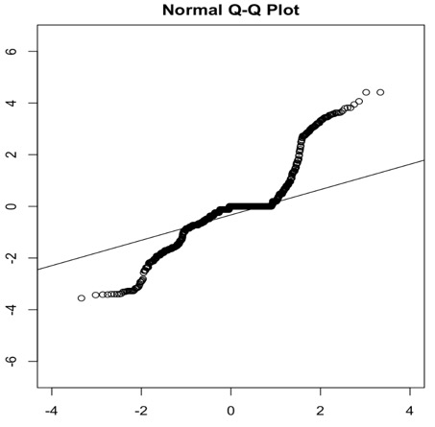
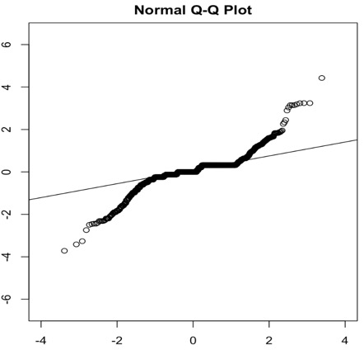
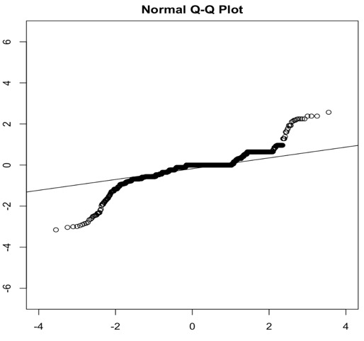
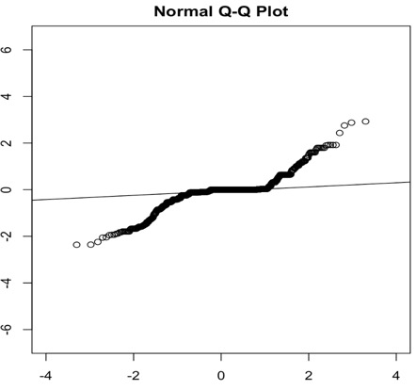
T-Score QQPlots
chr1:150,340,000-150,420,000
chr2:94,120,000-94,220,000
chr2:123,740,000-123,800,000
chr2:142,940,000-143,220,000
Sample Quantiles
chr7:19,320,000-19,380,000
chr3:52,840,000-52,900,000
chr3:92,900,000-92,960,000
chr5:3,700,000-3,960,000
Theoretical Quantiles
Notes:
The deviation from 0 on the y axis demonstrates strength of t-score (proxy to significance)

Slide 5
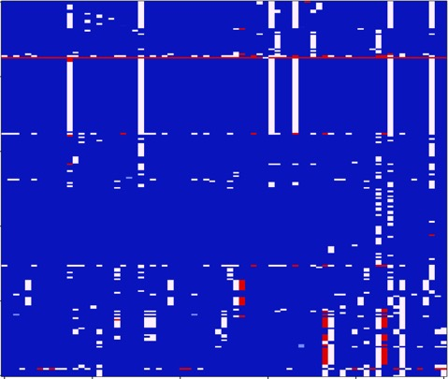
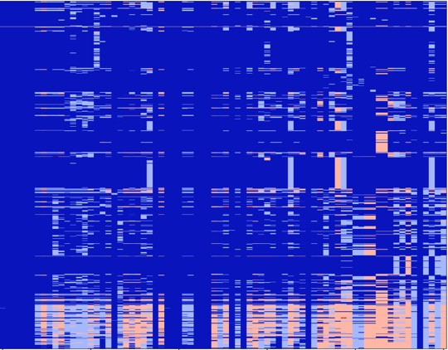
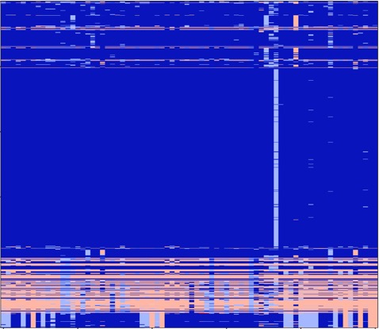
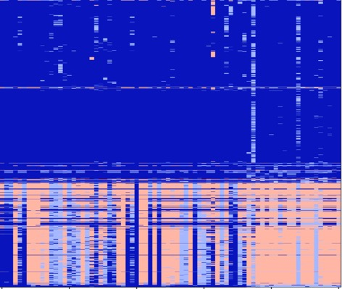
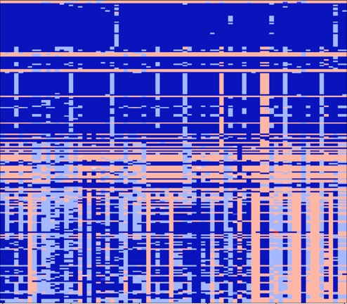
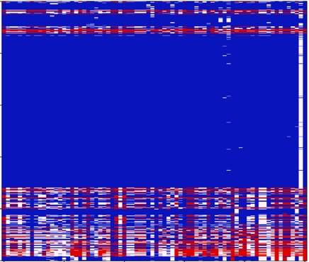

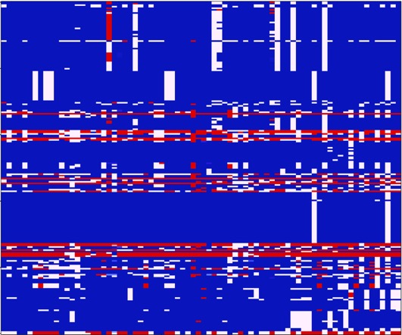
NxP Heatmaps (T>0)
0 (AA)
1 (AB)
or
2 (BB)
chr1:150,340,000-150,420,000
chr2:94,120,000-94,220,000
chr2:123,740,000-123,800,000
chr2:142,940,000-143,220,000
SNPs as Rows (arranged by T-score)
chr3:52,840,000-52,900,000
chr3:92,900,000-92,960,000
chr5:3,700,000-3,960,000
chr7:19,320,000-19,380,000
Samples As Columns
Notes:
The deviation from 0 on the y axis demonstrates strength of t-score (proxy to significance)

Slide 6
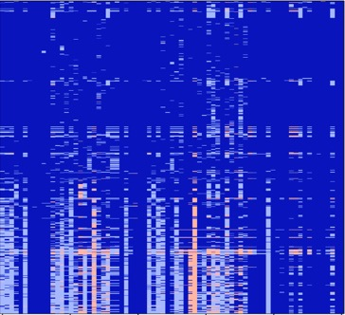
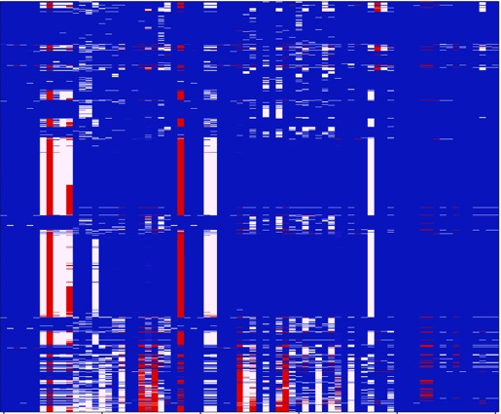
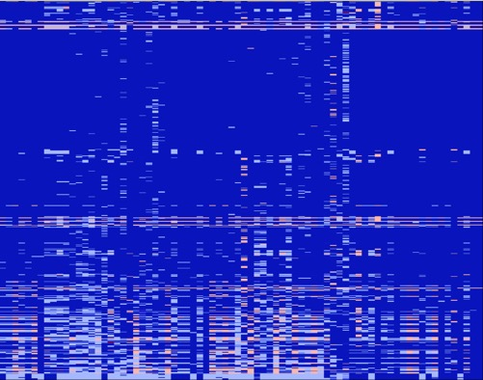
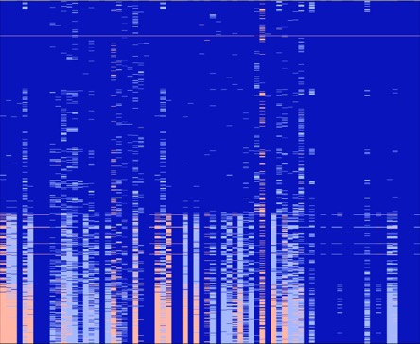
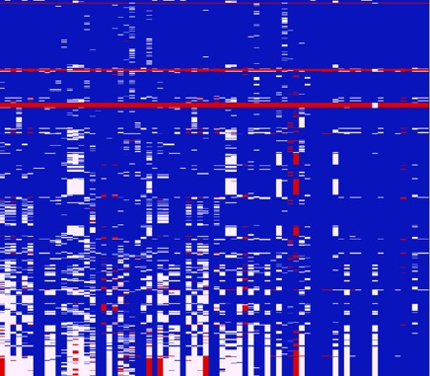
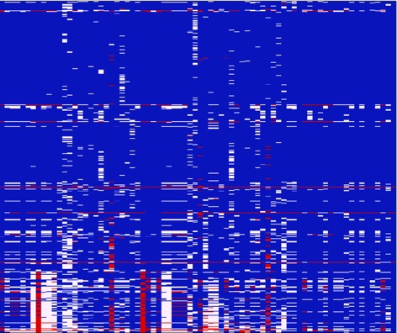
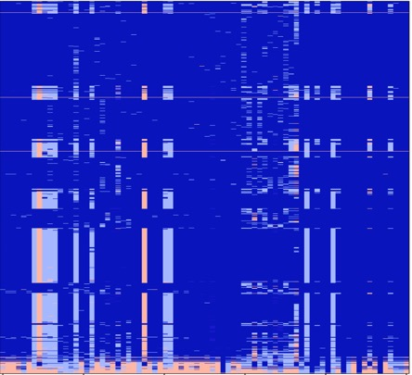
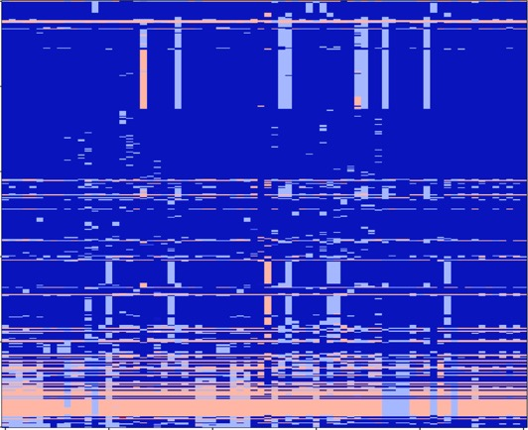
NxP Heatmaps (T<0)
0 (AA)
1 (AB)
or
2 (BB)
chr1:150,340,000-150,420,000
chr2:94,120,000-94,220,000
chr2:123,740,000-123,800,000
chr2:142,940,000-143,220,000
SNPs as Rows (arranged by T-score)
chr3:52,840,000-52,900,000
chr3:92,900,000-92,960,000
chr5:3,700,000-3,960,000
chr7:19,320,000-19,380,000
Samples As Columns
Notes:
The deviation from 0 on the y axis demonstrates strength of t-score (proxy to significance)

Slide 7

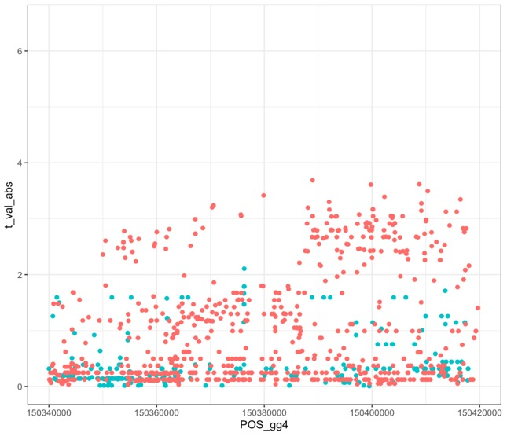
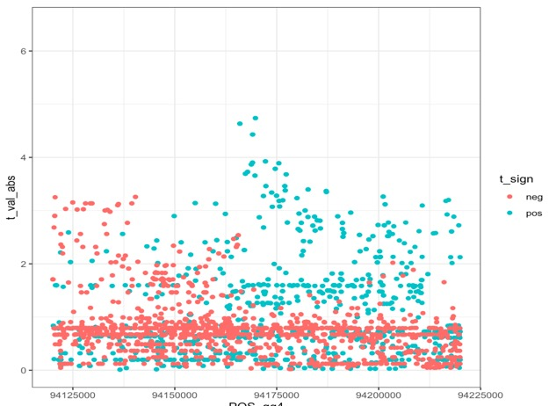
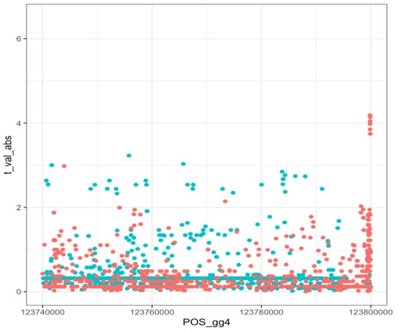
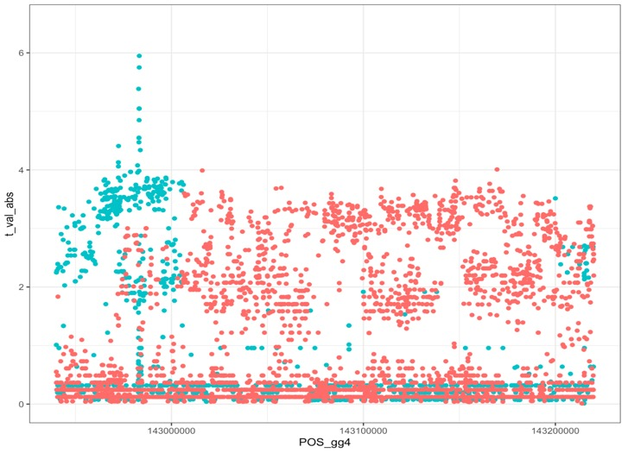
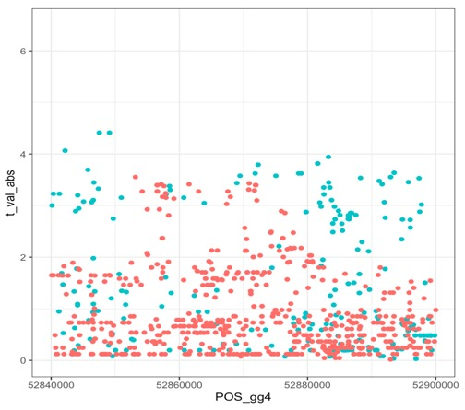
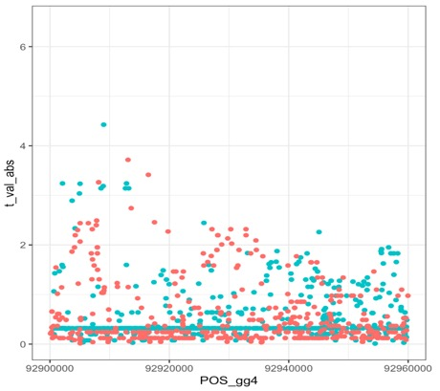
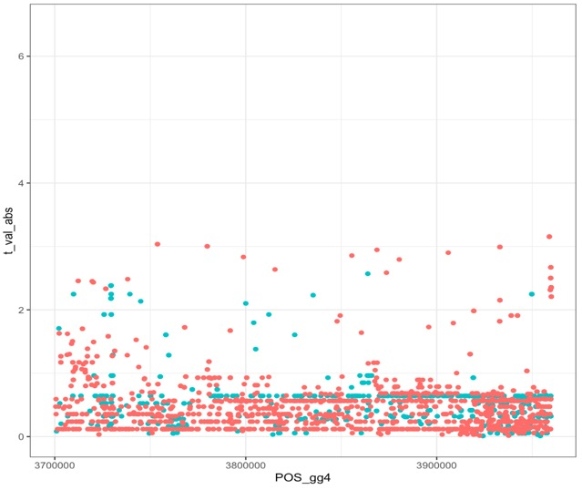
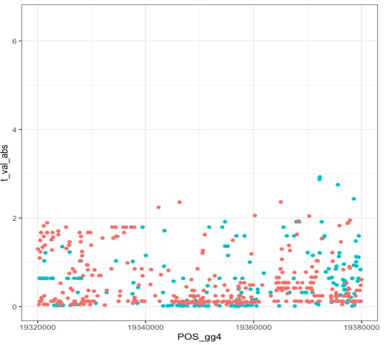
Sweep Location x Abs(T-scores)
chr1:150,340,000-150,420,000
chr2:94,120,000-94,220,000
chr2:123,740,000-123,800,000
chr2:142,940,000-143,220,000
Absolute Values of T-scores
chr3:52,840,000-52,900,000
chr3:92,900,000-92,960,000
chr5:3,700,000-3,960,000
chr7:19,320,000-19,380,000
Chromosome Position (Galgal4)
Notes:
The deviation from 0 on the y axis demonstrates strength of t-score (proxy to significance)

Slide 8
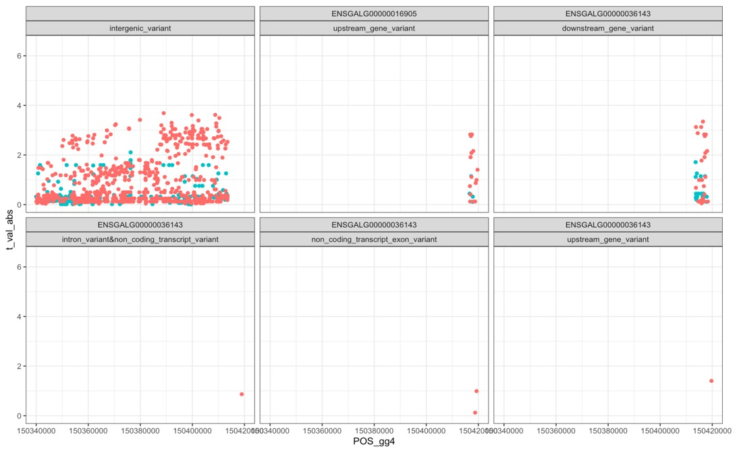
chr1:150,340,000-150,420,000

Slide 9
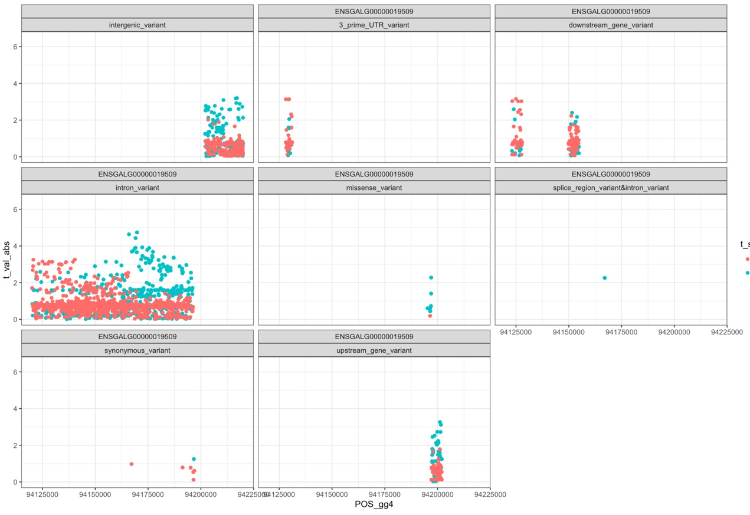
chr2:94,120,000-94,220,000

Slide 10
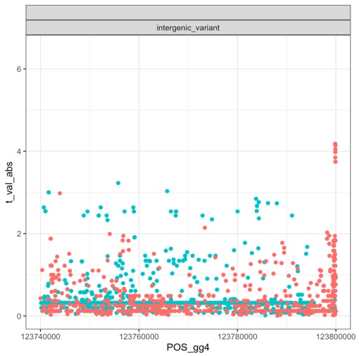
chr2:123,740,000-123,800,000

Slide 11
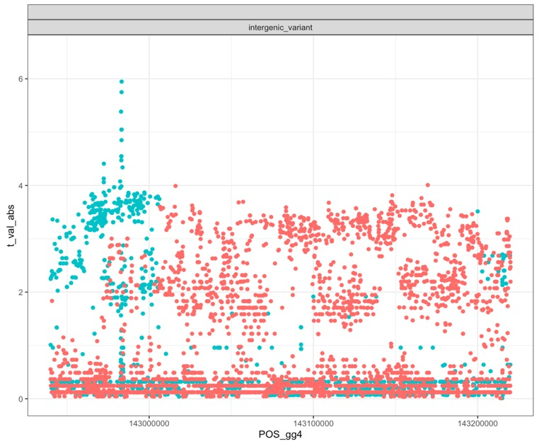
chr2:142,940,000-143,220,000

Slide 12
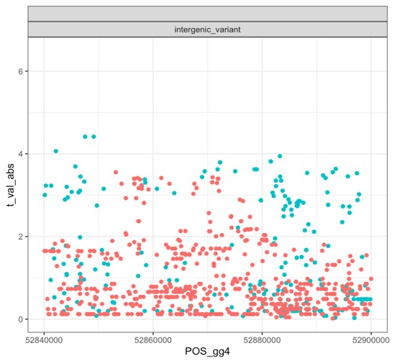
chr3:52,840,000-52,900,000

Slide 13
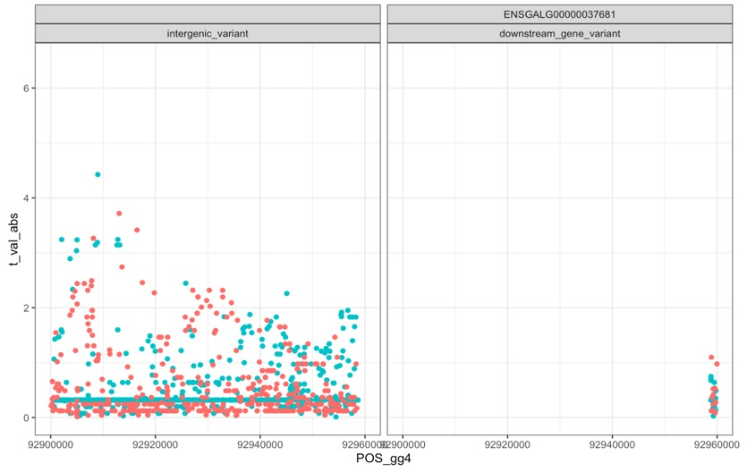
chr3:92,900,000-92,960,000

Slide 14
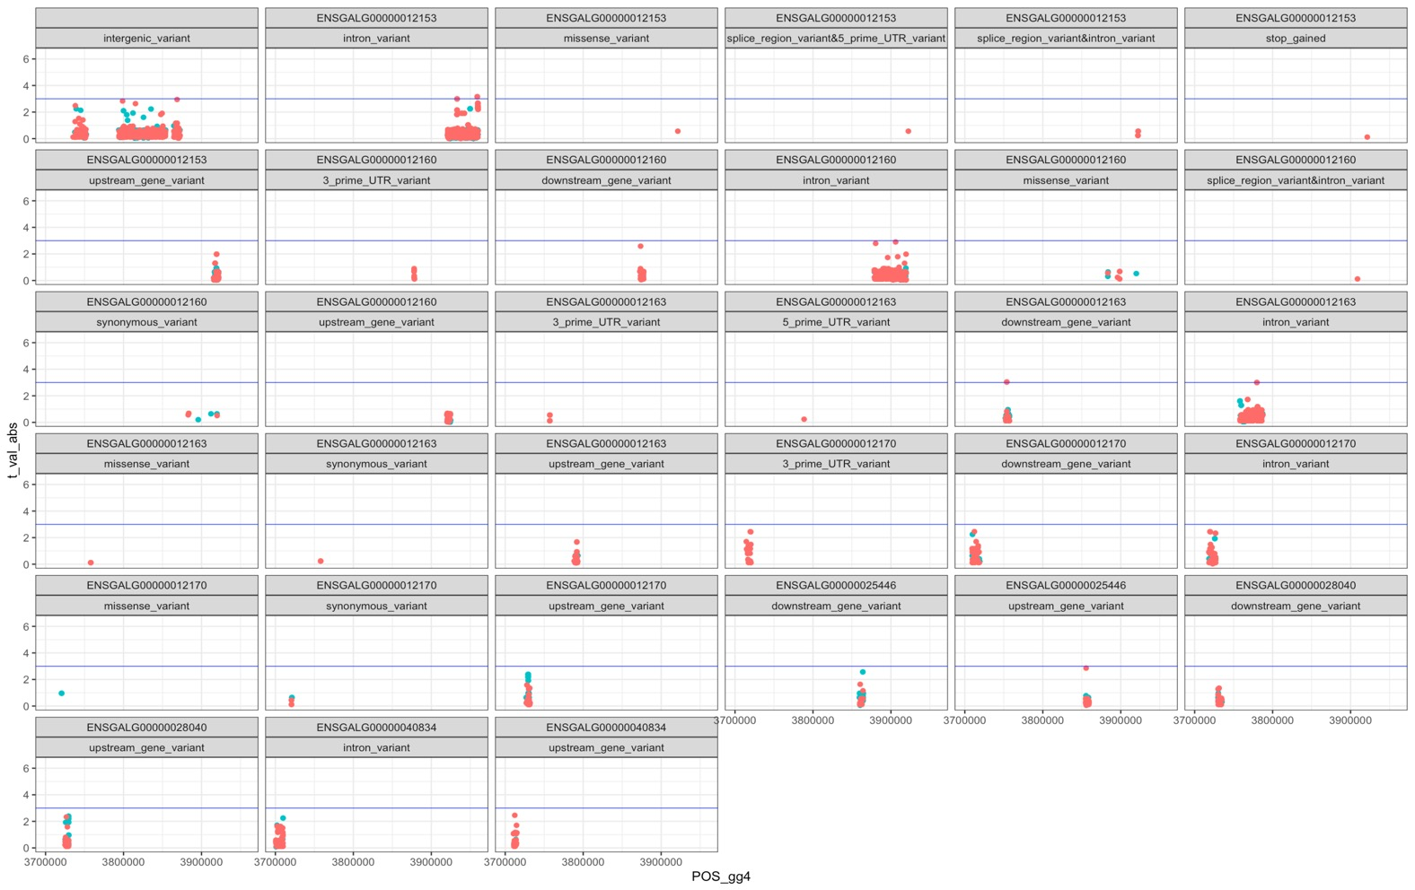
chr5:3,700,000-3,960,000

Slide 15

chr7:19,320,000-19,380,000

