Slide 1

Postdoc Preview October 2019
UMMS Training Grant Information

Slide 2
Program Directors at Friday Lunch
Faculty Director | Contact | Training Grant/Program Title
David Kohrman | dkohrman@umich.edu | Hearing, Balance and Chemical Senses
Jordan Shavit | jshavit@umich.edu | Boxer Training Program in Molecular and Translational Hematology
Yatrik Shah | shahy@umich.edu | Michigan Postdoctoral Pioneer Program
Ormond MacDougald | macdouga@med.umich.edu | Multidisciplinary Training Program in Basic Diabetes Research
Richard Auchus | rauchus@med.umich.edu | Training Program in Endocrinology and Metabolism
Shannon Carty | scarty@med.umich.edu | Research Training in Experimental Immunology
Patrice Fort | patricef@med.umich.edu | Vision Research Training Program
John Traynor | jtraynor@umich.edu | Postdoctoral Training in the Biology of Drug Abuse
Scott Roberts | jscottr@umich.edu | UM Training Program in ELSI Research
Sunny Wong | sunnyw@umich.edu | Cell and Molecular Dermatology Training Program
Colin Greineder | coling@med.umich.edu | Michigan Resuscitation Innovation and Science Enterprise (M-RISE)

Slide 3
Boxer Training Program in Molecular and Translational Hematology
Currently in 31st year of funding, supporting 6 postdoctoral fellows each year for research in benign and malignant hematology
Prospective trainees are typically nominated during their first year of postdoctoral training, although may be appointed later
Support is available for a master’s training program for those who wish to gain more training in other areas, e.g. clinical trial design for translational studies, bioinformatics
For more information, contact Jordan Shavit (Director) jshavit@umich.edu

Slide 4
Vision Research Training Program
The goals of the Vision Research Training Program are to provide breadth in research training and professional development to keep pace with the opportunities for careers in vision research. The VRTP (1) supports candidate-level predoctoral fellows as they undertake and complete their thesis research; (2) supports postdoctoral fellows as they begin independent research careers; (3) provides a formal structured education; (4) and requires trainees to participate in a program of professional development specific to vision research.
Contact: Patrice Fort, Ph.D. patricef@umich.edu

Slide 5
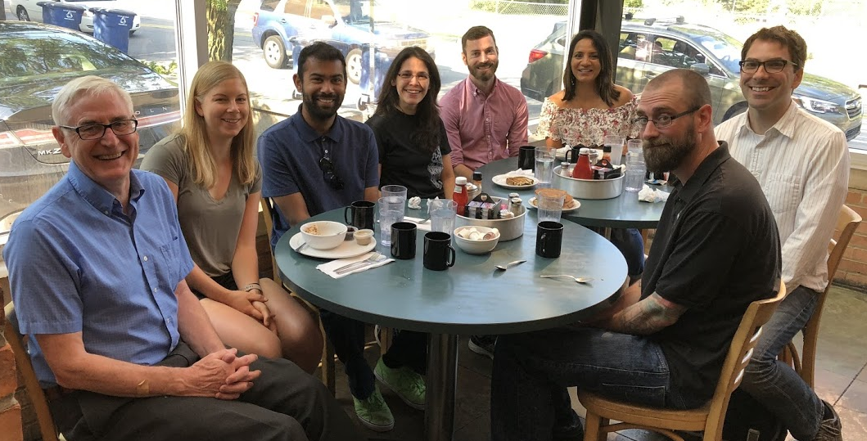
Biology of Drug Abuse Training Program
Opportunities for postdoctoral fellows to pursue training in any aspect of drug abuse/addiction research.
State-of-the-art science: cell/molecule & anatomical; animal behavioral models; human imaging; genomics, proteomics, informatics; medications development
Faculty mentors from a wide range of departments: Pharmacology, Psychology, Neuroscience, Psychiatry, Pharmacy, Chemistry, Cell and Molecular biology
Strong drug abuse community; training faculty
have long-term scientific collaborations
Sophisticated, supportive, research and training
environment.
https://sites.google.com/umich.edu/bda/home

Slide 6
Michigan Postdoctoral Pioneer Program
https://umichpioneerprogram.org/
In an effort to support innovative and collaborative work within the University of Michigan Medical School (UMMS), the Michigan Postdoctoral Pioneer Program has been established by the Endowment for Basic Sciences (EBS) to provide financial and mentoring support to highly motivated and accomplished post-doctoral fellows. Pioneer fellows will be actively co-mentored by the participating investigators and will be expected to share their time between the participating laboratory settings. Awardees will be appointed for three consecutive years. The EBS will provide 90% of the financial and logistical support for the first two years. Participating mentors will jointly provide 10% of the financial support for years 1 and 2, and 100% of the support for year 3. The stipend is set at 120% of the NIH scale for postdoctoral fellows.

Slide 7
Experimental Immunology
Currently funds 5 pre-doctoral and 2 post-doctoral scholars
Support for 1 or 2 years depending on progress
Supports any project broadly related to immunology in any preceptor laboratory.
Requires post-doctoral fellow to present during years of support in the Wednesday, noon seminar series
Requires formation of a research advisory committee to meet twice yearly
Applications due in Spring for July start
For more information, contact Beth Moore (bmoore@umich.edu) or Shannon Carty (scarty@umich.edu)

Slide 8
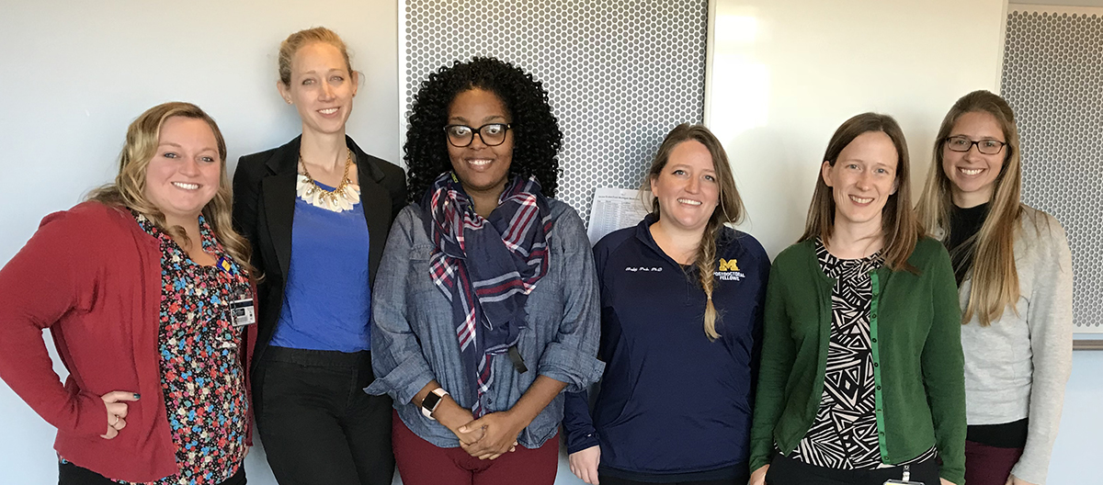
Multidisciplinary Training Program in Basic Diabetes Research
This program provides an opportunity for postdoctoral fellows to pursue training in diverse aspects of diabetes research. Training grant preceptors fall into major interest groups across the spectrum of type 1 and 2 diabetes research - islet biology, autoimmune diabetes, adipocyte biology, neuronal regulation of metabolism, mechanisms of insulin resistance, metabolic control in liver and muscle, and diabetes complications - each area containing investigators pursuing basic research with potential translational applicability.

Slide 9
Molecular Mechanisms in Microbial Pathogenesis
Currently funds 5 predoctoral and 2 postdoctoral students per year.
Prospective trainees are typically nominated at the end of their first year in PIBS (predoctoral) or during their first year or postdoctoral training.
Coursework for predoctoral students is aligned with Departmental requirements
All trainees participate in Science in the Clinics, a course that explores infectious diseases from a translational perspective, connecting basic science to clinical and therapeutic aspects of pathogenesis.
All trainees participate in the “Young Investigators” program, which brings junior investigators to campus for seminars on their research and meetings with trainees.
For more information, contact Vern Carruthers (Director) or Adam Lauring (Associate Director).

